Slide 1



March 2026
30 Days of Prayer for Muslims
Notes:
During Ramadan, many Muslims adjust the rhythm of their lives through temperance, prayer, and reflection, seeking inner purity and peace.
This is a time for expressing sincere faith and focusing on family bonds and community responsibility.
In our prayers, we remember the Muslims observing Ramadan, and wish that all who call upon the truth during this time may experience comfort and hope.

Slide 2
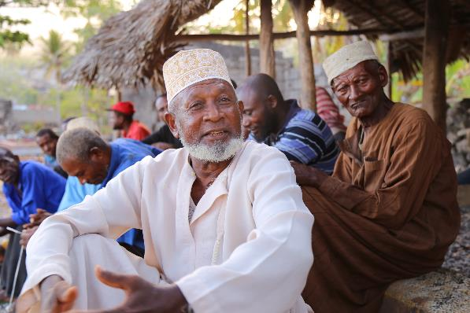

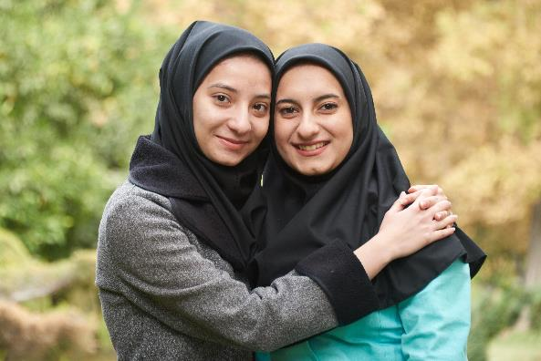
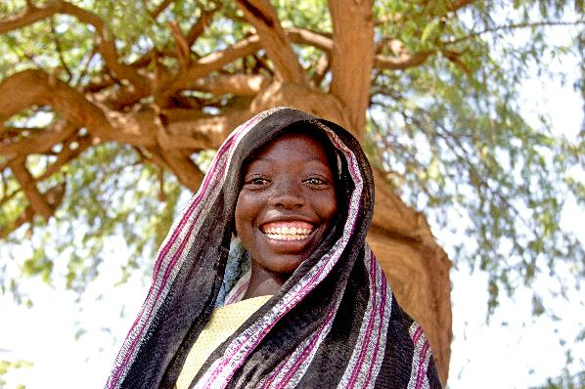
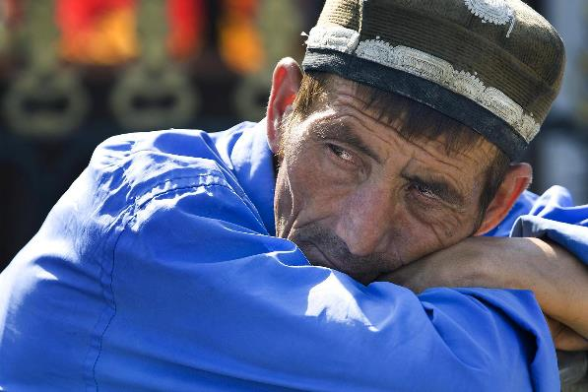
Key Features of Ramadan
Recalibrating Life
Through fasting and regular prayer, Muslims temporarily set aside daily desires and distractions, creating space to slow down and refocus.
Inner Reflection and Shared Responsibility
Ramadan encourages self-examination while strengthening community bonds, reminding people to care for one another and take responsibility for each other’s needs.
Mercy, Generosity, and Caring for Others
It is a time to emphasize compassion and giving, putting faith into practice through concrete acts of love and service.
Notes:
1. A Time to Slow Down and Recenter
Through fasting and a steady rhythm of prayer, Ramadan invites Muslims to step away from daily distractions and desires, making space for reflection and spiritual renewal. It is not only a season of physical discipline, but also a journey of realigning one’s heart—learning self-control, devotion, and deeper dependence on God.
2. A Month to Strengthen Community and Shared Responsibility
Ramadan highlights the importance of family, community, and faith. As people fast, pray, and gather together, personal spiritual practice becomes closely connected to communal life. It is a reminder to care for one another and to carry shared responsibility for the well-being of the community.
3. A Season of Compassion, Generosity, and Caring for Others
During Ramadan, charity and compassion are given special focus, especially toward the vulnerable and those in need. By remembering others, people are encouraged to grow in empathy and to express their faith through tangible acts of love and service.

Slide 3
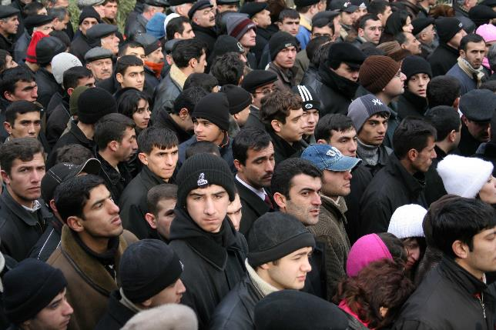
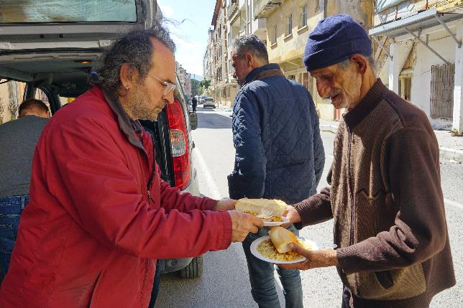
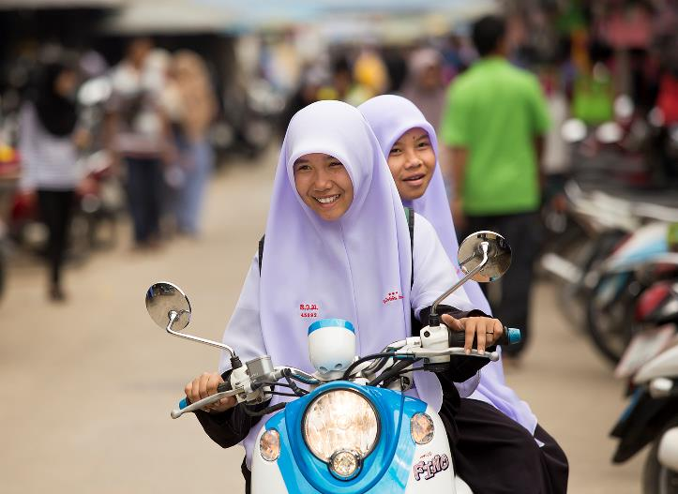
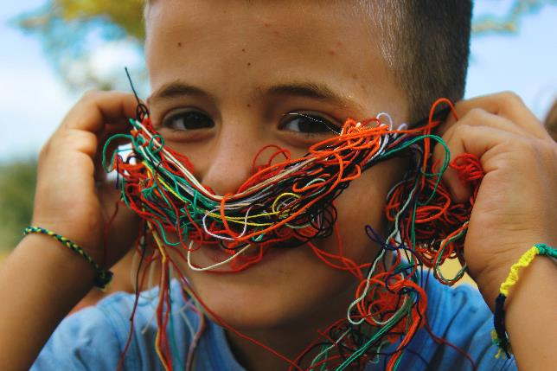
Prayer Needs
For those under physical and mental stress:
Fasting can place an added burden on those working long hours or struggling with poor health.
For those seeking meaning in life:
May the Lord be present in every seeking heart and honest question, so that people do not simply fulfill religious obligations, but truly face their deepest longings, confusion, and hopes
For understanding and peace within communities:
May the Lord nurture mutual understanding, respect, and peace
Notes:
1. Pray for those under physical and mental stress
Fasting and changes in lifestyle place an additional burden on those who need to work long hours or are in poor health. Pray that the Lord will grant strength and protection, so that people may be cared for and supported in their spiritual practice.
2. Pray for those seeking meaning in life through reflection
Ramadan is a time for profound reflection on one's life direction. Pray that the Lord will work in people's seeking and questioning, enabling them not only to fulfill religious obligations but also to genuinely confront their inner desires, confusion, and hopes.
3. Pray for understanding and peace within communities
In a diverse society, Ramadan sometimes makes Muslims appear out of step with their surroundings. Pray that the Lord will promote mutual understanding and respect, enabling people from different backgrounds to build peace and goodwill in their daily interactions.

Slide 4
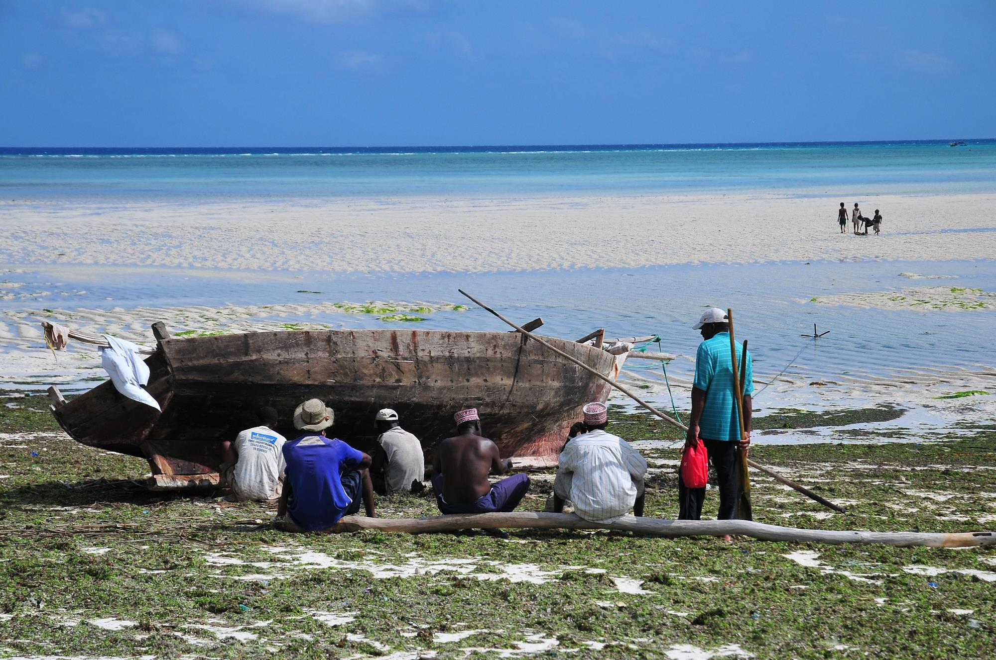
Let us pray together for Muslims

Slide 5

Dear Heavenly Father, those who practice self-discipline, meditation, and prayer during Ramadan need You. You see their sincere pursuit of the true way, and You understand the weariness and pressures of daily life. In this season that requires patience and adjustment, please watch over their bodies and minds. May they not only complete outward disciplines, but also receive deep within their hearts the comfort that comes from the Holy Spirit.
As people quietly contemplate the direction and meaning of life, may You draw near to them. And may You work among different communities, replacing conflict with empathy and hostility with respect. May this season become a time when goodwill and compassion overflow. In the name of Jesus Christ, Amen.

Slide 6




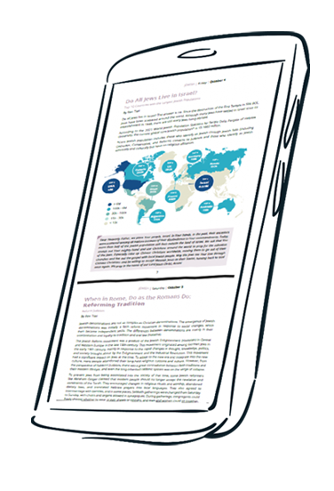
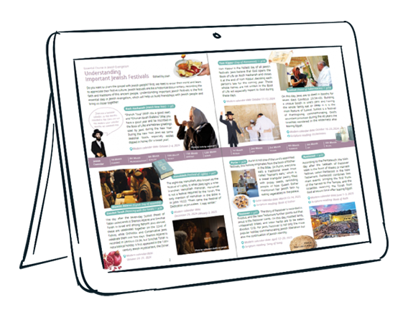



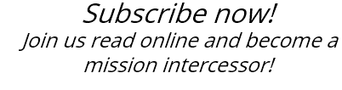

Slide 7
cross-roads.org/eng

