Slide 1
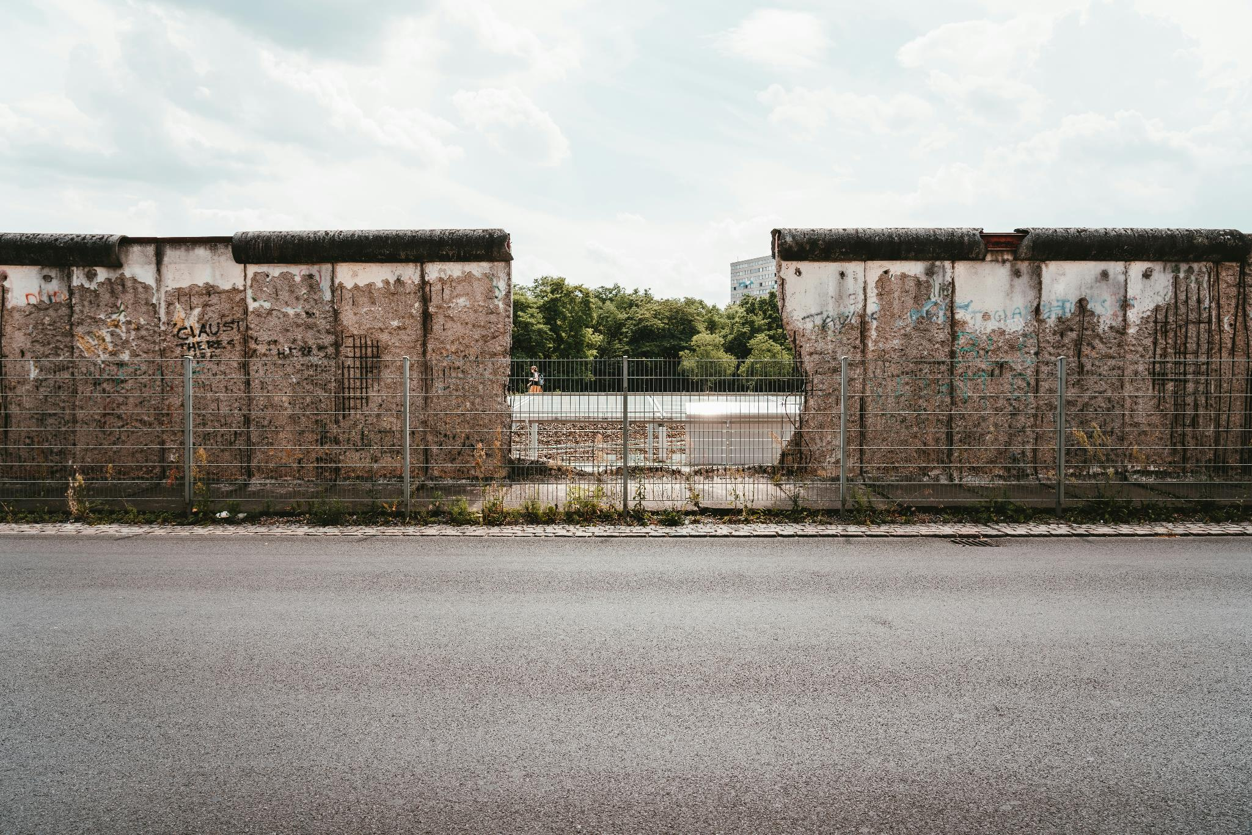

June 2026
My Faraway Homeland
People on the Move
Notes:
When "I can't go on here" intersects with "hope is over there", migration becomes inevitable.
In the global tide of dispersing and gathering, we may have seen these people around us: refugees, international students, or digital nomads.
Perhaps what we witness is not random wandering, but a divine purpose of God to lead people to places where they can hear the Truth and to send His people to corners where hope is needed.
June 20th is World Refugee Day. Let us come together to learn more about five different groups of people who are on the move, including refugees, and seek God together for them.

Slide 2
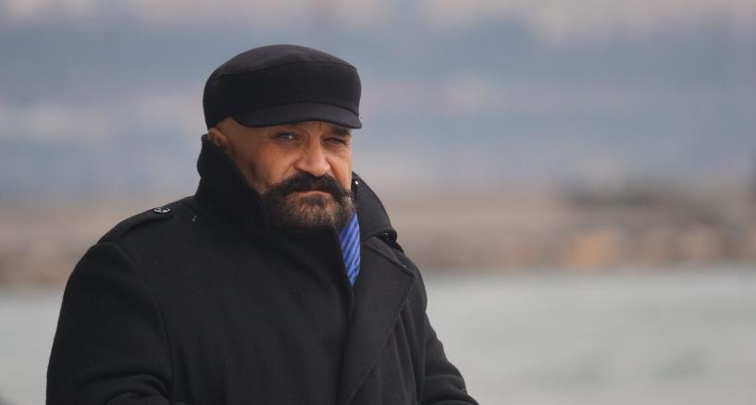
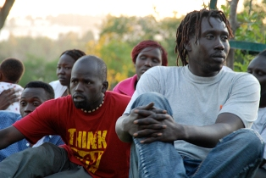
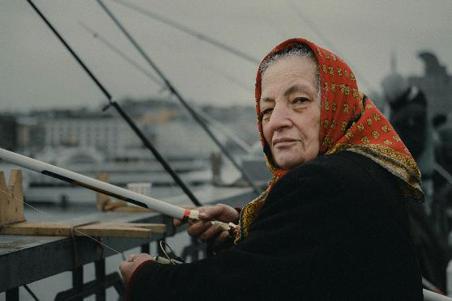
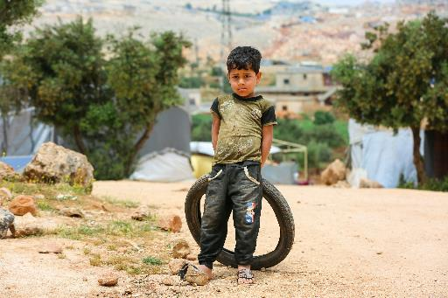
Profiles of People on the Move
Refugees: “Forced migrants” who are compelled to flee their home countries due to war, violence, or religious or political persecution
Economic Migrants: People who move to another country in search of job opportunities, higher wages, or international business development.
International students: Young people who leave home countries to pursue higher education abroad
Traditional Nomadic Peoples: Ethnic groups that have inherited a self-sustaining, seasonally migrating lifestyle
Digital Nomads: Individuals leveraging technology and the internet for an autonomous and selective mobile lifestyle, making the whole world their office.
Notes:
1. Refugees — Survivors Forced Into Displacement:
Forced migrants who flee their home countries because of war, violence, religious persecution, or political oppression.
More than 122 million people worldwide are currently displaced, including 42.7 million refugees.
In the short term, they need safe shelter and humanitarian aid; in the long term, many face the hardship of waiting 6–15 years in temporary camps before resettlement.
2. Economic Migrants – The Largest Group of Migrants:
People who migrate to other countries in search of job opportunities, higher salaries, or international business development.
There are approximately 167 million migrant workers worldwide. The money they send home has become an economic lifeline for many developing countries (including large numbers of undocumented migrants).
Economic migrants fill labor gaps. Many Christian migrant workers build unique bridges for the Gospel in cross-cultural settings through their workplaces.
3. International Students – Highly Influential Future Talent:
Young people who leave their home countries to pursue higher education abroad.
There are about 6.9 million international students globally, most of whom study in Europe and North America. Some developing countries face the challenge of “brain drain” as students settle overseas after graduation.
Many students hear the gospel through the care of local churches while living abroad. Those who come to faith during their student years have tremendous potential to become vital forces in cross-cultural ministry in the future.
4. Traditional Nomadic Peoples – Ancient Communities Living on the Margins:
Ethnic groups that have inherited a self-sustaining, seasonally migrating lifestyle (e.g., Central Asian herders, Maasai, Bedouins, etc.).
There are approximately 30 to 40 million of traditional nomads worldwide. In the process of modernization, their traditionally living space is under severe pressure due to national borders, land privatization, and climate-related drought.
Living on the societal margins of their host countries, they often lack access to basic education and healthcare services, clean water, and legal protection.
5. Digital Nomads — Freelancers of the New Era
Autonomous, mobile individuals who leverage modern technology and the internet to realize the concept of “the world is their office.”
There are now over 40 millions of them worldwide, including remote workers in fields such as software development, digital marketing, design, and online education.
Their mobility blurs the boundary between vacation and work. Shepherding this group of “global citizens” while leveraging their role as cultural bridges through innovative online and offline approaches is a new challenge for contemporary missions.

Slide 3
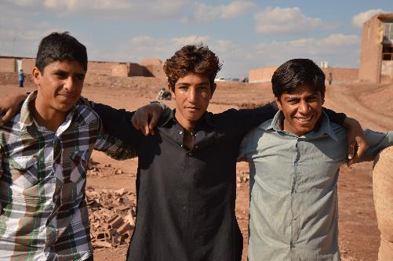
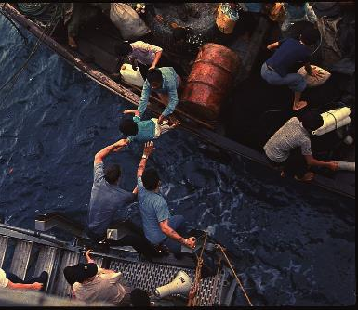
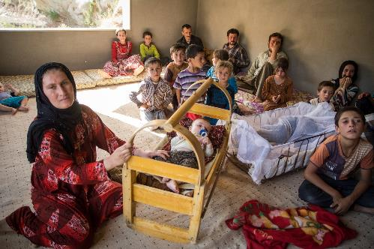
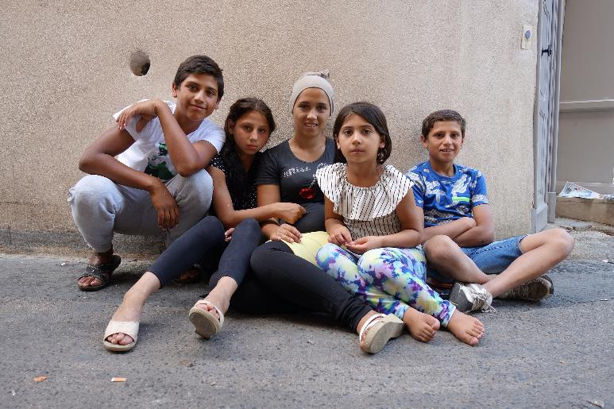
Prayer Guides
Basic Survival Needs of Migrants
May the Lord care for refugees and nomads, providing them with shelter, food, and medical care.
Rights and Gospel Bridges for Economic Immigrants
May the Lord protect the rights and safety of economic immigrants and lead Christian workers to become gospel messengers in cross-cultural workplaces.
Gospel Opportunities for International Students
May the Lord use local churches to sow the Gospel seeds among international students, so that they may come to know the Lord in a foreign land.
Connections and New Missions for Digital Nomads
May the Lord protect digital nomads to have stable spiritual support in changing environments, and that they may become bridges for missions in various places.
Notes:
1. Pray for the Basic Survival and Holistic Well-Being of Migrants
We ask God to have mercy on refugees and undocumented migrants living in the midst of instability, as well as traditional nomadic peoples who are losing their living space under the pressures of modernization.
Pray that God would provide refugees with safe shelter, food, and medical care; open doors for international aid organizations and schools to reach nomadic communities, improve access to education and clean water - so that those living on the margins of society may experience God’s care and dignity.
2. Pray for economic migrants’ workplace testimony and return of resources to their home countries
We pray that God will protect the labor rights and safety of these economic immigrants. May the Lord ignite the spirit of Christian migrant workers among them, granting these Christians wisdom and courage to become messengers of the gospel in foreign workplaces with different culture; and also that the funds and new technologies they send back to their home countries will bless and uplift their communities and families.
3. Pray for Gospel Opportunities and Future Missions for International Students
We ask God to lead local international student fellowships and churches to actively care for these students with the love of Christ, providing practical support such as language assistance and accommodation, so that they may encounter the Lord when they feel lonely in a foreign land. We ask God to use these young people—whether they will stay overseas or will return to their home countries—to become a new force in cross-cultural missions with a global vision.
4. Pray for Spiritual Connection and a New Vision for Global Missions Among Digital Nomads
We pray to the Lord to enable the digital nomads to find spiritual community and support amid their free and constantly changing lifestyles, so that they do not lose their way.
Pray that God would grant today’s churches creative wisdom to shepherd and equip them through both online and in-person ministries, so that wherever they go, they may become mobile bridges for God’s kingdom and carriers of the gospel.

Slide 4
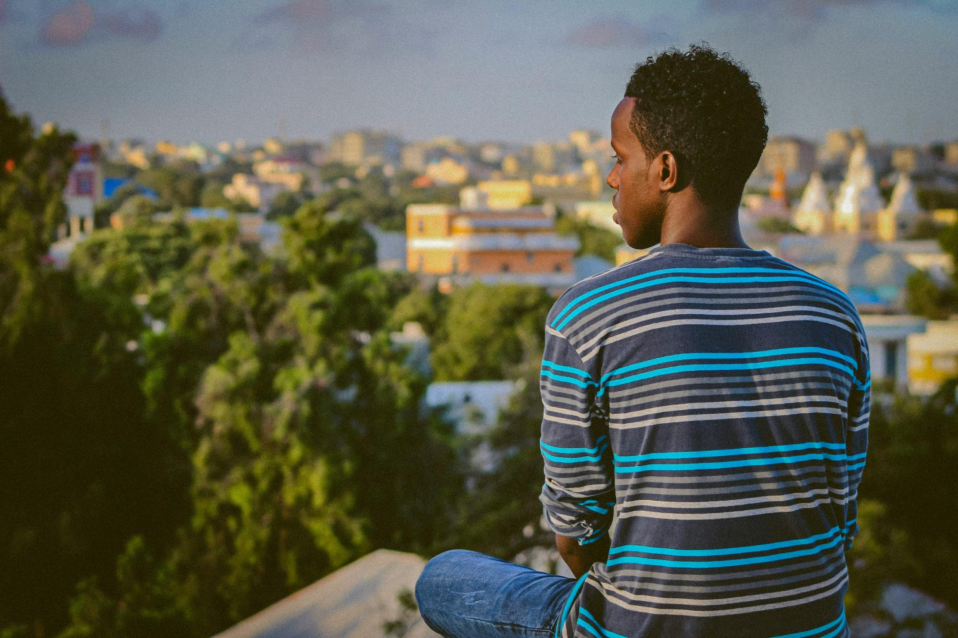
Let Us Pray Together for the People on the Move

Slide 5
Lord, in this age of people constantly moving around,
You manifest Your heart through those who are on the move.
Grant them fresh manna daily,
so that the basic survival of vulnerable mobile people may be assured.
When they are lonely, You speak to them; when they seek, You open doors for them;
Reveal to them You are the God of justice, love, and mercy in their daily lives.
We pray that You will also ignite the hearts of Christian workers in foreign lands
to proclaim Your gospel and live out Your Word of life.
We also ask the Lord to grant today’s churches innovative wisdom
to equip these “global citizens,”
so that in their mobile journeys, they may become channels of mission for Your kingdom.
In the name of Lord Jesus Christ, Amen.

Slide 6
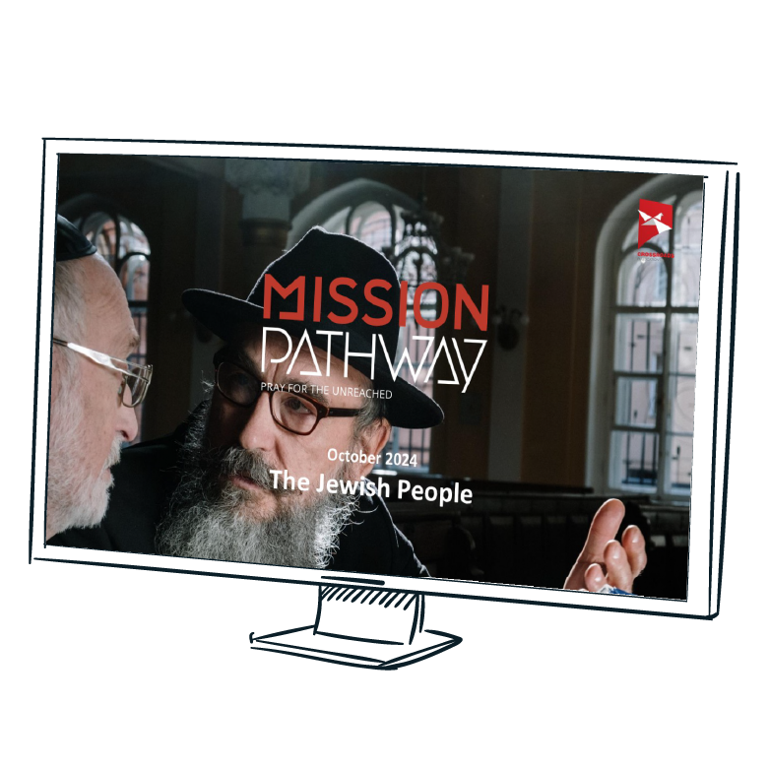
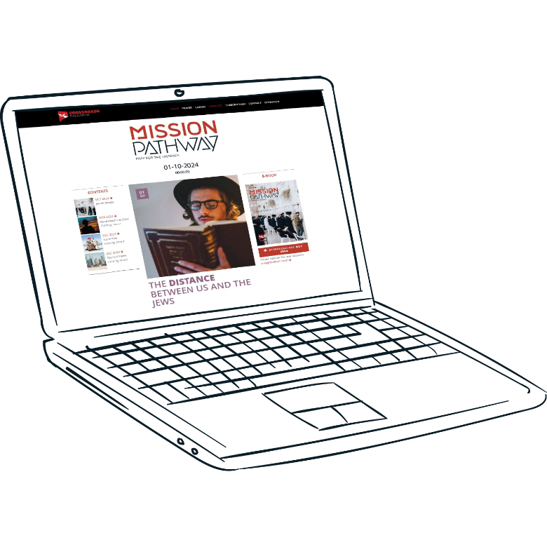
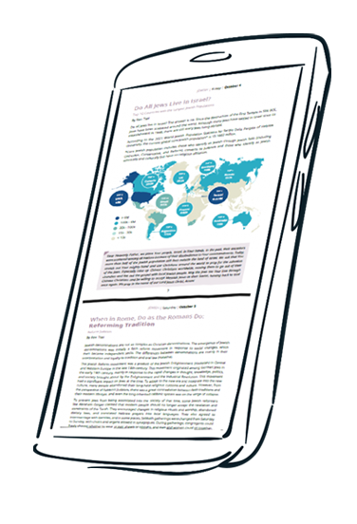
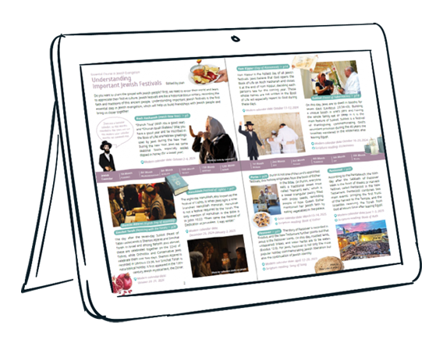

Slide 7
cross-roads.org/eng

