Slide 1
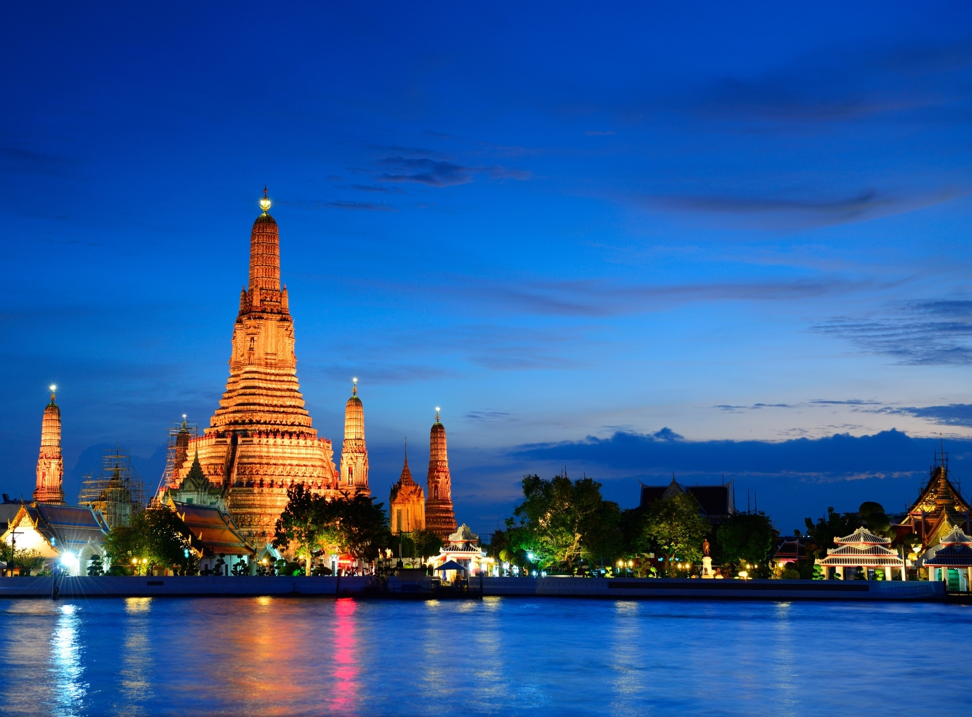


February 2026
Thailand - Land of Smile
Notes:
From February to March, we will focus on Thailand's multiculturalism and religious life, with understanding the Thai people's hearts as our primary goal.
We will also pray for the lives and hopes of Muslims during Ramadan.
In this diverse Land of Smiles and among communities of different faiths, we pray for understanding and true peace from God.

Slide 2
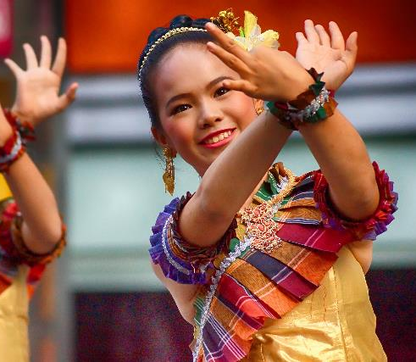
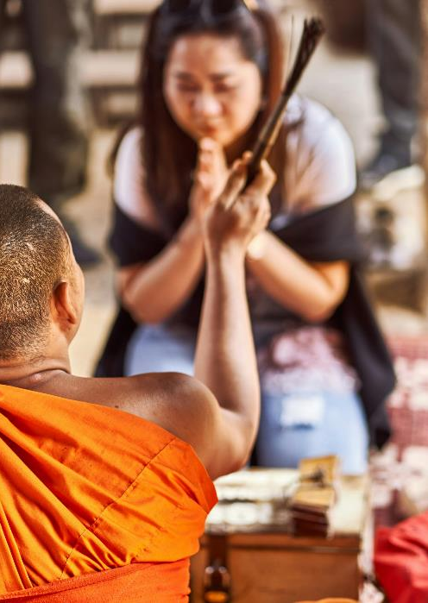

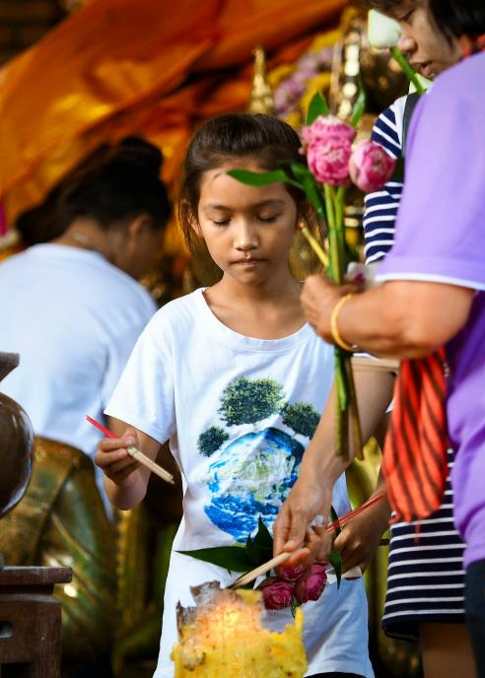
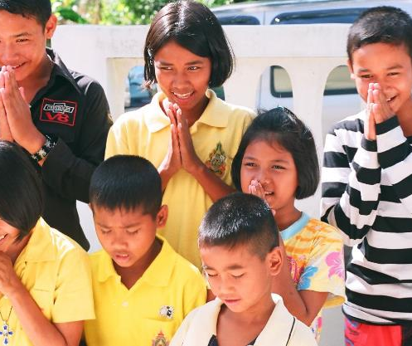
Social Characteristics
Valuing Harmony
Thai culture highly values harmonious relationships
Emotional suppression
A great deal of negative emotion and psychological stress is suppressed deep down
Faith Closely Interwoven with Daily Life
People seek peace, protection, and security in life through religious practices
Anxiety Amid Rapid Change
Many experience confusion and uncertainty caught between traditional values and real world challenges
Notes:
1. Valuing Harmony Thai society places great importance on maintaining harmony in relationships. People tend to avoid direct conflict, often choosing patience, stepping back, or remaining silent to preserve interpersonal connections. While this creates a calm surface, it can also lead to long-term suppression of underlying tensions.
2. Emotional Withdrawal Within the cultural expectation of “keeping a smile,” many negative emotions and psychological pressures are suppressed deep within. People often choose not to express their feelings or seek help.
3. Faith Closely Interwoven with Daily Life Religious practices deeply influence daily rhythms and values. Many people seek peace, protection, and life’s security through these practices. Faith thus becomes an important, yet hopeful, source of support when facing an uncertain reality.
4. Anxiety Amid Rapid Change Economic pressures, urbanization, and social mobility leave many feeling lost and uncertain between traditional values and real-world challenges. As familiar frameworks gradually loosen, the longing for stability and guidance becomes even more urgent.

Slide 3
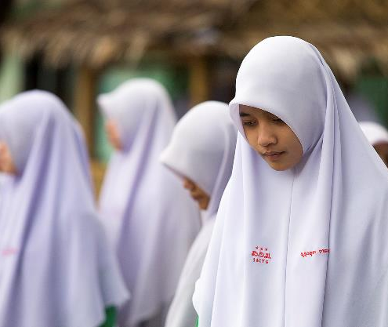
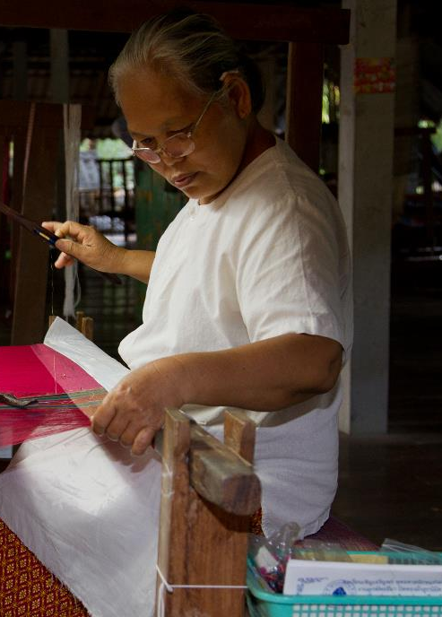
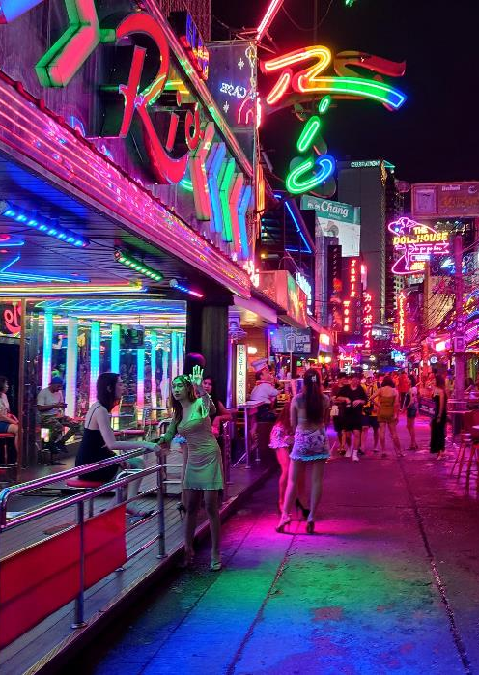
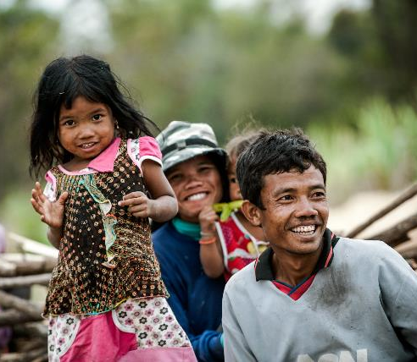
Prayer Needs
Hidden Souls
Pray that God would see every unspoken struggle, and help people lay down their burdens in safety and understanding.
True Peace
Many seek a smooth life with fewer conflicts, yet still lack inner calm and stability.
Healing in Family and Relationships
In a society that places great value on relationships, issues are often unaddressed or handled in silence.
People Seeking Direction Amid Change
May they find hope and a steady path for life even in times of uncertainty.
Notes:
1. Hidden Souls In a culture where people are accustomed to keeping the peace and maintaining a smile, many have long suppressed their anxiety, disappointment, and exhaustion. Lord, please see the struggles that have not been spoken aloud, and enable people to lay down their burdens in safety and understanding.
2. True Peace Many pursue a smooth life with fewer conflicts, yet still lack inner calm and stability. Lord, grant a peace that does not depend on changing circumstances, so that hearts may find rest and no longer be driven by fear and unease.
3. Healing in Family and Relationships In a society that places great value on relationships, issues are often unaddressed or handled in silence. Lord, come into families, marriages, and relationships. Heal the misunderstandings and tensions that have built up over time, and restore what has been broken.
4. People Seeking Direction Amid Change Amid rapid economic and social change, many feel lost and uncertain about the future. Lord, guide those who are searching for a way forward, so that even in uncertainty they may find hope and a firm direction for their lives.

Slide 4
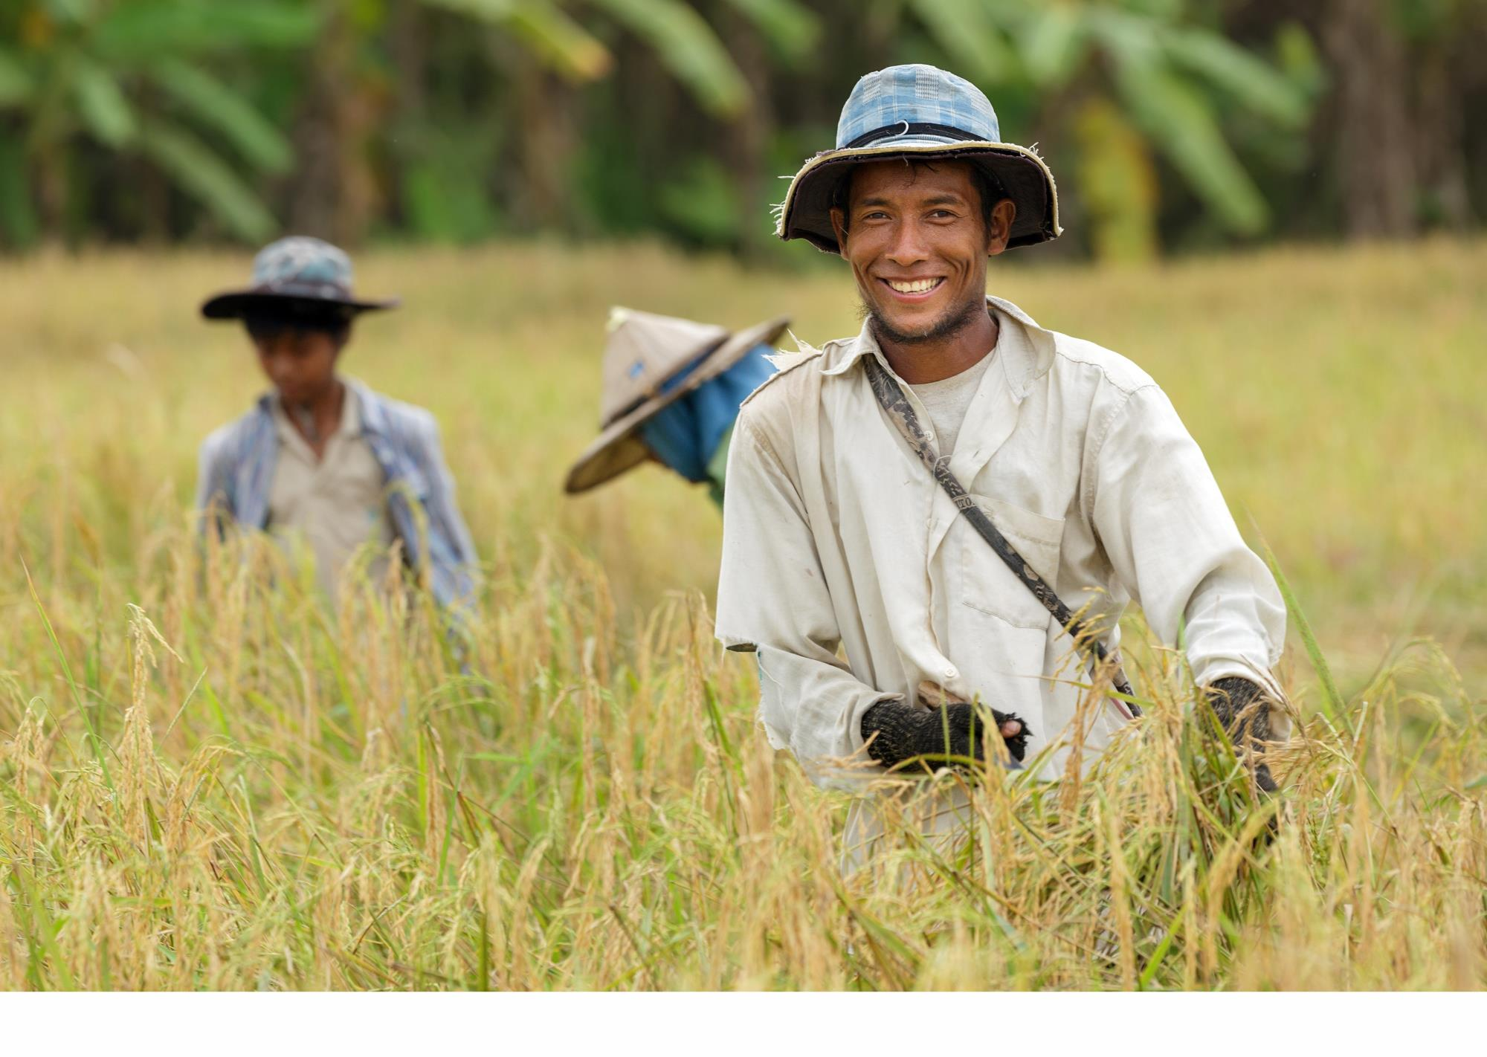
Let’s pray together in unity for Thailand

Slide 5

Dear Heavenly Father, Beneath the gentleness and courtesy so often seen in Thai society, there are many hidden burdens that remain unspoken.
So many feel weary under the weight of relationships and the pressures of daily life, yet they grow accustomed to carrying it all alone, afraid or unwilling to speak.
Please draw near to every broken heart in those quiet, wordless moments. Be their refuge and comfort— a green pasture where they can finally rest.
Please grant the people true peace— a peace that does not depend on everything going smoothly or on the temporary stability of circumstances. Even in the midst of change and uncertainty, teach them to look to You as their firm foundation. May You be the strength and support of people, guiding them step by step toward hope and light. In the name of the Lord Jesus Christ, Amen.

Slide 6




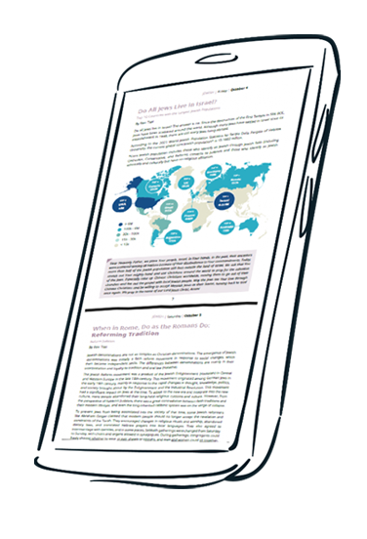
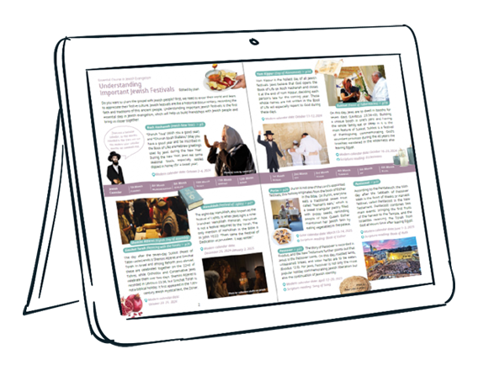



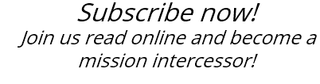

Slide 7
cross-roads.org/eng

