Slide 1
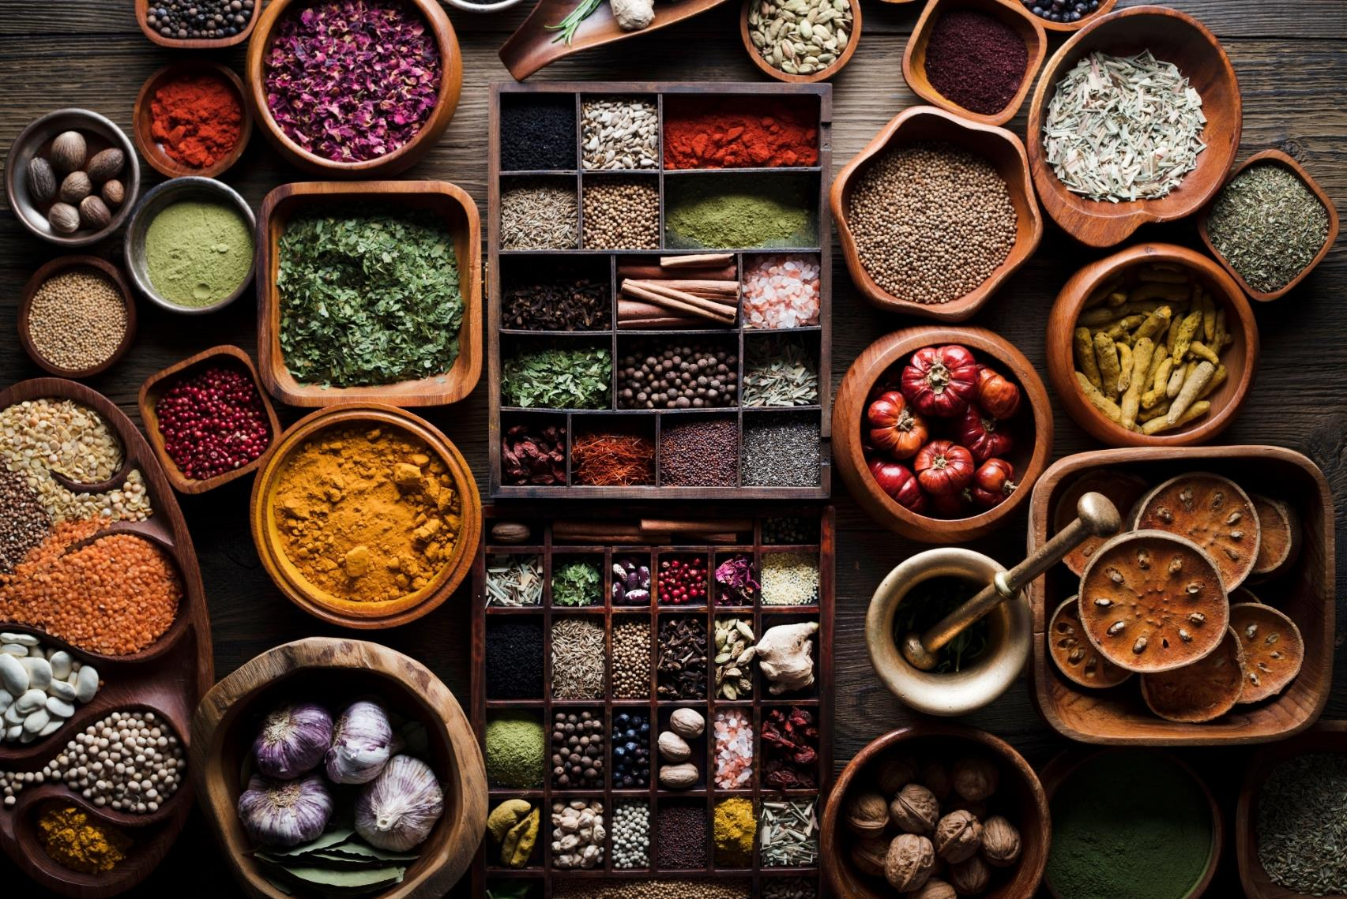


April 2026
Peoples who Produce Spices
Notes:
The aromas and flavors we savor at our dinner tables every day often come from lands and hands on the other side of the globe.
Spices, goods, and crops may seem like mere commodities, but behind them are the histories, labor, wounds, and long waiting of different peoples.
As the produce of distant places enters our daily lives, we are reminded to see those who supply the world’s needs, to notice people groups who have yet to hear the Gospel, and to respond in prayer to God’s heart for all nations.

Slide 2
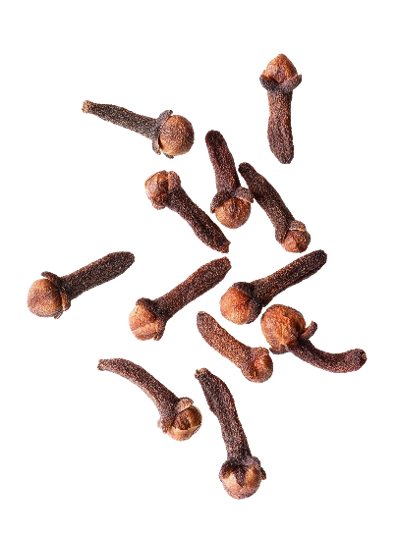
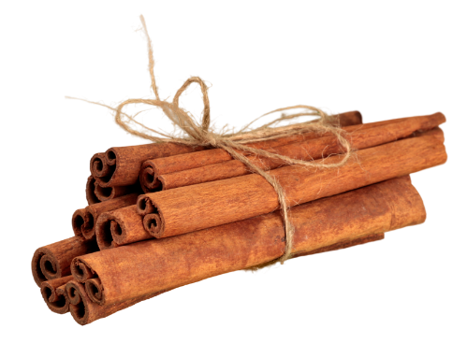
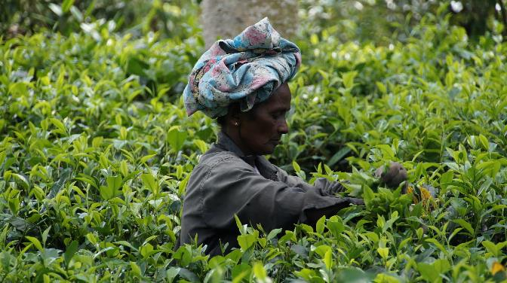

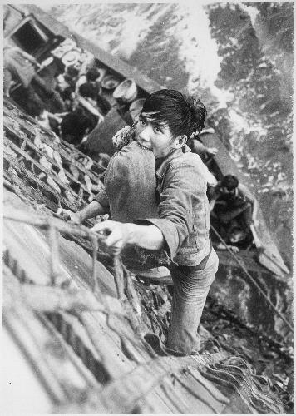
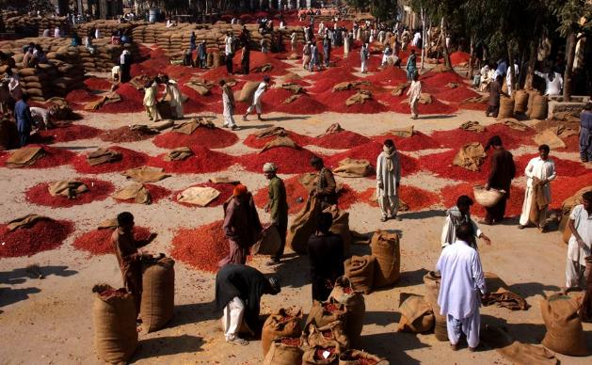
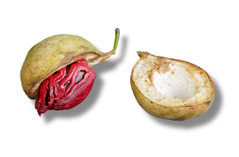
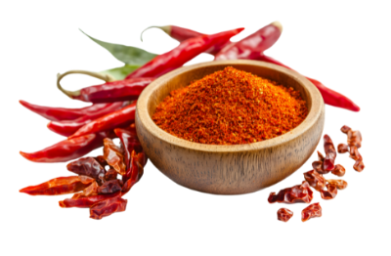
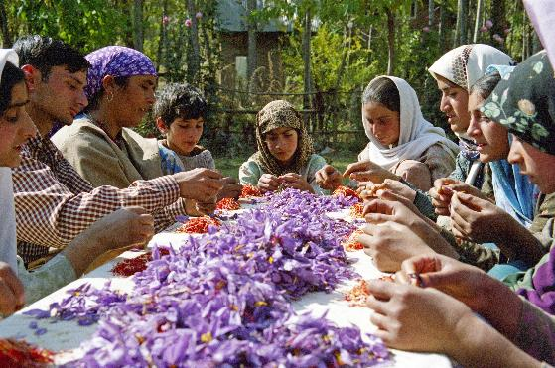
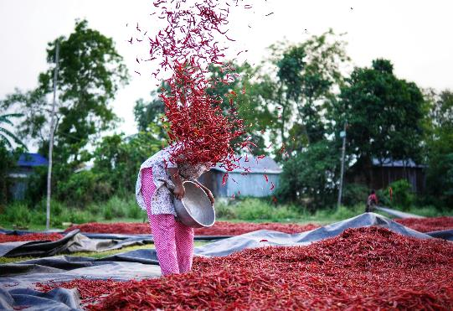
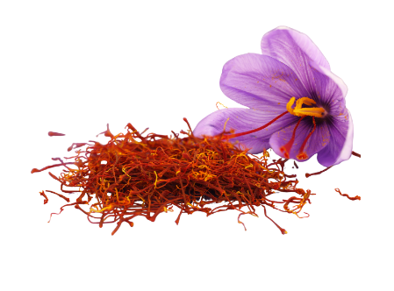
Meaning behind the Spices
Spices were once symbols of value and status
Nutmeg and cloves were once treasures flaunted by nobility. They also represented wealth, status, and cultural refinement.
The high cost behind flavors
From monsoon routes and the dangers of pirates to colonization and violence, a single fragrance often comes at a long and heavy cost.
Our tables connects to the unreached peoples
From planting and harvesting to transportation and sales, countless workers quietly take part yet are rarely truly seen.
Notes:
1) Spices Were Once Symbols of Value and Status
Spices such as nutmeg and cloves were once prized treasures used by the nobility to display their wealth; the spices mentioned in the 《Song of Songs》also signify something “precious and rare.”
They were not merely seasonings, but also represented wealth, status, and cultural refinement. People pursued these spices not only for flavoring, but to express an aspirational lifestyle.
2) The High Cost Behind Flavors
From monsoon routes and the dangers of pirates to colonization and violence, a single fragrance often comes at a long and heavy cost.
In many places, lands and peoples were plundered, controlled, and even trapped in prolonged oppression because of these products.
What we easily obtain today may conceal centuries of wounds and imbalances. Therefore, our prayer is that the Lord Himself would intervene in the scars left by history.
3) Today's Table Still Connects to the Unreached People Groups
The flavors we taste daily come from the diligent hands on the other side of the earth. Many of those who provide these fragrances have yet to hear the Gospel.
From planting and harvesting to transportation and sales, countless workers quietly take part yet are rarely truly seen.
Our daily lives are already interconnected with all people, though we often are not aware of it.
As the produce from distant lands enters our kitchens and tables, it also reminds us that a gospel perspective can begin with the familiar things around us.

Slide 3
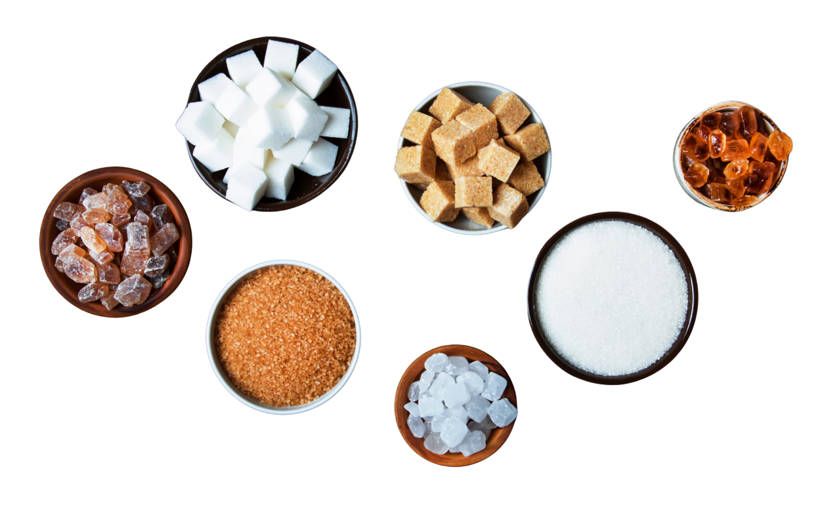
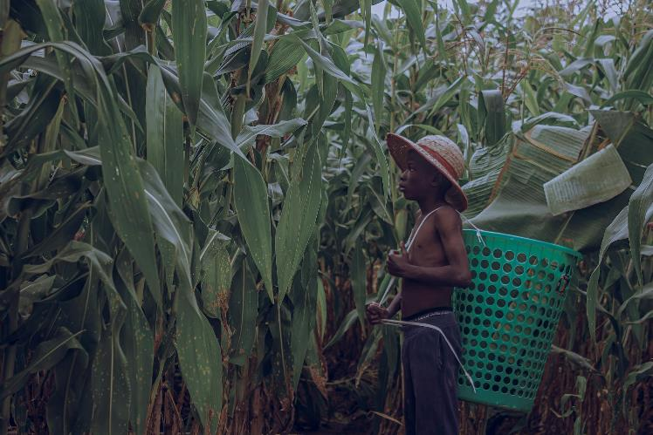
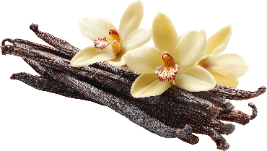

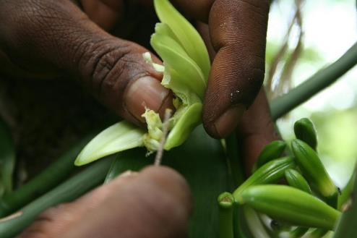
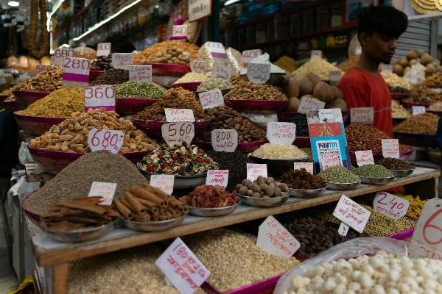

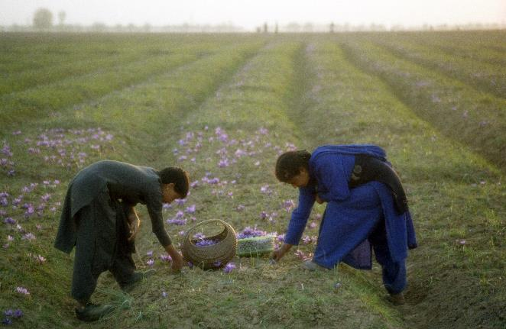
Prayer Guides
Places of production and laborers
May the Lord remember those involved in planting, harvesting, transportation, and trade
Scars of history and oppressed lands
May the Lord heal the wounds left by colonialism, exploitation, drugs, poverty, and injustice
The church and ourselves
May the Lord give us sensitive hearts, so that we do not treat "production" merely as commodities. May our dining tables be the starting point for remembering all nations.
Notes:
1) Pray for places of production and laborers
We ask the Lord to remember those involved in planting, harvesting, transportation, and trade; may those who supply the world's flavors also have opportunities to hear the gospel and receive dignity and hope.
2) Pray for the scars of history and oppressed lands
May the Lord heal the wounds left by colonialism, exploitation, drugs, poverty, and injustice; and may He bring justice, comfort, and renewal to places long oppressed.
3) Pray for the church and for ourselves
May the Lord give us sensitive hearts, so that we do not treat "production" merely as commodities; may God send workers into the unreached peoples, so that all nations may come to know the fragrance of Christ.
May our dining tables be the starting point for remembering all nations.

Slide 4
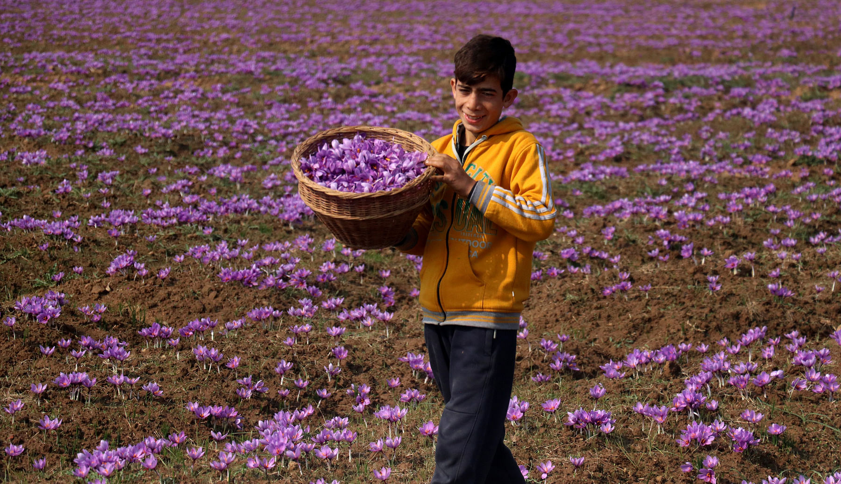
Let Us Pray Together for Peoples Who Produce Spices

Slide 5

Lord, as we enjoy the produce of the ends of the earth,
we ask that You do not let us stop at merely savoring the flavors and aromas,
but help us see the real people, families, and laboring hands behind them.
May You remember those who have long lived in poverty, exploitation, oppression,
and the wounds of history, and personally bring comfort, healing, and justice.
May the Holy Spirit awaken the church, so that we would not only consume the richness of the world but also be willing to bear the needs of all peoples.
May the Gospel reach those who have yet come to know You;
may You raise up workers to go into every corner of the earth,
bringing the fragrant aroma of Christ to the ends of the earth,
so that all nations may come to worship and praise You.
In the name of the Lord Jesus Christ, we pray. Amen!

Slide 6
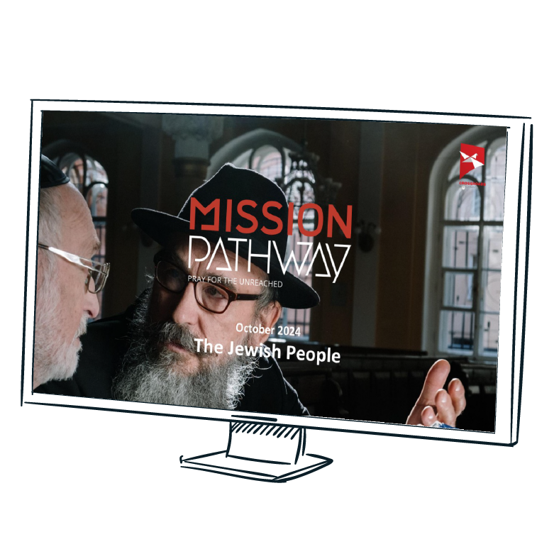
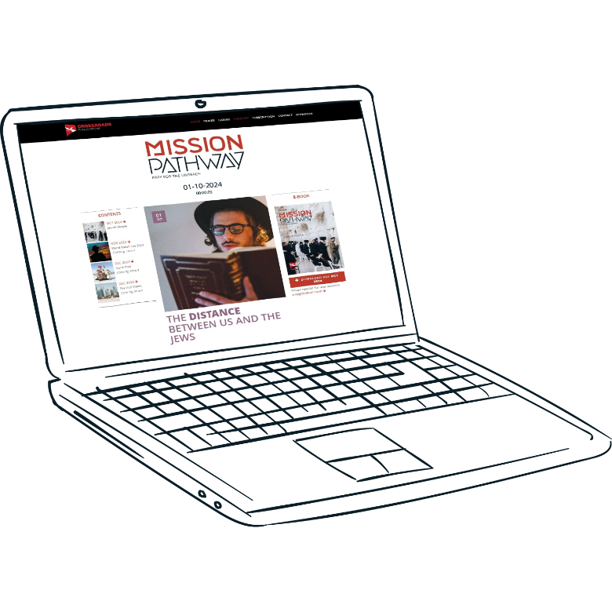

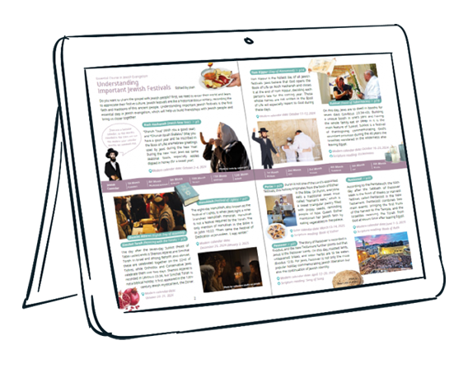

Slide 7
cross-roads.org/eng

