Slide 1
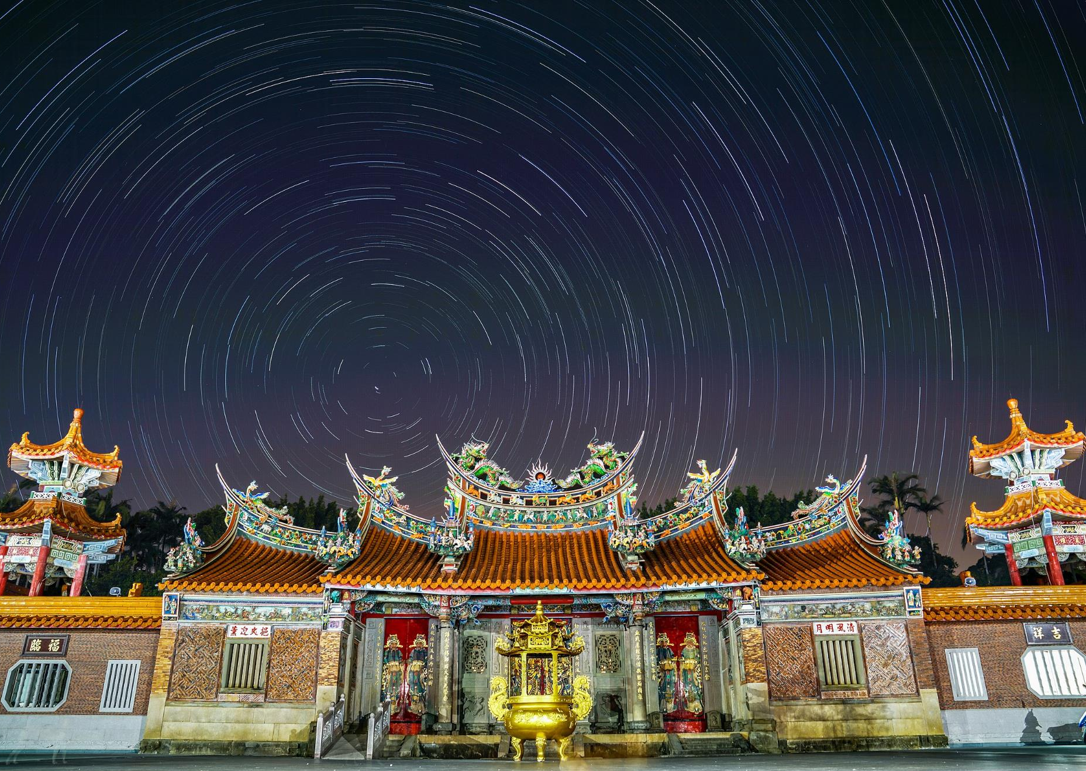


September 2025
Hakka People

Slide 2
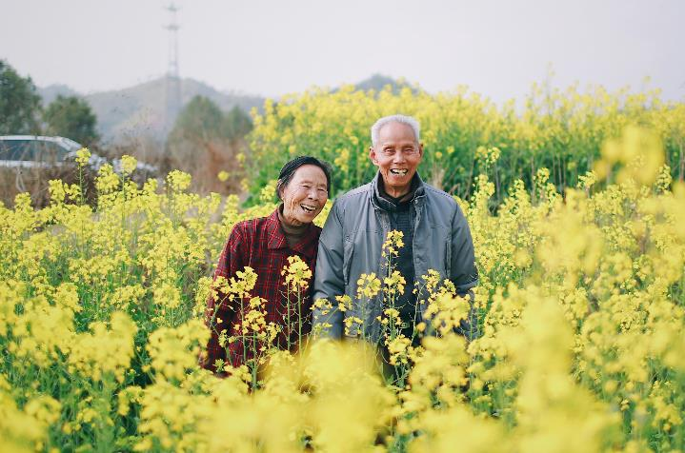




About Hakka People
Who are Hakka People?
Hakka People Worldwide
  About 80 million
  Across 5 continents and 82 countries
Taiwanese Hakkas
  About 4.669 million
Notes:
1）Who are the "Hakka" people?
The Hakka people are a significant branch of the Han Chinese and the only subgroup of Han that is not named after a specific geographic region.
Historically, the ancestors of the Hakka people migrated southward on a large scale due to wars. They moved from the Yellow River basin (such as Shanxi, Henan, Shandong, and Shaanxi) to southern provinces such as Guangdong, Fujian, and Jiangxi.
In contrast to the local "native" residents, they were called "guest” residents (Hakka in Chinese), the term that evolved to become "Hakka people" over time.
2）Hakka people worldwide
There are approximately 80 million “ethnic Hakkas” globally, including Hakka language speakers and their descendants.
The Hakkas are spread across five continents and 82 countries, earning them the title of “the people on whom the sun never sets.”
3) Taiwanese Hakkas
The Hakka population in Taiwan is estimated at approximately 4.669 million, accounting for about 19.8% of total population.
The Hakka people in Taiwan primarily immigrated from the mountainous areas of northern Guangdong and Fujian during the late Ming and Qing dynasties.
Based on their dialectal accents, Taiwan's Hakka settlements can be divided into regions and traced to their ancestral origins, primarily including the "Sixian Dialect," "Hailu Dialect," "Raoping Dialect," and the Tingzhou Prefecture’s Yongding Dialect.

Slide 3

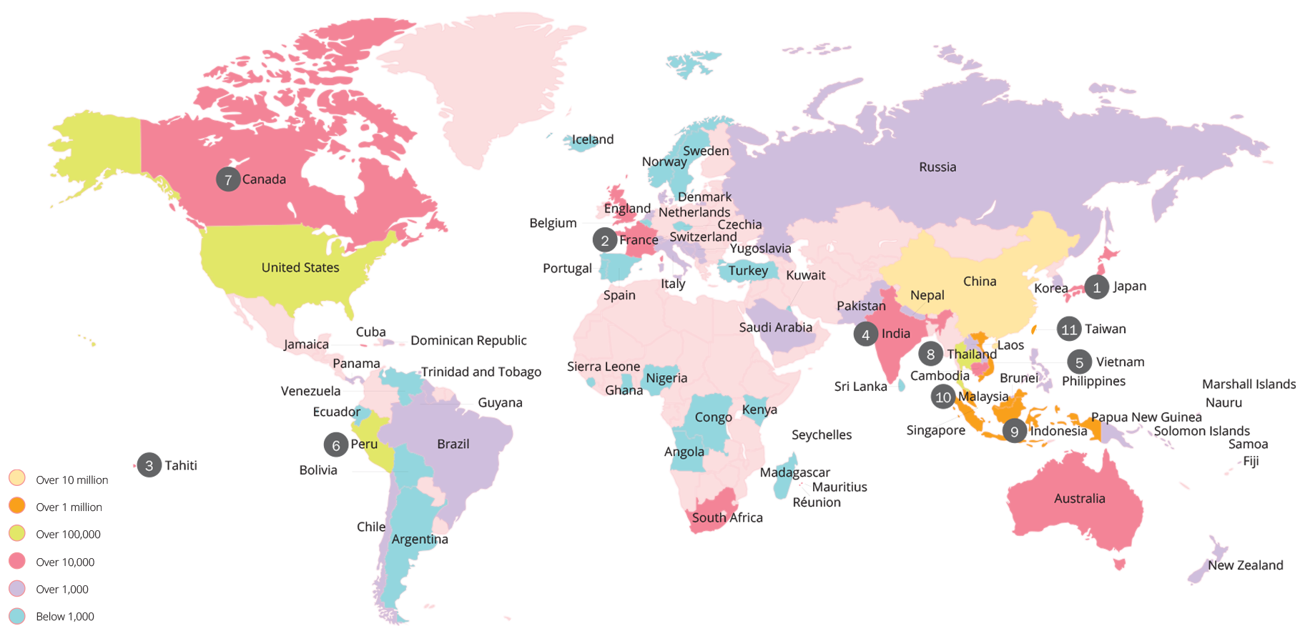
Notes:
1）Who are the "Hakka" people?
The Hakka people are a significant branch of the Han Chinese and the only subgroup of Han that is not named after a specific geographic region.
Historically, the ancestors of the Hakka people migrated southward on a large scale due to wars. They moved from the Yellow River basin (such as Shanxi, Henan, Shandong, and Shaanxi) to southern provinces such as Guangdong, Fujian, and Jiangxi.
In contrast to the local "native" residents, they were called "guest” residents (Hakka in Chinese) and evolved into the term "Hakka people" over time.
2）Hakka people worldwide
There are approximately 80 million “ethnic Hakka” globally, including Hakka language speakers and their descendants.
The Hakka are spread across five continents and 82 countries, earning them the title of “the people on whom the sun never sets.”
3) Taiwanese Hakka
The Hakka population in Taiwan is estimated at approximately 4.669 million, accounting for about 19.8% of total population.
The Hakka people in Taiwan primarily immigrated from the mountainous areas of northern Guangdong and Fujian during the late Ming and Qing dynasties.
Based on their dialectal accents, Taiwan's Hakka settlements can be divided into regions and traced to their ancestral origins, primarily including the "Sixian Dialect," "Hailu Dialect," "Raoping Dialect," and the Tingzhou Prefecture’s Yongding Dialect.

Slide 4
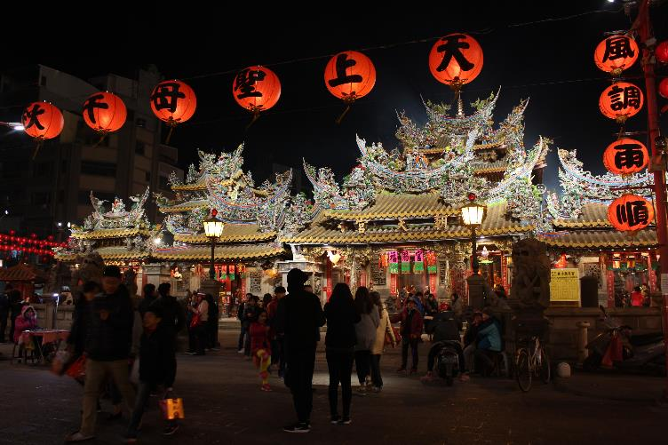
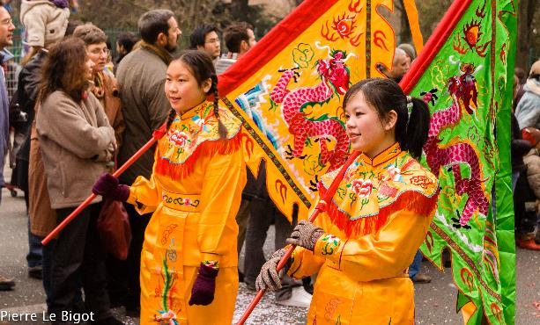
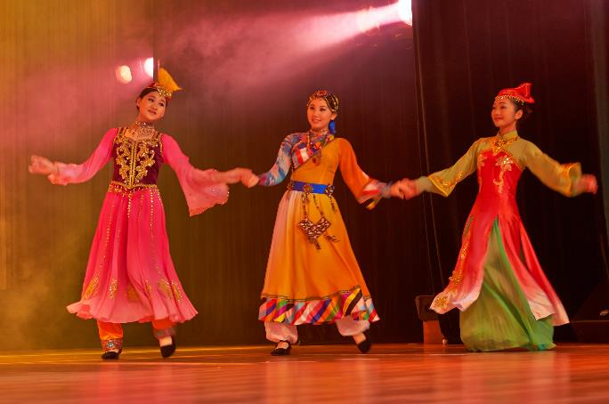
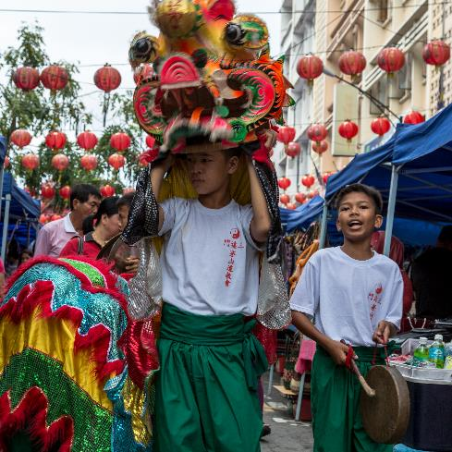
Hakka Culture and Traditional Beliefs
Cultural Labels
Decline of Hakka Language
Traditional Beliefs
Art in Daily Life
Notes:
1）Cultural Labels of the Hakkas
Hakka culture carries various labels, including "thriftiness”, " fearless courage," "migration and resettlement," "Hakka language," "spirit of striving and pioneering," as well as "frugal lifestyle and character."
These characteristics are closely related to the Hakka people's history of multiple migrations and harsh living environments, fostering their spirit of hardworking, resilience, and striving.
2）Decline of Hakka Language
There are approximately 30 million people who speak Hakka daily or fluently. Compared to the global population of about 80 million "ethnic Hakka people," the use of Hakka language is declining.
Globalization has accelerated this decline, raising concerns about the preservation of Hakka culture.
As one of the important cultural labels of Hakka people, the Hakka language holds an indispensable position in sustaining Hakka ethnic identity.
3）Traditional Hakka Beliefs
Traditional Hakka beliefs are closely connected to their cultural background, blending multiple religions and with an orientation leaning toward Buddhism.
Hakka people particularly emphasize ancestral worship with reverence for the deceased and remembrance of ancestors. In Taiwan, the Hakka communities have Yimin (righteous martyrs) beliefs, Bogong (Earth God) worship, and the Hakka temples featured in the Tingzhou region.
These belief systems reflect the Hakka people's respect for ancestors and attachment to their land during their migration, which are their vital cultural legacies.
4）Art in Daily Life
Hakka culture is not only reflected in language and beliefs but also deeply influences art and daily life.
Hakka mountain songs (also called "Hakka Pingban") are the most iconic folk art, expressing emotions and wisdom through improvised call-and-response singing. Hakka opera such as "tea-picking opera" is closely intertwined with agricultural life.
Characterized by its savory, salty, and oily flavors, Hakka cuisine, such as braised pork with preserved vegetables and lei cha (ground tea), reflects the Hakka people's pragmatic and frugal life philosophy.
The walled villages and earthen buildings of the Hakkas serve as both defensive structures and symbol of their unity.
These traditional cultures not only showcase the Hakka people's life wisdom but also serve as important means to foster ethnic identity.

Slide 5
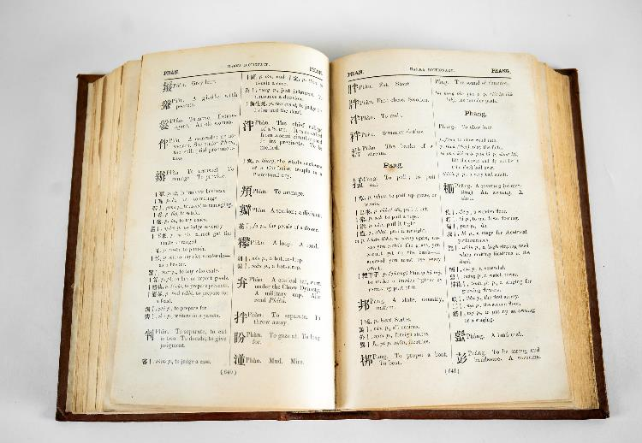

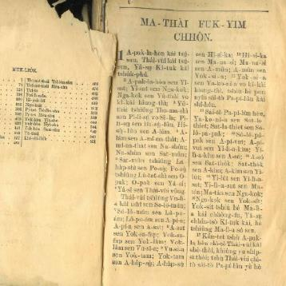
Spiritual Landscape & Prayer Items
Hakka Gospel Needs and Challenges
Translation and Publication of the Hakka Bible
History of Hakka Mission in Taiwan
Current Hakka Mission Resources
Notes:
1）Hakka Gospel Needs and Challenges
Hakka people have a strong sense of cultural identity, but due to deeply rooted traditional beliefs and decline of the Hakka language, their acceptance of Christianity is generally low.
Long-term evangelistic efforts and intercessory prayers are needed. May the Lord raise up workers to spread the gospel in culturally relevant ways.
2）Translation and Publication of the Hakka Bible
The Hakka Bible translation began in 1960. After years of hard work, the "Modern Taiwanese Hakka Version" was published in 2012.
Today, a variety of Hakka Bible resources are available, allowing Hakka people to hear the gospel in their mother tongue.
3）History of Hakka Mission in Taiwan
In 1865, James MacArthur was sent by the Presbyterian Church of England in dual-role of a missionary and a doctor to share the gospel in Kaohsiung.
In 1875, Pastor Hugh Ritchie established the first Hakka church, becoming a pioneer in Hakka missions in Taiwan.
4）Current Hakka Mission Resources
Today, Taiwan has the Hakka Theological Seminary, the Christian Hakka Evangelical Association, and the Hakka Chinese Presbyterian Church in Taiwan, along with abundant Hakka hymns and teaching materials, forming a solid foundation for advancing Hakka missions.

Slide 6
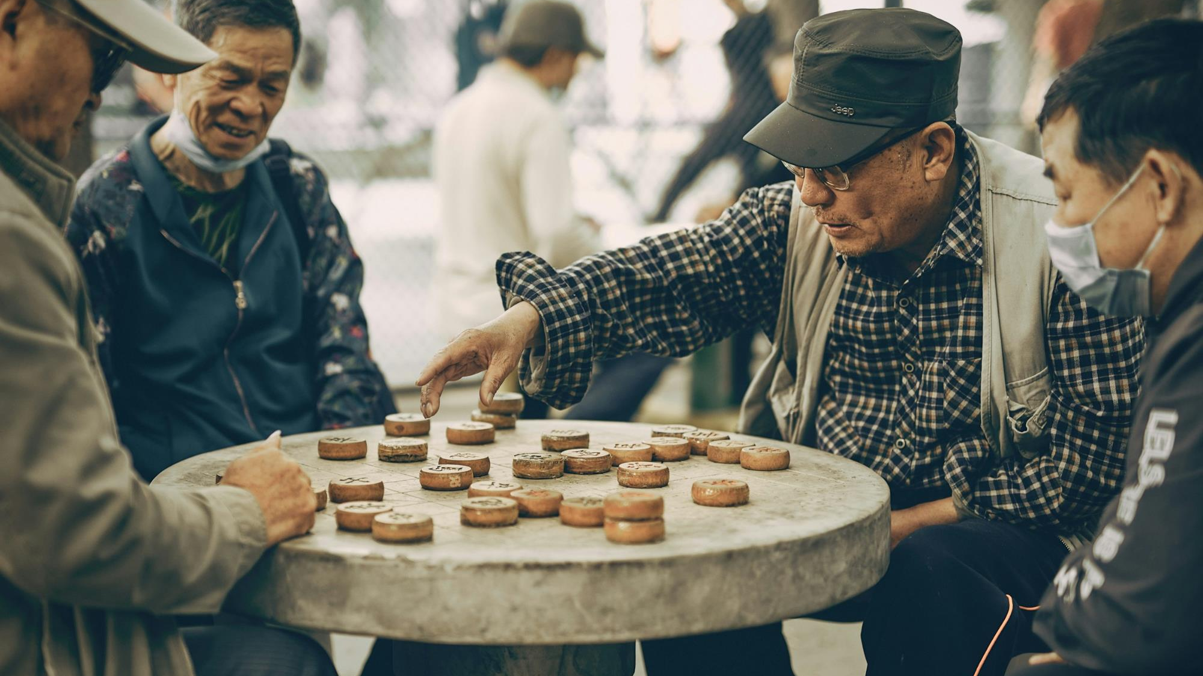
Let’s Pray Together for the Hakka People

Slide 7
Dear Heavenly Father, thank you for Your wonderful creation and provision,
allowing Hakka people to have their unique culture, traditions, language, and way of life.
Although Hakka people have developed a distinctive language system during their long-term migration and settlement in different places,
You are still able to express Your grace to them in a language familiar to them around the world.
Thank you, Lord, for having reached the Hakka community long ago through missionaries, establishing many Hakka churches.
May the Holy Spirit touch Hakka people from different backgrounds,
so that Hakka people all over the world may see that You are the Father,
for You made all the nations from one man, that they should inhabit the whole earth;
and You marked out their appointed times in history and the boundaries of their lands.
You did this so that they would seek You and perhaps reach out for You and find You,
though You are not far from any one of us.
May the Lord continue to expand missionary work among the Hakka people,
raising up generation after generation of Hakka people to become missionaries,
bringing the gospel of the Lord Jesus Christ to every corner of the world!
In the name of our Lord Jesus Christ we pray, Amen!

Slide 8





