Slide 1
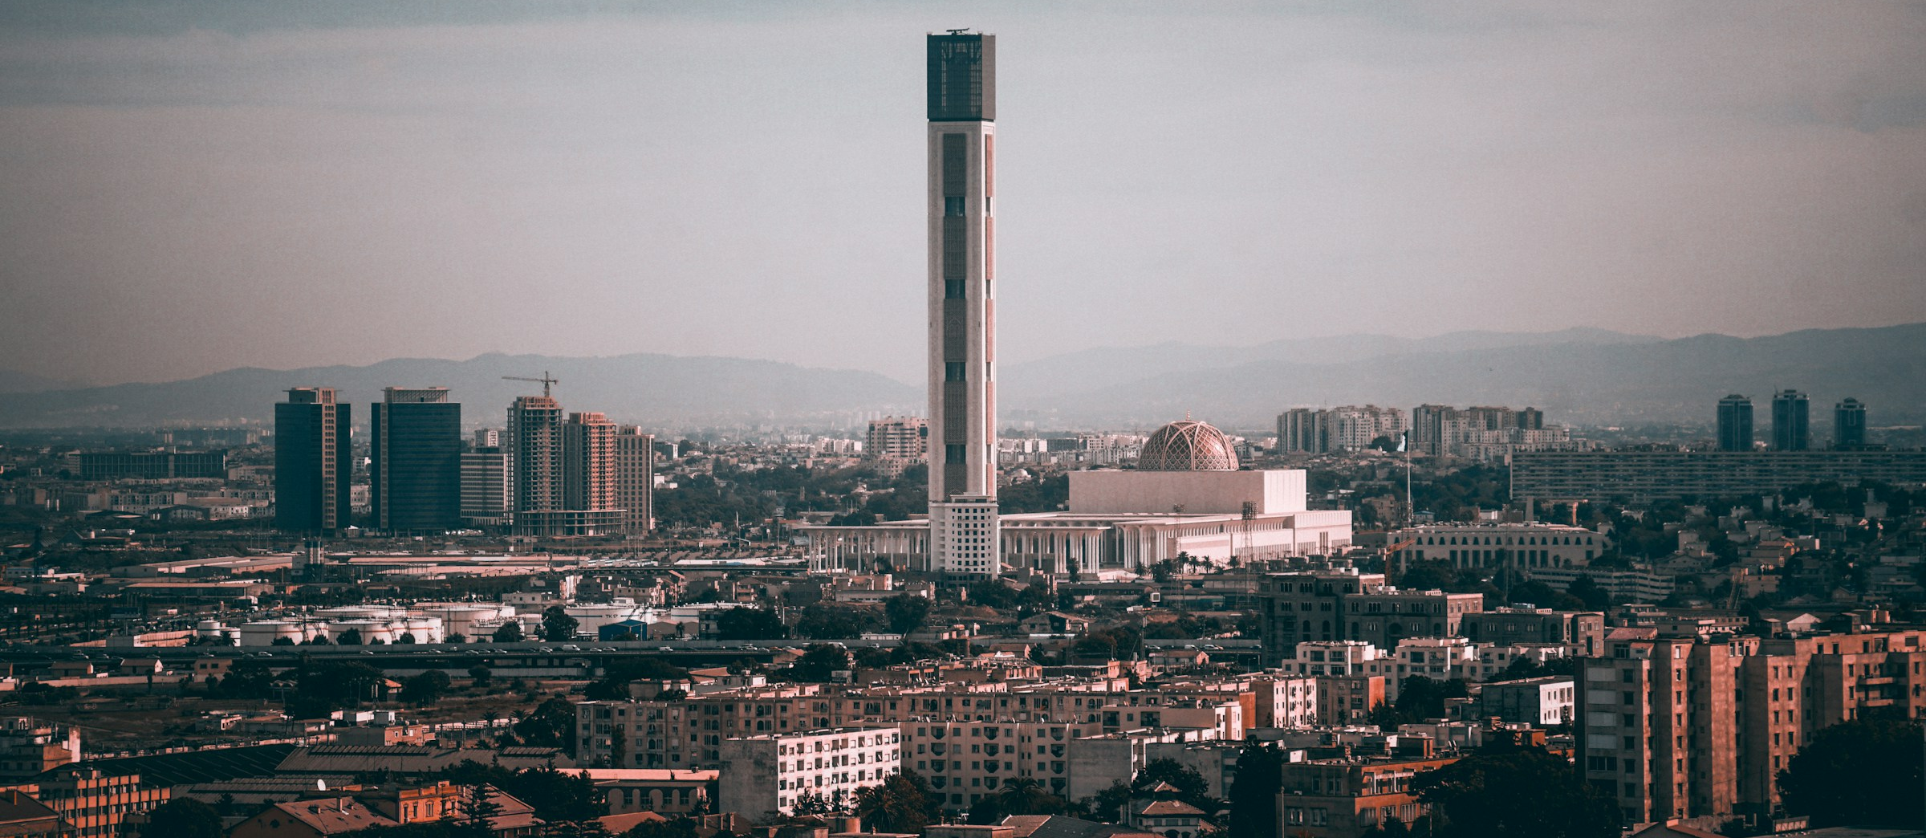


October 2025
North Africa’s Three Nations
Notes:
Today's North Africa may seem an unlikely place to associate with “Christianity,” yet in the 1st century AD, it was a pivotal center for the development of the Christian faith.
Tertullian was Carthaginian from North Africa, while Cyprian and Augustine were Amazigh.
The Amazigh are the indigenous people of North Africa. This land bears witness to the spread of the Christian faith to all nations.
This month, let us pray for Algeria, Tunisia, and Morocco in North Africa, that the name of Christ may once again be exalted.

Slide 2
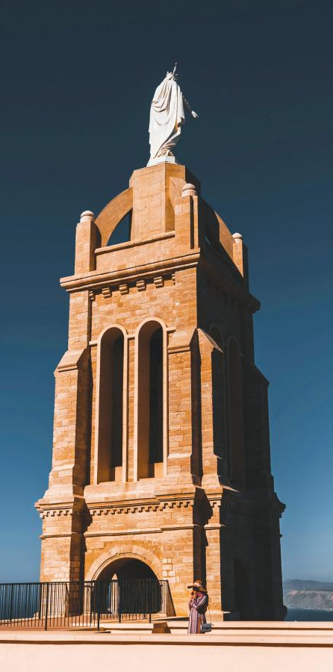

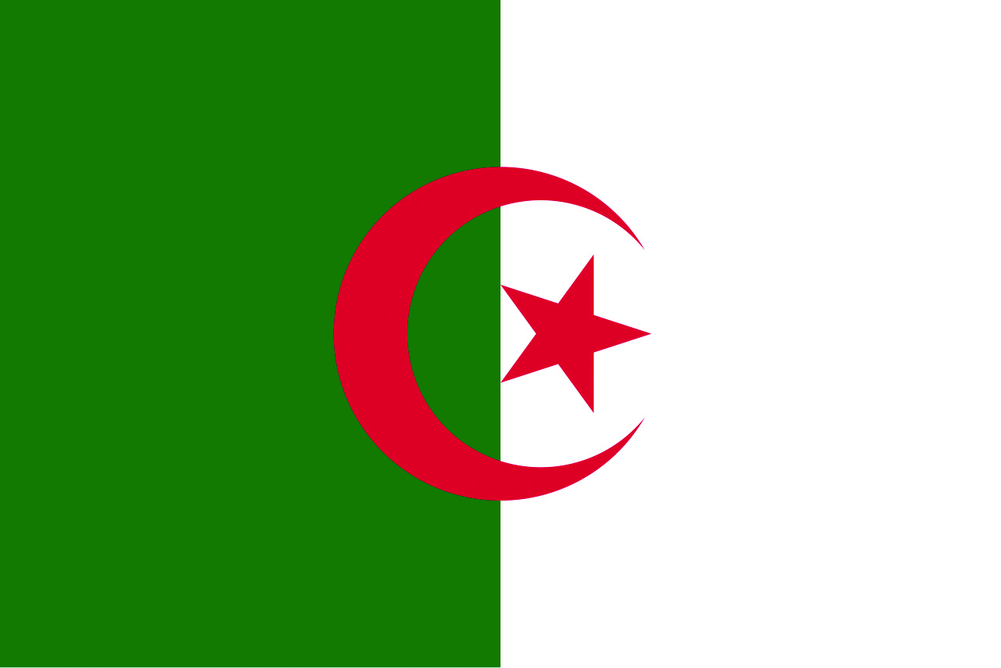
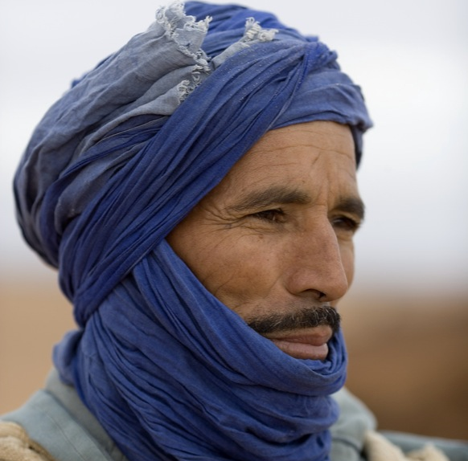
Algeria
Population: 46.16 million
99% Sunni Muslim, Christians less than 1%.
Closed, authoritarian, and conservative. Difficult to obtain visas to enter
Monolithic Economic Structure, heavily relies on exports of natural gas and oil.
Difficulty in development, infrastructure outdated, lacks management, underdeveloped economy.
Notes:
1) Population and Religion
Population: 46.16 million. Algeria is an Islamic country, a major regional power in North Africa and a middle-power state.
99% of the population is Sunni Muslim, with Christians comprising less than 1%.
Christianity vanished in the 9th century. By the 12th century, no Christians or Christian churches remained.
2) A Closed Mediterranean Country
Closed, authoritarian, and conservative are the labels often applied to Algeria. It is difficult for foreigners to obtain visas to enter.
Some describe Algeria as the North Korea of North Africa—the military controls politics, views the world through conspiracy theories, trusts no one, and uses anti-Semitism and Islamism to divide and rule the country.
The current Algerian president is regarded as a puppet figure supported by the military.
3) Monolithic Economic Structure
Algeria's economy relies heavily on exports of natural gas and oil. The government has been trying to diversify the country’s economic structure.
France, Italy, Spain, and China serve as Algeria's major import-export trading partners.
4) A Difficult Path to Development
Algeria has endured countless hardships, from independence, the civil war of the 1990s, the Arab Spring of 2011, the global oil price crash of 2014, to the global shutdown caused by the COVID-19 pandemic in 2020.
Despite being Africa's largest natural gas producer and the world's fourth-largest producer, the country's infrastructure is outdated and backward, lacks management, has an underdeveloped economy. Its wealth level falls in the global middle tier, comparable to South Africa and Mongolia.

Slide 3
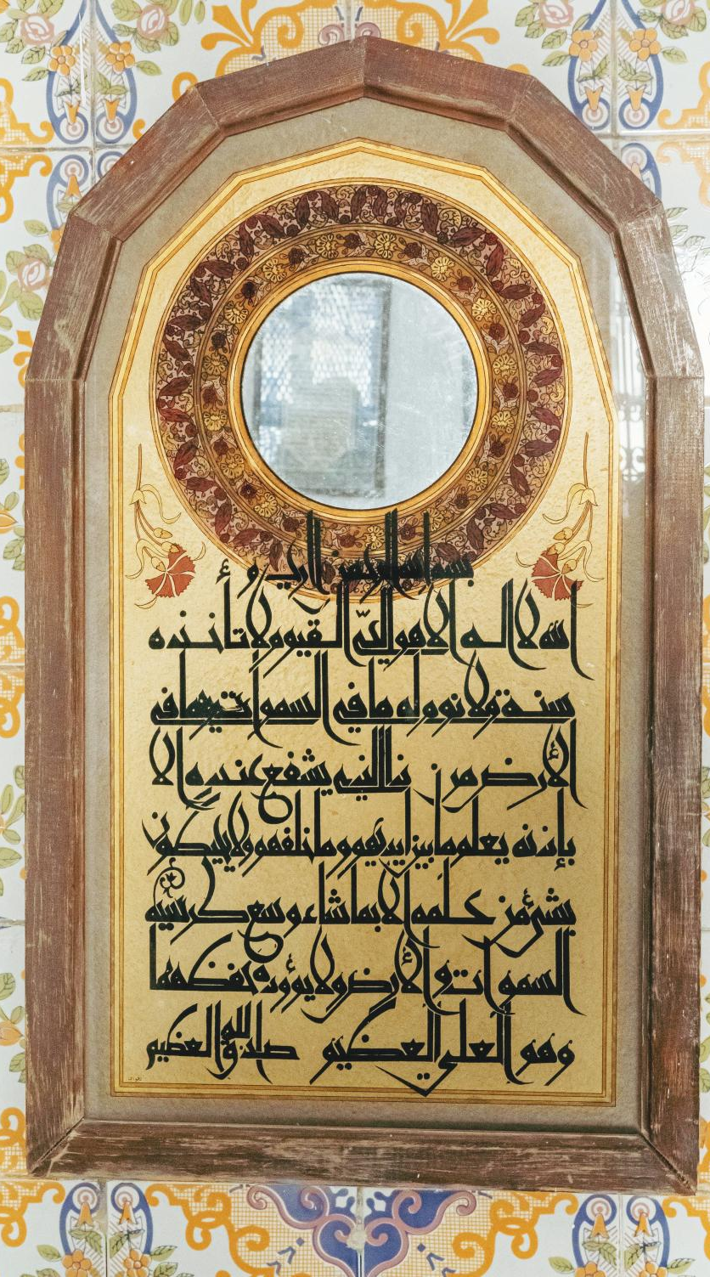
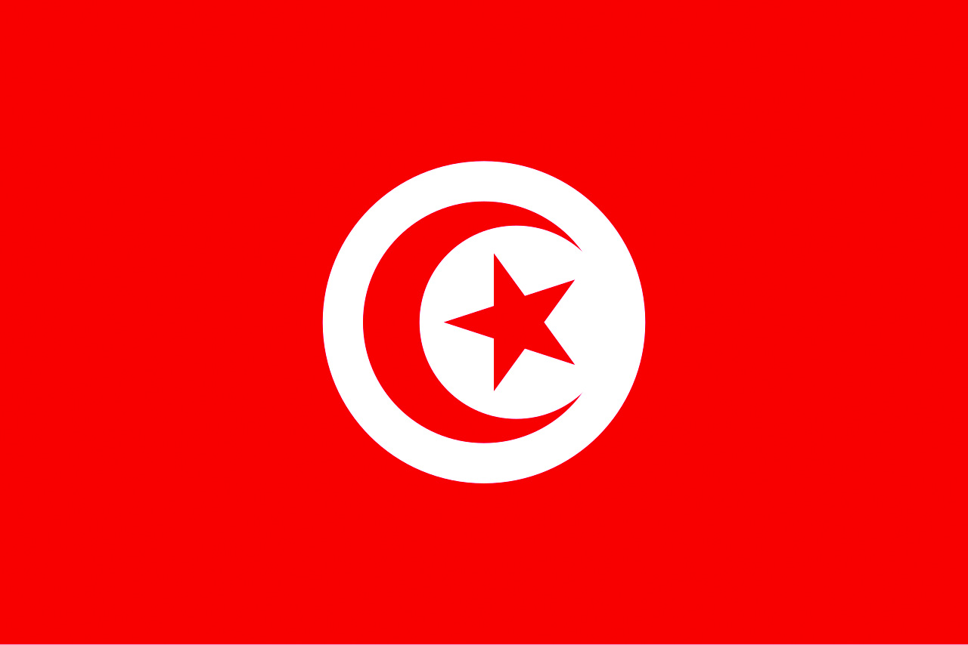
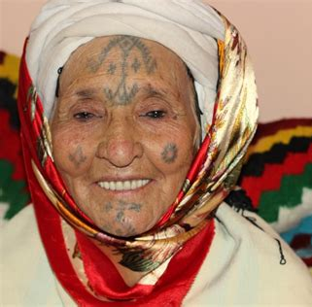
Tunisia
Population: 12.2 million
  Religion: 99% Sunni Muslims, about 3,000+ evangelical Christians
Carthage was North Africa's most important Christian center, home to Church Fathers: Tertullian, Cyprian, Augustine
Birthplace of the "Arab Spring"
Decade-long state of emergency
Notes:
1) Population and Religion
Population: 12.2 million, 99% Sunni Muslim.
Other religions include Christianity, Judaism, Baha'i Faith, and atheism. Currently, there are approximately 3,000+ evangelical Christians.
2. The Vanished Christian Beacon
Carthage, Tunisia, was the most important Christian center in North Africa, once nurturing several important Christian fathers:
Tertullian, the first to propose the concept of the Trinity
Cyprian, who, despite persecution, still declared "Thanks be to God"
Augustine, who studied and taught in Carthage
The Council of Carthage confirmed the 27 books of the New Testament in 397 AD
The rise of Islam in the 7th century dealt a devastating blow to the North African churches, with many martyred or converting to Islam.
The dwindling Christian community continued to struggle for survival in adversity until by the 15th century that Christians were virtually extinct.
3) Birthplace of the "Arab Spring”
In 2011, a Tunisian youth self-immolated in protest, sparking the Jasmine Revolution and igniting uprisings across Arab countries, known as the "Arab Spring."
Tunisia was the only country among them to have successfully overthrown its authoritarian government and establish democracy.
4) Decade-long State of Emergency
In 2015, a presidential guard was attacked in Tunisia, and the entire country entered a state of emergency.
To this day, the government continues to ban large gatherings, impose strict media censorship, and enforce curfews, restricting fundamental freedoms while aggressively suppressing opposition voices and critics.

Slide 4
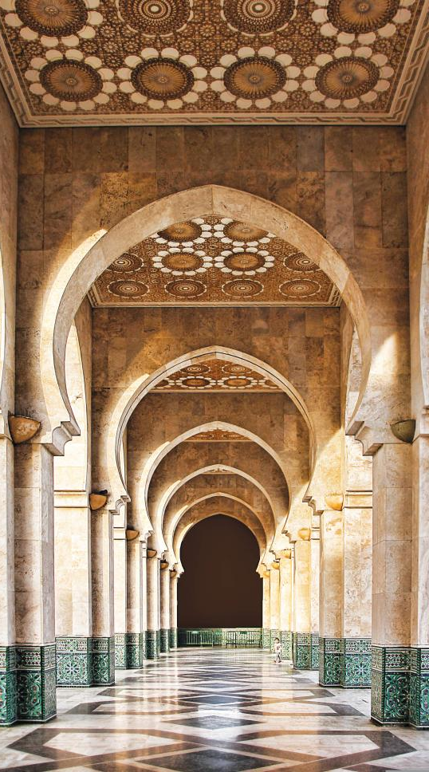
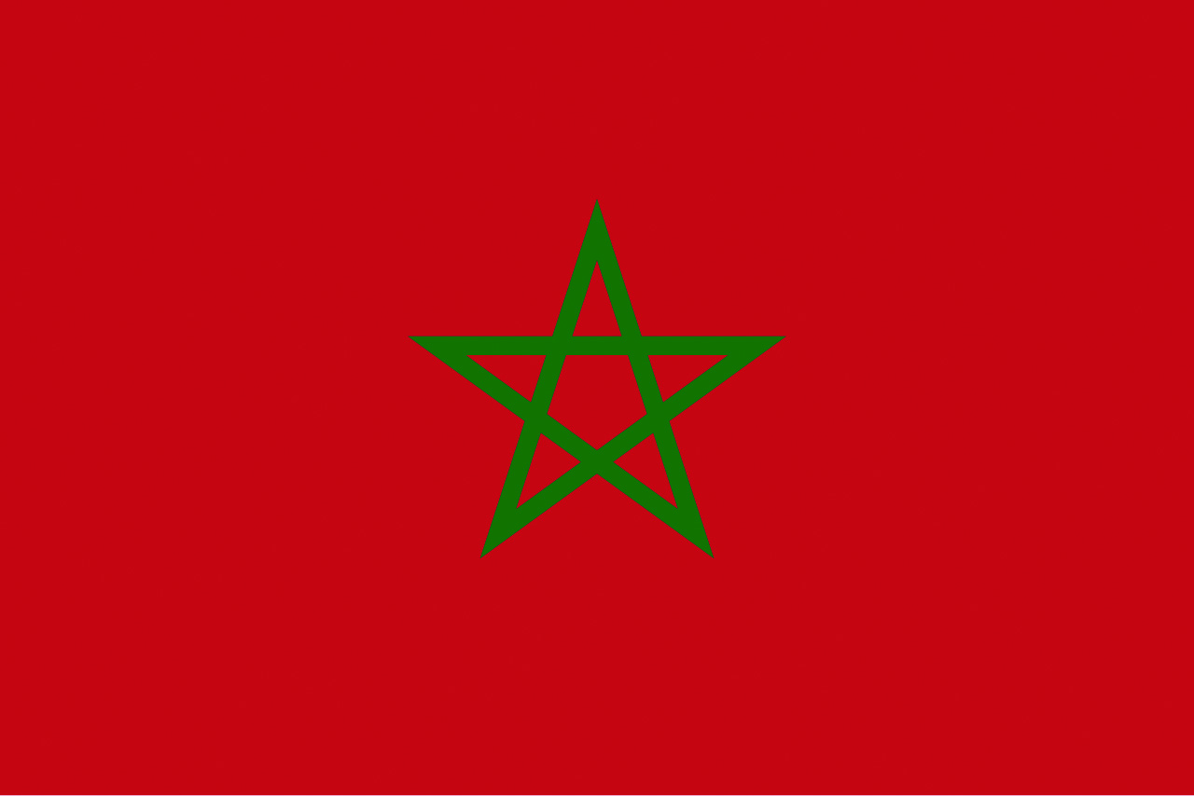
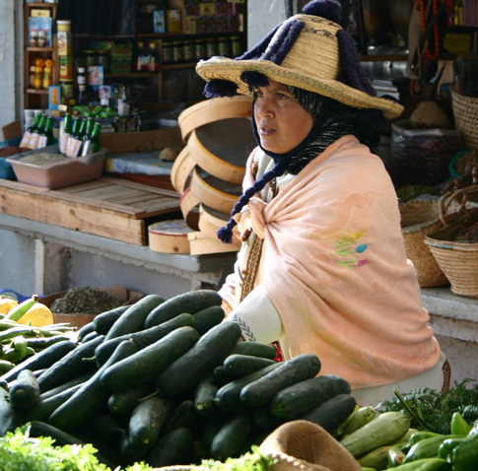
Morocco
Population: 37.71 million
Religion: 99% Sunni Muslim
About 40,000 Evangelical Christians
Ethnically diverse, most self-identify as Arabs
Fifty-year war with Western Sahara people continues to this day
Tourism as the main economic source, competing with Tunisia
Notes:
1) Population and Religion
Population: 37.71 million, 99% Sunni Muslim.
Other religions include Shia Islam, Ibadism, the Bahá'í Faith, and Christianity.
Christianity is Morocco’s the second-largest religion, though most Christians are technical immigrants. There are approximately 40,000 Evangelical Christians.
2) Self-identify as Arabs
Morocco has diverse ethnic groups, such as Amazigh people, Phoenicians from the east, sub-Saharan Black Africans, and Roma, Andalusians, and Jews from the north, among others.
However, due to the dominance of Arab culture, most Moroccans identify themselves as Arabs.
3) The Fifty-Year War
Morocco annexed the former Spanish colony of Western Sahara in 1975, sparking a conflict with the Sahrawi people of the Polisario Front. The war continues to this day without resolution.
4) Competing with Tunisia for Tourists
Tourism is Morocco’s main source of income. In 2023, the number of international visitors reached 14.5 million, generating over 1 billion dirhams in revenue—a historic high.
Currently, the Moroccan government is actively developing hiking and desert tourism to compete head-to-head with Tunisia in the tourism sector.

Slide 5


Prayer Items
Knowing Jesus: May the Lord open their eyes to see Jesus is the only way, the truth,
and the life.
Opportunities for Dialogue: May the Lord grant Christians wisdom and love to witness for Christ as they interact with friends of the three North African countries.
Missionaries and Local Christians: May the Lord preserve their faith, make them strong and courageous, and enable them to continue to bear witness to Christ.
Notes:
1）Knowing Jesus
The three North African countries are all Muslim nations, with majority of the population practicing Islam. Pray that God would open their eyes to see that Jesus is the only way, the truth, and the life.
2) Opportunities for Dialogue
Pray that God would grant Christians wisdom and love to witness for Christ as they interact with friends of diverse ethnicities in the three North African countries.
Pray for the Holy Spirit’s guidance, so that their words would be gentle yet powerful.
3) Missionaries and Local Christians
Evangelizing in the three North African countries is a dangerous undertaking, with many missionaries and local believers facing persecution and imprisonment.
Pray that God would preserve their faith, make them strong and courageous, and enable them to continue to bear witness to Christ.

Slide 6
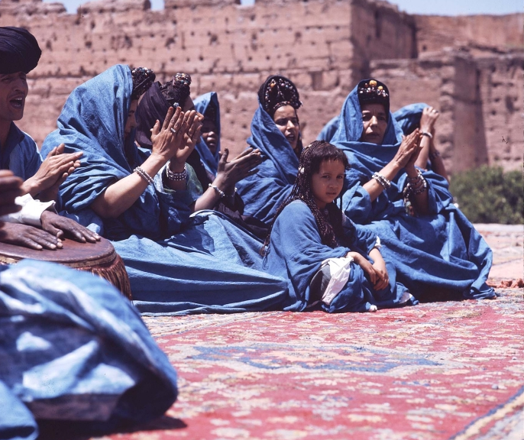
Let’s pray together for the three African Countries

Slide 7
Dear Heavenly Father,
Just as You once called Your people in the wilderness,
please call the people of Algeria, Tunisia, and Morocco to turn to You today.
The steps of evangelism there is difficult.
Many pastors and believers often face persecution, imprisonment,
and churches shutting down.
Please be their strength, that though hard-pressed on all sides, they would not be crushed; though persecuted, not forsaken.
We earnestly pray that You would remember the neglected ethnic minorities, those who are lonely and voiceless, ignored and marginalized.
May You heal their wounds and personally seek them out.
Let them know that they are no longer a forgotten people,
but Your chosen children.
May they find eternal salvation and hope in Christ.
In the name of Lord Jesus Christ we pray, Amen!

Slide 8










[

Slide 9
[
cross-roads.org/eng

