Slide 1
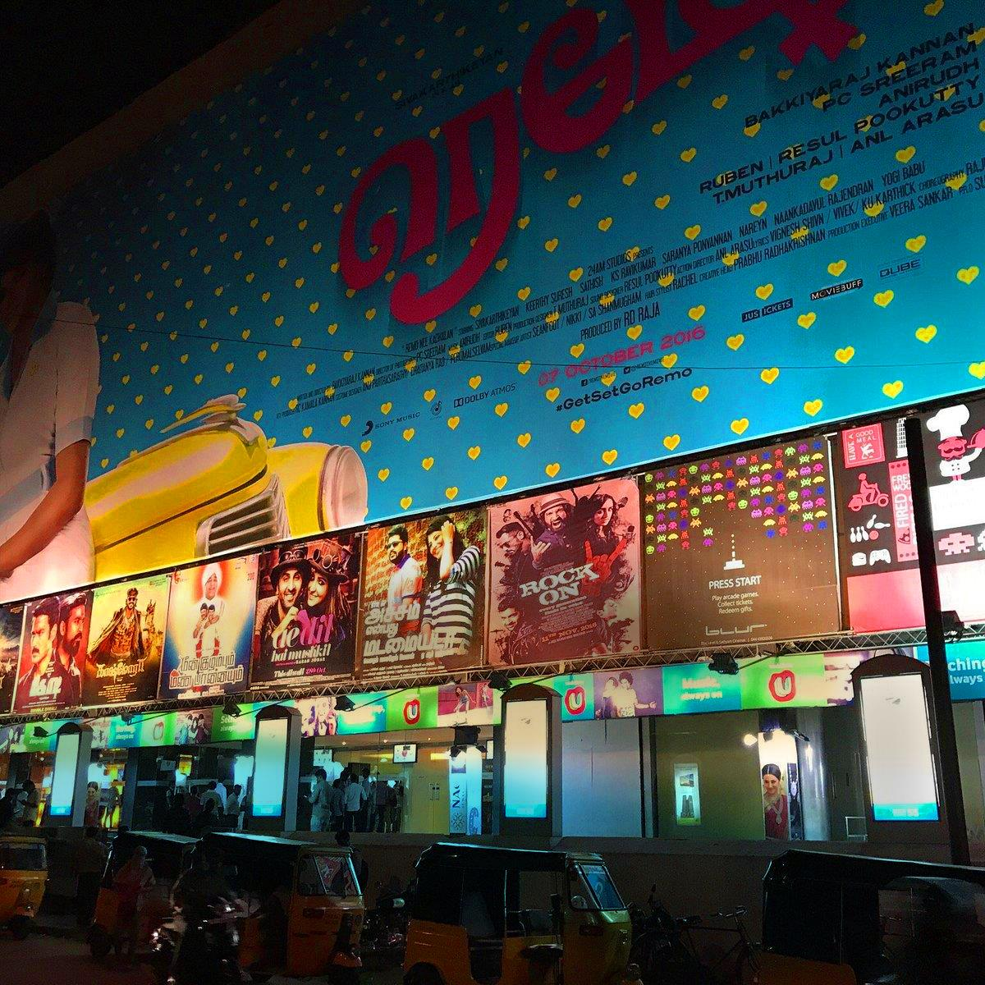


October 2025
“Reel” India

Slide 2


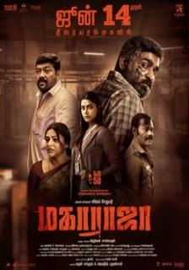



Cinema as a Cultural Lens
India’s film industry (Bollywood) produces over 1000 films annually
Notes:
1）India’s film industry (Bollywood) produces over 1,000 films each year, making it one of the largest film industries in the world.
But behind the colorful songs and dances, many of these films actually explore deep and pressing social issues.

Slide 3



Cinema as a Cultural Lens
Themes and Representative Films
Sexual Violence and Injustice: Many Indian women are wounded by societal norms, shame, and violence. Films like Delhi Crime and Pink portray the painful realities behind these issues.
Sanitation and Women's Dignity: Menstruation remains a stigmatized topic. Pad Man highlights the struggles women face in meeting basic physiological needs with dignity.
Structural Injustice: Caste discrimination, a flawed legal system, and police abuse are recurring themes in Indian cinema. Examples include Article 15 and Maharaja.
Educational Pressure: 3 Idiots captures the confusion and pressure many young Indians experience within the country's rigid education system.
Notes:
2）The following are key themes and representative works from recent Indian films:
Sexual Violence and Injustice:
Many Indian women are deeply wounded by societal norms, shame, and violence.
Films such as Delhi Crime and Pink portray the harsh and painful realities behind these issues.
Although the Indian government has imposed stricter penalties for sexual crimes, the number of such incidents has not significantly decreased.
Victims often come from marginalized groups—such as lower castes and women—and face tremendous pressure throughout the reporting, investigation, and trial processes.
Sanitation and Women’s Dignity:
Menstruation is still heavily stigmatized in many cultural contexts.
Women are frequently harmed and shamed due to the lack of access to proper sanitary resources.
In these films, characters often pay a high price in their fight for the basic right to use sanitary pads.
Structural Injustice:
Caste-based discrimination, flaws in the legal system, and police abuse are recurring themes in Indian cinema.
Many individuals—especially those from the Dalit community—remain marginalized because of their social identity.
Films like Article 15 and Maharaja confront and reflect on these injustices.
Educational Pressure:
Under the intense weight of academic performance and societal expectations, many young people lose their sense of self, suffer physically and mentally, or even take their own lives.
3 Idiots explores the pressure young Indians face within the education system, and the way the pursuit of success can lead to a loss of personal identity.

Slide 4
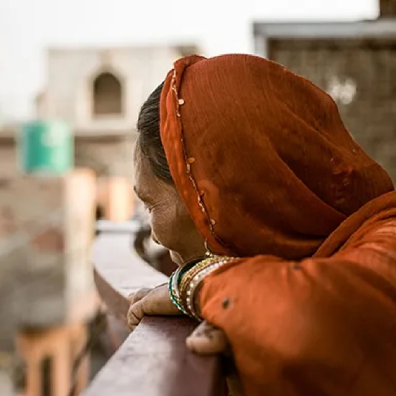
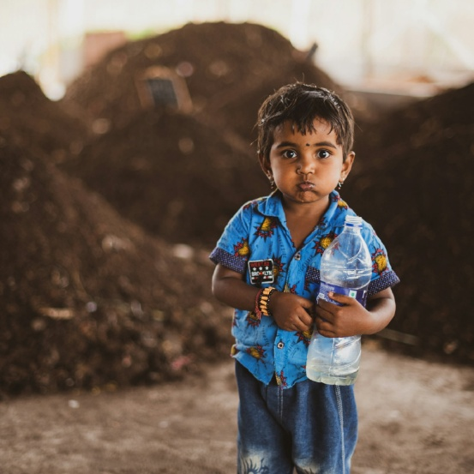
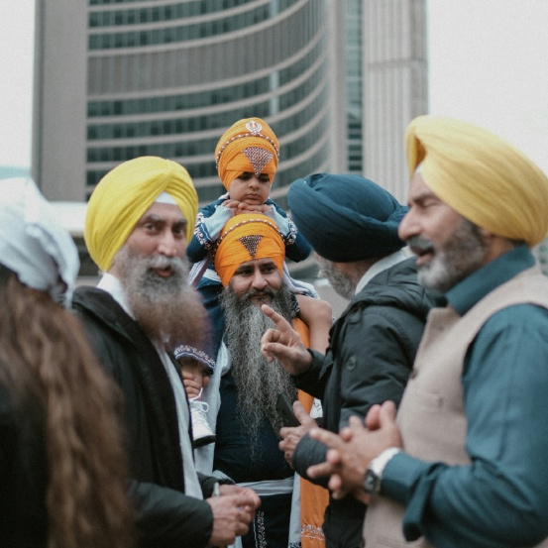
Hope and Prayer Focus
Film allows us to see just how broken the world God loves truly is.
What kind of transformation can the gospel bring in such places?
Possible ministry pathways for the Church:
  Presence and Listening: Walk alongside others without assuming we have all the answers; instead, listen to the pain embedded within their culture.
  Engaging Art and Culture: Bear witness to the gospel through film, media, and artistic expression.
  Support and Intercession: Support local ministries, filmmakers, and believers—equipping them with resources to raise their voices and share hope.
Notes:
1) Film reveals how broken the world that God loves truly is
The challenges India faces are not merely economic or political—they are rooted in the loss of human dignity and worth.
If we only stand at a distance and criticize India’s culture or religion, we will soon lose compassion.
But when we begin to listen to their stories, our hearts are moved—we begin to weep with those who weep.
2) What kind of transformation can the gospel bring?
Film reveals the brokenness of the world—not to leave us in anger or helplessness, but to prompt us, as Christians, to ask:
What kind of change can the gospel bring here?
Jesus entered a broken world not by looking down from heaven, but by walking with the marginalized and the rejected, bringing redemption and renewal, and declaring: the Kingdom of God has come.
3) The Church’s possible paths of ministry in this conversation between culture and the gospel:
Presence and Listening
Instead of arriving with answers, we learn to cross cultural divides by walking with others and listening deeply to the pain embedded in their culture.
Engagement with Art and Culture
Through film, media, and artistic expression, we can bear witness to the gospel in creative and contextual ways.
Support and Intercession
We can uphold local ministries, filmmakers, and believers—equipping and protecting them so they can speak out with boldness and hope.

Slide 5
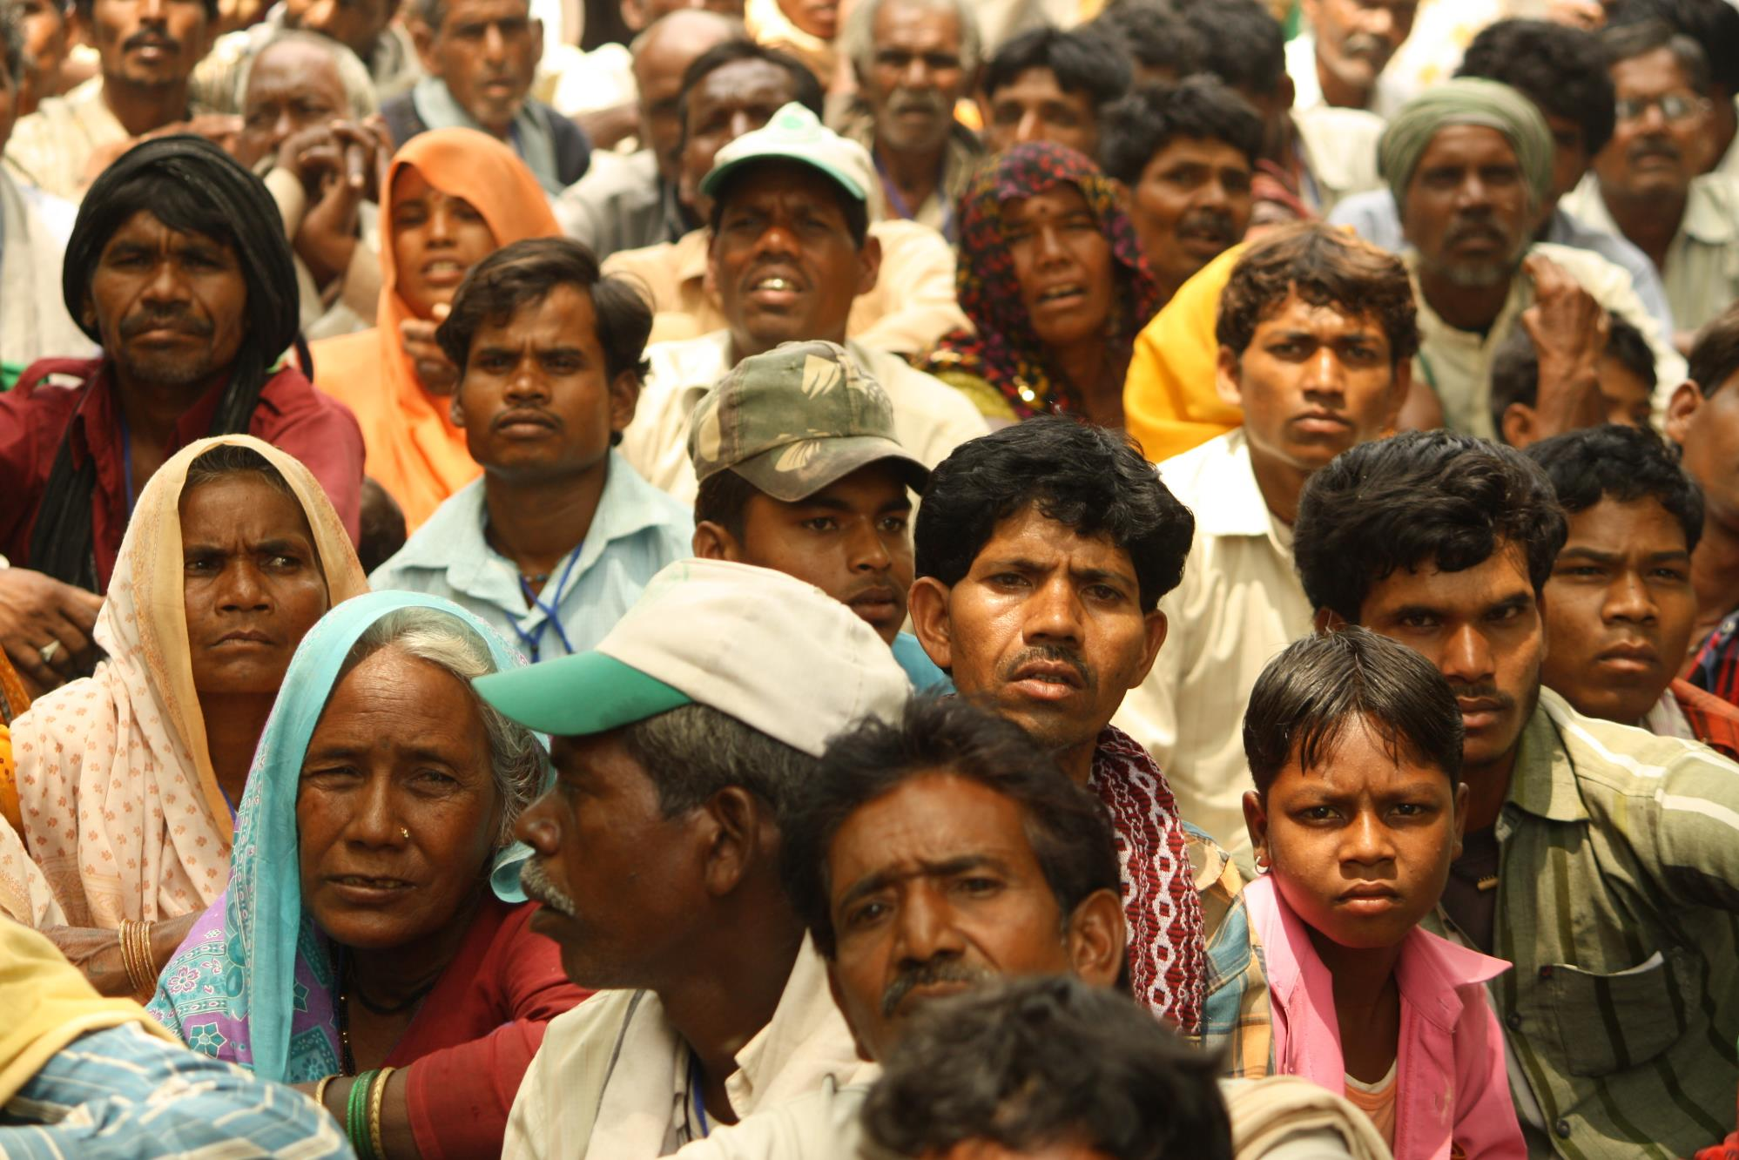
Let us pray for India together

Slide 6
Our Dear Heavenly Father,
You see the land of India—a nation both ancient and full of life.
Behind its vibrant colors, music, and cinema, You know the deep longings of countless
hearts searching for dignity and freedom.
You hear the cries of women suffering in shame,
the weary sighs of children under the weight of academic pressure,
and the silent struggles of laborers and the poor who are so often forgotten.
Lord, draw near to them. Be their comfort, their healer, and their Savior.
Lord, may Your Church live out the truth in the midst of unjust cultures,
share Your love among the poor,
and bear witness to the hope of Your cross in places of despair.
May Your Spirit stir more believers to proclaim Your glory
through art, education, and acts of service,
so that every person may come to know You—the Lord who brings justice to the oppressed.
In the name of our Lord Jesus Christ we pray, Amen.

Slide 7











Slide 8
cross-roads.org/eng

