Slide 1
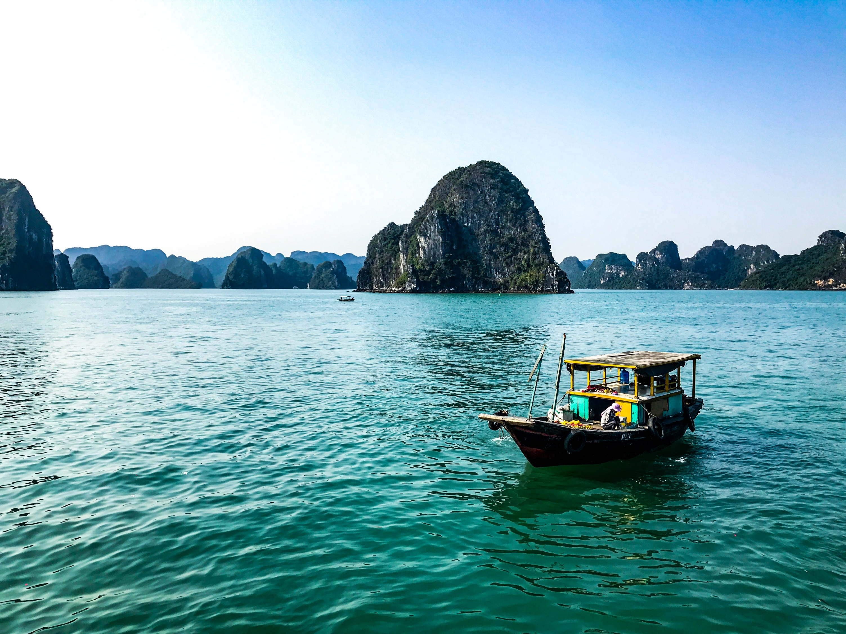
May 2024
Vietnam
Notes:
For many, Vietnam means the Vietnam War, people fled across the raging sea in boats, Vietnamese pho, spring rolls, Vietnamese coffee, and French baguettes. Today, let's take a look at other aspects of Vietnam.

Slide 2
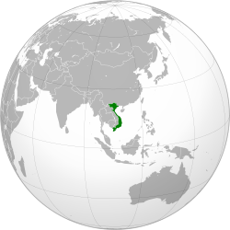
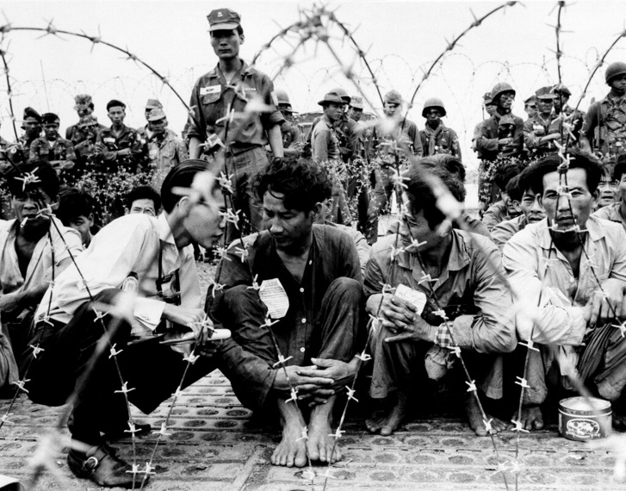
Vietnam
Densely populated, land in elongated shape, big difference between North and South
Population: 99.54 million, 90 million Jing people, 53 ethnic groups, 103 dialects
“Salty in the north, sweet in the south”; “peach in the north and plum in the south”; “male in the north and female in the south”.
A vassal of China In old days; An ideological battlefield for Europe and the United States today
Directly ruled by various Chinese regimes for nearly 1,000 years
Became a French colony in the 19th century
In 1945, Hu Chi Minh established the Democratic Republic of Vietnam in the north (a.k.a. North Vietnam).
The U.S. military intervened in South Vietnam in 1954 and withdrew in 1973.
North and South reunited in 1975
Notes:
Vietnam, formerly known as the land of the Baiyue, is located at the strategic gateway connecting the South China Sea and the Indian Ocean. It has always been a battleground since ancient times, ruled directly by various ancient Chinese regimes for nearly a millennium. The title of "King of Vietnam" bestowed by the Qing Emperor Jiaqing has been retained to this day. In the 19th century, It became a French colony during the Qing-French conflicts.
In 1945, Ho Chi Minh led the establishment of the socialist Democratic Republic of Vietnam (commonly known as North Vietnam) in the north, supported by China and the Soviet Union. Nine years later, to prevent communism from growing in Southeast Asia, the US military intervened in South Vietnam in 1954. After ten years of bitter fighting, they began withdrawing troops in 1973. In 1975, North Vietnam unified the country.
With a population of 100 million, Vietnam is home to 54 ethnic groups speaking 103 dialects. Its geography is shaped like an elongated "S", with the narrowest point being only 50 kilometers wide east to west, but stretching 1,600 kilometers north to south, resulting in diverse regions and cultures. Naturally, it is divided into north and south, leading to differences in food preferences ("saltier in the north, sweeter in the south") and physical appearance ("men in the north, women in the south"). Due to historical reasons, there are distinct ideological and lifestyle differences between the north and south, even within the government, with factions known as the "southern faction" and "northern faction."

Slide 3
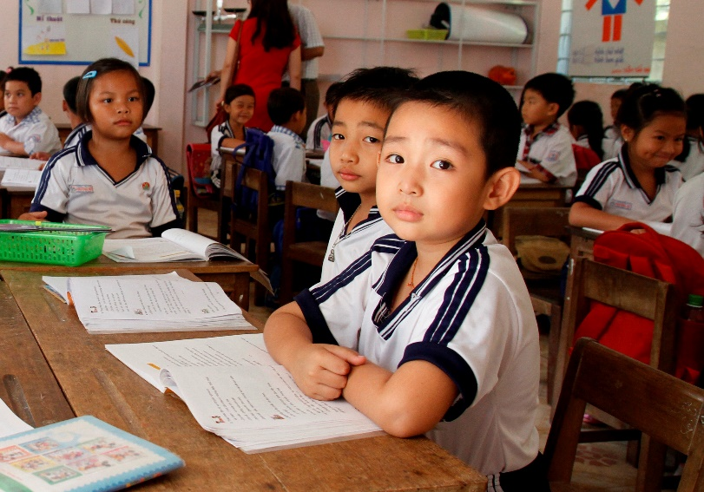
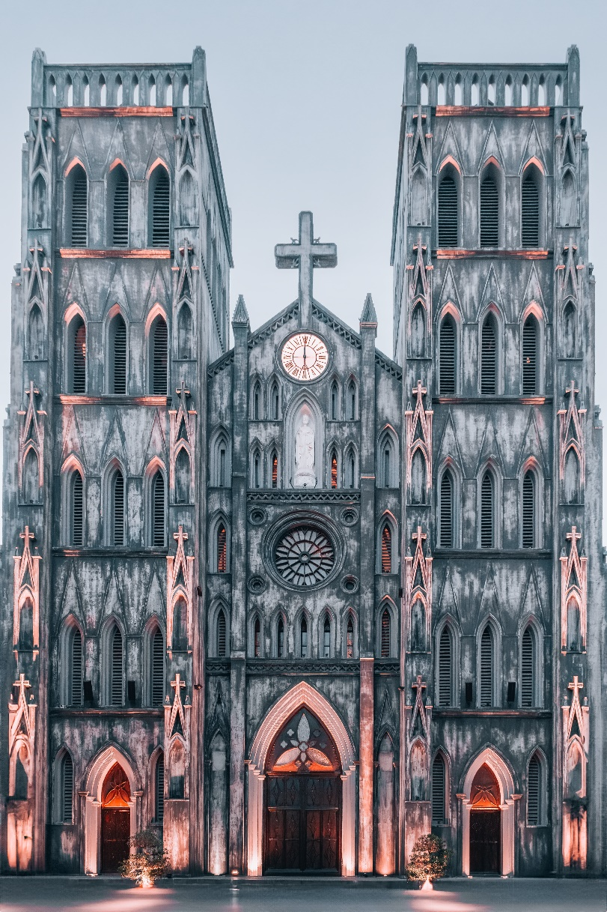
Vietnam
Global supply chain restructuring presented opportunities
In 2014, a new constitution was implemented, relinquishing party-state privileges and promoting elite education.
An average age of 33, laying the foundation for manpower needed.
Ambivalent yet showing hope in faith
Atheistic government, polytheistic populace, approximately 9.6 million broadly-defined Christians.
Reforms opened up small entrances for evangelism and worker cultivation.
Believers still face rejection, discrimination, and attacks.
The majority are ethnic minorities such as the Miao and Heye in the mountainous areas.
Notes:
During the COVID-19 epidemic, in order to get rid of dependence and risks on manufacturing in China, foreign businessmen in Europe and the United States moved some technology industries to Vietnam, which has an average age of 33 and is a gathering place for global video game masters and has a better manpower base. Products from Nike, Adidas put on the label of "Made in Vietnam”. Biden and Xi Jinping visited Vietnam successively in 2023. Vietnam has attracted the attention of major powers. It has the ambition to transform into a new generation of global factory by 2045.
Christianity set foot in Vietnam as early as the 16th century. In 1967, the total number of believers reached 150,000, accounting for about 1% of the total population. After 1975, the number of Christians dropped sharply, and church properties were confiscated. Seminaries and church-run orphanages and hospitals were closed. All missionaries left the country, and Christians were regarded as enemies of the country.
However, although Vietnam is ruled by an atheist political party, only about 20% of its people are atheists. The rest of the people have their own beliefs. Even with an atheistic government and polytheistic people, it is actually a country with many beliefs.
Thank God that Christians have been able to spread the gospel during the reform process of the government's integration into the world's supply chain. The training of workers to a certain extent has also gained ground. Today there are 9.6 million believers, most of whom belong to ethnic minority groups such as the Miao and live in mountainous areas. They suffer from social exclusion, discrimination, and attacks. Church gatherings face constant surveillance and frequent raids.

Slide 4
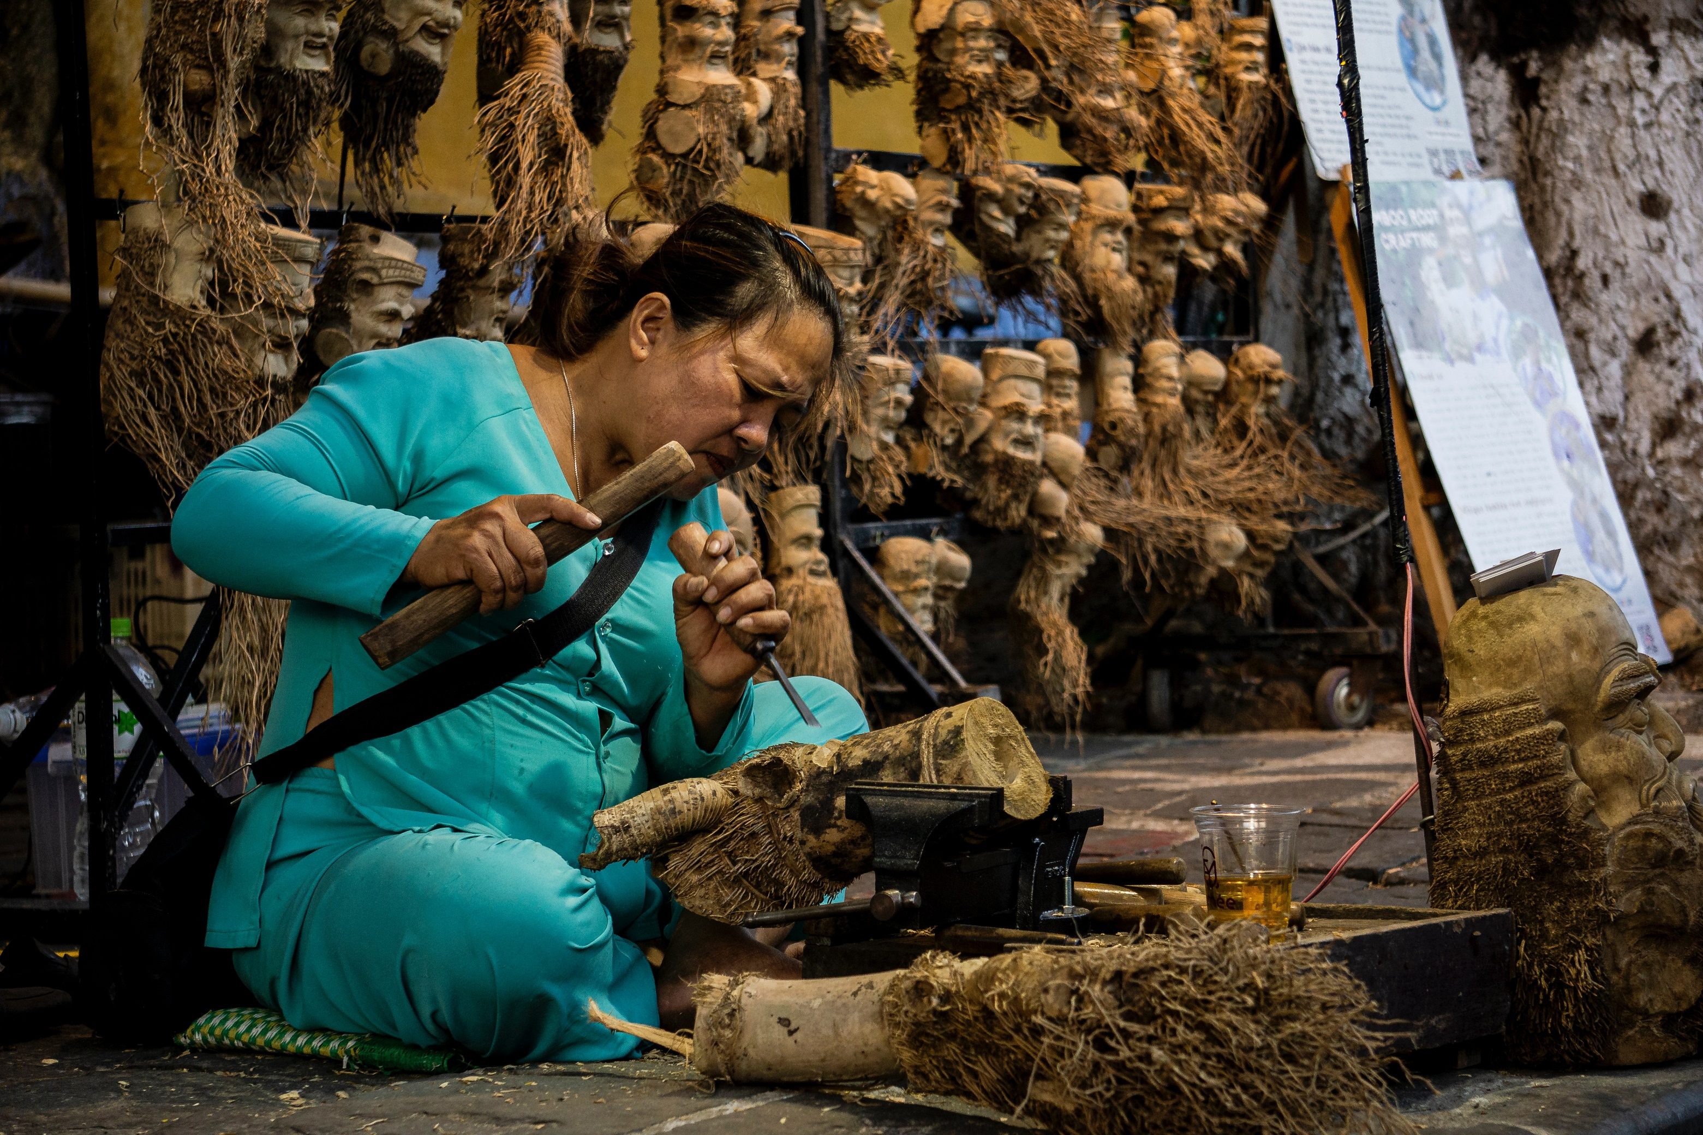
Let us pray in unity for Vietnam

Slide 5
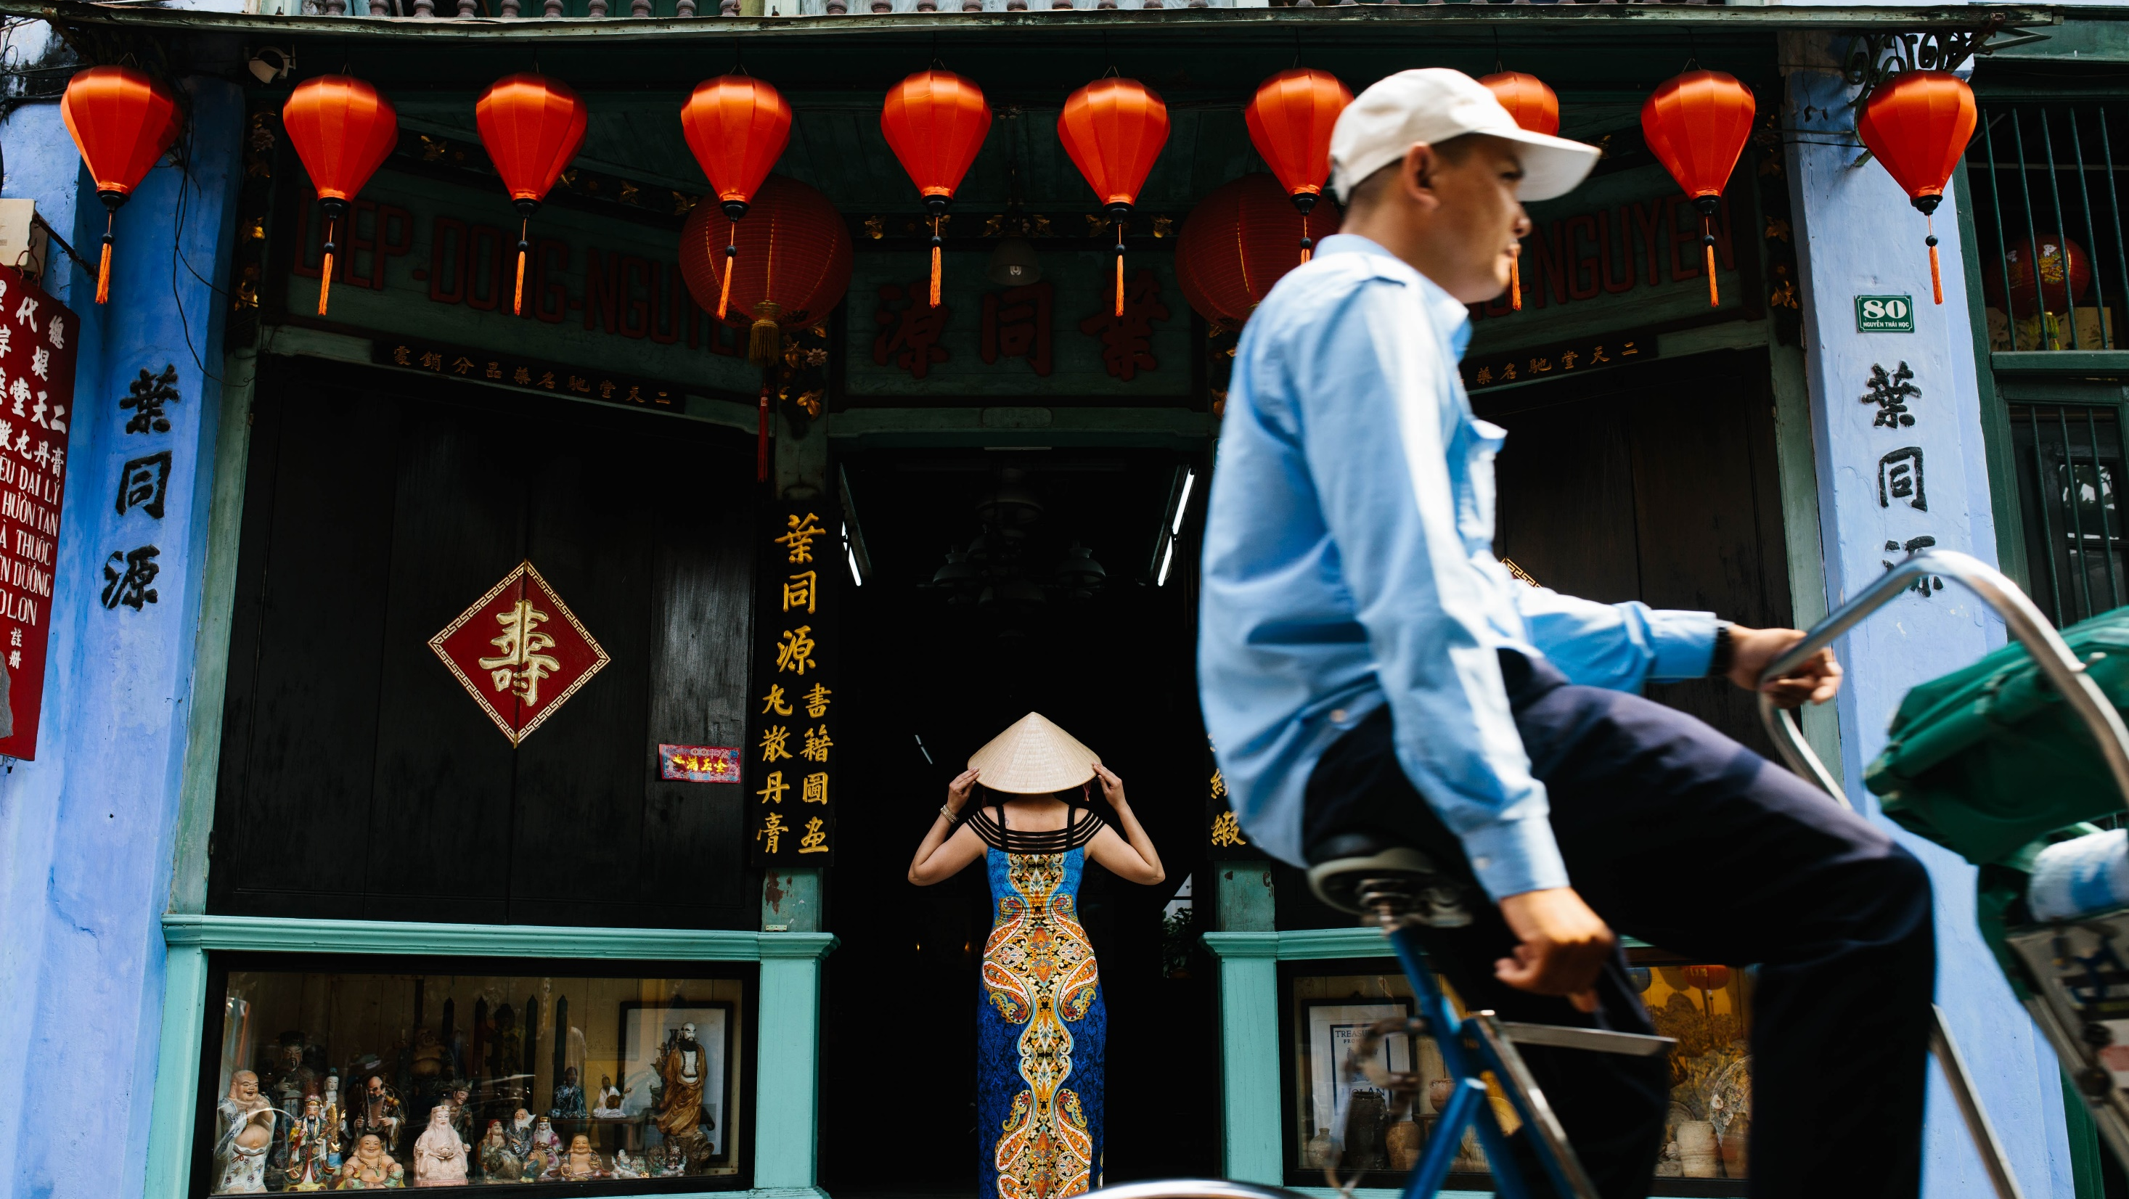
Heavenly Father, we pray together for the 90 million Jing people
who believe in Buddhism and Taoism.
Thank you for making them prosperous and influential in Vietnam.
We pray that they will govern wisely and graciously and support the 53 surrounding minority groups with the power You have bestowed upon them.
May all the 54 ethnic groups, amidst fears and confusion regarding customs and superstitions and spiritual and existential dissatisfaction, discover the truth and the meaning of life in the creation in Christ.
May they come to know that You are the nourisher of the land,
the fish and shrimp, and the Creator who cares for their lives.
May their hearts turn to You.
Notes:
讓我們同心開口禱告。

Slide 6
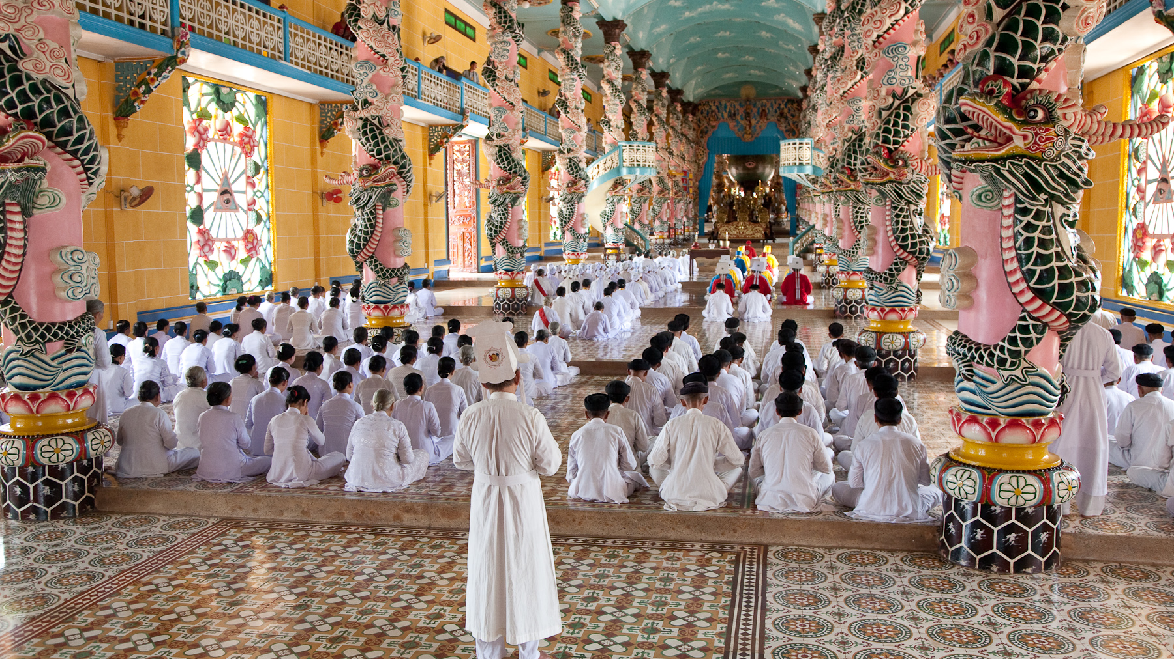
Heavenly Father, the churches in Vietnam have weathered many storms,
especially the Hmong churches.
As they face various challenges, please give them faith
to firmly rely on You and not be discouraged.
Please heal their wounds and provide for their needs.
May pastors and evangelists in the mountainous regions prosper in body, soul, and spirit, becoming examples and encouragement to the flock.
We pray for the evangelization of Vietnam, asking that leaders cherish the Christian faith and allow Christians to worship freely.
Bless all 54 ethnic groups in Vietnam,
each with Bible in their own dialect, and may the Holy Spirit fill them.
May the Lord get the young people of Vietnam, who will encounter suitable mentors in their lives to guide them in their walk with God.
In the name of the Lord Jesus, Amen.
Notes:
Let us pray aloud in unity.

Slide 7
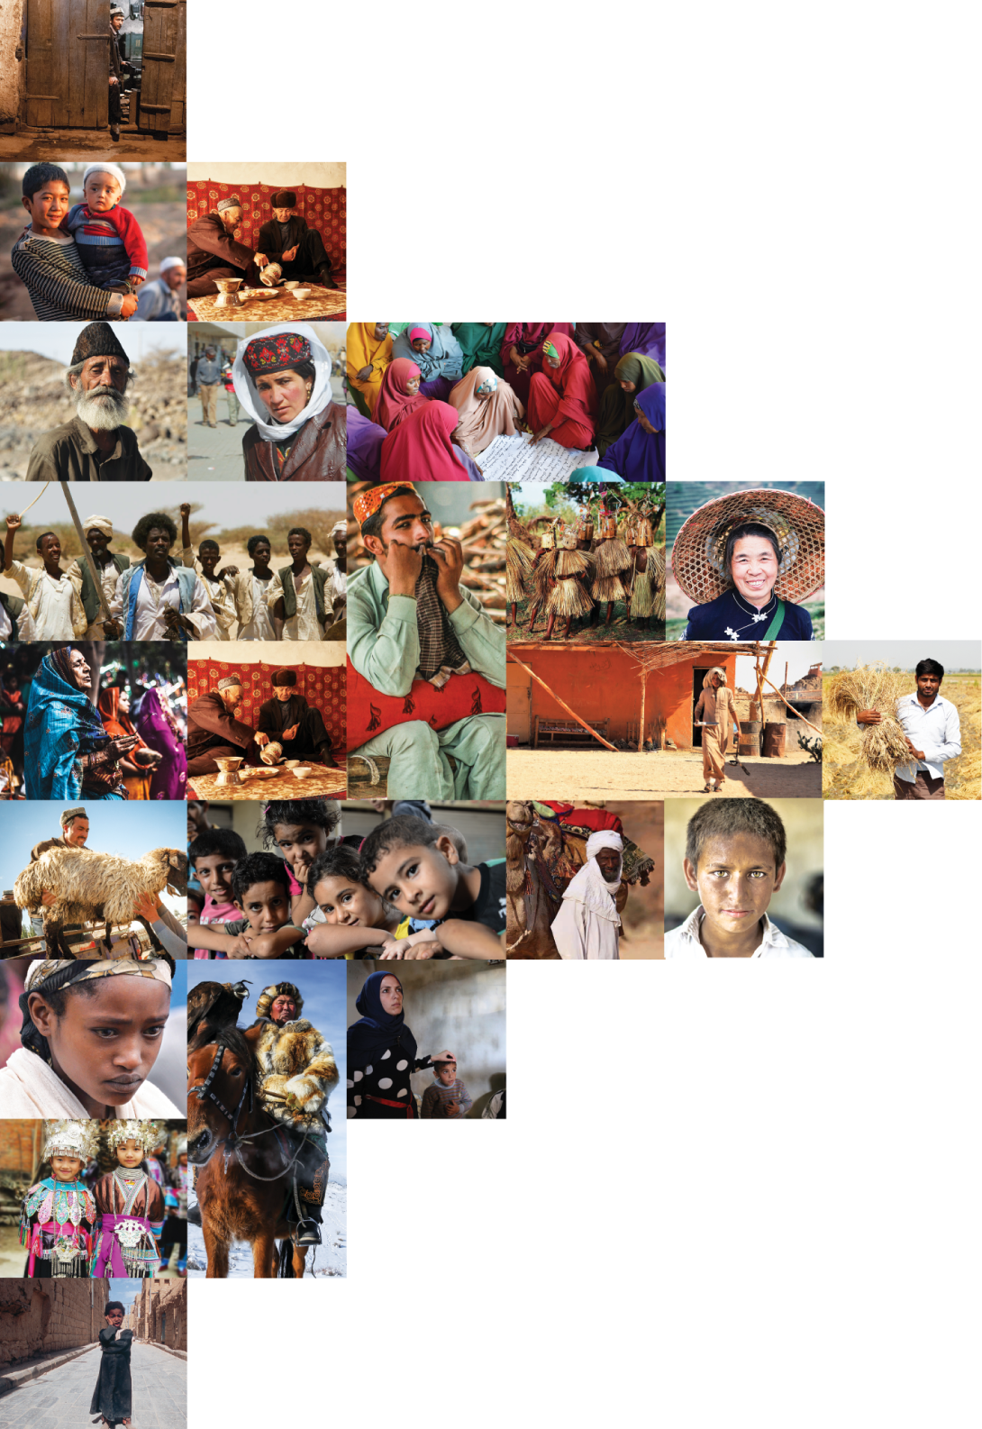
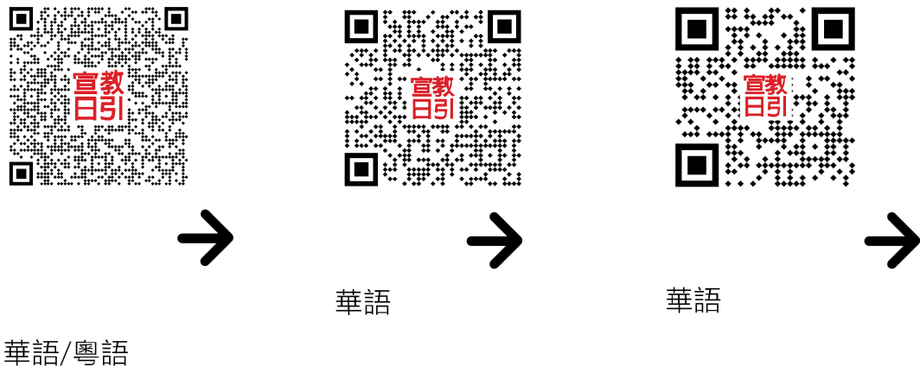
不再是個人的禱告，我們開始一起祈禱。 30分鐘，生活再忙碌的人都能找到時間參與。

