Slide 1
March 2024
30 Days of Prayer for the Muslim World
Notes:
March 11 to April 9 of 2024 is the month of Ramadan for Muslims. We are doing [30 Days of Prayer for the Muslims World] during this period. The more we understand Islam, the better we can pray for them.
Today, let’s learn about the growth of the Muslim population and the status of women in the Muslim world.

Slide 2
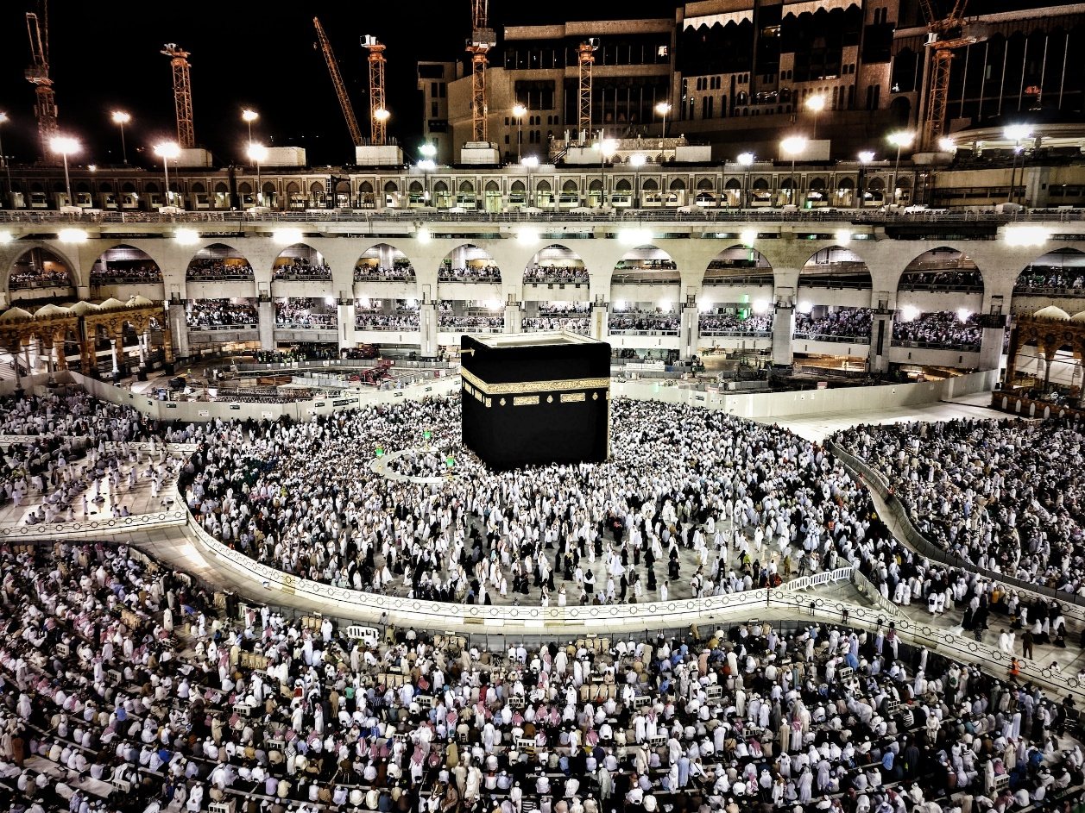
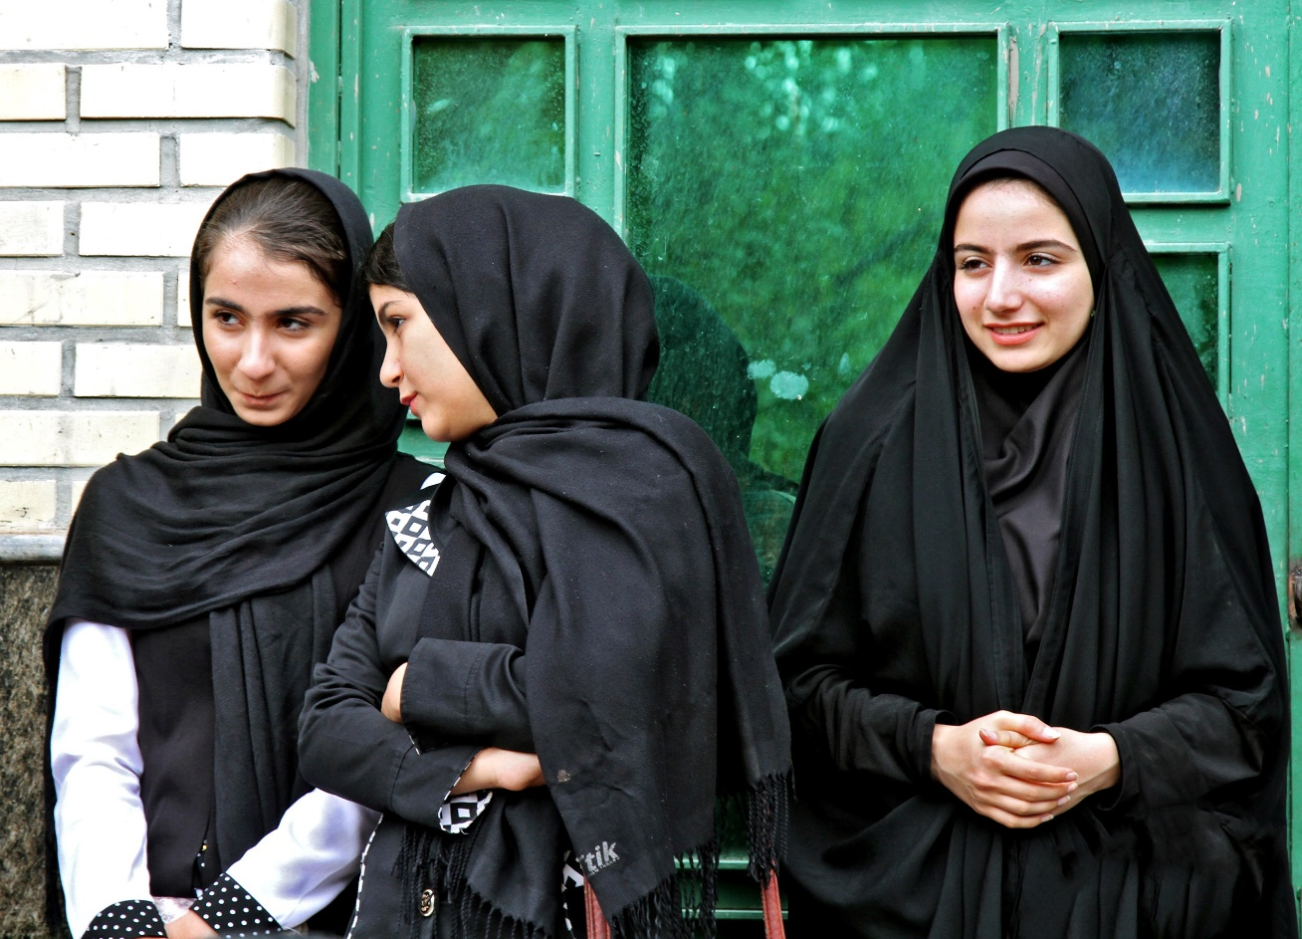
The Muslim World
Islam - the world's second-largest religious faith
1.6 billion Muslims, 23% of the global population
Europe’s Muslim population surged due to refugee influx
In North America, 20,000 people convert to Islam every year
In the UK , 6,000 converts each year, predominantly women
Notes:
Islam is the world's second-largest religious faith, with a Muslim population exceeding 1.6 billion, accounting for 23% of the global population, second only to Christianity.
Islam is the predominant religion in the entire Middle East, North Africa, the Horn of Africa, sub-Saharan Africa, and Central Asia.
Additionally, significant Muslim populations exist in China, Russia, India, and the Balkan region.
After the Arab Spring in 2011, a large influx of Muslim refugees sought asylum in European countries, leading to a surge of approximately 2.5 million in the Muslim population.
It is predicted that by 2050, Muslims in Europe may constitute 7% to 14% of the total population.
In addition to challenges to the social structure of Europe, the rise of radical Islamic extremists has further heightened tensions in European societies through terrorist attacks.
In North America, observers estimate that up to 20,000 Americans convert to Islam annually.
In the UK, around 6,000 people convert to Islam each year, with the majority being women.
Now, let's delve into the situation of Muslim women.

Slide 3
Muslim Women
Traditional Islamic law highly objectifies women, with protection in name yet control in reality.
Unable to freely participate in social activities
No right to inherit property
Required signed permission from husband or father to engage in work
Muslim women’s loneliness and helplessness
Under marriage law, women lack autonomy in marriage, divorce, and child custody
No help available facing spouse’s infidelity or domestic violence
What do Muslim women see in Jesus?
Best Blessings - Hope of Eternal Life
Purpose and meaning of life
Notes:
A brother who once served as a short-term missionary in Syria said, “Before 2011, Syrian women must follow their husbands when walking on the street to show obedience and respect.”
After the 2011 civil war in Syria, he returned to Syria for a visit. He found that The situation had changed. It was not men who were leading the way, but women. “I'm curious - Have Syrian men become lady-first and respected women?
The local residents traveling with him said, “Things are not what you think. The land is now full of landmines, so women must walk in the front.”
Among more than 50 Muslim countries in the world, only 5 of them have marriage laws that allow women to divorce, provide some protection measures, and allow their right to inherit property.
Women's rights in other countries have long been subjugated to men's status.
After the US military left Afghanistan and the Taliban returned to power, women have been unable to hold public office. Even orphanages were ordered to expel girls.
An orphanage supported by Mission Pathway’s Compassion and Care Fund once faced this situation.
In traditional Islamic law, women are highly objectified and viewed as possessions being controlled by men. Marriage is a "contract”, and women cannot enter it "independently" but must be decided by their guardians.
Since Muslim women do not have the right to divorce or get child custody, their spouses are often unfaithful and domestic violence is common.
Even more, according to tradition, Muhammad taught that the vast majority of people who end up in hell will be women.
Can you feel the loneliness, lack of attention, helplessness, and hopelessness of Muslim women?
They need to encounter Jesus, the Messiah who loves them unconditionally and provides them with purpose, meaning, and eternal hope in their lives.
For details, please refer to Mission Pathway’s March publication of “30 Days of Prayer for the Muslim World – What do Muslim women see in Jesus?”
https://www.cross-roads.org/prayer-2024-03.php
https://www.islamtaiwan.com/contents

Slide 4
Let us pray together for the Muslim World

Slide 5
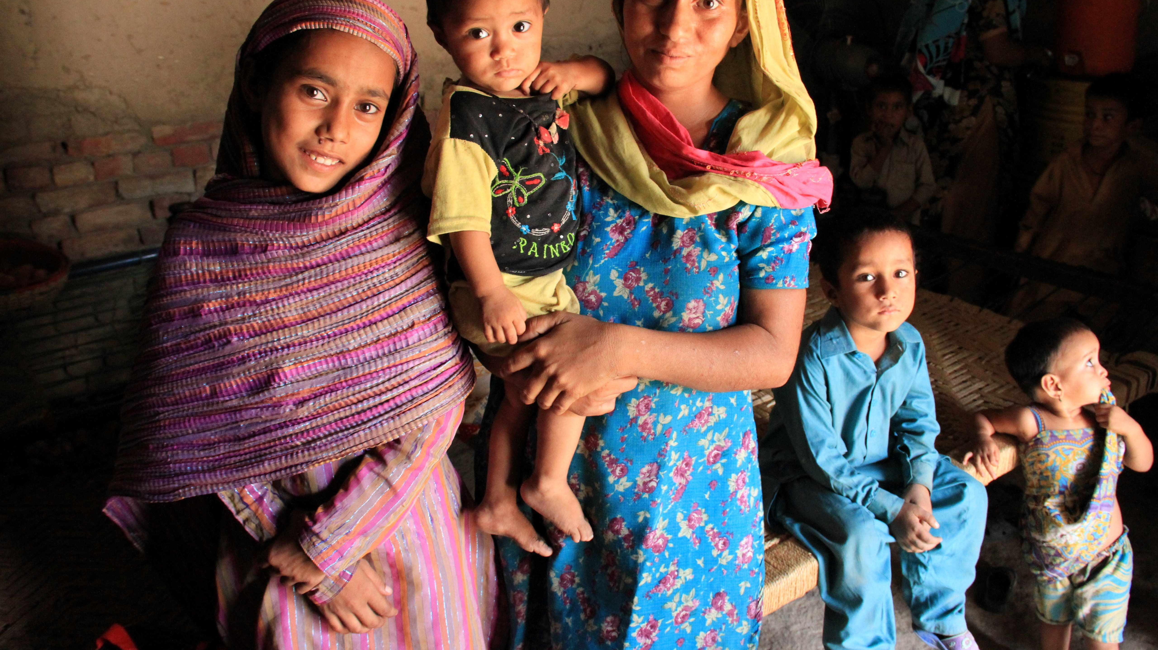
Pray for Muslim Women
Heavenly Father, we cry out to You for the marginalized Muslim women who have lost their individuality.
Please seek justice for Your daughters who live in the Muslim world. God created male and female in His own image. They are all Your wonderful creation. Yet, Muslim women continue to be treated as subordinate
in various aspects of law, marriage, education, and work.
Lord, only You can give them purpose and meaning in life and
restore them to the beauty and dignity in which they were created.
In the name of Jesus Christ, we pray. Amen.

Slide 6
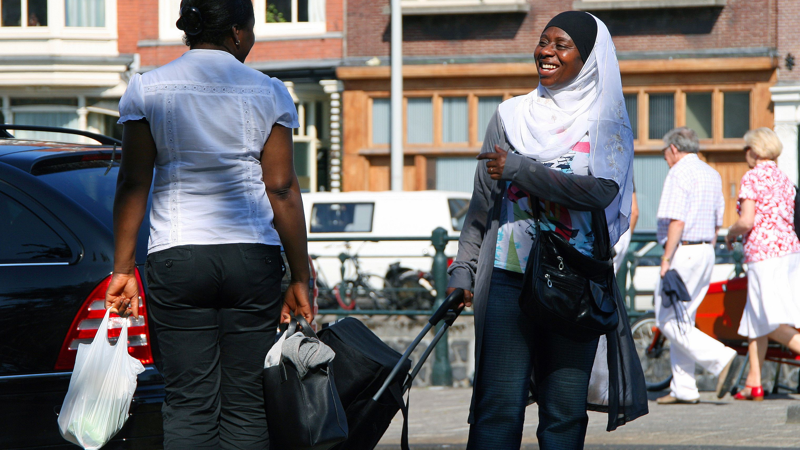
Pray for the Muslim World
Lord, the Muslim population is growing in Europe. Many grassroot Muslims who immigrate for a living
has altered the social structure of Europe. A minority of radical Muslims has deepened anti-Islamic sentiments.
We ask earnestly the Lord to help the 2.5million Muslims living in Europe
That they will not become a dangerous factor to cause social conflicts
but rather to become good neighbors,
To be illuminated by the true light of Lord Jesus, and to encounter Him.
May the Lord help the Christians in Europe
That they will be willing to extend a hand of friendship to the Muslims,
Turning each interaction into an opportunity to witness for Jesus.
In the name of Jesus Christ, we pray. Amen.

Slide 7
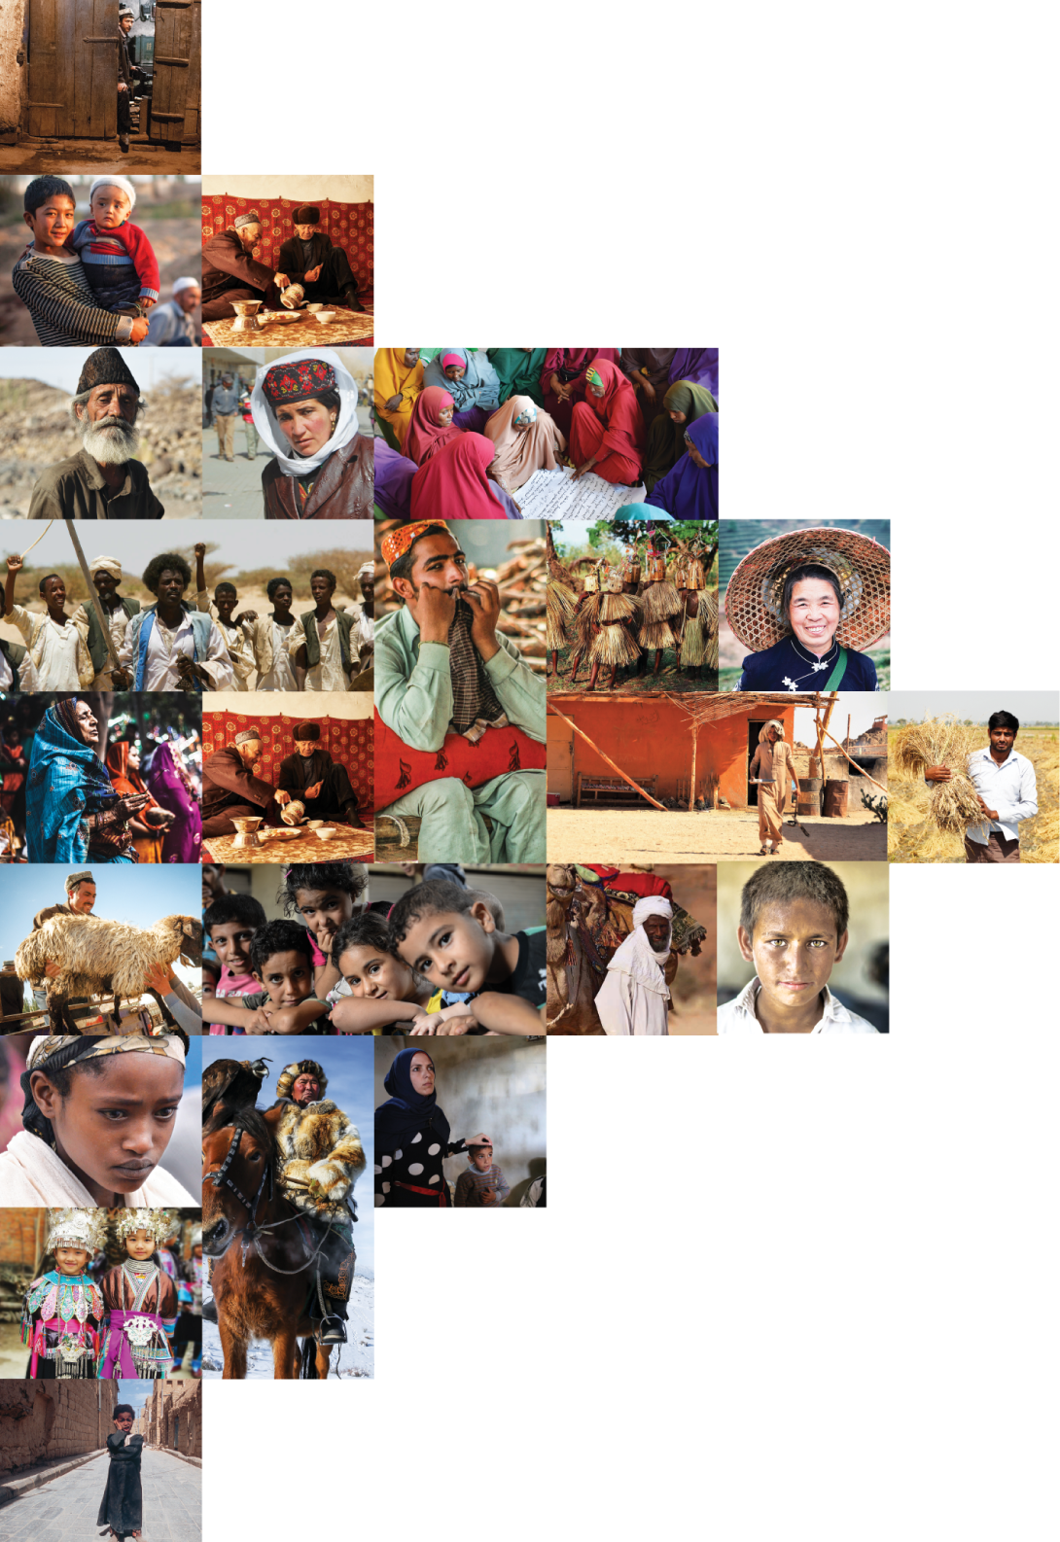
不再是個人的禱告，我們開始一起祈禱。 30分鐘，生活再忙碌的人都能找到時間參與。

