Slide 1
Feb 2024
Myanmar, Mozambique, Bangladesh, Philippines

Slide 2
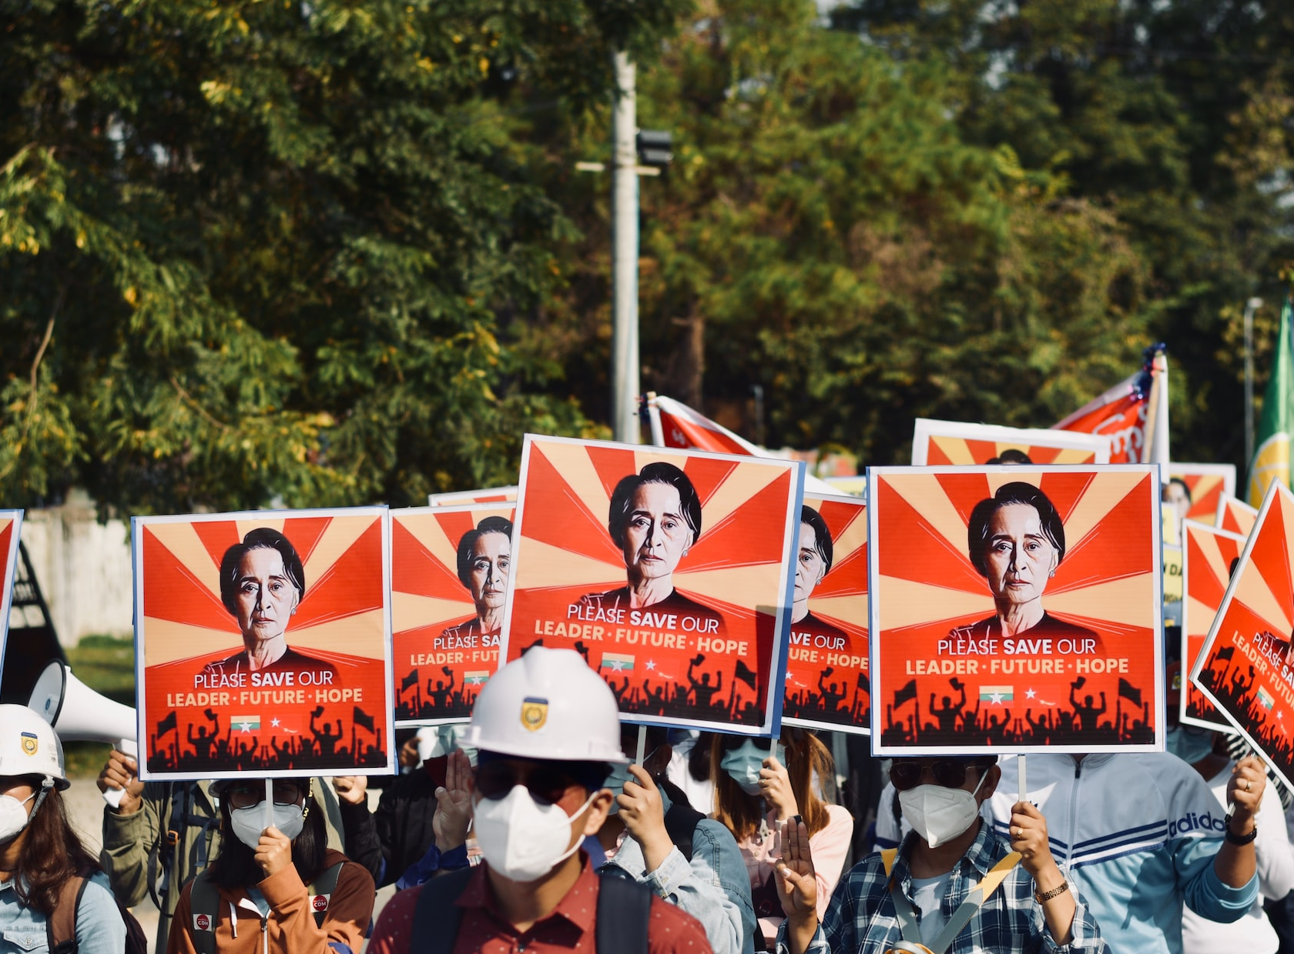
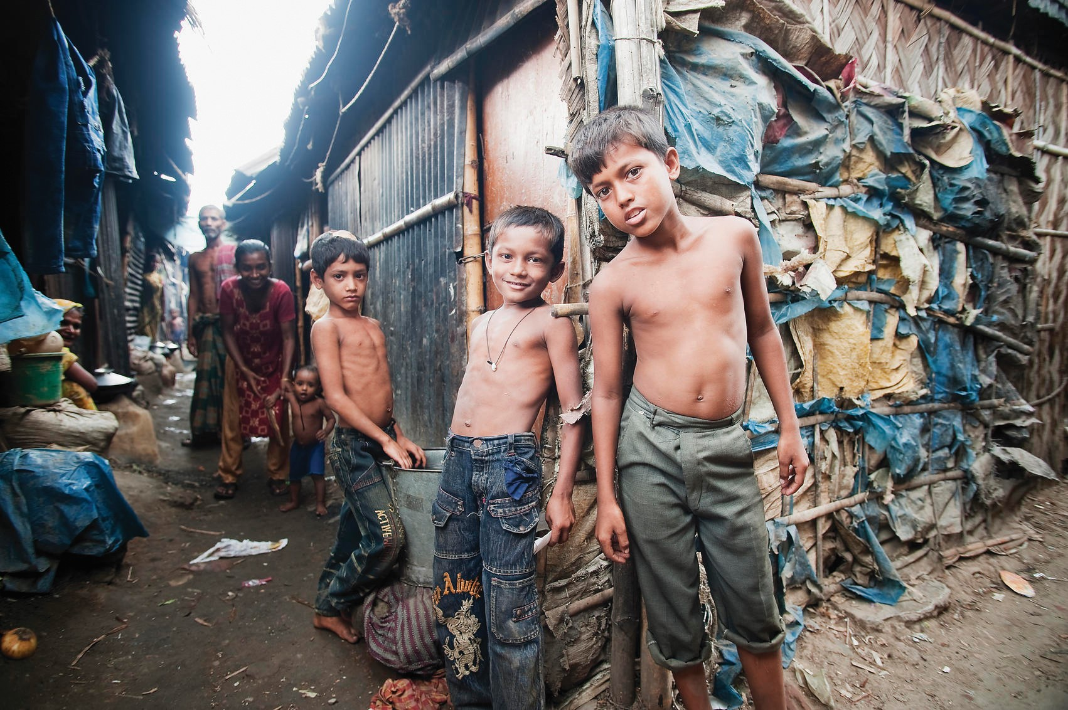
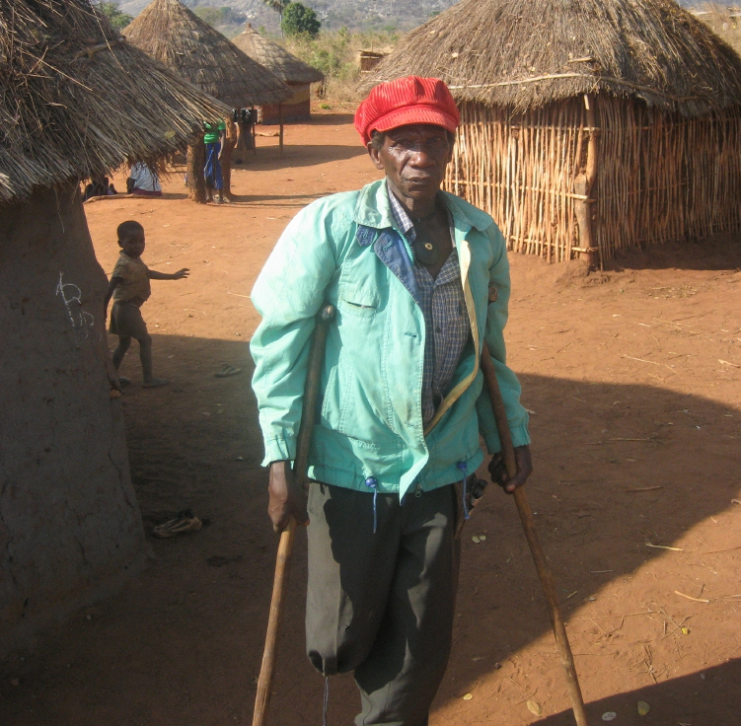
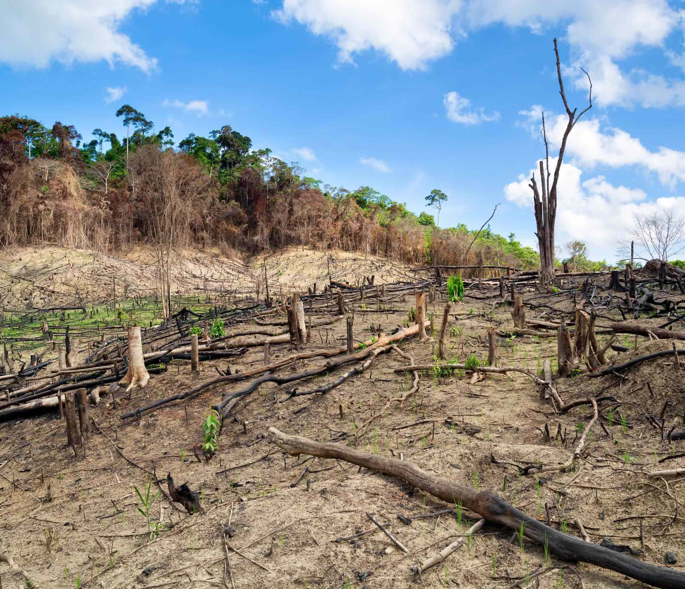
Countries Most Affected by Climate Change
Dominican Republic
Myanmar
Haiti
Philippines
Mozambique
Bahamas
Bangladesh
Pakistan
Thailand
Nepal
Notes:
Ranking of countries most affected by climate change
Last month, we prayed for the Climate Vulnerability countries including Nepal, Thailand, and Pakistan. Today, we come to see on 4 more countries, they are Myanmar, Mozambique, Bangladesh and Philippines.nd the Philippines. These four nations fall within the precarious 1040 Window, hosting a majority of the world's poorest populations. Many individuals in these regions earn less than $300 annually, facing not only the challenges of extreme temperatures, droughts, famine, floods, sea-level rise, and typhoons but also the additional burdens of conflicts and human-made disasters. In the face of the intertwining of natural and man-made catastrophes, these nations endure significant hardships.

Slide 3
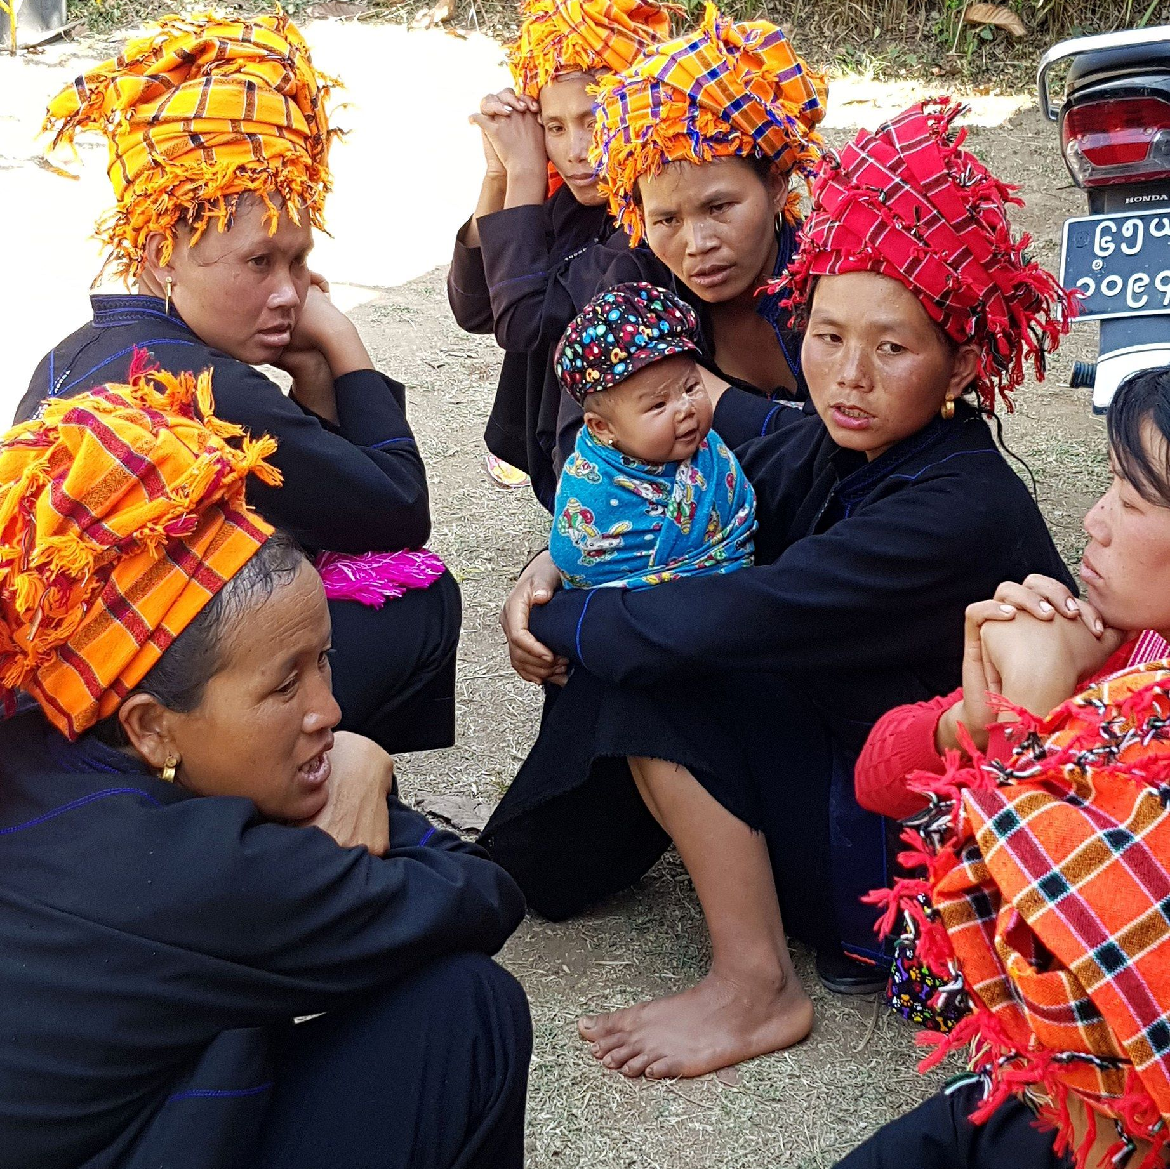
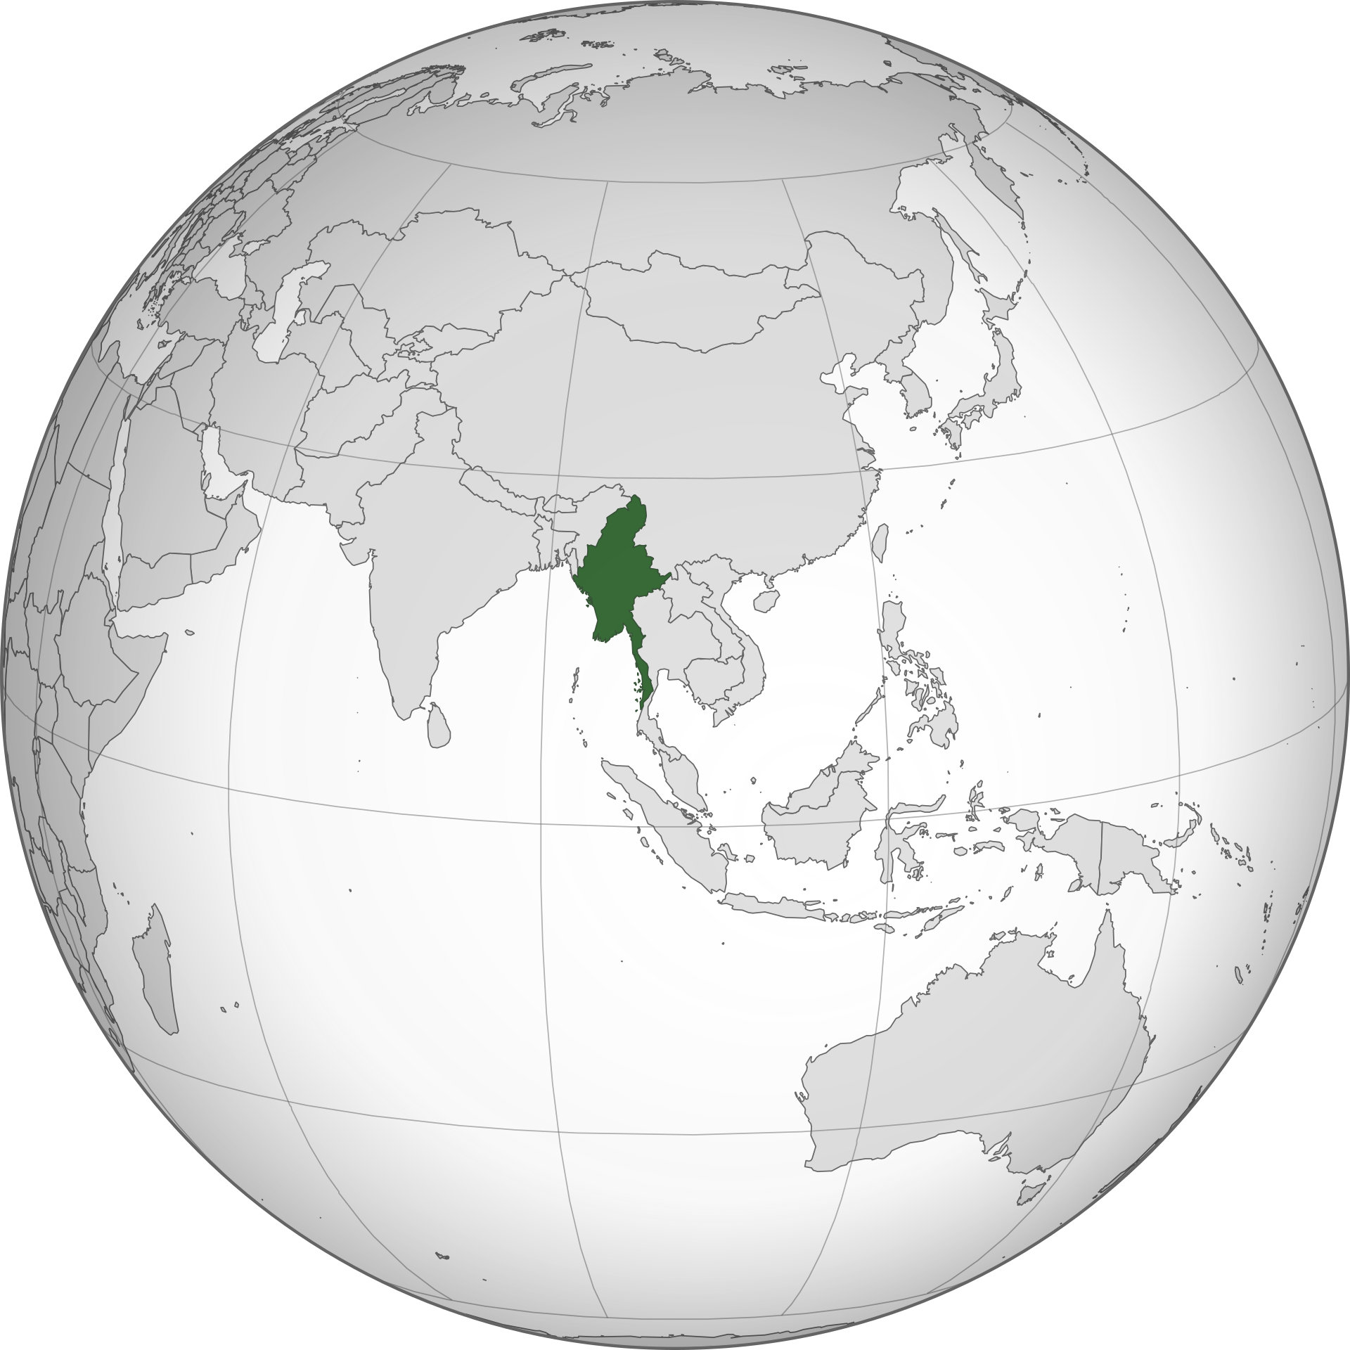
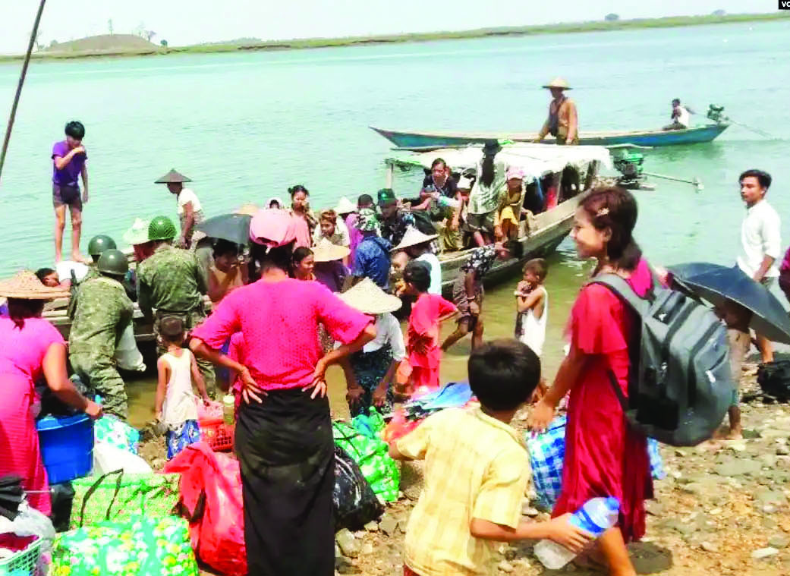
Myanmar Who Still Remember Us？
55.67 million, 4.4 million Christians. Second most climate-affected.
Battling extreme weather amid conflict and restrictions.
May 2023: Cyclone Mocha triggers floods, landslides, straining government response.
100,000+ Christian refugees in Kachin State face challenges.
Church struggles to support vast displaced Christian population.
Notes:
Myanmar is a predominantly Buddhist country , and thank God for the4.4 million Christians there, comprising 8% of the population. Since the 2021 military coup, the nation has been suffering from civil war for over three years. The military continues to attack states like Chin, Kachin, Karen, and Kayah, some with significant Christian populations. Camps in Kachin State alone house over 100,000 displaced Christians.
Due to the coup, experienced civil servants refuse to work for the military. In May last year, Cyclone Mocha caused floods and landslides, with the government unable to provide warnings or manage the crisis. No evacuation nor international aid was allowed. Christian refugees in camps face hardship, overwhelming hope. Churches struggle to support the vast displaced Christian population. Many turn to alcohol or drugs due to difficult living conditions. Some young people leave for jobs at fraudulent companies along the Myanmar-China border.

Slide 4
Pray for Myanmar
Heavenly Father, have mercy on Myanmar, a nation in conflict, violence, and now extreme weather compounds their struggles. Please encourage and comfort the disillusioned youth who have lost hope for the future. May your Holy Spirit guides them to find solace in our Lord Jesus.
Lord Jesus, we uplift the Christians in Chin, Kachin, Karen, and Kayah states. Grant them your protection, assistance, and strength. Be their refuge and shield as they place their hope in you. Amidst uncertainties, they find peace and security in your steadfast love and boundless grace.
In the powerful name of Jesus Christ. Amen.

Slide 5
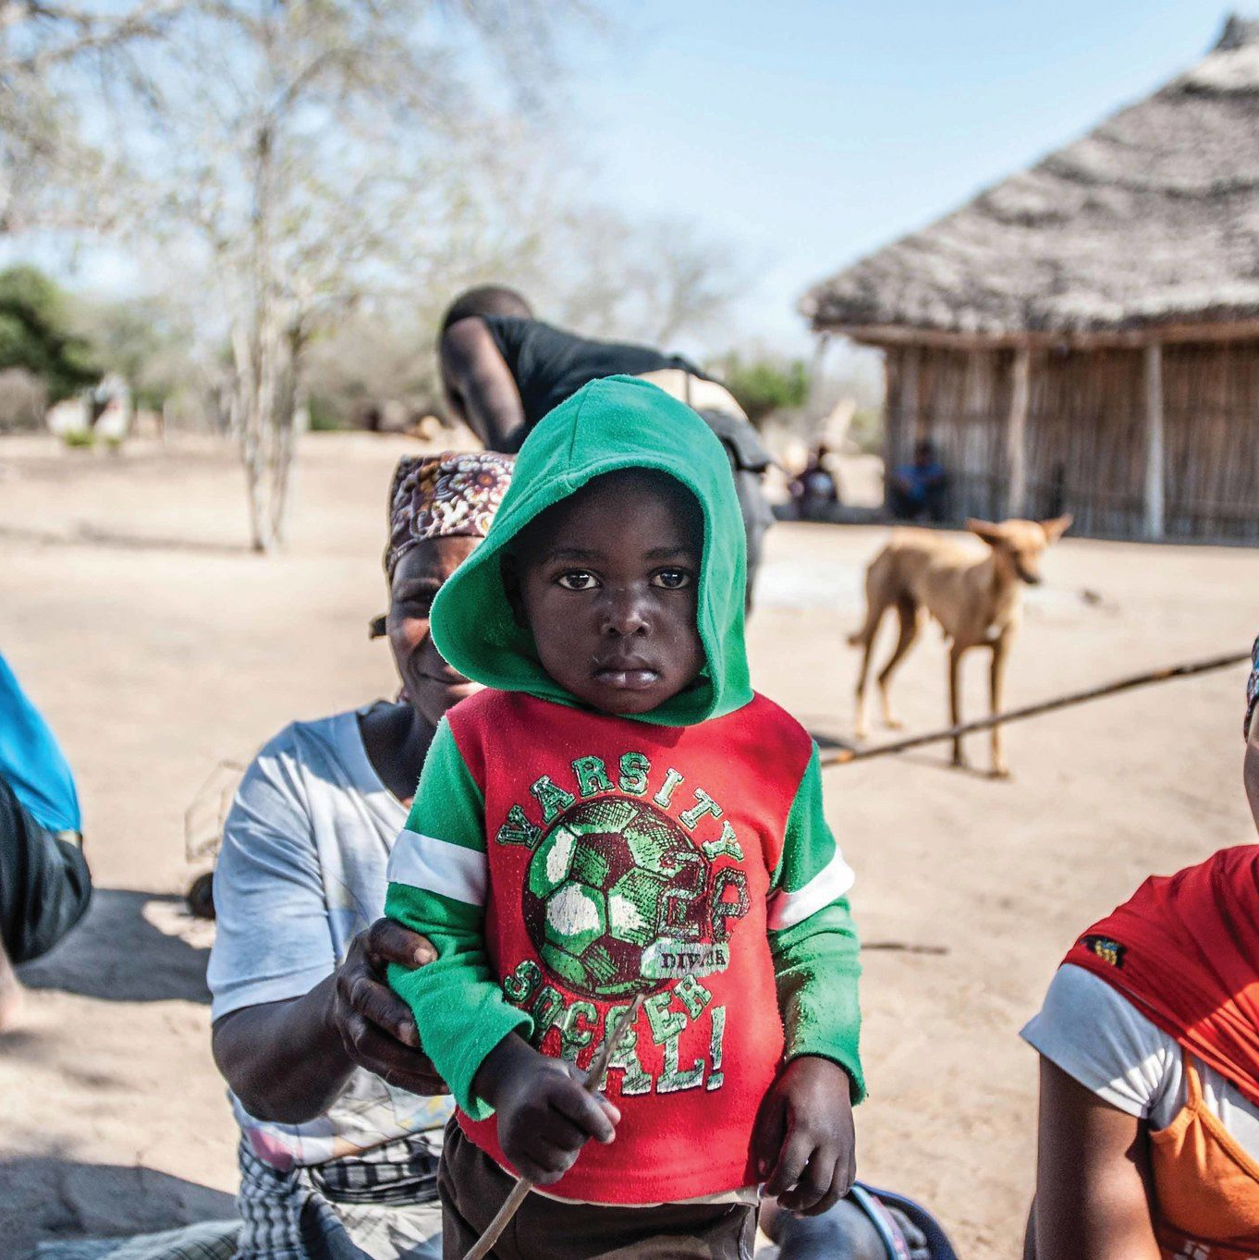
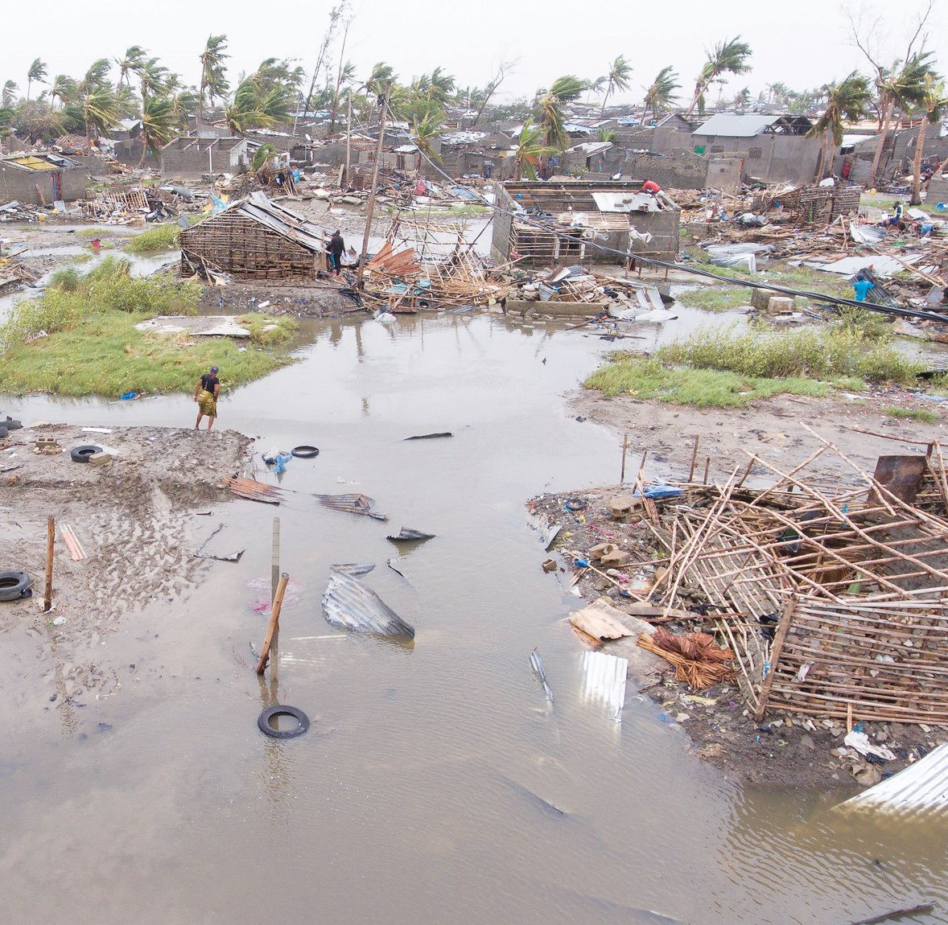
Mozambique Natural Disasters and Human Tragedy
30 million in population.
Ranked the 5th country most affected by climate change.
Coastal areas devastated by cyclones.
Southeastern coast of East Africa.
Former socialist country.
Dominant religion: Christianity.
Christians in Northern regions facing ISIS attacks
Notes:
Mozambique, a nation afflicted by climate and internal conflict, has experienced a surge in cyclones on its southeastern coast. In the past decade, the frequency has increased from once every ten years to now 3-5 times annually,(30 times) the devastating cyclone in April 2023 flattening the entire coastal region, destroying 100,000 homes and 1,000 schools.
Mozambique was formerly a Portuguese colony, she became a socialist country after gaining independence in 1975 followed by a 16-year civil war.
Despite its rich mineral, coal, and natural gas resources, and the economic restructuring efforts post-1992 civil war, Mozambique still facing challenges due to corruption, leaving the nation underdeveloped and heavily indebted.
With a population of 30 million, over half are broadly classified as Christians. However, the northern region is controlled by the Islamic State (ISIS), aiming to establish a Muslim-led state. Continuous violent incidents target Christians, resulting in church burnings, killings, and displacement of nearly a million people. Let us join in prayer for their plight.

Slide 6
Pray for Mozambique
Heavenly Father, we pray for Your help to the cyclone victims in Mozambique. Protect the rescue teams smoothly delivering relief supplies to shelters. Be the refuge for the innocent civilians and Christians, protect and shield them, keep them safe from ISIS violence.
Lord, be with those who are abducted. You are the constant help and grace in time of need for women and girls. Safeguard them from trafficking and reunite them with their families swiftly. Crush the wicked schemes of radicals, removing hatred and violence from their hearts. In the name of Jesus Christ, we pray. Amen.
Notes:
Heavenly Father, we pray for Your help to the cyclone victims in Mozambique. Protect the rescue teams smoothly delivering relief supplies to shelters. Be the refuge for the innocent civilians and Christians, protect and shield them for their safety from ISIS violence.
Lord, be with those who are abducted. You are the constant help and grace in time of need for women and girls. Safeguard them from trafficking and reunite them with their families swiftly. Crush the wicked schemes of radicals, removing hatred and violence from their hearts.
In the name of Jesus Christ, we pray. Amen.

Slide 7
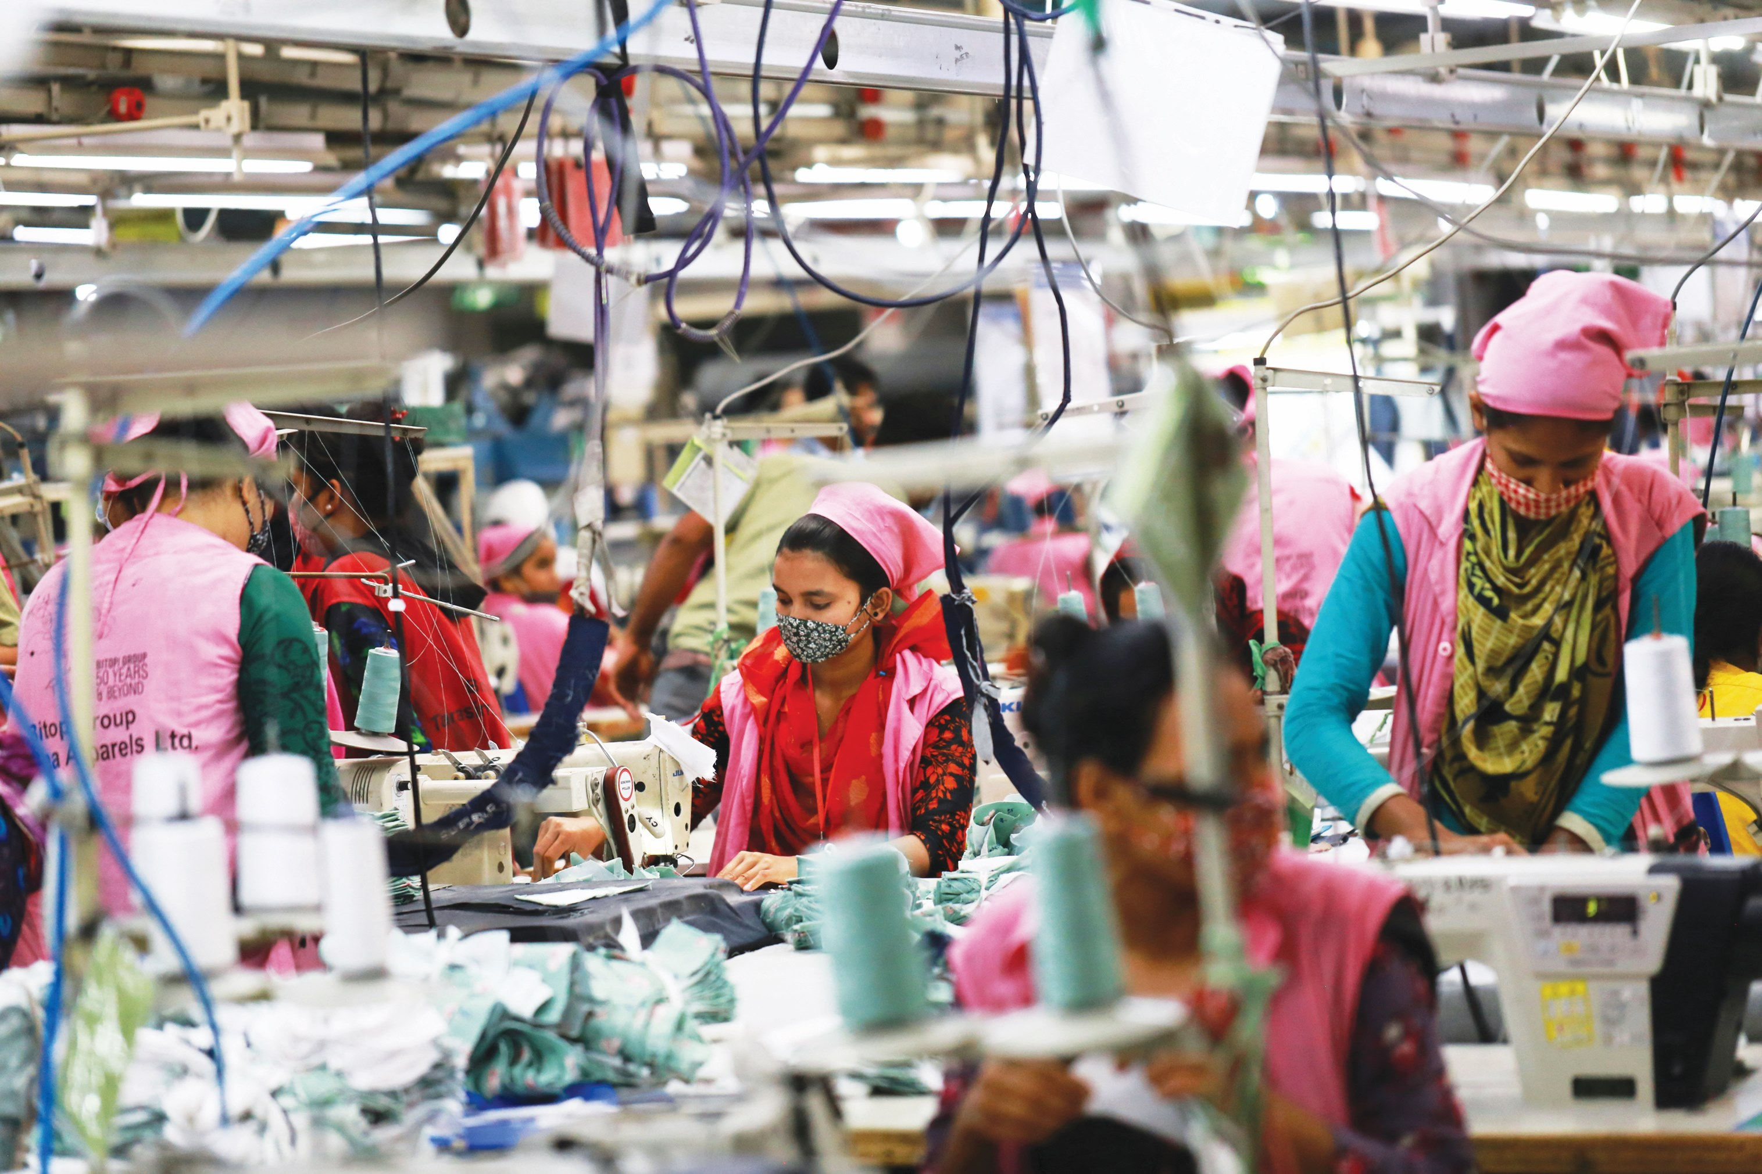
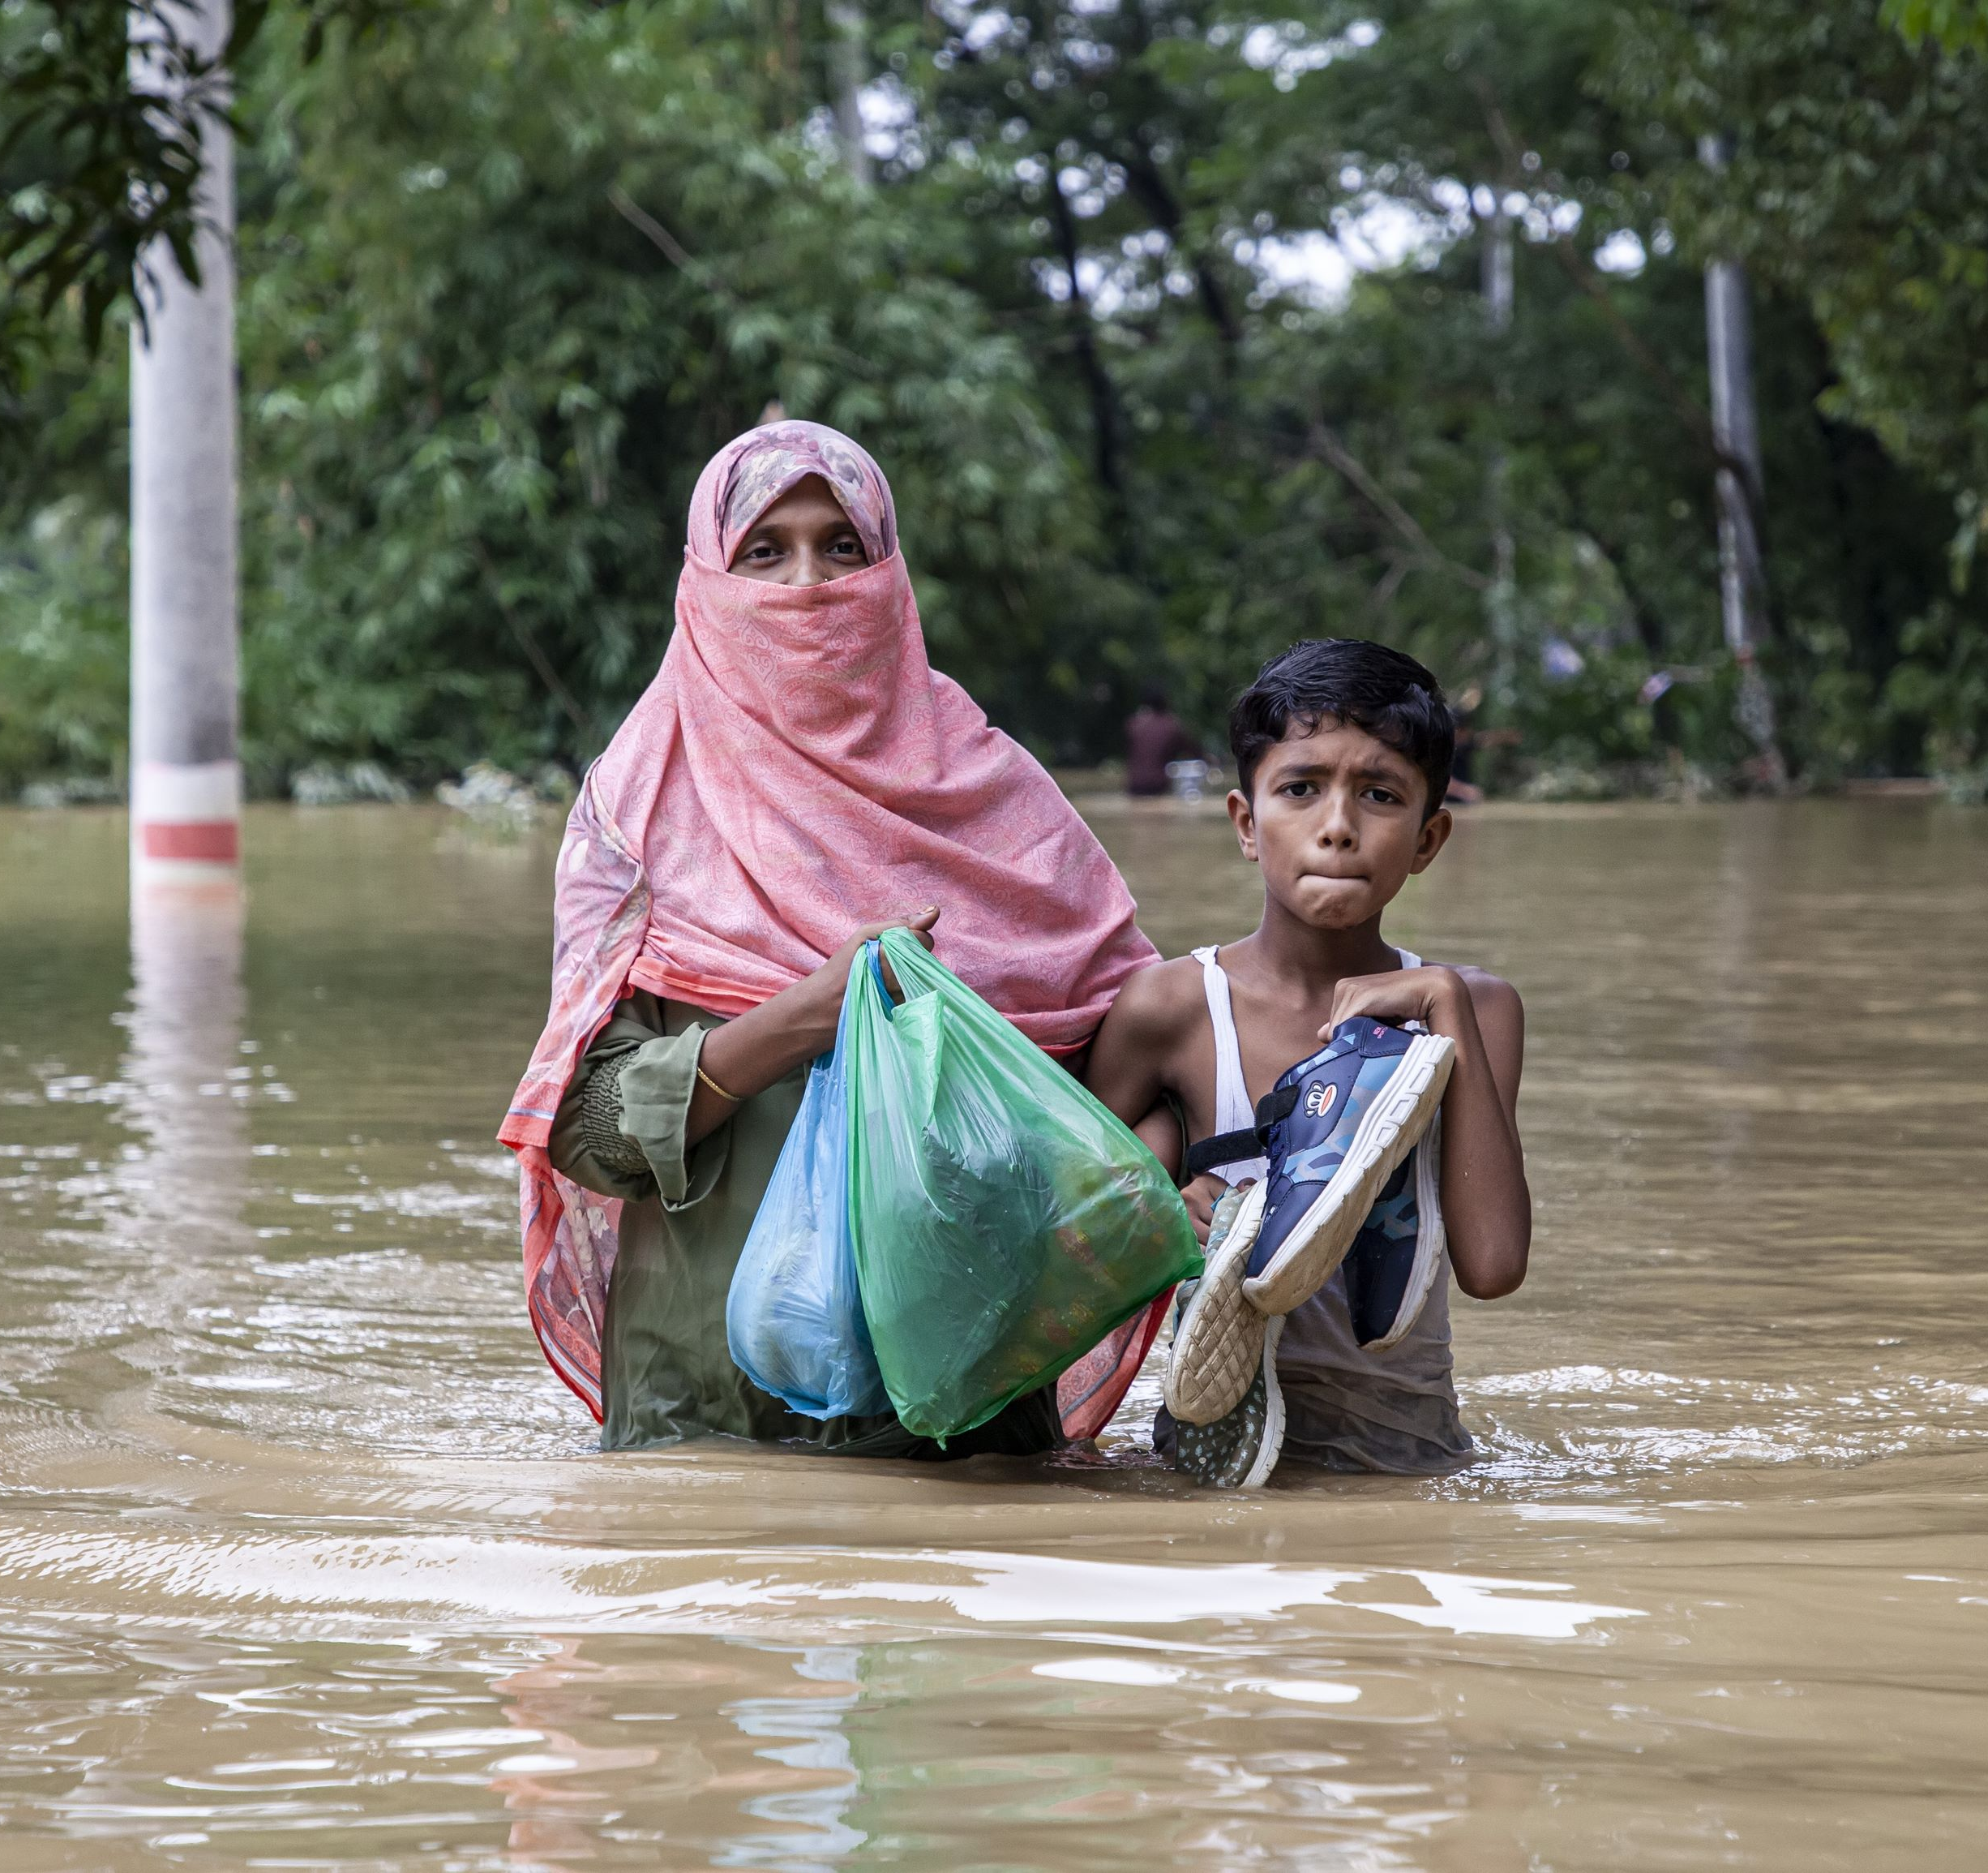
Bangladesh The Cost of Fashion
Population 170 million
Ranked the 7th country most affected by climate change.
Half of the country's income comes from heavily polluting industries.
2/3 of Nation’s land below sea level.
By 2050, 19 million people may be displaced due to rising sea levels.
Extreme climate conditions result in both droughts and floods.
Notes:
The Extreme weather is linked to carbon emissions. And the world’s carbon emissions 10% came from the fashion industry.
In 1990s, Bangladesh, with a population of 170 million, became a major player in the fast fashion industry which provide 50% of the country’s income, yet unfortunately processes like tie-dyeing, distressing, fixing colors, leather tanning, involve the use of thousands of chemicals, causing severe environmental pollution.
Often referred to as the "South Asian Netherlands," two-thirds of Bangladesh's land is below sea level, facing constant threats from hurricanes and rising sea levels making the country land submerged in seawater damaging the farm land and jeopardizing the food supply.
By 2050, an estimated 19 million people may be displaced due to rising sea levels. In addition, Bangladesh also experiences alternating disasters of prolonged droughts and excessive rainfall.

Slide 8
Pray for Bangladesh
Father God, The garment industry sustains Bangladesh's economy, providing livelihoods for many, but the massive carbon emissions cause harm to the climate and environment, and rising sea levels is going to make 19 million people losing their homes.
We pray for healing this land, a renewal of livelihoods, and a balanced sustenance and environmental policies. May the people treat the land with respect and find sustainable ways of living. Guide Muslims and Hindus in Bangladesh to walk the path of truth, understanding that Christ is the garment of righteousness they need to wear. In Jesus Name, we pray. Amen.

Slide 9
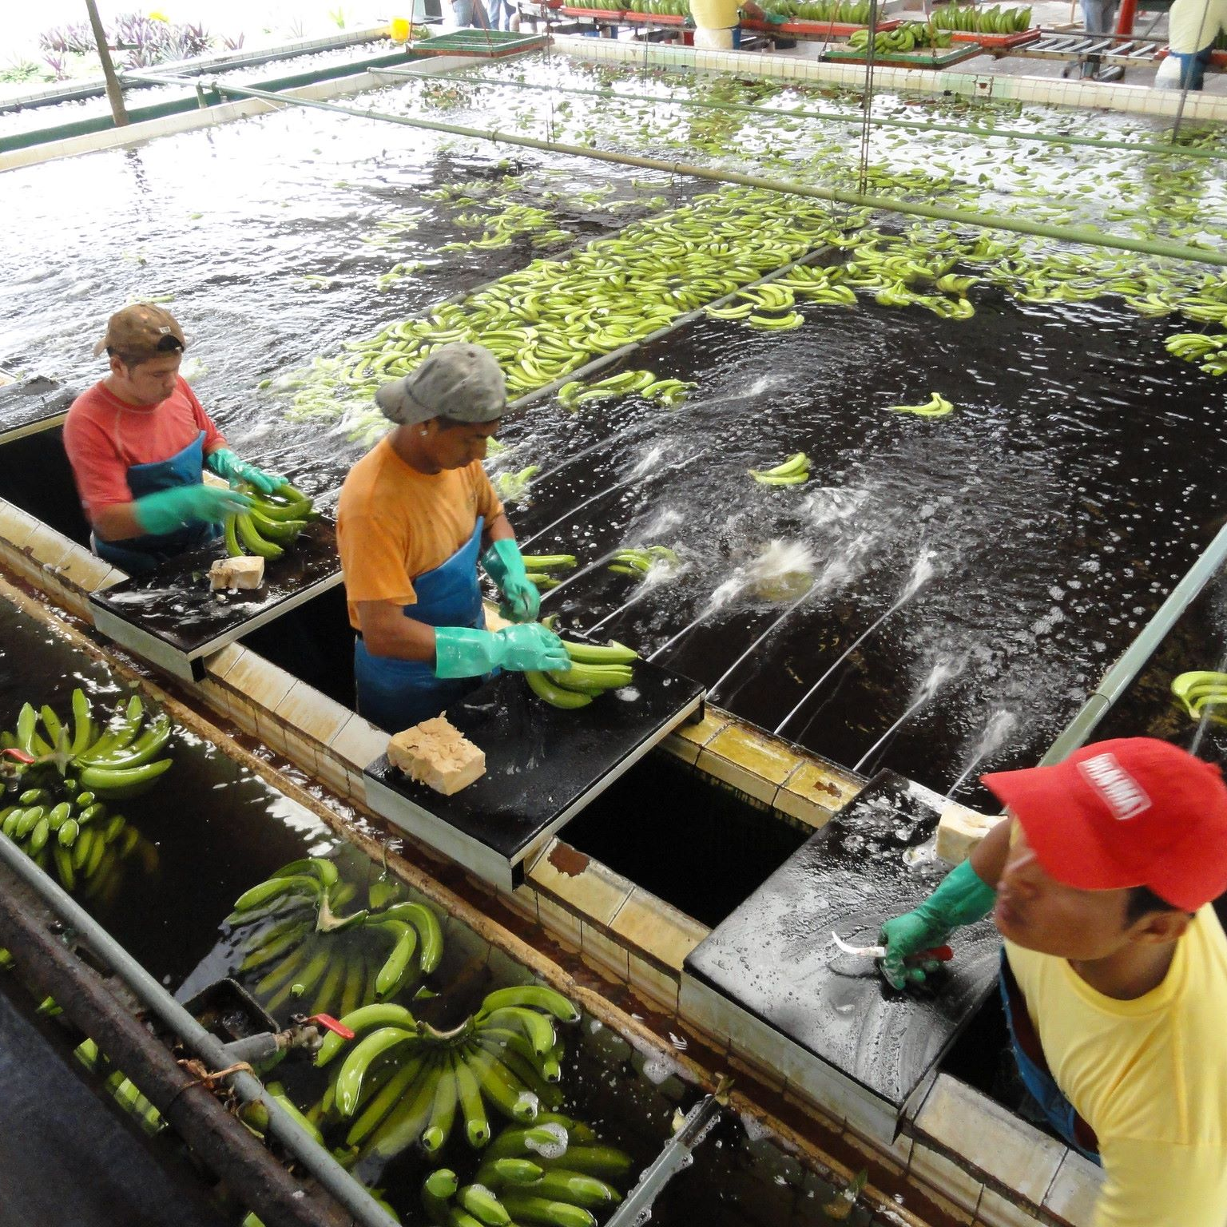
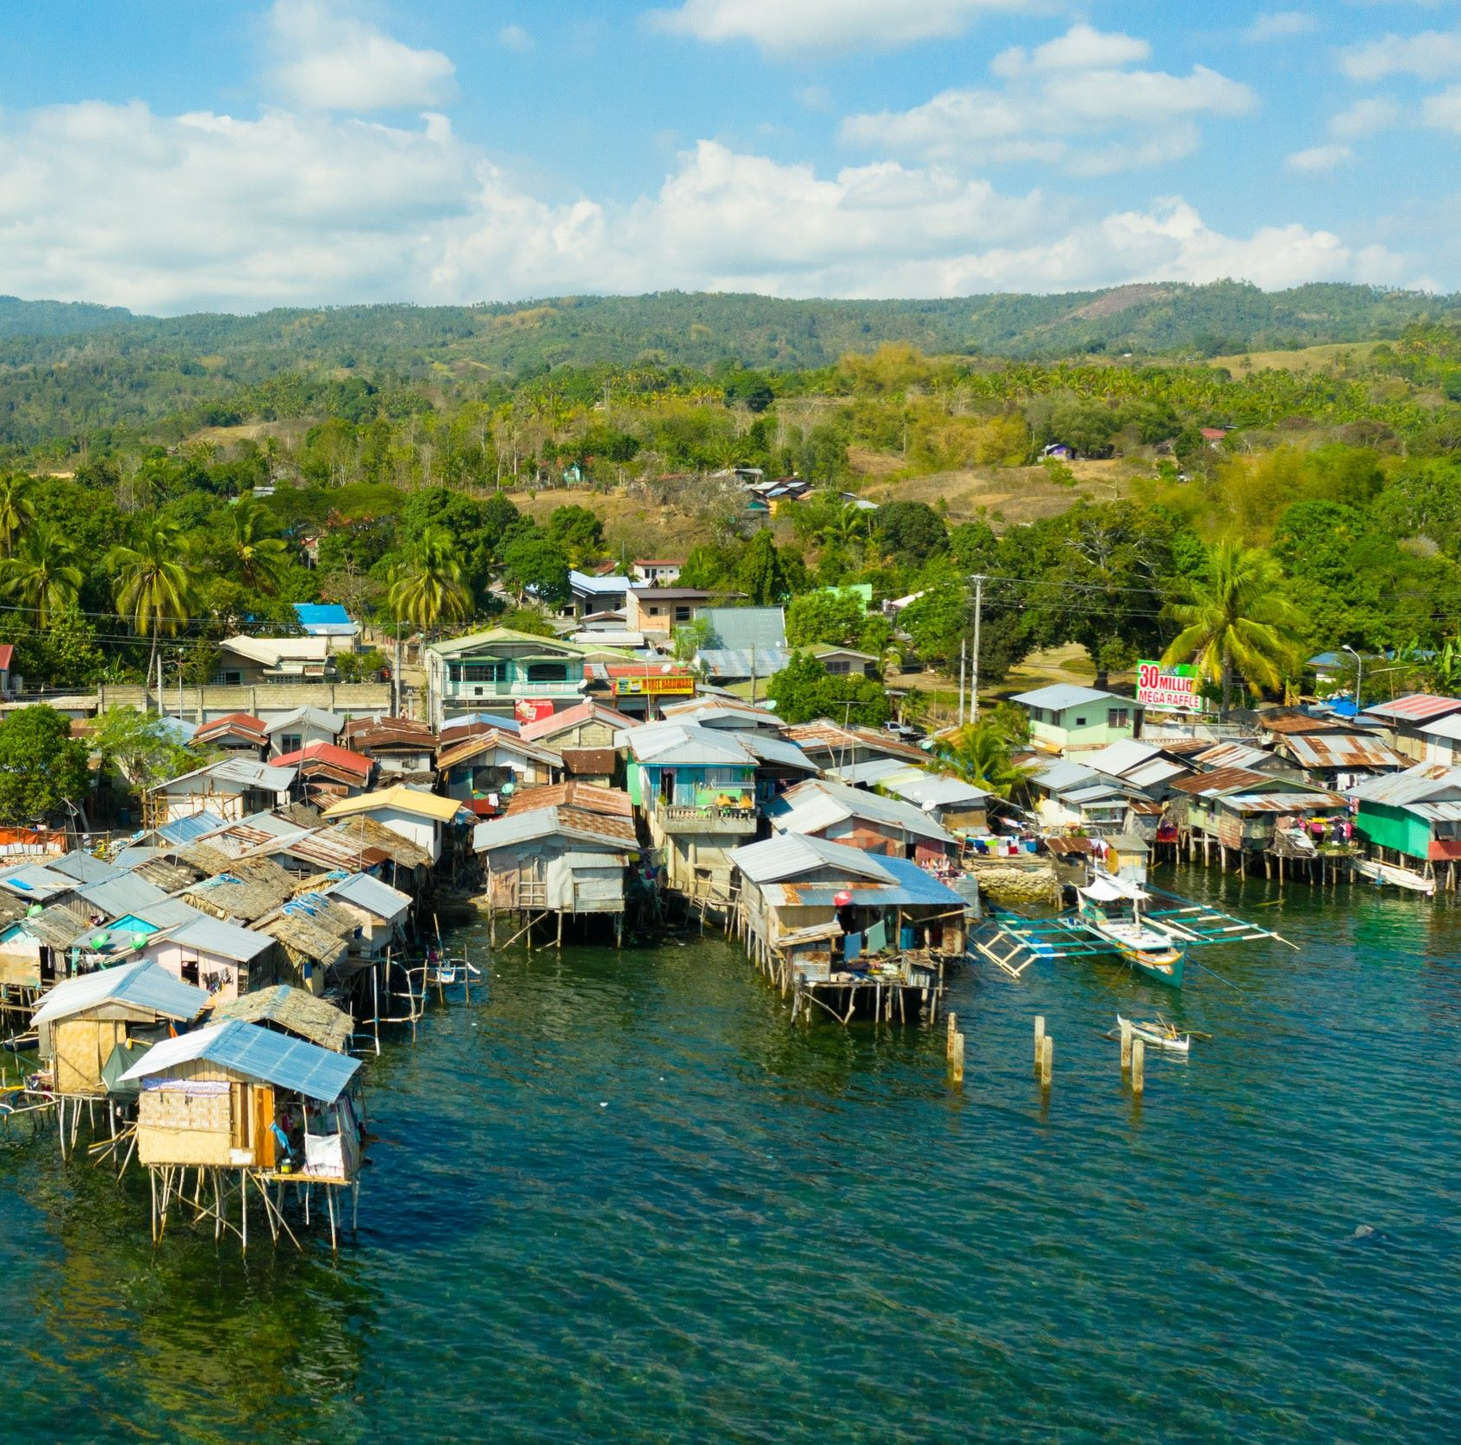
Philippines The Homeland of Typhoons
Fourth most climate-affected country.
Island nation breeding ground for typhoons.
From an Islamic nation to the largest Catholic country in Asia, southern part controlled by ISIS.
Ocean pollution largest single contributor.
Agricultural workers the most impacted by extreme temperatures.
Sea level rise rate 3 times the global average.
Notes:
In the 13th century, Islam took root in the southern Philippines, and after becoming a Spanish colony in the 16th century, Catholicism became dominant. However, the southern region remains predominantly Muslim and controlled by ISIS, leading to conflicts with the government.
The Philippines once had lush greenery, with the island of Luzon boasting precious tropical rainforests. However, deforestation has drastically reduced forest coverage to just a fraction in a few decades.
Manila, due to excessive groundwater extraction, experiences land subsidence at a rate of 4 to 6 centimeters per year, coupled with climate change causing sea levels to rise three times the global average. With 70% of towns built along the coast, rapid inundation is imminent.
The country's heavy use of small plastic bags in consumer goods packaging making Philippines being the world's largest contributor to ocean plastic pollution.
The impact is felt strongly by agricultural workers who face extreme temperatures, leading to health issues and fatalities. The rising temperatures also force workers to take more breaks and increase water intake, reducing working hours and pushing farmers to work harder, risking overexertion.
Agricultural workers suffer severe economic and health consequences due to the devastating effects of extreme temperatures.

Slide 10
Pray for Philippines
Pr
Dear Heavenly Father, grant grace and hope to Filipino farmers overcome the challenges in lives from the extreme weather, Guide the government and people to sustainable practices, in cultivating suitable crop varieties, reforesting rainforests, give them the wisdom of your REST, refraining from excessive consumption and exploitation of nature.
May the Philippines, as Asia's largest Catholic nation, pursue holiness and justice, wisely managing resources. May you bring peace between Muslim communities and the government in Mindanao, that they may coexist peacefully on the land You have provided. In Jesus Christ's name, we pray. Amen!

Slide 11
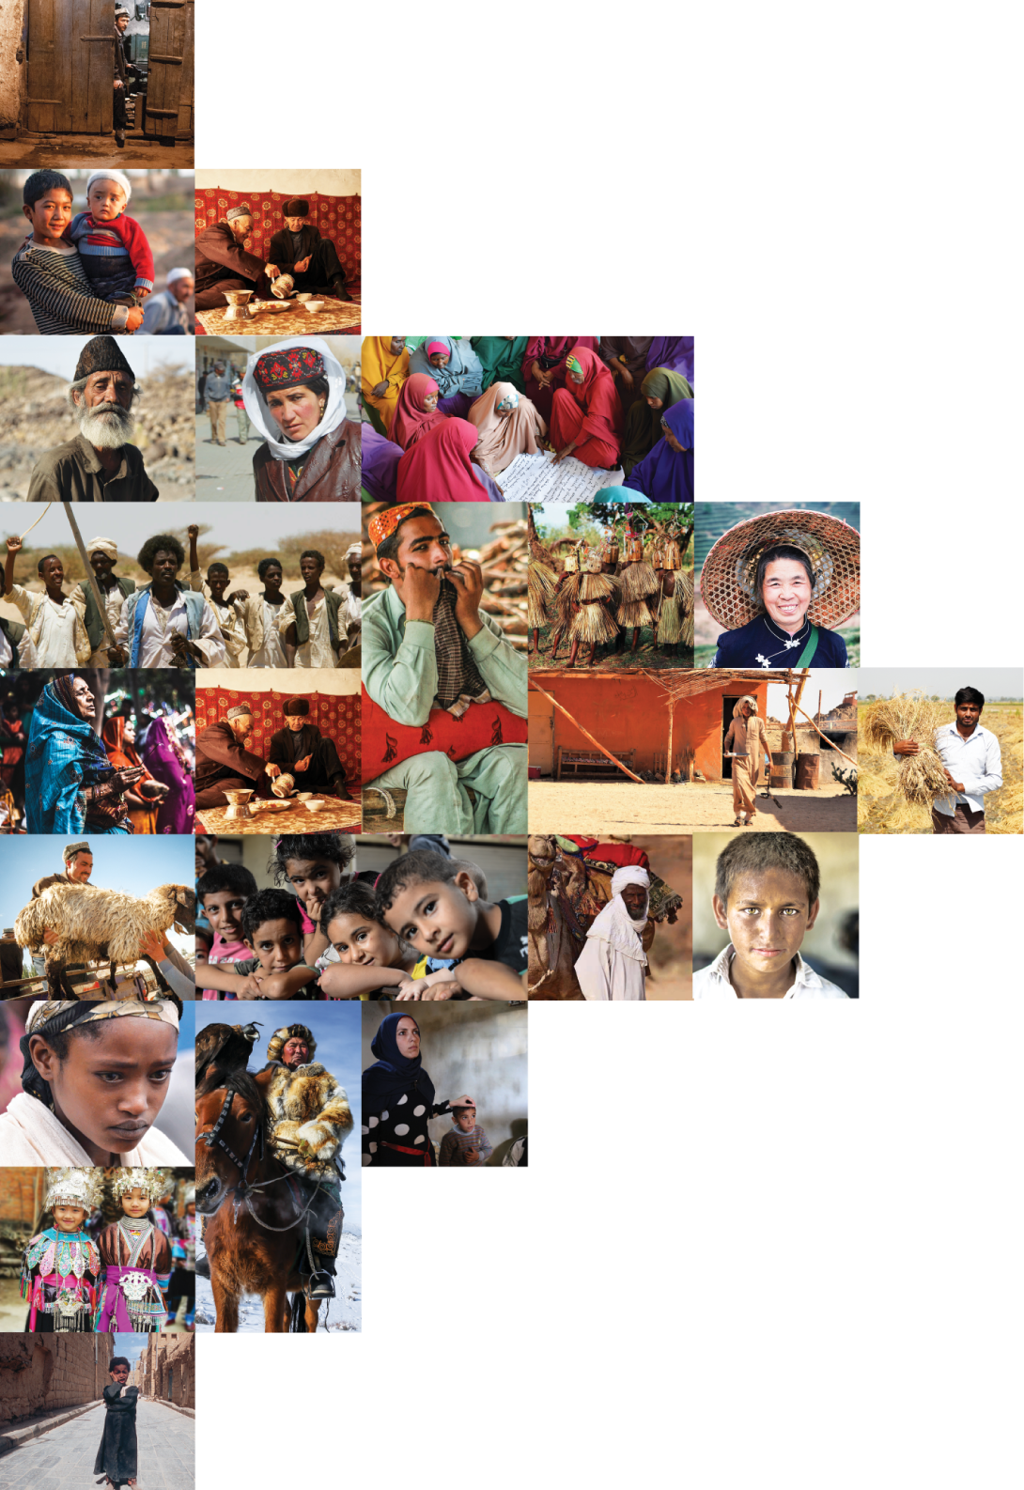
不再是个人的祷告，我们开始一起祈祷。 30分钟，生活再忙碌的人都能找到时间参与。

