Slide 1
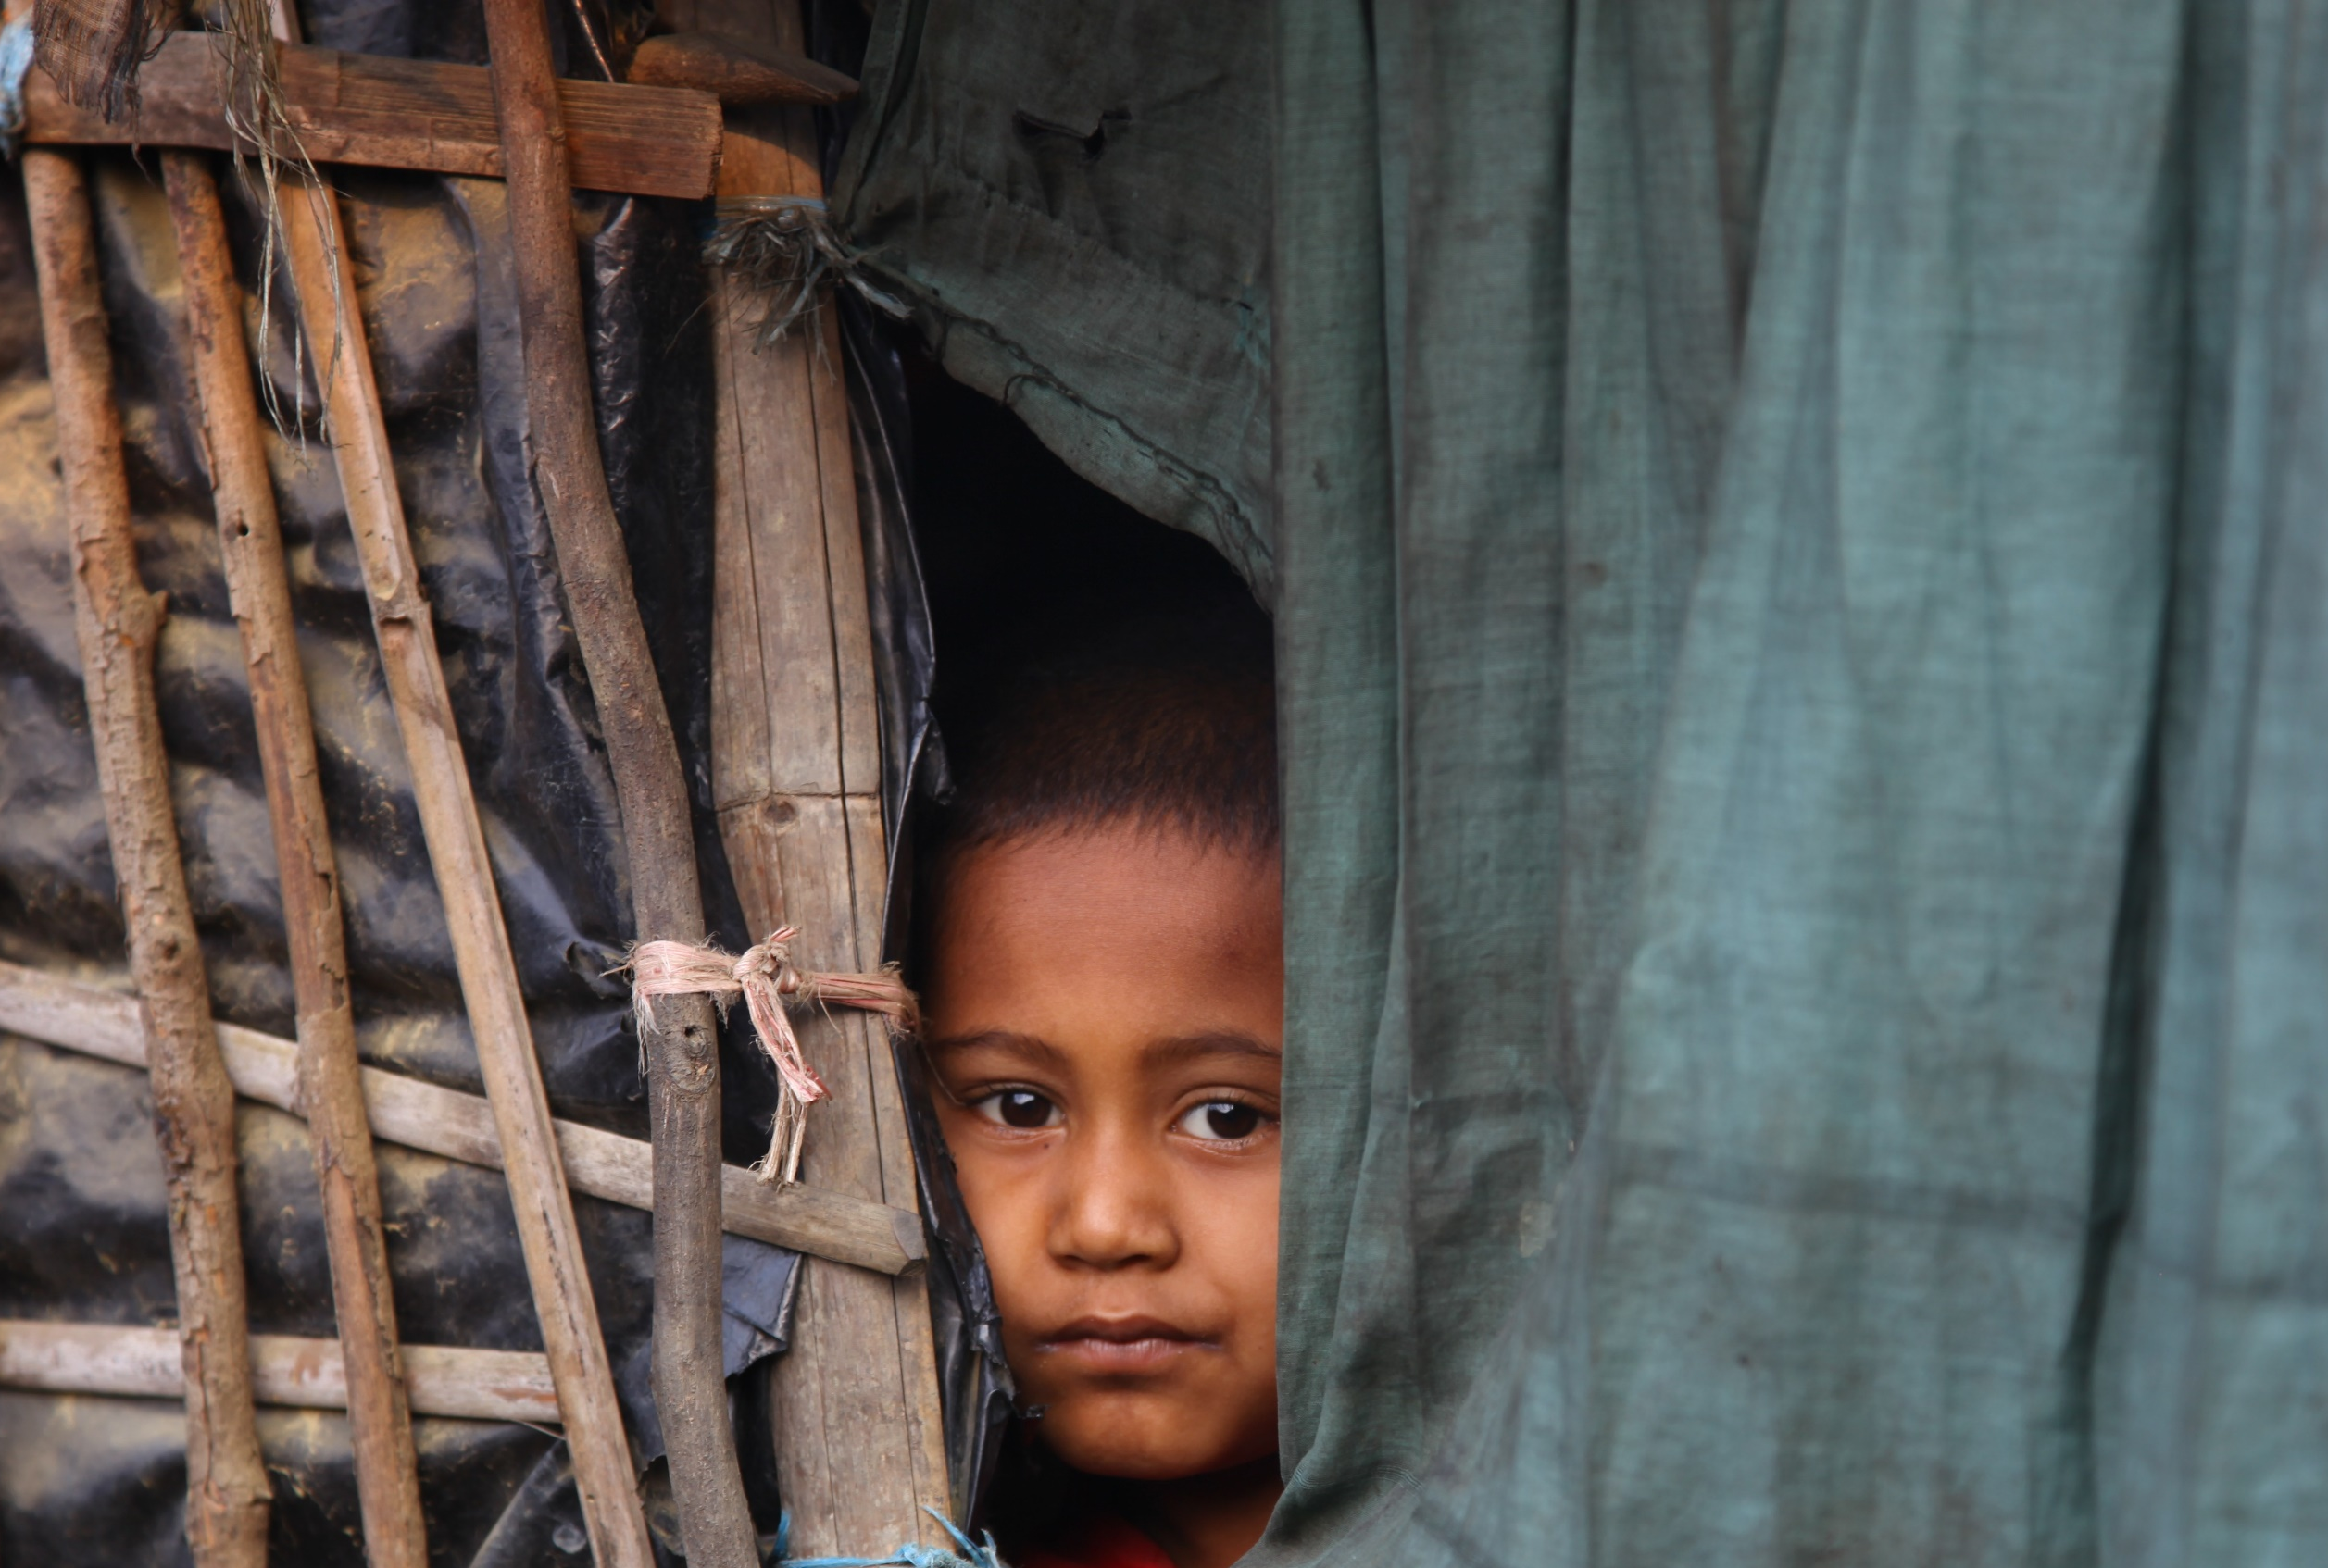
April 2024
Refugees and Migrant Workers in Malaysia
Notes:
The uprooted refugees from Afghanistan, Yemen, Ethiopia, Somalia, and Myanmar have fled for their lives from their homeland. They have stepped onto foreign soil that rejects them, dwelling in dark corners unseen, awaiting a thin refugee permit, which offers them a chance of a new life.
Another group sharing the same fringes are the exploited migrant workers, who have rights deprived.
Through local interviews in Malaysia, we will listen to the stories of these sorrowful travelers and pray for both refugees and migrant workers.

Slide 2
Refugees
Globally displaced people: 110 million
Refugees: 36.4 million
Internally displaced: 62.5 million
Stateless displaced: 13.28 million
40% are children, 43.3 million
52% originated from
Syria: 6.5 million
Afghanistan: 6.1 million
Ukraine: 5.9 million
Malaysia: 5.8 million
181,000 refugees
5.7 million migrant workers (foreign workers)
Notes:
There are 110 million people displaced by natural disasters or wars around the world. 40% of them (43.3 million) are children. Of the 110 million, 60% (62.5 billion) remain in their original place of residence, while about 35% (36.4 million) want to flee their own country. More than half (52%) of these displaced people are from Syria, Afghanistan and Ukraine
Generally speaking, refugees can start a new chapter in their lives if they are accepted by the host country.
Today, 148 of the 195 countries in the world are signatories to the United Nations [Convention Relating to the Status of Refugees] and the [1967 Protocol relating to the Status of Refugees] , providing the refugees protections in the Refugee Convention: such as freedom of movement, education, employment or self-employment for income, property rights, travel and identity documents, and access to public relief and assistance in the host country including medical services.
However, there are still some countries that have not signed the agreements, and Malaysia is one of them. Let's take a look at the situation of the refugees in this country.

Slide 3
Malaysia Gathering Place for Sad Travelers
Refugee issues in context of national security
National security control vs. humanitarian protection, refugees are equal to illegal immigrants, and life returns to step zero
In countries not signatories to the Convention on the Status of Refugees, refugees have no rights to public education, medical benefits, employment and national protection
Engaging in 3D jobs: dirty, difficult, and dangerous
5.7 million migrant workers feeling lost and hopeless
Lack of labor rights
Being violated, deceived, exploited
What can we do?
Notes:
Malaysia has a population of 40 million, mainly Malays, Chinese, and Indians. The authorities strongly advocate Islamization in terms of religious freedom policies.
In the 1990s, Myanmar arrested dissidents, and many of them fled to Thailand and Malaysia. Since 2000, in addition to Myanmar, refugees have also come from war-torn countries such as Yemen, Palestine, Syria and Somalia. Currently there are 180,000 refugees, mainly Rohingyas from Myanmar.
The Malaysian government has long viewed refugee issues from the perspective of "national security control" rather than "humanitarian protection." Malaysia is not a signatory to the United Nations Convention on the Status of Refugees and has no legal framework to assist refugees. Official documents have never recognized the existence of refugees, instead, they are all classified as illegal foreign workers. They are deprived of rights to access public education, medical subsidies, employment, and national protection. Most people work in 3D jobs (dirty, difficult, and dangerous), making them vulnerable to exploitation by their employers and at risk of arrest and deportation. In other words, the Malaysian authorities have adopted an attitude of tolerating their short stay (but not taking responsibility) while waiting for refugee quotas in countries like the United States and Canada. However, there are very few resettlement quota. The prospects for refugees are bleak and uncertain.
Economic transformation introduces migrant workers
Malaysia's manufacturing, palm plantation, and service industries have long relied on low-wage foreign migrant workers (foreign labor). The migrant worker population is approximately 5.7 million. However, due to labor rights issues, migrant workers are prone to violations, deception, exploitation, and domestic helpers not being paid for years and facing dire situations. Some migrant workers found the working conditions promised in their home countries not met upon arrival in Malaysia. When they complain, their employers will cancel their work permit, leaving them undocumented. Some worked in jobs that were not in compliance with the work permit. They would be classified as undocumented if found. The police or gangsters may take their money by force. They feel lost, disappointed and hopeless. Also, many of them are unreached people.
Is there anything we can do?
______________________________________________________________
Here are some reference points:
The population of Malaysia is 34 million, consisting of Malays (57.2%), Chinese (23.2%), Indians (6.7%), Indigenous people (12.2%), and others (0.75%).
Religious beliefs: Islam (63.5%), Buddhism (18.7%), Christianity (9.1%), Hinduism (6.1%), and others (1.8%).

Slide 4
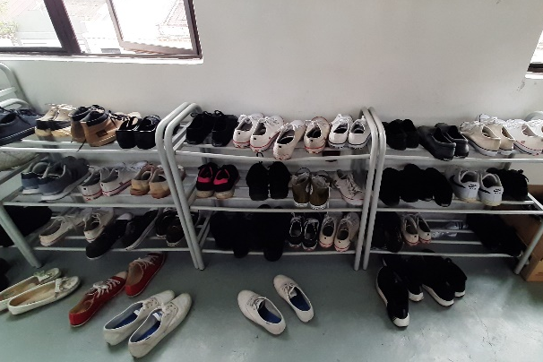
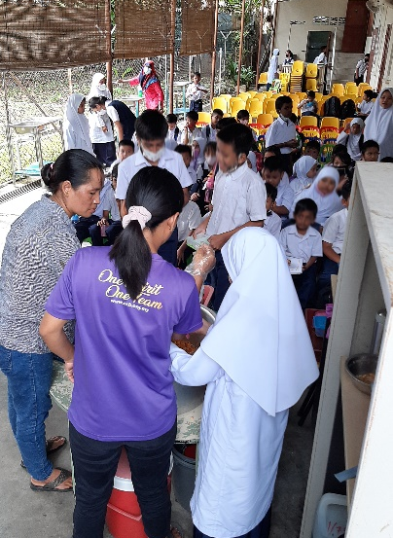
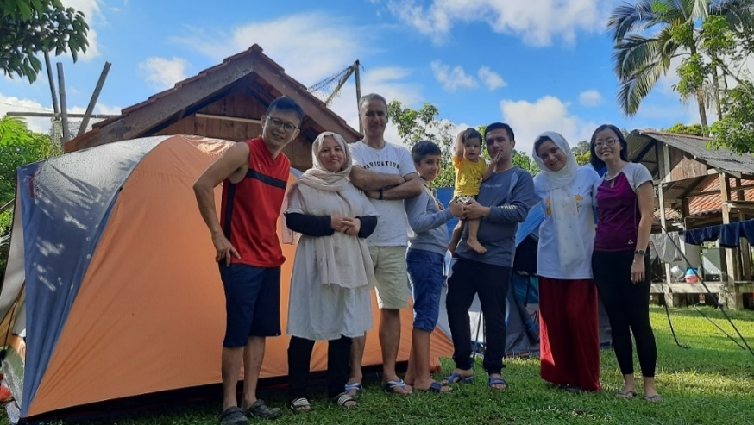
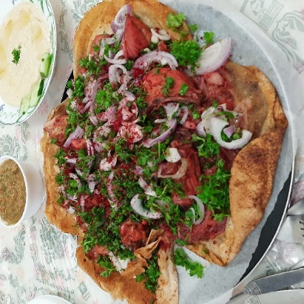
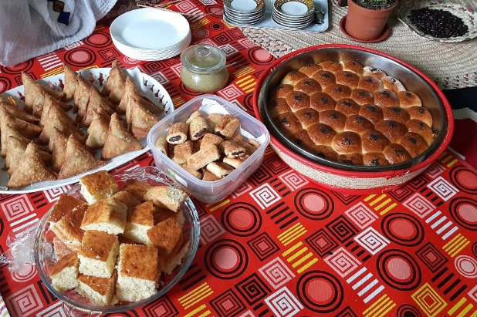
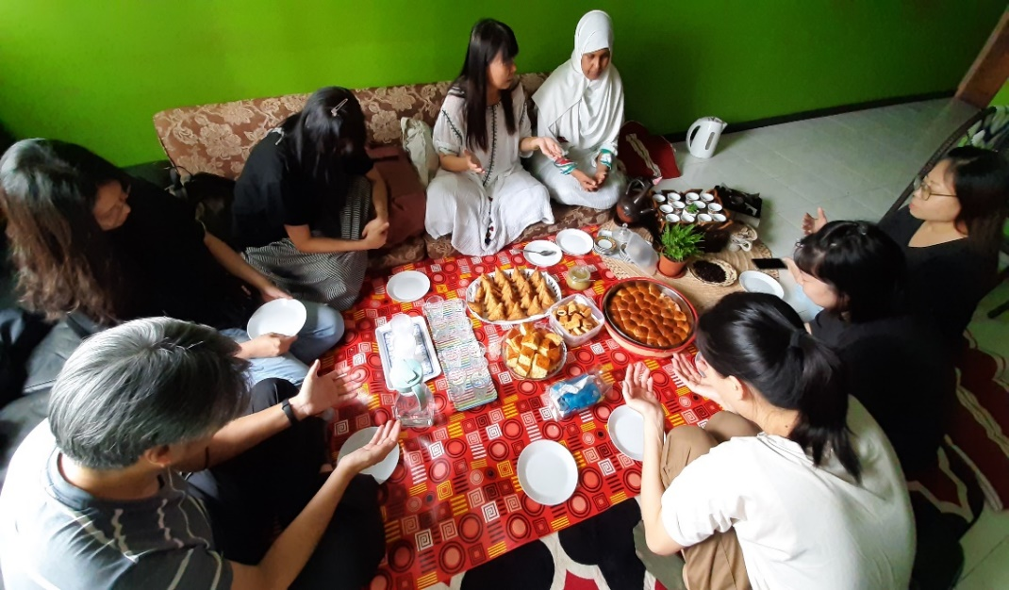
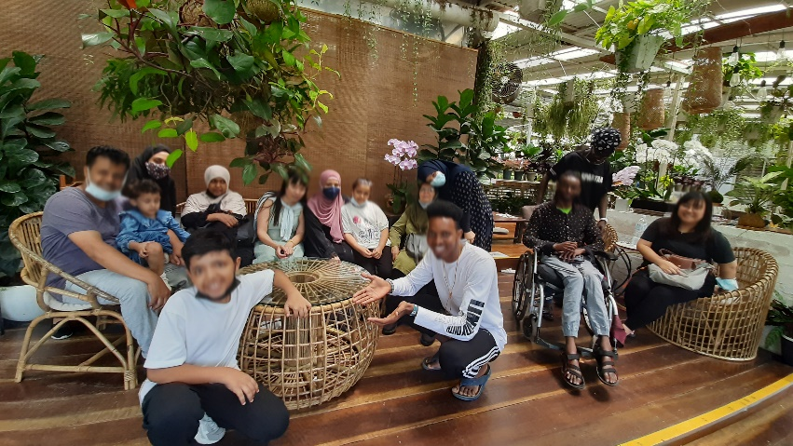
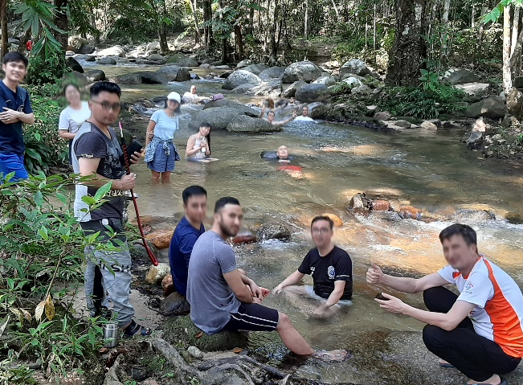
School for refugees
Gathering/ Coffee chats
Camping/Day trips
Notes:
In need of English-speaking teachers: There are many Christian organizations in Malaysia that establish refugee schools. Teachers teach in English to prepare children to continue their education or adapt to new life when they resettle in Western countries.
Missions Pathway highlights the "Compassionate Care Ministry," focusing on the spiritual needs of refugees. Regular activities include camping, day trips, picnics, etc., to build close relationships with refugee families and youth from Afghanistan, Yemen, Somalia, Myanmar.
Alternatively, you can donate to support the "Compassionate Care Fund" to provide timely assistance to refugee friends in urgent need, such as medical emergencies, food shortages, children's school fees, etc.
------------------------------------------------------------------------------------------------------------------------------------------------------------------------
If time permits, below is a sharing on the refugee ministry of the Mission Pathway’s "Compassionate Care Ministry" in Malaysia:
In Malaysia, there are many Christian organizations that particularly focus on the educational needs of refugee children. You can become a teacher at these refugee schools, where instruction is primarily in English. This education prepares them for resettlement in Western countries, where they can continue their studies or adapt to life.
We also address the spiritual needs of refugees. In Malaysia, we engage in activities such as camping, day trips, picnics, and family gatherings to accompany refugee families and youth from countries like Afghanistan, Yemen, Somalia, and Myanmar, building close relationships with them. Especially during the pandemic, refugees who haven't left their homes for nearly two years express their heartfelt gratitude, showing the joy and appreciation in their hearts.
Your contribution of time, arranging transportation, or providing a meal may seem simple but can be a blessing for them throughout their lives.
Muslim women are not allowed to work outside their homes. Tasha, a widow from Yemen, earns her livelihood by hosting meals at her home through the efforts of frontline workers. Apart from preparing Middle Eastern cuisine, she has a skill in brewing Ethiopian coffee. With elegant gestures, she brings out the rich aroma of coffee, complemented by homemade Middle Eastern pastries, inviting you to savor the moment together!
We encourage churches to organize teams to visit Malaysia. Feel free to connect with the "Compassionate Care Ministry" to actively show care for the unreached in our midst. Alternatively, you can donate to support the "Compassionate Care Fund" to provide timely assistance to refugee friends in urgent need, such as medical emergencies, food shortages, and children's school fees.

Slide 5
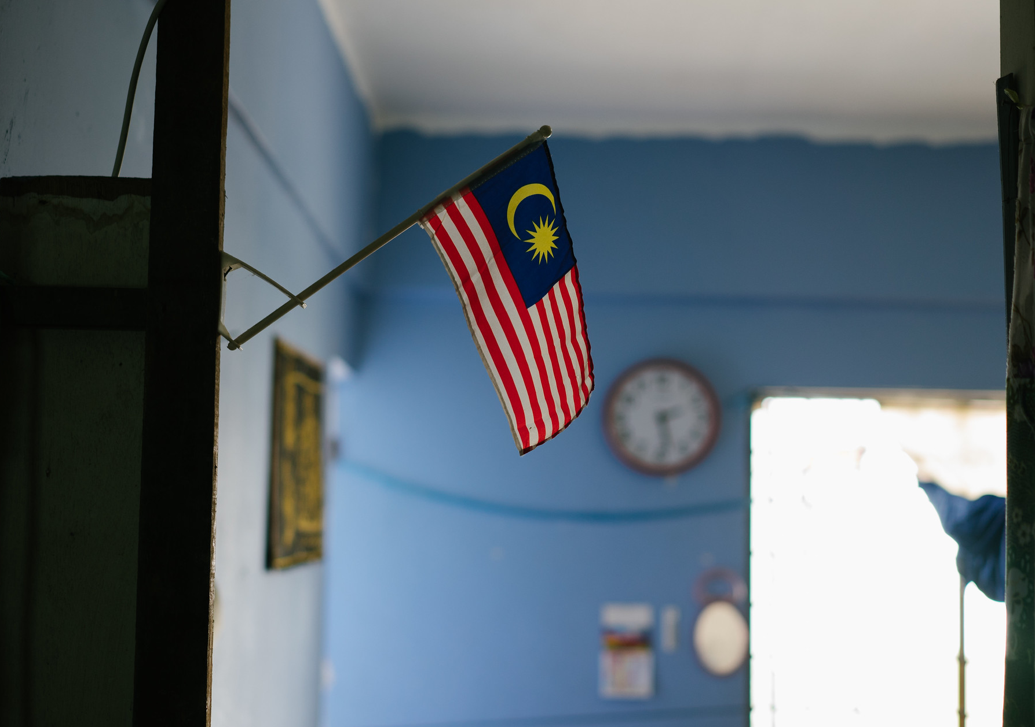
Let us pray together for the Refugees and Migrant Workers in Malaysia

Slide 6
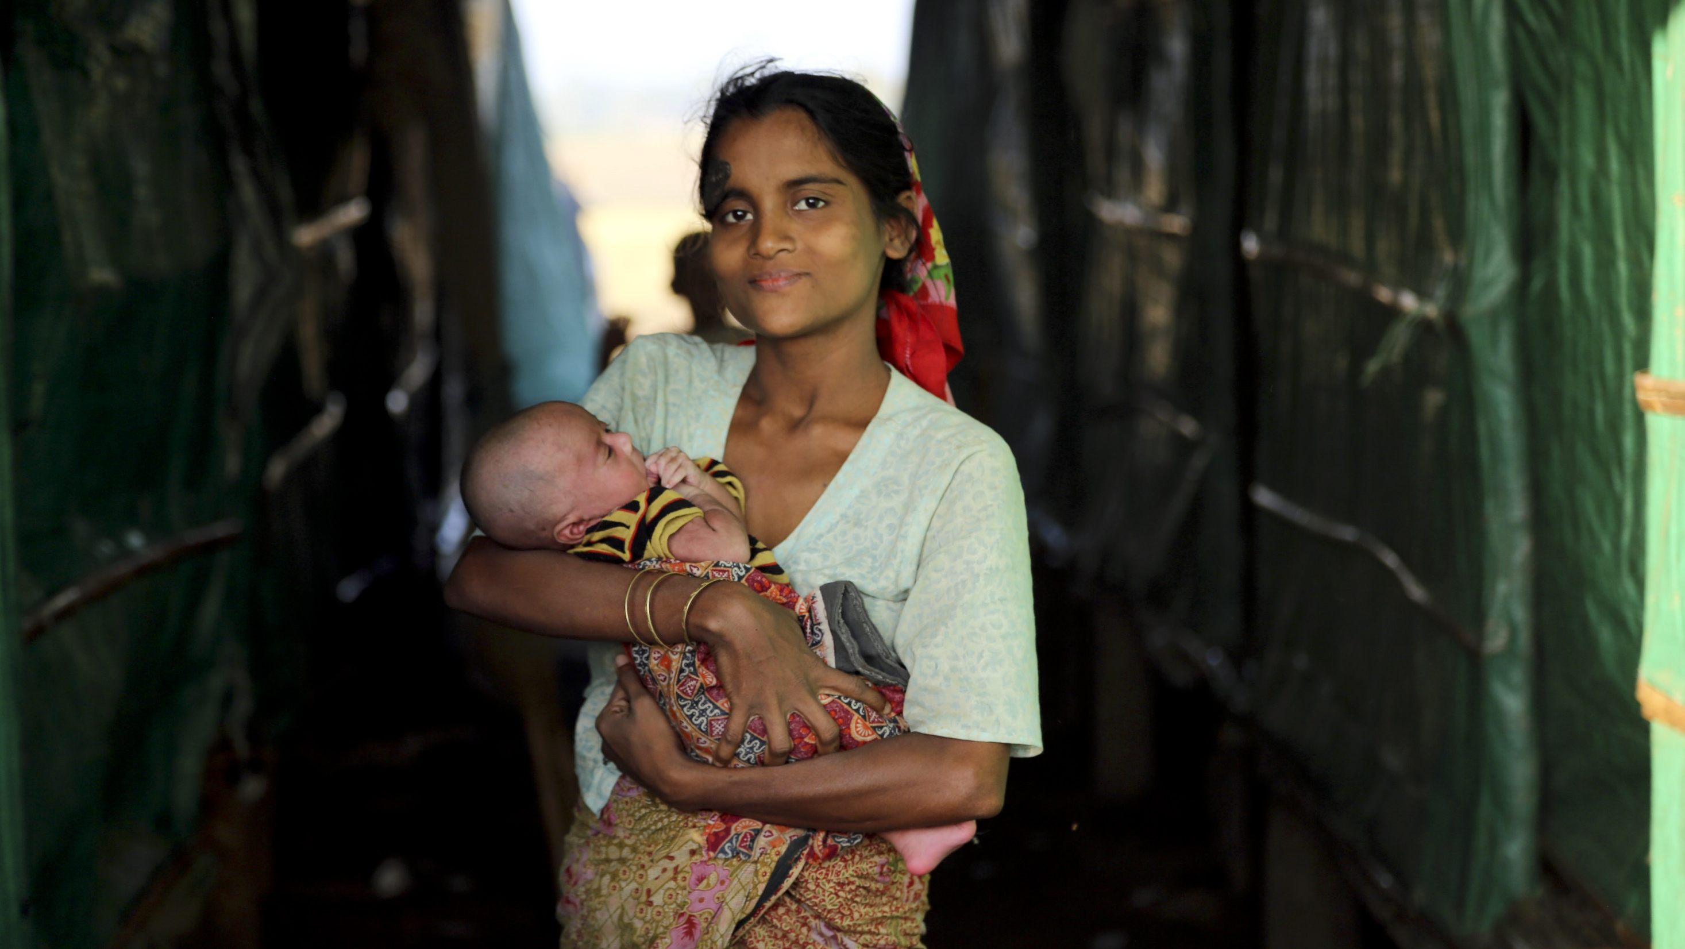
Pray for Refugees in Malaysia
Heavenly Father, please keep watch over the over 180,000 refugees in Malaysia. Some have lost their loved ones in wars. As they miss their families, we ask for Your comfort. In their times of need and lack, we pray for Your provision.
When their future seems uncertain, we trust You to make a way for them and prepare opportunities for them to be resettled in host countries soon.
Father, the children among the refugees have many dreams.
They hope to go to school, explore the world, and desire a future filled with hope and brightness. May You grant them grace and opportunities.
Though refugee families may have limited resources, Your power transcends limitations. Please carry them aloft on Your wings and lead them to ride on the heights of the land.
May the Lord bless the refugee schools established by Christians with sufficient funds and teachers. May all workers joyfully serve according to Your will.
We pray in the name of Jesus Christ, Amen.

Slide 7
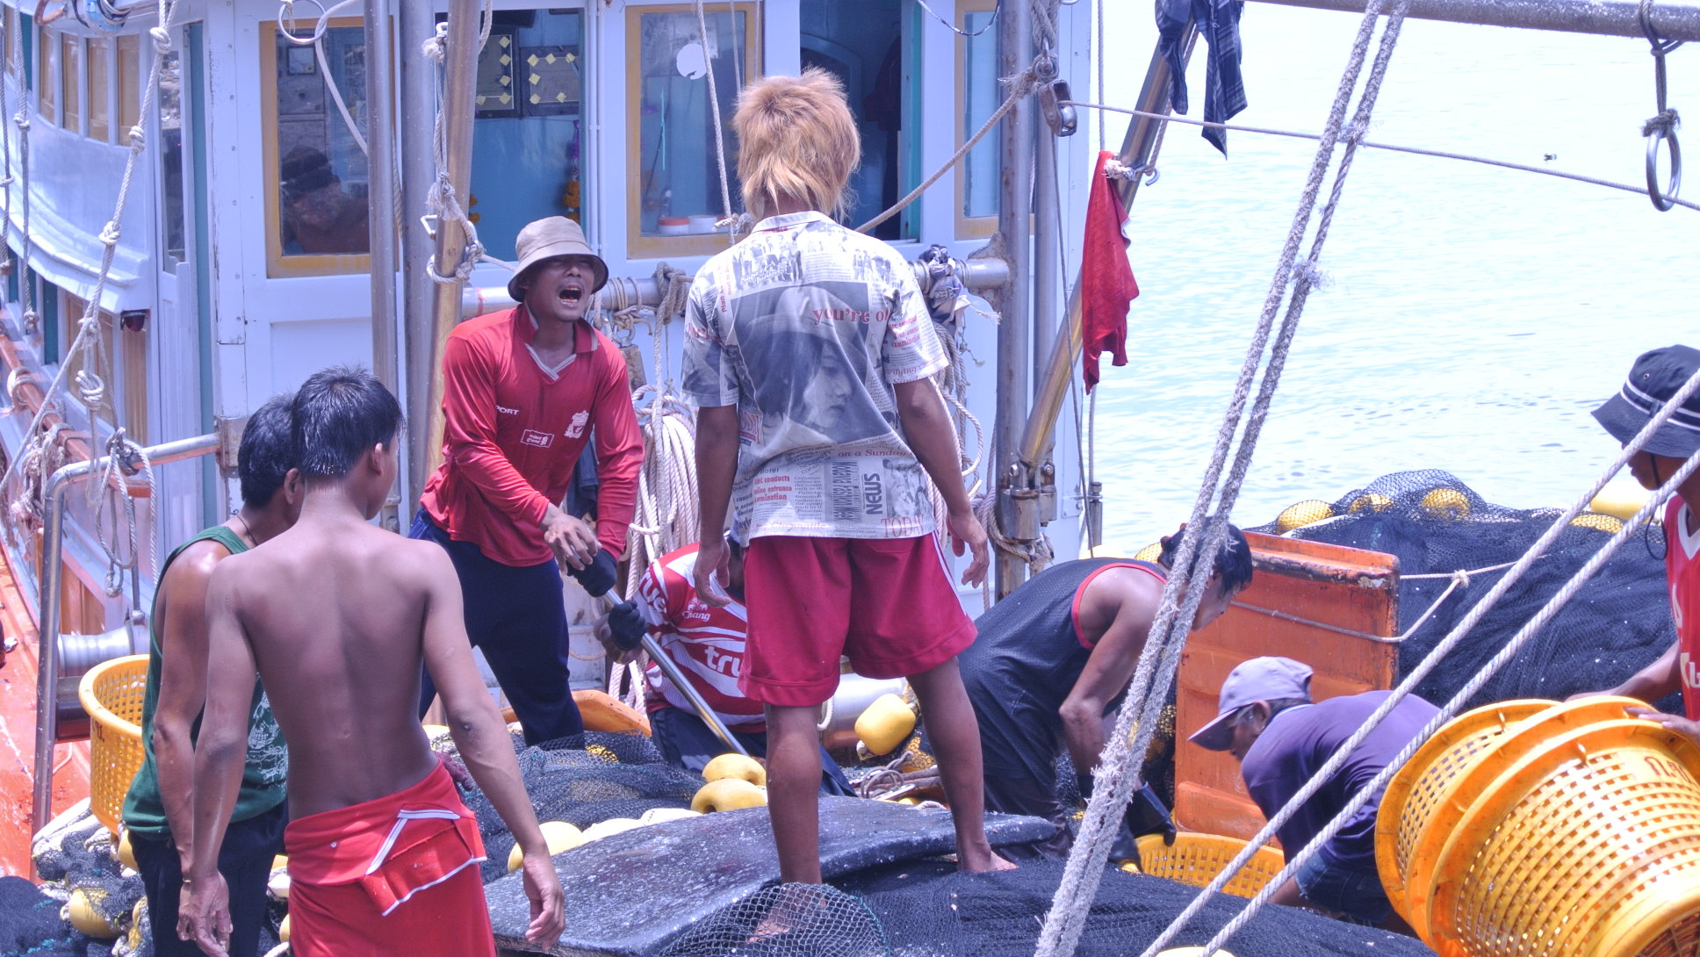
Pray for Migrant Workers in Malaysia
Heavenly Father, we pray for the migrant workers who have come to foreign lands to start a new life. We ask that You send Your children to help them adapt to the new social and cultural environment, guide them to find places to live, and provide supportive neighbors for them.
May the Lord help them understand how to interact with their employers, establishing appropriate self-esteem and confidence.
May the Lord Jesus Christ give vision and ability to the churches in Malaysia to become channels for the 5.7 million migrant workers to hear the Gospel. Help them understand the workers' true needs and humbly learn, acknowledge, and respect the cultures of the workers' home countries.
We pray that our church may have the wisdom and love to receive them, allowing them to feel through natural and comfortable interactions that
God is love and be willing to open their hearts to the Lord.
In the name of Jesus Christ, we pray, Amen!

Slide 8
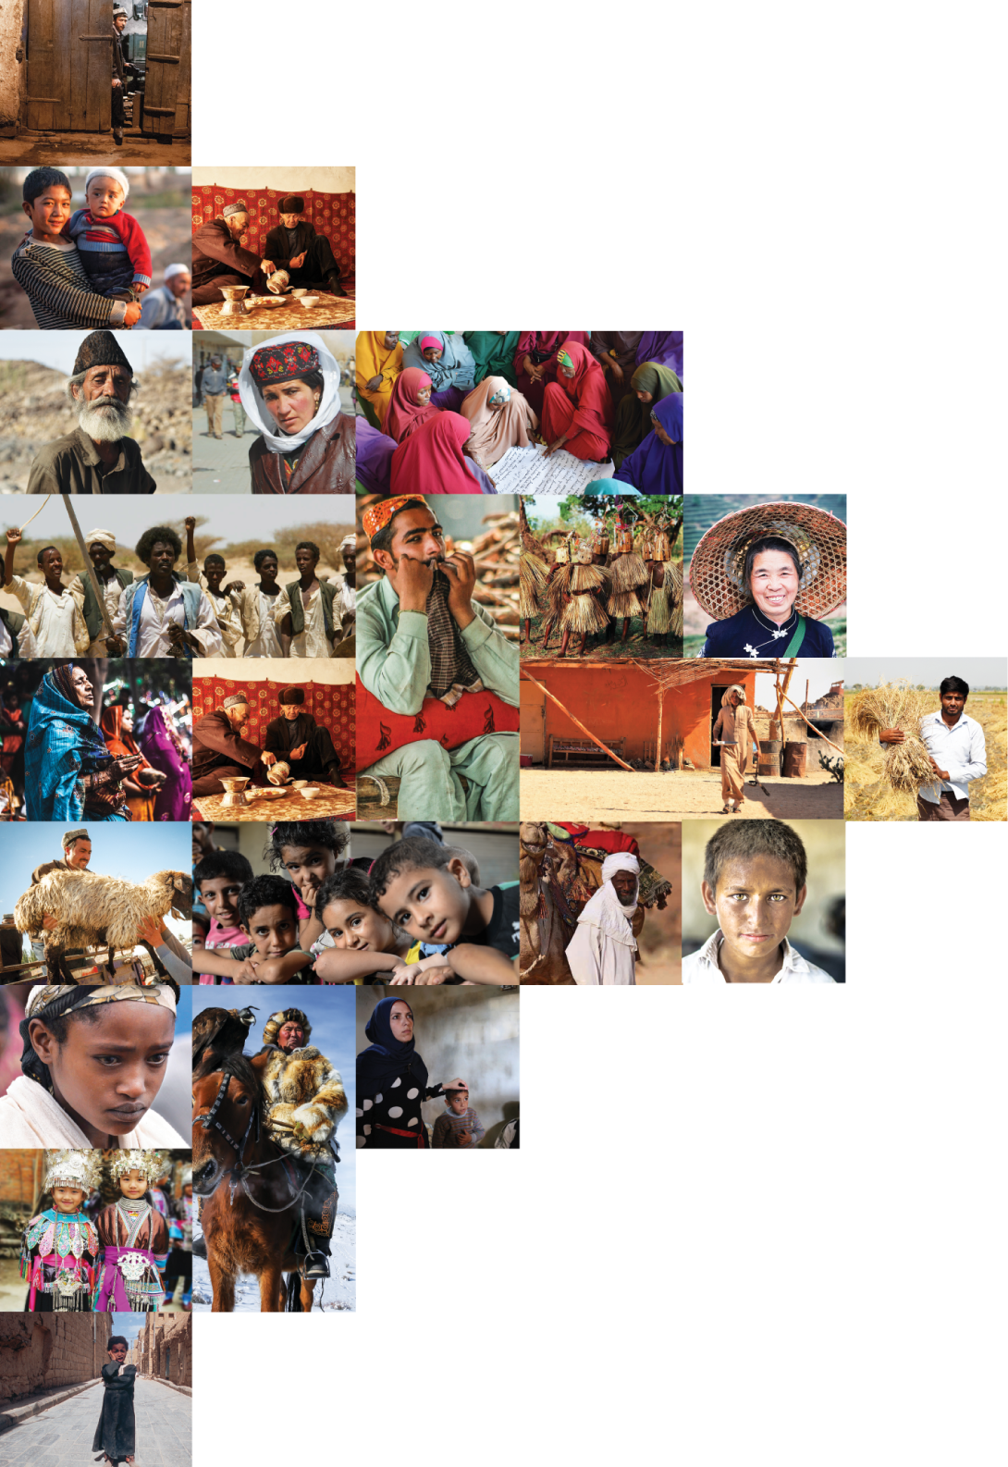
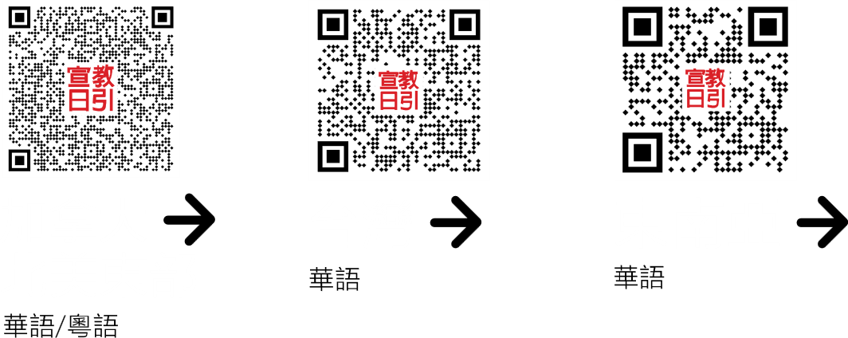
不再是個人的禱告，我們開始一起祈禱。 30分鐘，生活再忙碌的人都能找到時間參與。

