Slide 1
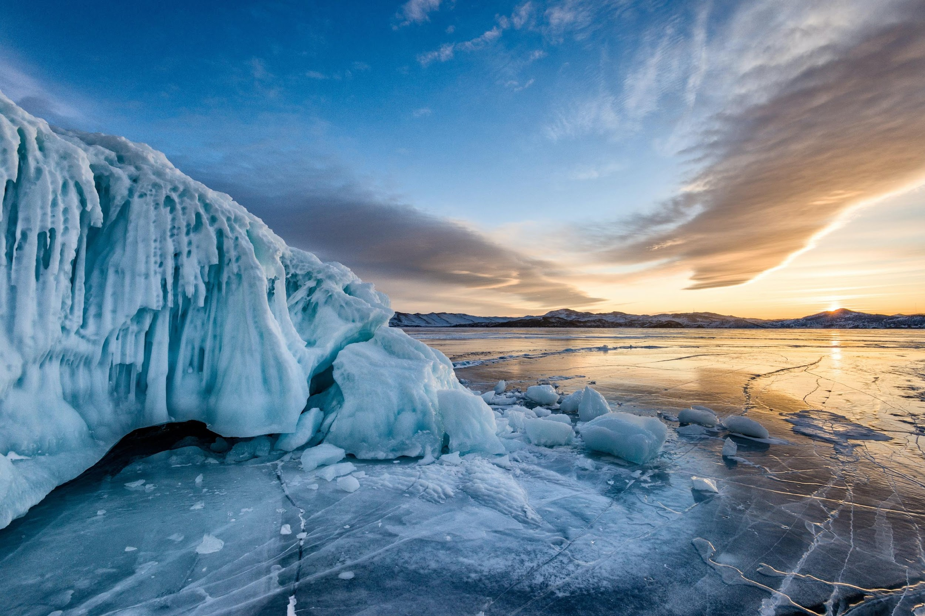
September 2023
Russia
Siberian Federation

Slide 2
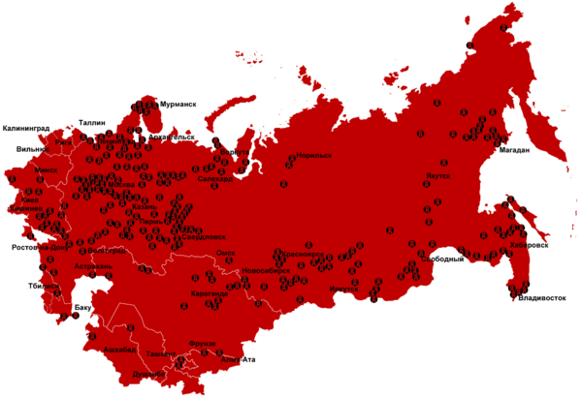
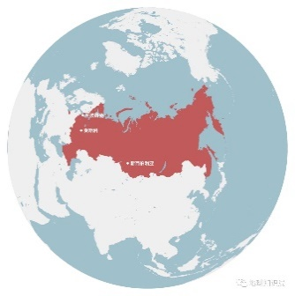
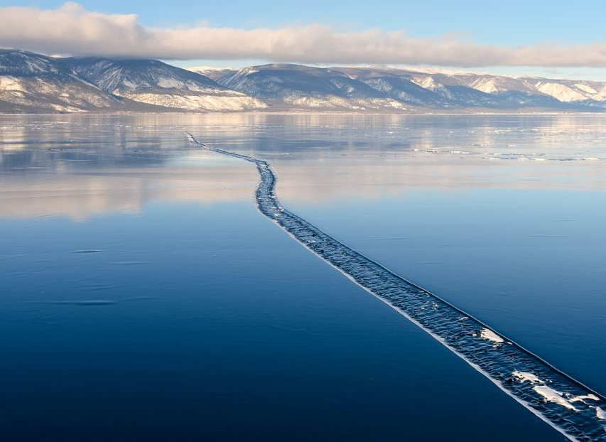
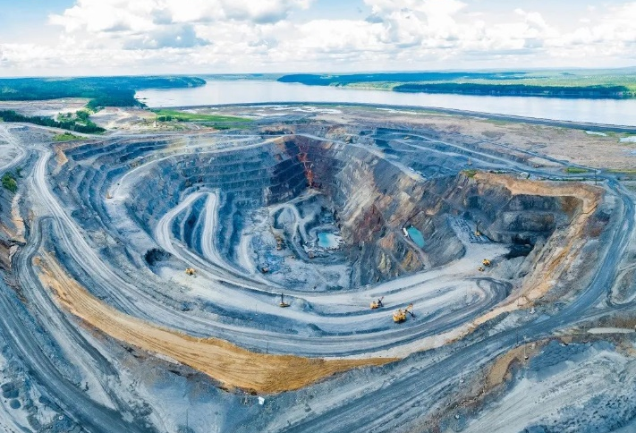
Siberia’s Top 7
Largest Area: 13.1 million sq. kilometers
Least Populated: 37 million
Coldest in Asia: -71°C
Largest Freshwater: Lake Baikal
Most abundant resources
Highest Percentage of Beautiful Women
Most Labor Camps
Lake Baikal
Mine field
Notes:
Siberia is part of Russia
Largest Single Region globally: 13.1 million square kilometers. (China is 9.6 million square kilometers)
Least Populated: Siberia has a total population of about 37 million, with a population density of 2.8 people per square kilometer. In comparison to the most densely populated region of Macau, which has a population density of 21,000 people per square kilometer, the difference is 7,500 times! This is due to its extremely cold climate.
Coldest in Asia: In 1964, the coldest temperature I Siberia was recorded at -71 degrees C. It is the coldest region in Asia.
Largest Freshwater Reservoir: Lake Baikal holds 20% of the world's freshwater resources, making it the largest freshwater lake on Earth.
Most Abundant Resources: Rich in minerals such as coal, iron ore, copper, nickel, tin, uranium, etc.. It also holds substantial reserves of oil and natural gas, which accounts for 85% of Russia's total resource reserves.
Highest Percentage of Beautiful Women: Many Siberians are descendants of mixed European and Asian ethnicities. Most women in Siberia are good looking. Siberia is located in the southeastern part of Russia and belongs to the Asian region of Russia. Throughout history, it has been ruled by Genghis Khan of the Mongols in the 14th century, colonized by Russian tsars in the 16th century, taken over by the Qing Dynasty of China in the 17th century after China defeated Mongols, and governed by Japan during the Sino-Japanese War.
Most Labor Camps: There has been a lot of Gulag, Soviet Union's well-known system of prisons and labor camps, in Siberia. (Red map: Distribution of Gulag concentration camps from 1923 to 1961.) At its peak, there were millions of prisoners. Siberia was a destination for forced labor and exile in the Soviet Union. https://en.wikipedia.org/wiki/Gulag

Slide 3
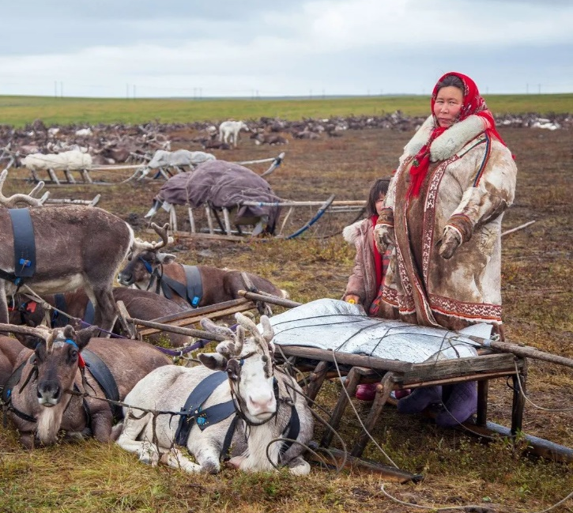
Challenges in Siberia
Abundant resources, yet cannot alleviate poverty
Forests and mountains are barriers for Education
Development and exploitation brought inconvenience without benefits
Tension between Ethnic Groups and the Kremlin
17 major ethnic groups, strong sense of autonomy of indigenous peoples in different regions
Yakuts not identifying with Russians
Popularity of Separatist ideology
Religion
Shamanism, Eastern Orthodoxy, Tibetan Buddhism, Christianity
The Nenets Pastures
Notes:
Challenges in Siberia：
Abundant resources yet failed to alleviate poverty
Siberia is the region with the richest natural resources in Russia. However, its development lags due to limited access to education.
Different ethnic groups residing in forests and mountains still predominantly use their own, rather than Russian, languages and traditions.
They are unable to receive Russian’s modern formal education.
The Siberian Federal District consists of four republics, three territories, and five regions. It holds 85% of Russia's natural resources. Nevertheless, local communities bear the burdens of development without reaping the benefits.
For instance, lead and platinum mining were sold to Europe, but the money was used to fund ammunition production.
All these led to a tense relationship between these ethnic groups and the Kremlin.
With a population of 37 million, Siberia is home to various ethnicities. There are 17 major ethnic groups, which are classified based on a population size of over 7,000. They include Russian, Tuvan, Yakut, Buryat, Tatar, Turkic, Shamanic, and other indigenous groups in different areas.
Since these ethnic groups have long survived in harsh living environment, they have developed a strong sense of independence and are accustomed to their own ways of doing things.
Additionally, the region historically has been an exile destination for dissidents, dissatisfied individuals, and ethnically marginalized groups from other parts of Russia.
These displaced persons, political prisoners, and criminals from different regions of Russia integrated with the locals and formed sub-groups in Siberia.
They welcome separatism, viewing autonomy or independence as an alternative route to get rich.
In recent years, declining living standards and business closures in Siberia led to an exodus of Russian ethnic elites. Together with the increase in population of indigenous ethnic groups because of their higher birth rates, separatist sentiments have risen.
Since the 1990s, Eastern Orthodoxy has become a symbol of aligning with Russian. The rising separatist consciousness among ethnic groups further led to exclusion of this Moscow-planted religion. Today, Shamanism and Tibetan Buddhism have become the primary religions in Siberia.

Slide 4
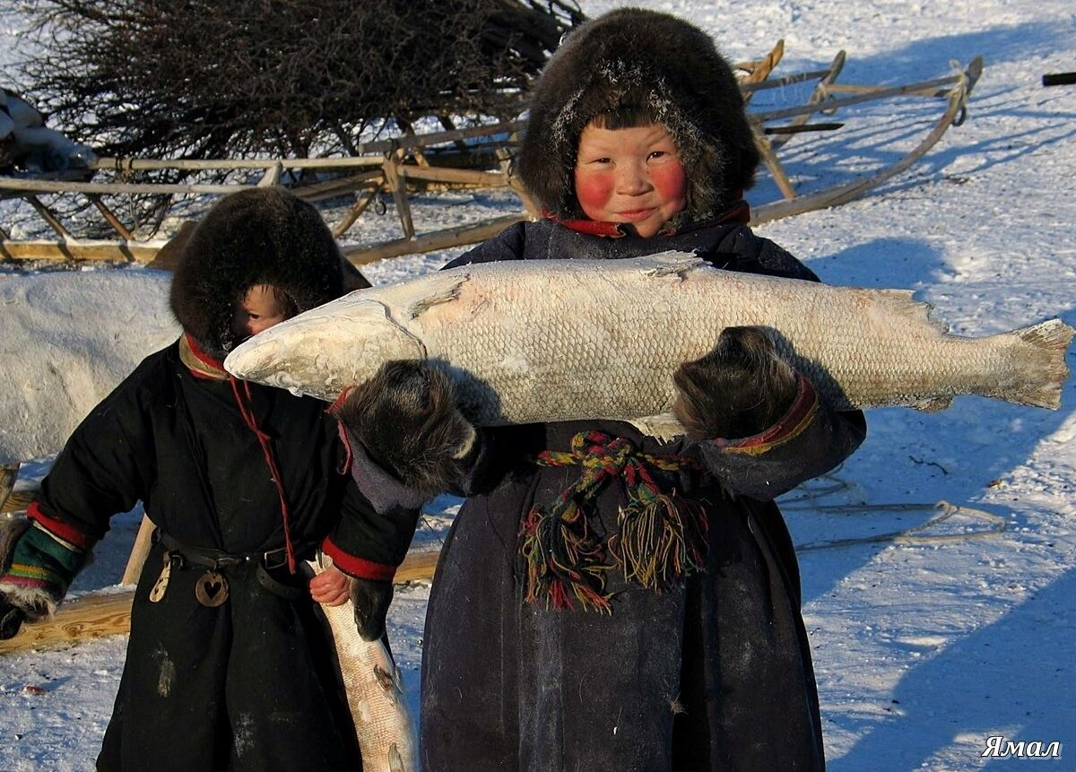
Let us pray for Siberia together

Slide 5
Dear Heavenly Father, please take care of the 37 million Siberians.
They live in a cold place of marked with suffering and death where millions of prisoners were once imprisoned.
May You bless this land of abundant resources. May the face of the Lord shine on these people, so that they can enjoy God’s grace in its various forms.
Thank you, Heavenly Father, for preserving the many indigenous peoples in Siberia.
May Your peace and hope be upon this vast land, that the lives of these ethnic groups can be improved, poverty can be lifted, and children can get good formal education.
May all ethnic groups maintain a harmonious relationship with the the Moscow government, reducing conflicts and distrusts.
May the government’s development projects benefit the people, providing them with sufficient infrastructure, medical services, and more employment opportunities.
Notes:
The prayer is divided into the regular and bold fonts. It can be recited in response format, rotating by brothers, sisters, and whole congregation.
Gentle Reminder:
1. During prayer, please avoid reading too quickly. Because for the congregation, it is their first time seeing this prayer.
When the leader reads too fast, the congregation might struggle to keep up. When they feel unable to keep up, they might choose to simply watch without participating, which would defeat the purpose of united vocal prayer.
Thank you for your leadership.
2. This PowerPoint can be edited. If the screens at your church are not large enough and the text on the PPT prayer slides appears too small, please divide the content of the prayer into multiple slides.

Slide 6
Dear Heavenly Father, we pray for the Christians in Siberia.
We ask that You remind them and assist them to share the gospel and their testimonies with their fellow countrymen, in season or out of season.
May the mighty power of the Holy Spirit touch people’s hearts so that they are willing to humbly listen to and respond to the calling of Your love.
For the various Siberian ethnic groups, if their misconceptions on Christianity was due to their perception that Eastern Orthodoxy was linked to politics, please remove that misunderstanding.
May each ethnic group have a Bible in their native language, so that they can directly connect to the truth and the Gospel,
Breaking free from the Shamanism witchcraft that has held them captive for centuries, becoming the sheep of the Lord, and enjoying peace and abundance in Christ.
May the Lord’s true light shine upon Siberia, allowing each ethnic group to worship and praise the Lord through their unique cultures, dances, and languages.
Deeply experiencing the Creator’s love, acceptance, and the value He sees in them.
In the name of Jesus Christ we pray, Amen!
Notes:
The prayer is divided into the regular and bold fonts. It can be recited in response format, rotating by brothers, sisters, and whole congregation.

Slide 7
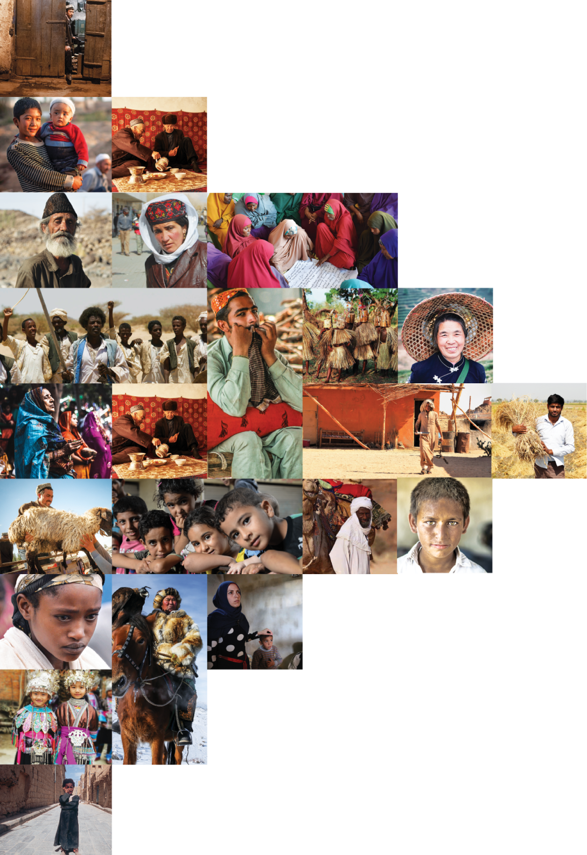
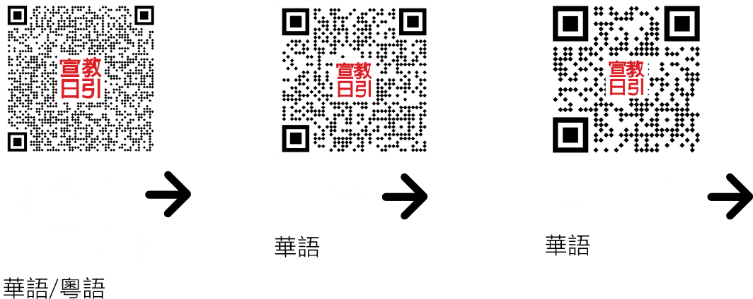
不再是个人的祷告，我们开始一起祈祷。 30分钟，生活再忙碌的人都能找到时间参与。

