Slide 1
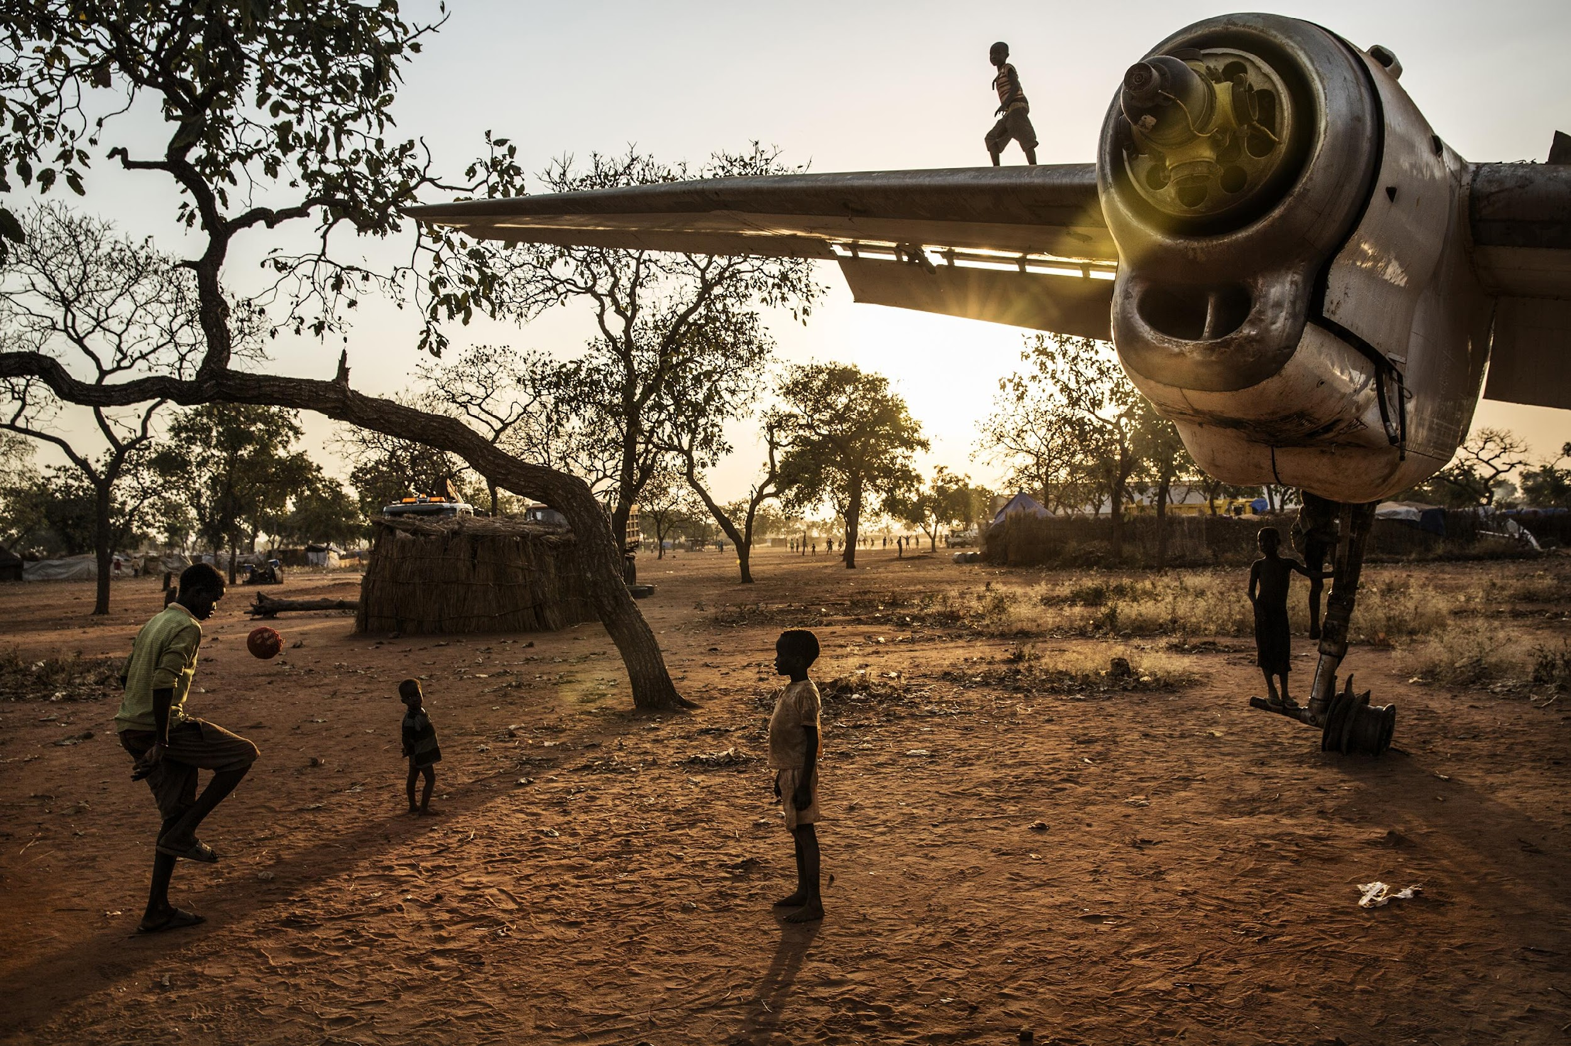
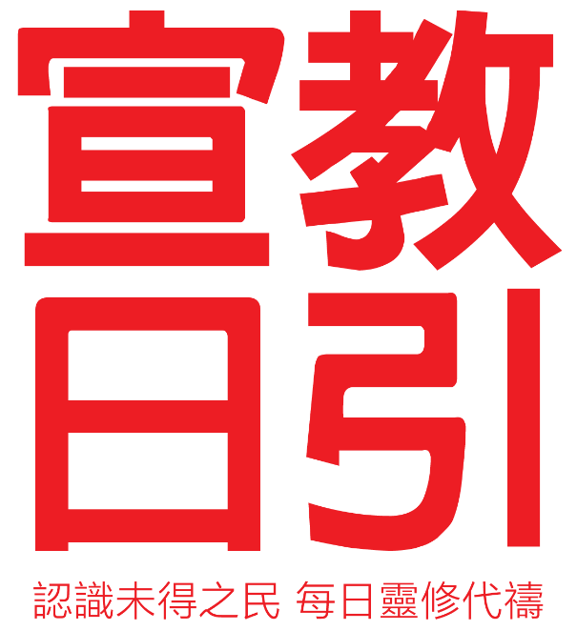
October 2023
Bible Translation

Slide 2
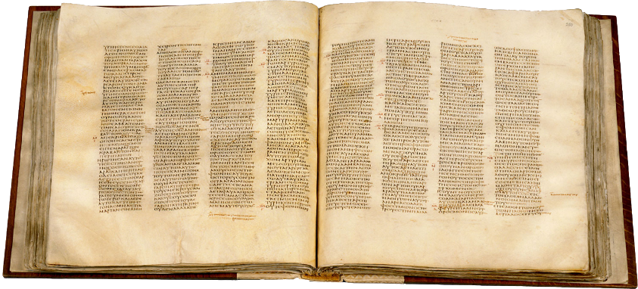
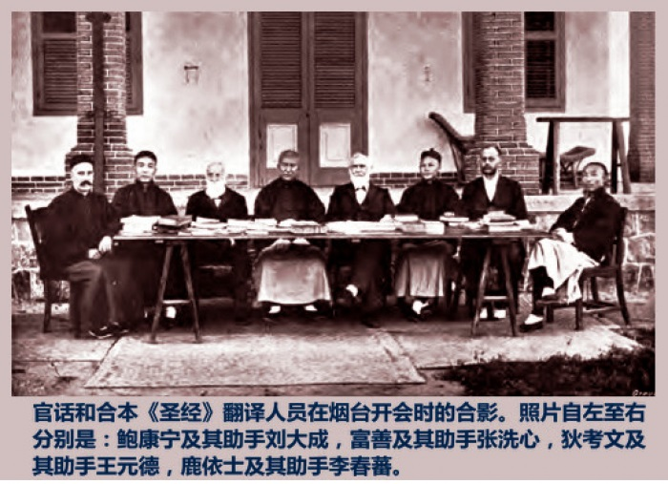
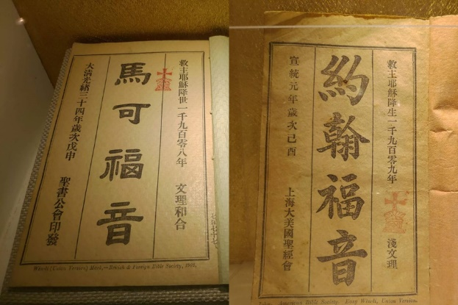
History of
Bible Translation
Septuagint - 200BC Hebrew - Greek
Vulgate (Latin Vulgate) - 400AD Greek - Latin
King James Bible - 14th century Latin – English
Chinese Union Version Bible - 1919
Notes:
Chinese Union Version Bible
In 1919, led by the missionaries in China in cooperation with Chinese believers, the content of the Bible was translated into modern Chinese, rather than classical Chinese.
The purpose was to make the teachings and messages of the Bible easier to be understood and communicated to the Chinese.
The name of the “Union Version” came from a Hebrew word and an original Greek phrase that meant "reconciliation" or ”united," emphasizing its goal to maintain a truthful translation of the original text of the Bible. The Chinese Union Version of the Bible played an important role in the development of the Chinese vernacular.
Photo of Translators of the Union Version
The Septuagint Translation
The Jews lost to Babylon and were exiled. Babylon was later conquered by Persia.
During the Persian rule, some of the Jews returned to the land of Judah.
Later, Persia was conquered by the Hellenistic Empire of Alexander the Great. The Jews who remained in Hellenized Persia were not familiar with the Old Testament, which was written in Hebrew.
Therefore, in the 2nd century BC, 72 Jewish scholars translated the Bible from Hebrew into Greek, the common language of the time. This translation is known as the Septuagint.
The New Testament was also written in Greek.
The Vulgate that influenced the Latin world
About six hundred years after the Septuagint, the lingua franca of the Western Roman world had switched from Greek to Latin.
The Vulgate (Latin Vulgar Version) translation was produced in response to the times, fulfilling the need to share the faith in a new linguistic environment while influencing the church's history for over a thousand years thereafter..
Wycliffe English Bible Translation
At the end of the 14th century, British theologian John Wycliffe translated the Bible from Latin into English, the King James Version, making it easier for countries in the English-speaking world to understand and interpret the Bible.

Slide 3
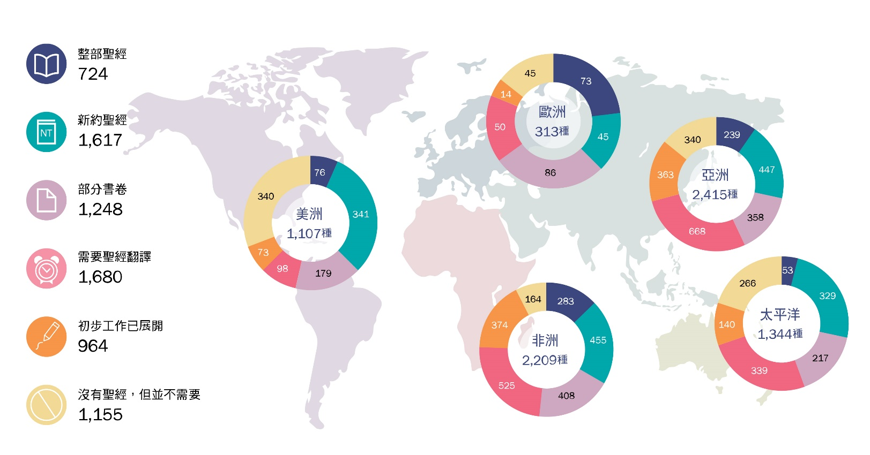
Current Status of Bible Translation
Global Languages 7,388
The whole Bible 724
New Testament 1,617
Some Books/Scripture 1,248
In need of translation 1,680
Preliminary work has begun
964
1,680 language groups, 200 million people without a Bible in native language
Mostly in Central Africa, Southeast Asia, and the Pacific Islands.
Notes:
The Current Status of Bible Translation
Globally, there are approximately 7,388 different languages.
The entire Bible has been translated into only about 10%, or 724, of these languages.
There are still over 1.4 billion people worldwide who do not have the complete Bible translated into their native languages.
These people are mostly in Central Africa, Southeast Asia, and the Pacific Islands.
The Wycliffe International Alliance estimated that as of the end of 2022, there were still 1,700 language groups, nearly 200 million people, who did not have any portion of the Bible in their native languages. Many of these language groups are ethnic minorities.
Some language groups may have a significant population but live in inaccessible areas. They also need to hear the Gospel in their own language.

Slide 4
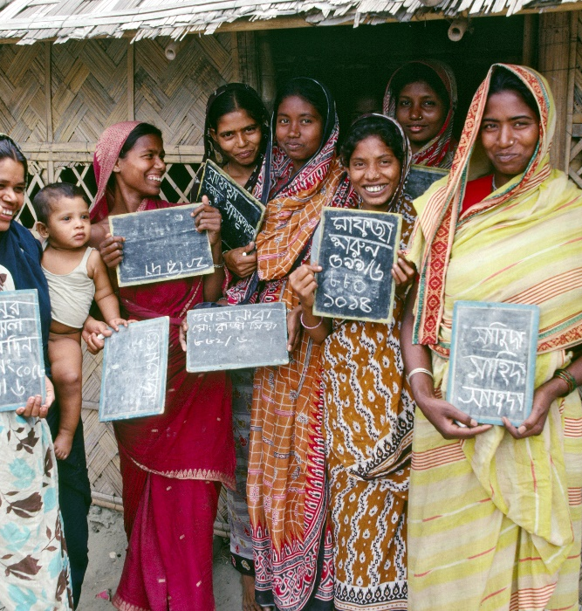
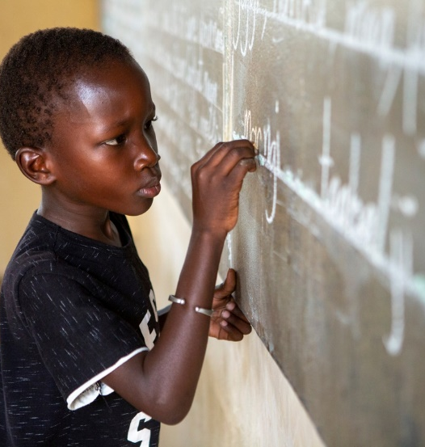
Initiating Bible Translation
Reach out and communicate: Vanguard team to search for contacts
Enter the area: To establish a support system
Writing system: To design alphabets, compile dictionaries, create literacy materials, health pamphlets, folk stories, native language Bible.
Key Individuals: Bible translation missionaries, native speakers, support staff, Bible translation consultants
Notes:
Contact and communication: The vanguard team to search for communication contacts
Many language groups in need of Bible translation live in remote and rugged areas that are challenging to reach. Some live in places that are extremely unfriendly to the Christian faith politically, religiously, and/or culturally. Extra caution would be needed for these situations to ensure safety of the workers and the ministries. To initiate Bible translation, a very critical point is to have language surveyors as the first team to boldly venture in, such as trekking dangerous routes and/or overcoming spiritual world, etc., and look for contacts who are easy to communicate with and willing to help. Currently, there is a severe shortage of language surveyors. We pray to the Lord to call upon the right people to join the team!
Enter the area: Establish support systems
Once relationship has been established, Bible translation missionaries would prepare to go into the language group. If the area is remote, then it will be essential to have a support team to prepare for the Bible translators. This may involve tasks such as building clean water collection systems in villages, constructing housing for translators, setting up regional offices, installing communication infrastructure and power networks, renovating and maintaining facilities, repairing generators, or even designing and laying new airstrips—requiring various specialized technical collaborators. Before the pandemic, there had been up to 1.6 million Christians from US volunteering in various remote areas for these short-term services, allowing the Bible translators to have more time to translate the words of God.
Writing System
Next is to design a set of letters and a writing system for the language group. This is followed by compiling dictionaries, creating health pamphlets, developing literacy education materials, preserving folk stories, and eventually producing a Bible in their mother tongue.
Most of the ethnic groups that needed Bible in their native languages are minorities. They reside in developing countries and mostly ranked the lowest social-economically in their country, 98% illiterate. Because of that, the missionaries also needed to develop educational materials and train literacy teachers. (Presenter can decide to use the following information or not: 2/3 of the illiterate globally are women. Some missionaries would teach them to read and train them to be teachers! As they awkwardly picked up the chalk to write on the board, they faces glowed. At that very moment, not only were they able to be teachers, but they also began to teach their children anytime. Developing in parallel literacy education and Bible translation is the most ideal situation. Widespread literacy encourages more people to engage with the translated Bible effectively, allowing the native language Bible to effectively transform people's lives.
Key Individuals
Besides Bible translation missionaries and the support personnel, another group of critical players is the native language workers. The native language translators are not necessarily Christians. They could be hired for their education, bilingual abilities, and training in translation principles and techniques. But personally, they do not know God.
Furthermore, every Bible translation must undergo guidance and rigorous scrutiny from translation consultants. These consultants are experts in Biblical Hebrew or Greek with extensive backgrounds and experience in Bible translation. They work closely with translators, discussing and dissecting the translation passage by passage, sharing insights on handling challenging passages, and providing comprehensive feedback on various aspects of the manuscript. However, there is a severe shortage of consultants, and the pace of reviewing translations is falling behind the rate of translations that are being completed.

Slide 5
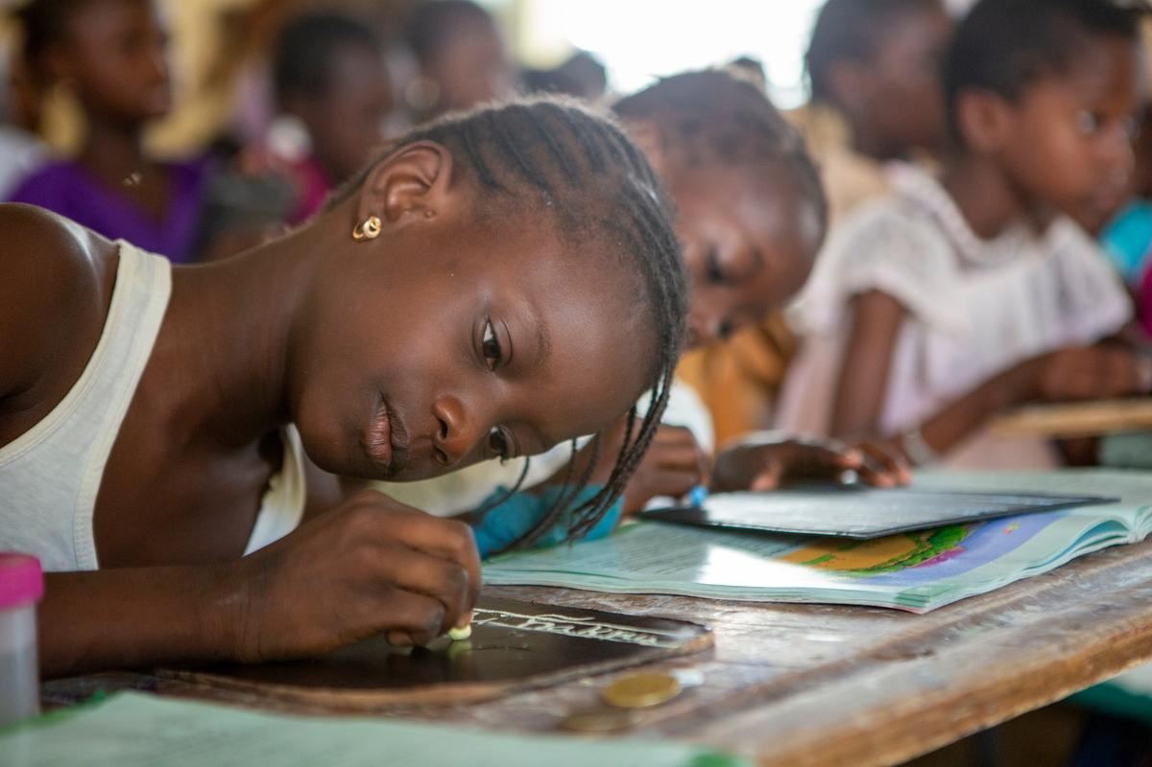
Let us pray together for Bible Translation

Slide 6
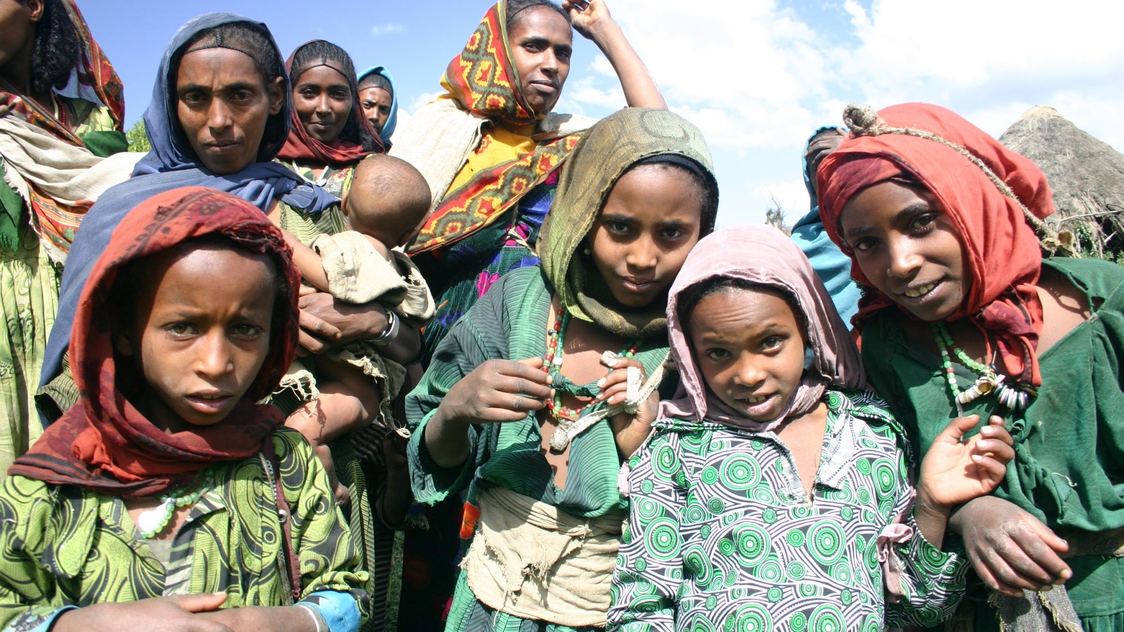
Dear Jesus Christ, thank you for becoming flesh and dwelling among humanity, revealing God to us in a language form that we can understand.
Lord, right now 90% of the native language groups still do not have a complete Bible in their own language. May the Lord raise up Your workers who are gifted in languages and with unwavering dedication facing hardship. Please send them out and help them obtain visas so that they can stay longer in the places they serve, enabling them to learn the local language and culture, earning trust and support from the local government, and being loved by the local people.
May the Almighty God move the hearts of various technical professionals to become the support team members and provide resources and equipment for the Bible translation work.

Slide 7
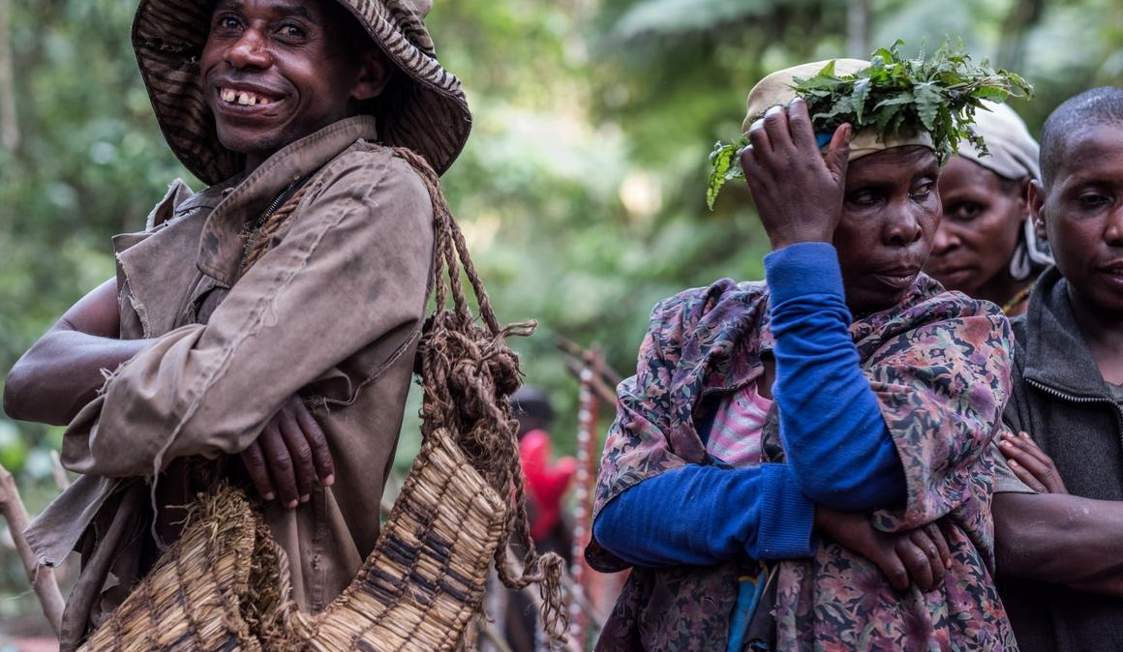
Heavenly Father, we pray for the 6,000 Wycliffe Bible translation workers worldwide. Many of them live in sensitive areas and are in isolated situation.
May they experience presence, protection,
and encouragement of Lord all the time.
Please grant them safety when visiting villages,
efficiency when collecting information, and wisdom in project planning.
We pray that during the translation process, they will be enlightened and inspired, being able to capture the meaning and essence of the Lord’s Words and use the most suitable words and syntaxes to translate the Bible.
Dear God, may Your words transform the lives and cultures of
these language groups so that they can receive
the hope and abundance of God’s kingdom.

Slide 8
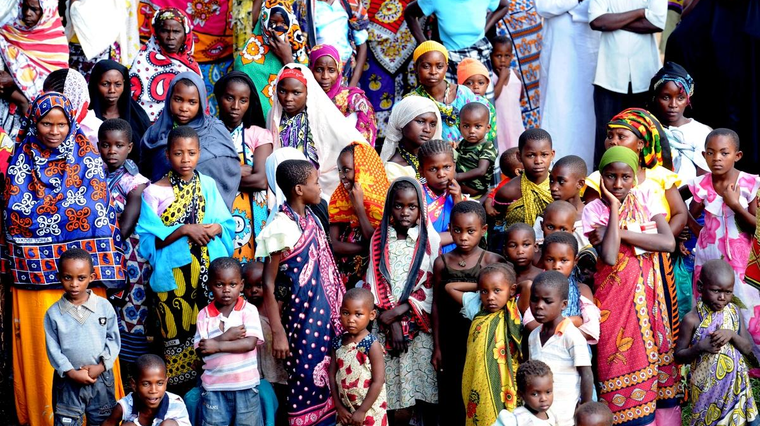
Lord, many translated Bible scriptures lack translation consultants.
May the Lord draw experts in the original texts of the Bible
to join this ministry.
We pray in unity for the local translators.
Most of them are yet to be Christians.
Father God, please protect and bless them to be guided by the Spirit of Truth, so that both themselves and their families will be drawn to Your words, to come to know Jesus Christ, to receive the grace of salvation, and to experience joy and peace.
Heavenly Father, may Your name be exalted among these language groups, may Your Kingdom come.
In the name of Jesus Christ. Amen.

Slide 9
