Slide 1
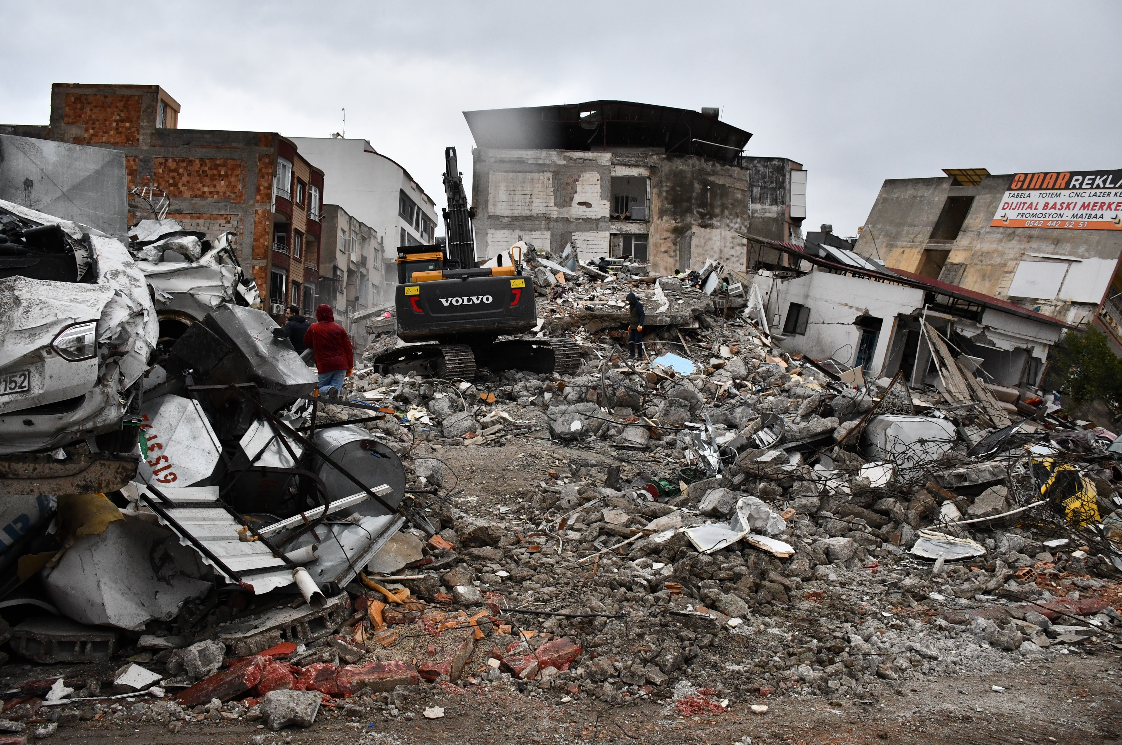
November 2023
Countries in Humanitarian Crisis
Notes:
In the months of November and December of 2023, Crossroad’s Mission Path pray for 7 countries that are in urgent humanitarian crisis, understanding the various vulnerabilities and acute suffering that they are facing and the hidden root causes. Please prepare to be in a praying heart.

Slide 2
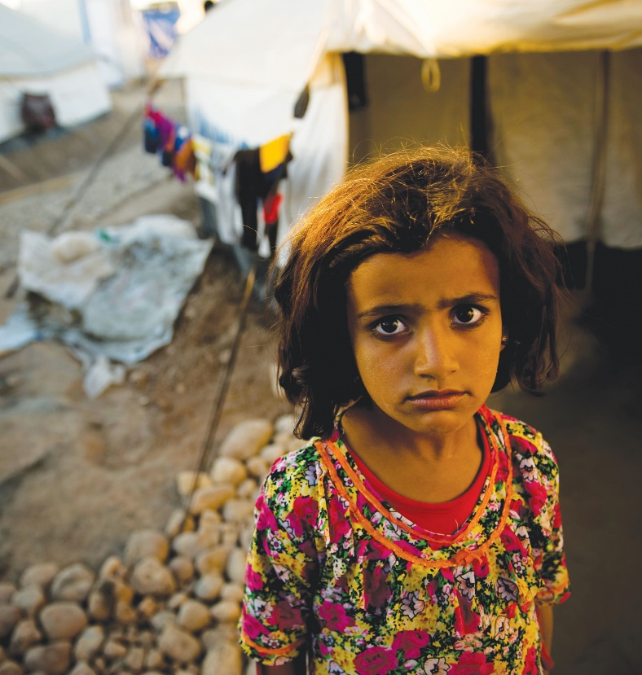
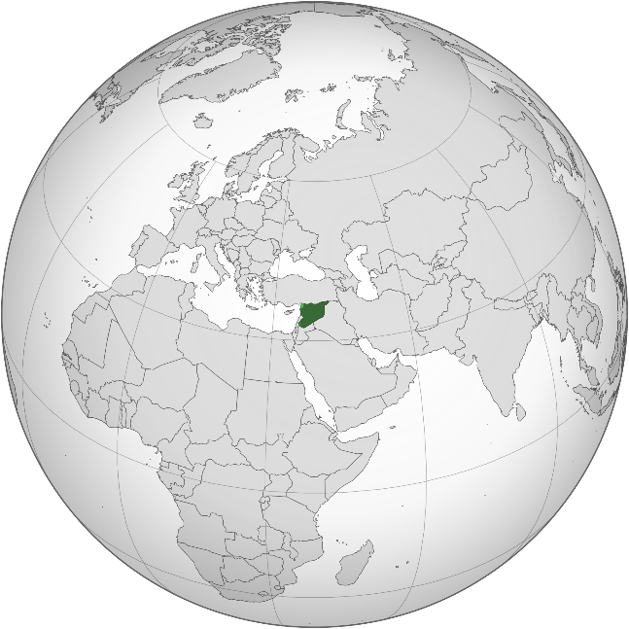
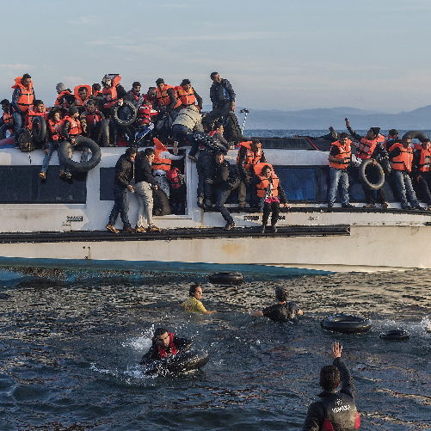
Syria -
Coexistence of the Living and the Dead
Population: 17 million (2011: 22.5 million)
Over 1 million school-age children out of school
Lack of clean drinking water leading to cholera outbreaks
730,000 people living in areas contaminated by landmines
8.8 million refugees displaced in Syria
In neighboring Turkey, children aged 5-12 are forced to work as child laborers, working up to 9-12 hours a day.
Notes:
Syria is the ancient land of Aram mentioned in the Old Testament. During the Tang Dynasty, the Syrian Church sent Bishop Alopen to China and established Nestorian Christianity.
Today, this ancient civilization has fallen into severe inflation crisis due to successive years of droughts and global financial crisis, leading to widespread public discontent. During the Arab Spring in 2011, protests broke in Syria.
The newly appointed President, Bashar al-Assad, suppressed the demonstrators with force, imprisoning tens of thousands of protesters in what has been described as one of the most inhumane and torturous prisons in the world. Mass killings, torturing, and chemical attacks on civilians coupled with sieges causing famine in besieged areas resulted in 15.3 million people losing their homes. Six and a half million had fled Syria, and over two million were children. They faced malnutrition and death. Many boys at the age of 12 were sent to war as soldiers. Syria remains under U.S. sanctions to this day.
Let us pray together for Syria.

Slide 3
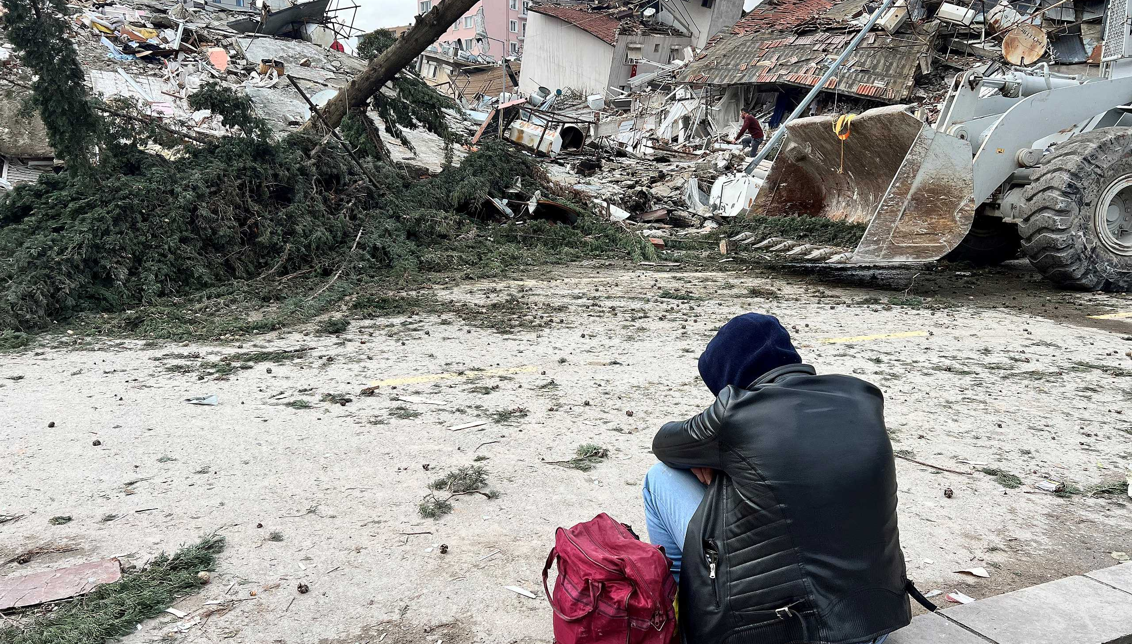
Pray for Syria
Heavenly Father, may Your love and mercy be revealed in Syria,
providing them with adequate food, water, and medical resources.
Lord, may You command and bring an end to the forces of darkness,
change the government's stance, and bring relief from oppression,
allowing the people of Syria to live in peace.
May the Syrian government rebuild infrastructure and clear landmines
to protect the citizens from harm.
Please protect the injured with timely treatment and prosthetics needed.
We pray for the care of the one million out-of-school children.
We ask the Lord to strengthen all Syrian churches to transcend conflict
and become the light and salt for the Lord.
May our Lord send missionaries with educational and medical expertise to Syria, becoming a source of help for the local people.
In the name of our Lord Jesus Christ, we pray. Amen.

Slide 4
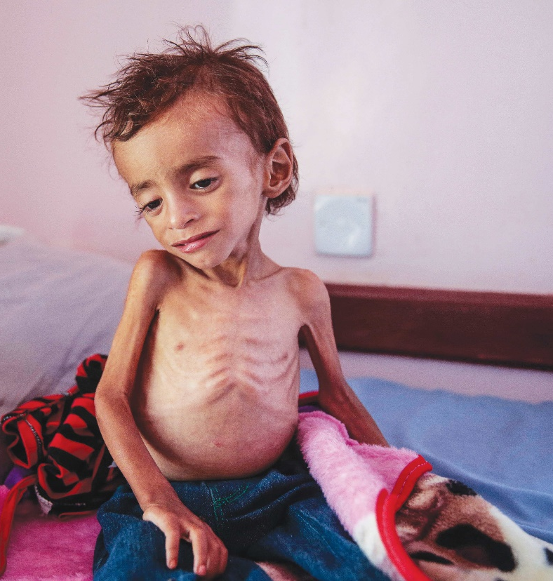
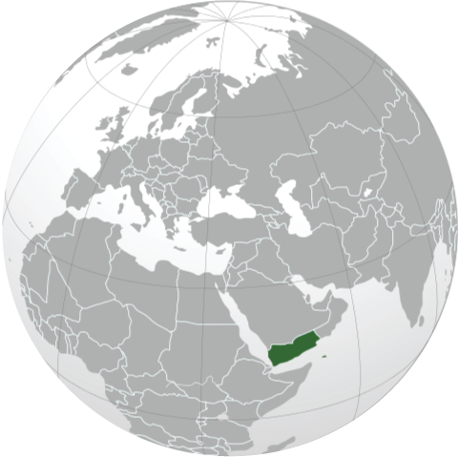
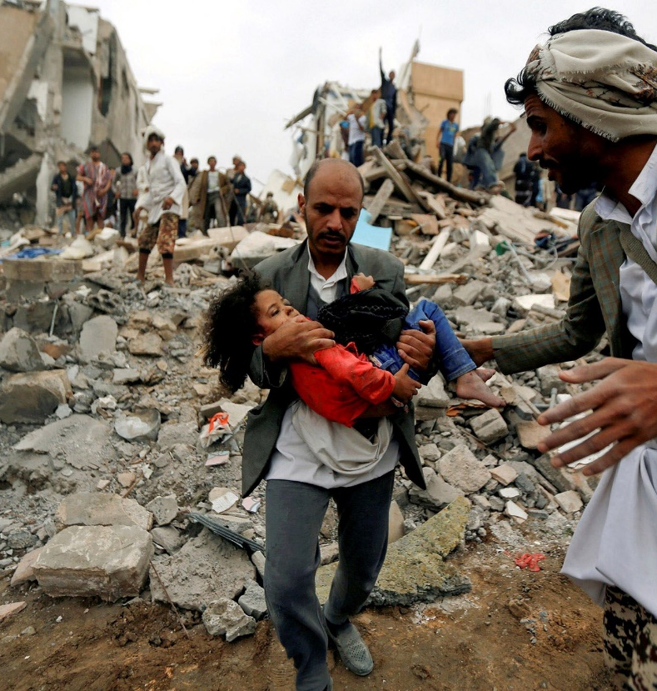
Yemen The Forgotten Corner of the World
Population: 30 million, one of the poorest countries in the Middle East.
In 2015, the Shia Houthi rebels backed Iran and the Sunni government supported by Saudi Arabia went into conflicts - A proxy war between the Powers of the Middle East and Muslim sects
380,000 Yemenis had lost their lives (70% were children under the age of 5)
24.1 million people in starvation. Children and pregnant women experienced extreme malnutrition, along with widespread diseases and a significant displaced population.
280,000 refugees from African countries in very harsh conditions
The third most oppressed country in the world for religious freedom violations, yet miraculously, the Gospel thrived.
Notes:
The kingdom of Sheba from the Old Testament was located in today’s southern Yemen. In recent times, Yemen was divided into North and South.
South Yemen is where the Bin Laden family resided. Shia rebel forces is in North Yemen.
Despite the declaration of unification in 1990, separatism was rampant. 1/3 of the population has been suffering from chronic food shortages and hunger,
In 2011, following the waves the Arab Spring, Yemen experienced anti-government protests and the president stepped down.
Three years later, in 2015, the Houthi Rebel group, a Shia militia supported by Iran, launched a coup.
A coalition of Sunni nations, led by Saudi Arabia, began continuous airstrikes against the Houthi armed forces, a conflict that continues to this day.
Civilians have been the hardest-hit group. It’s estimated that 80% of the population (around 24.1 million people) is in urgent need of humanitarian aid.
4.5 million people fled their homes. Apart from the way overcrowded refugee camps, Yemen has also been frequently hit by heavy rain, resulting in and the spread of cholera. However, only 51% of Yemen’s medical facilities are functioning properly.
In March 2023, with mediation from China, Saudi Arabia and Iran resumed diplomatic relations, offering a glimmer of hope for peace in the Yemeni civil war.
Let us pray together for Yemen.
https://www.unhcr.org/hk/yemen-emergency#:~:text=

Slide 5
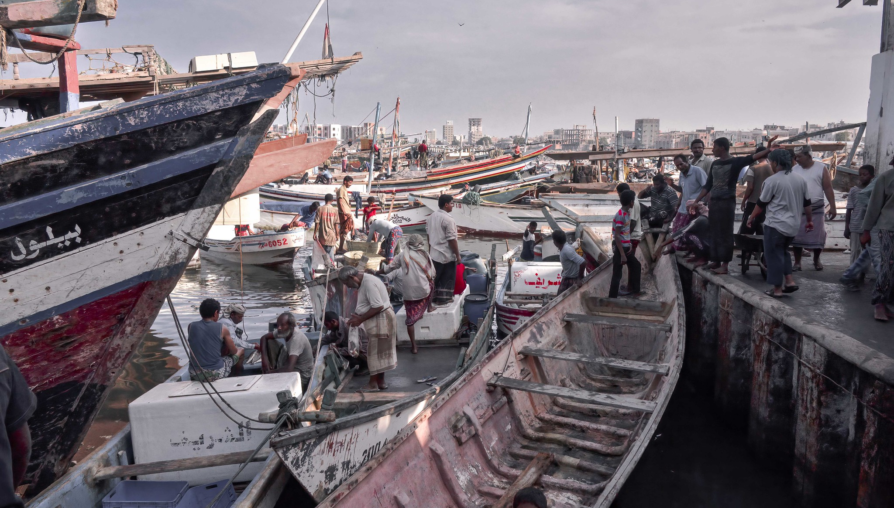
Pray for Yemen
Father God, we pray for Your abundant grace upon Yemen.
Please cease the armed conflicts among the religious groups.
Please heal the land, provide food, protect women and children from exploitation and trafficking, and provide medical care to the sick.
Heavenly Father, please help the persecuted Christians in Yemen,
extend Your righteous right hand to support, guide, and comfort them.
May the Holy Spirit touch the Yemeni government to treat the African refugees in their territory with kindness.
Please prepare other nations to be willing to receive these refugees.
In the name of our Lord Jesus Christ, we pray. Amen.

Slide 6
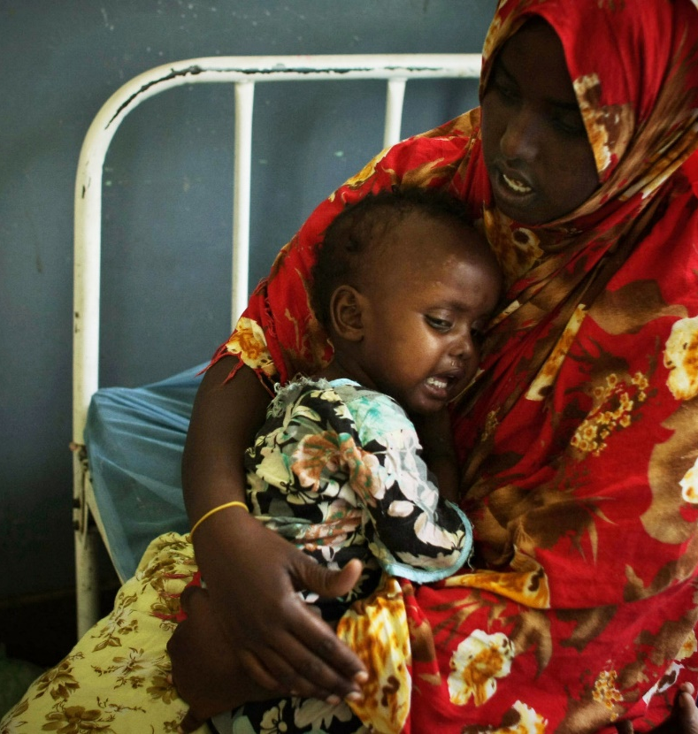
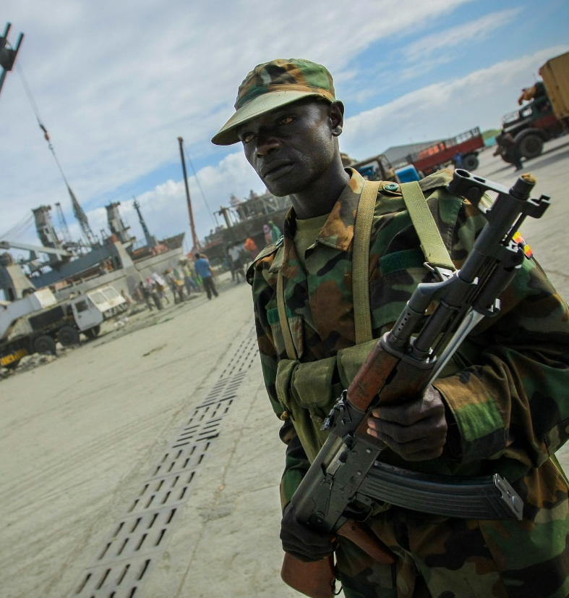
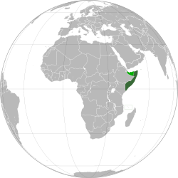
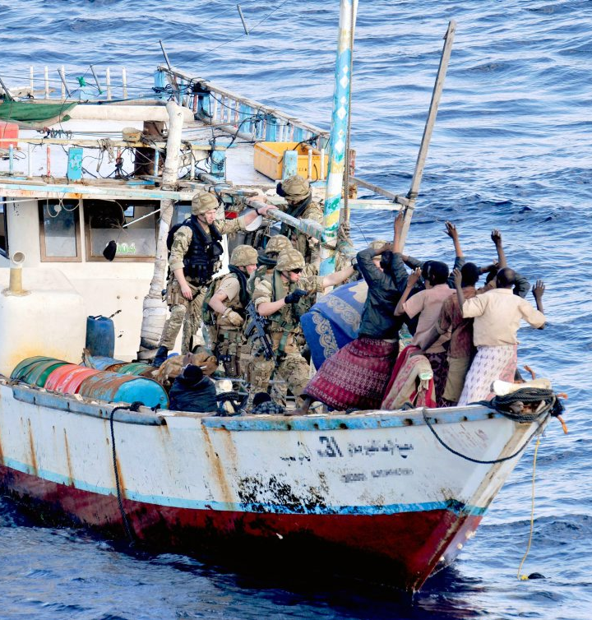
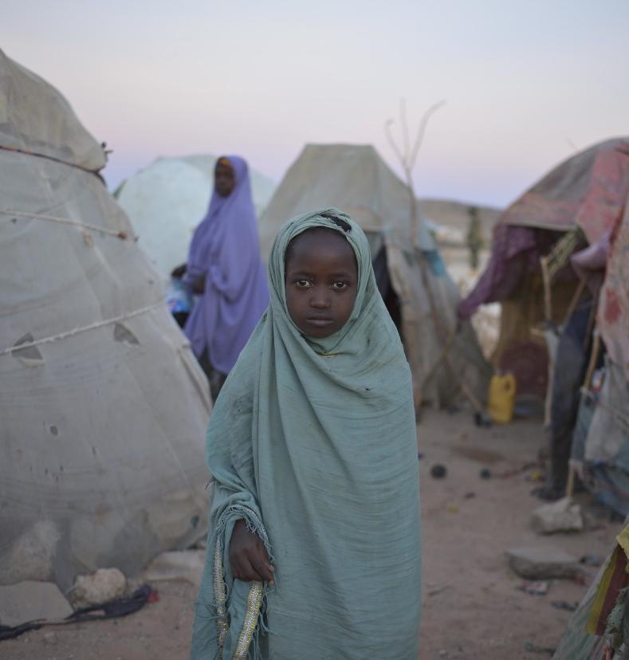
Somalia
The Pirate kingdom trapped in the Desert
Population: 15.2 million
Existential crisis
Piracy issues
Terrorism
Extreme hatred against Christianity
Notes:
Somalia is a country with a diverse population and multiple clans. There has been a lot of conflicts among these clans due to resource, land, and political power disputes.
In the early 1990s, Somalia experienced economic collapse and social unrest, becoming a breeding ground for international terrorist groups. Al-Shabaab, the Islamist extremist terrorist group associated with al-Qaeda, frequently targeted civilians and damaged public infrastructure, bridges, schools, and numerous wells.
Besides deliberately poisoning a well in the Hiran region during severe drought when people were already struggling to survive, Al-Shabaab also destroyed part of the Shebelle River's banks and houses, making the communication tower dysfunctional, and damaged 11 schools. It also frequently carries out terrorist attacks in the Horn of Africa, causing concern in the international community.
Somalia ranks second in the most severe country in the persecution of Christians, only next to North Korea. They openly encourage the people to oppose Christianity. The extremist group Al-Shabaab has repeatedly expressed its intention to eradicate all Christians in the country. Anyone discovered to be a Christian is immediately subject to execution.
Due to the lack of a strong and centralized government, the waters near Somalia have become not only a haven for illegal fishing, depleting fisheries resources, but also a free dumping ground for industrial waste. This has resulted in various diseases among coastal residents, such as infections, abdominal bleeding, and abnormal skin rashes. In order to protect their interests, fishermen armed themselves, laying the groundwork for Somali piracy. This piracy posed a significant threat to international shipping and maritime trade. In recent years, under the strict crackdowns by various countries, Somali pirates have shifted towards engaging in transnational criminal activities like human trafficking and drug trade.
In the past 12 years, Somalia has been plagued by persistent drought. In 2011 alone, this drought resulted in the deaths of over 200,000 people due to starvation. Millions of livestock also died. The drought continues unabated to this day. Currently, over 7 million people are facing severe food shortages. 1.5 million children under the age of five are suffering from severe malnutrition.
People fled to the urban areas to seek survival due to the drought. A mother lost all her four children because of starvation along the way. In a hospital in Somalia, 24 children died from hunger in only 2 months.
Without timely treatment, 386,000 people will be at risk of losing their lives. In 2022, due to the Russia-Ukraine conflict, a significant amount of humanitarian aid donations was directed towards Ukraine. Somalia has only managed to raise 30% of the required funds for relief efforts.
Let us pray in unity for Somalia.

Slide 7
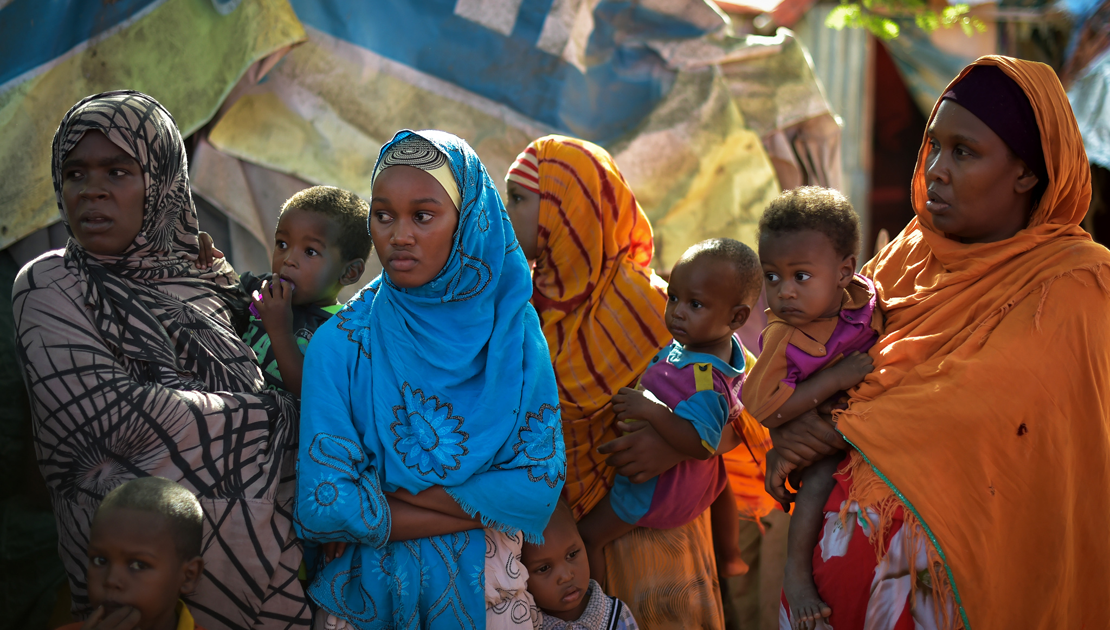
Pray for Somalia
Dear Heavenly Father, we join our hearts and voices in prayer for Somalia.
Ignorance, violence, famine, and terrorism have run rampant in this land,
even giving rise to international piracy, making the country to be a target of despise.
However, we know that You still love the Somalians.
Please break the power of terrorist groups
and dismantle the manipulation and schemes of religious leaders.
You are the Shepherd for the people of Somalia.
May the Lord grant them abundant rain, so that the adults and children alike lack nothing.
Please protect them from falling into sins of human trafficking, drug, and becoming pirates.
Lord, please protect and comfort the several hundred Christians in Somalia.
When they face loneliness and persecution, Your presence and peace be with them.
We pray in the name of our Lord Jesus Christ. Amen.

Slide 8
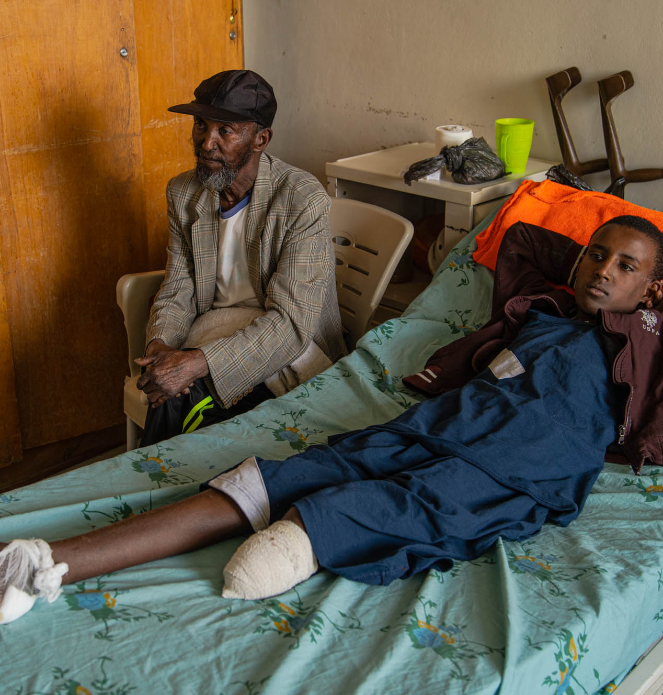
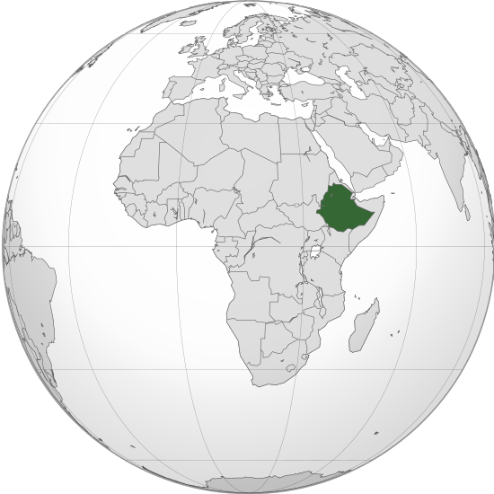
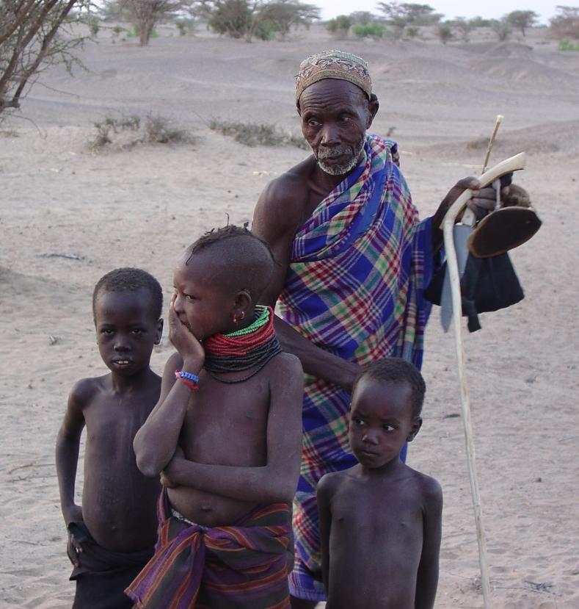
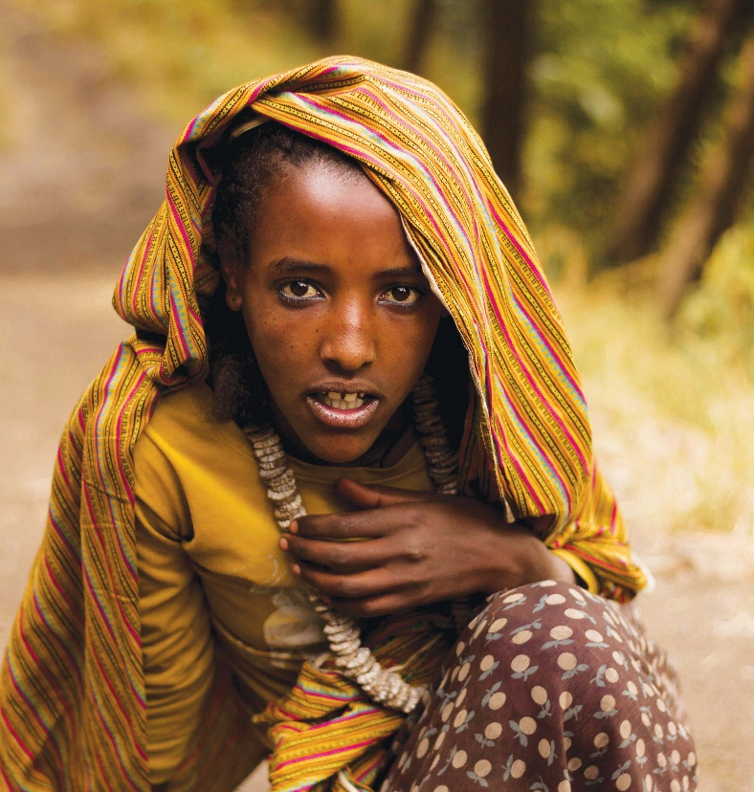
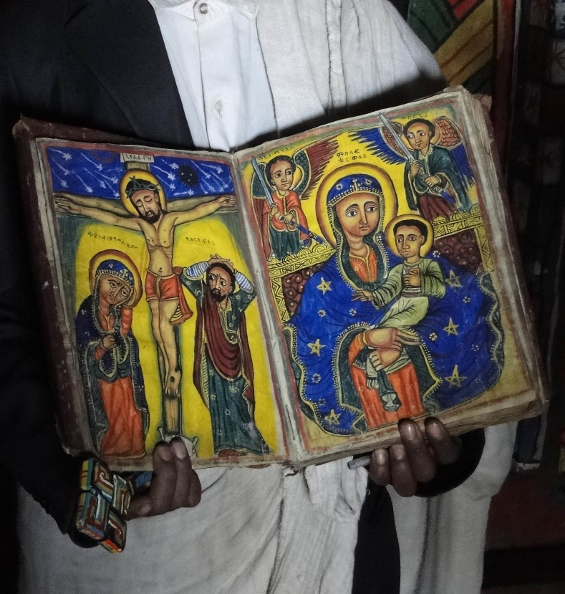
Ethiopia
The Christ Body Suffering in Africa
Population: 110 million
350,000 facing food shortages in Tigray Region
2.5 million Ethiopians need aids
Serious human rights abuses
Notes:
In 2019, Ethiopian Prime Minister Abiy was awarded the Nobel Peace Prize for his efforts to resolve the long-standing border conflict with neighboring Eritrea.
Ironically, the following year, in November 2020, Abiy ordered a military operation in the northern Tigray Autonomous Region due to disagreements with the political elite there. This operation included widespread arrests and arbitrary detentions, killings, starvations, destruction of schools and medical facilities, and displacement of the people. The Eritrean military took advantage of the situation to invade Tigray and committed sexual violence against Tigrayan women and girls.
Despite a ceasefire agreement reached in November 2022, war crimes continued to be reported. The violent conflict has damaged infrastructure, disrupted access to healthcare, education, and food supplies. Famine was widespread. 350,000 Tigrayans suffered from hunger and 2.5 million people were in need of assistance. Experts warn that the trauma caused by the atrocities may last for generations.
Let us pray for Ethiopia together.

Slide 9
Pray for Ethiopia
Heavenly Father, please watch over every Ethiopian who has suffered immense trauma during the civil war in the Tigray region.
They continue to live in this turmoil. We ask you to bring an end to the violence.
Please remember the psychological trauma, famine, and illness that they have endured.
May they receive complete healing and peace through our Lord Jesus Christ.
Please protect international relief organizations to safely and successfully deliver aids to those in need.
May God revive the Ethiopian Church to know that you are God.
Although the future is disheartening,
You bless Your people with eternal hope that comes from You.
We pray in the name of our Lord Jesus Christ. Amen.
Notes:
References
https://www.who.int/china/zh/activities/responding-to-the-humanitarian-crises-in-yemen
https://news.un.org/zh/story/2020/12/1072772#:~:text=《概覽》指出：“這,醫療服務和基礎設施%E3%80%82”
https://news.un.org/zh/story/2018/04/1006502
https://www.icrc.org/zh/where-we-work/africa/somalia/somalia-drought-hunger-crisis
https://news.un.org/zh/story/2022/09/1110091
http://www.fides.org/zh/news/72634-非洲_索馬里_人道主義危機_乾旱和恐怖襲擊_民眾呼籲聯合國干預
https://www.sohu.com/a/621394774_121111362
https://www.opendoors.org.hk/SC/persecution/countries/somalia/
https://www.rfi.fr/cn/專欄檢索/聚焦非洲/20210620-聚焦非洲-艾瑟爾比亞-提格雷戰爭與人道危機
http://cs.mfa.gov.cn/zggmcg/ljmdd/fz_648564/aseby_648690/#:~:text=居民中45%25信奉埃,450萬（2019年）%E3%80%82
https://www.christianitytoday.com/news/2023/january/christian-persecution-2023-countries-open-doors-zh-hans.html

