Slide 1
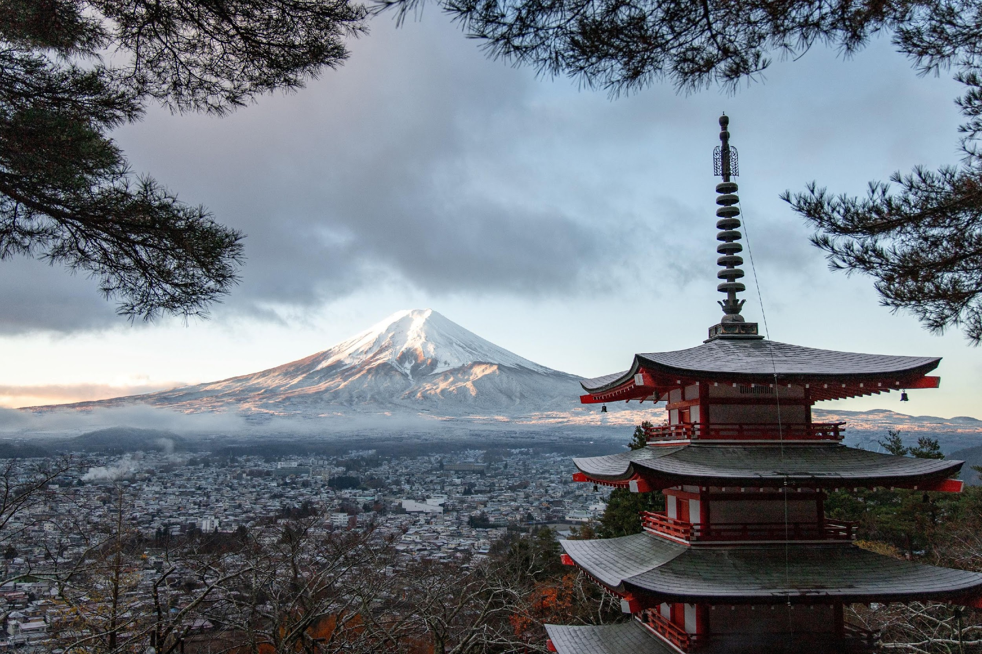
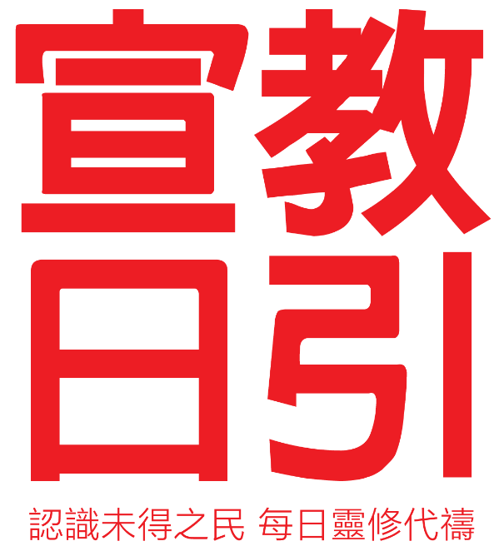
May 2023
Japan

Slide 2
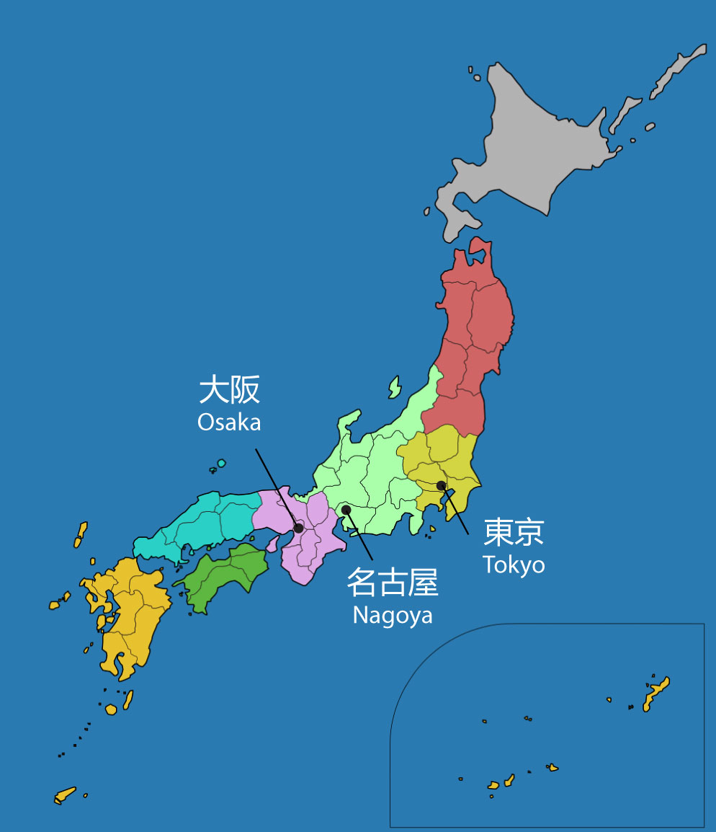
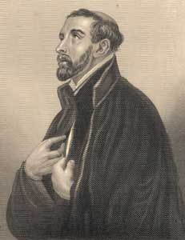
Japan
Population: 125 million
Concentrated in Tokyo, Osaka, and Nagoya
Current State of the Gospel in Japan
Shintoists or Buddhists
First missionary to Japan: Francis Xavier
2 million Christians in need of encouragement
Missionary shortage and aging churches
Hard for the island culture to identify with Christianity
Collectivism led to division between insiders and outsiders
沙勿略
Notes:
Japan’s population
125 million, second to US
The Population is concentrated in Tokyo, Osaka, and Nagoya
Tokyo: 36,192,261; Osaka11,913,722; Nagoy：5,754,972
Current State of Gospel in Japan
Majority of Japanese consider themselves Shintoists or Buddhists. Prior to their defeat in WW II, Japanese viewed themselves a sacred people governed by the code of Bushido and led by the family of the Emperor.
Only 1/3 of Japanese have an active religions life. and many value religion for its functions rather than its truth.
Catholicism first entered Japan in 1548 but was later persecuted, banned, and many believers were killed.
Evangelical missionary work began only after the WW II. There are about 2 million Christians. However, a lot of them stopped going to church within 5 years of baptism due to pressure from family and society.
Evangelism of Gospel still faces many restrictions:
Few missionaries going to Japan
Church pastors are aging. The number of pastors over 80 of age is more than those under 30 years old in Japan
Lack of young pastors to take over
Island Nation Culture: Japan is an island country. It experienced many earthquakes and tsunami and developed into a mentality of coexistence with threats from nature. Formed among Japanese a behavioural pattern and values that emphasized harmony, teamwork, and respect for authority.
This differs from Christianity's emphasis on personal freedom, relationship with God, and a sense of responsibility,. That caused fear of social isolation and exclusion. Making it difficult for Japanese to accept and understand the Christian belief.
Culture of Groupism: There are many large corporations in Japan. They used to offer life-time employment in the past. Big corporations are like big families.
These companies even extended their functions to many aspects of employees’ personal lives. Relationship between employers and subordinates has been very strong.
Even today, there are still cases of an employee committing suicide to exonerate the boss.
This corporate culture also led to division between insiders and outsiders. People can be indifferent to those who are outside of the circle, showing hostility and superiority especially against those in a disadvantaged position,
This has created the non-sociality of Japanese people and their lack horizontal connections.
Emphasized unity. The negative result is isolation and exclusivity, which are reasons behind their difficulty to accept Christianity.

Slide 3
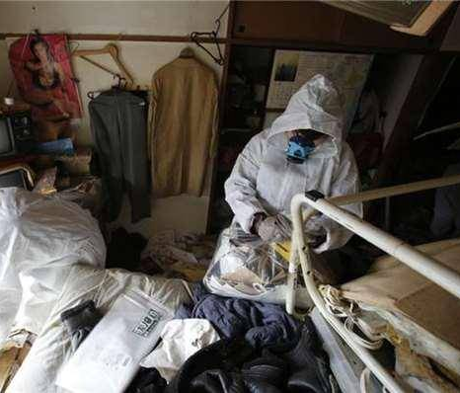
Japan’s Current Social Issues
Ranked among the highest in poverty rate
Aging population leading to elderly people’s lonely death
Suicide rate remains high
“Hikikomori” – young adults in reclusion at home and giving up on striving
Mental/Spiritual emptiness
Notes:
The social issues that Japan is facing.
Rank among the highest in poverty rate
Despite being the 3rd largest economy in the world, Japan experienced recession in the 1980s due to bankruptcy of financial institutions.
After economic restructuring, the lifetime employment system collapsed and shifted to a high-pressure, performance-based society. It changed from a country mostly with middle classes to low-income workforce, causing income gap between the rich and the poor.
Aging population leading to elderly people dying alone
In 2022, 36 million people were 65 years old or above, equivalent to 30% of the total population.
In recent years, there has been a new business of “cleaning up after the lonely deaths”.
Relatives or landlords would hire them to clean up rooms and belongings of the deceased.
It is Japanese culture to pay back any gratitude received. People are reluctant to bother and owe favors to other people.
That has led to an increasing number of elderlies living alone. Many of them passed away without their relatives even knowing.
Suicide rate remains high
Japanese society highly regards compliance to rules and regulations and emphasizes group benefits, leading to people easily being isolated or excluded.
Personal needs and feelings can be ignored or considered as unimportant. People see themselves without value, feeling lonely, depressed, anxious, and despaired.
They consider themselves burdens to people around them. On top of that, the high unemployment rate became a main factor behind suicides of 20-44 year old men.
“Hikikomori” – young adults in reclusion at home and giving up on striving
Besides the aging population that led to the decrease in consumer demand, birth rate in Japan has been low since 2011. The workforce shrank and caused economic downturn.
The parental system and demanding work culture, the high-pressure living environment, plus the recent covid-19 pandemic
led to the unique “tang ping” behavior of more and more young people who chose to stay at home, avoid the society, and not working. They stay hidden in their bedrooms, sometimes for years.
Photo by Jase Bloor on Unsplash

Slide 4
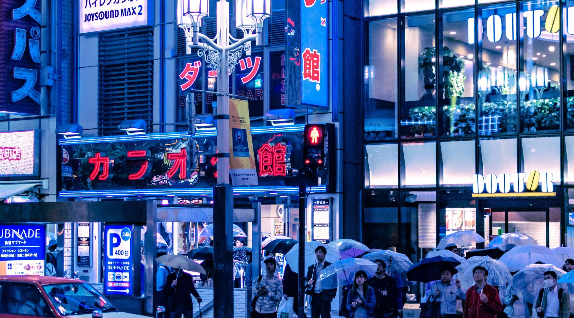
Let us pray together for Japan
Notes:
Photo by Josh Wilburne on Unsplash

Slide 5
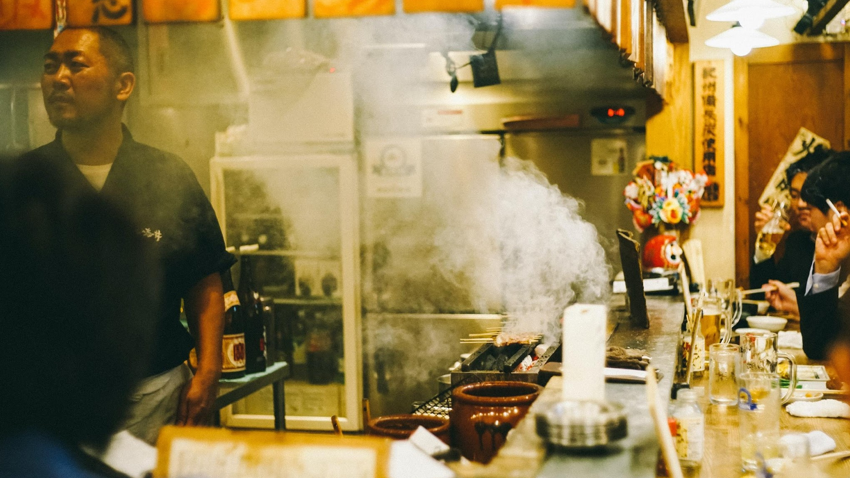
Dear Heavenly Father, We come before you today to pray for the people of Japan. We ask that you would bring peace and joy to their hearts, for they live in a society that is heavily crisis-conscious and often filled with suppression.
We pray for those who have fallen into depression and those who are contemplating suicide, that they may be touched by the hope of the Gospel and find freedom in Christ's salvation. We pray that you would break the chains that bind their hearts and fill them with your love and grace.
May those who are weary and burdened find rest in you. We pray that you would bring healing and restoration to the society of Japan, that they may know the peace that surpasses all understanding.
Notes:
Photo by Jase Bloor on Unsplassu

Slide 6
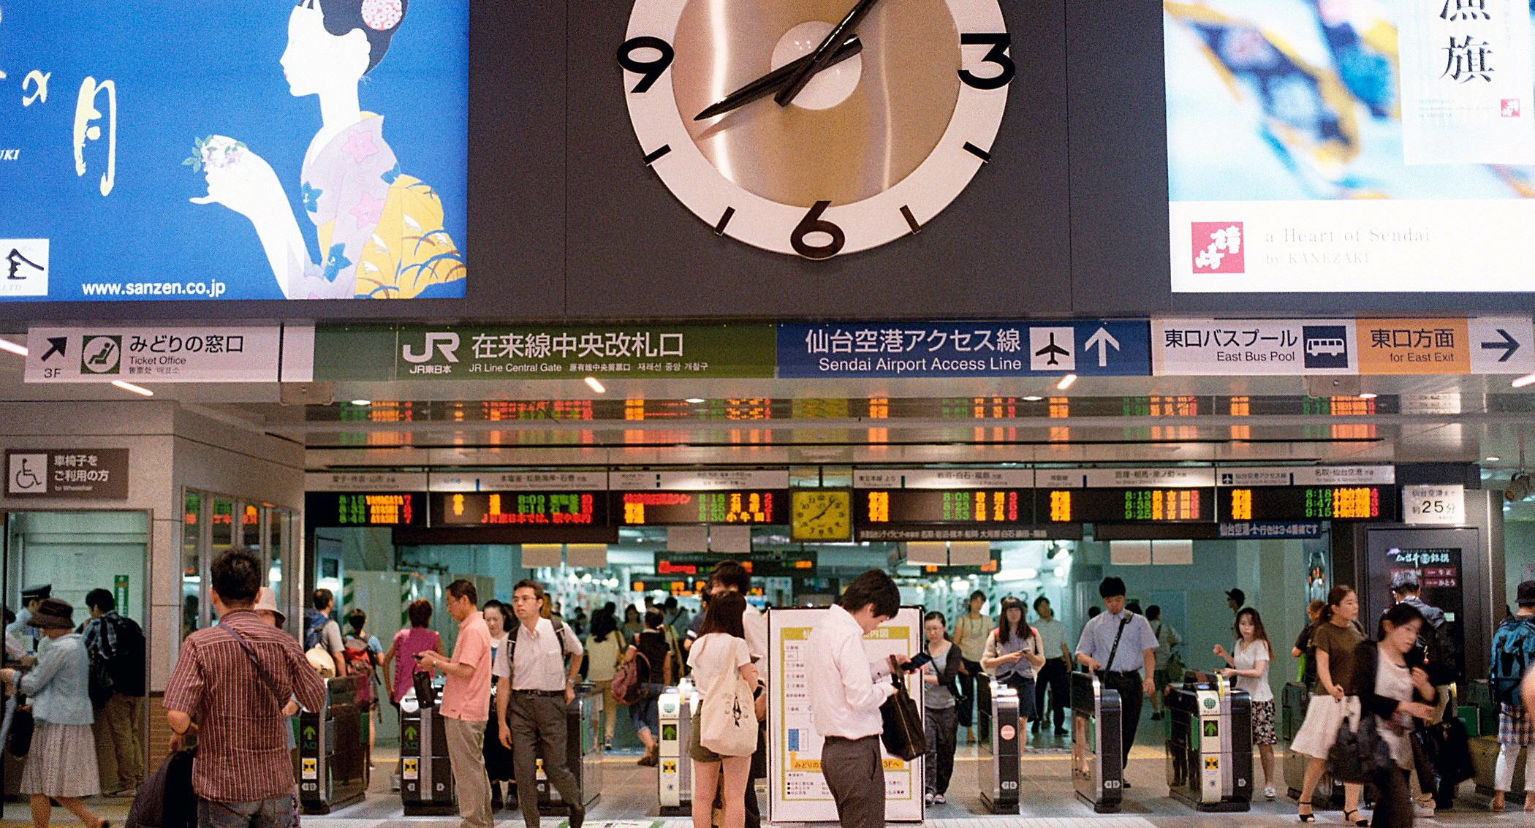
Dear Heavenly Father, may you pour out your Spirit on the Japanese churches so that they care about the needs of the 36 million elderly people, bringing to them peace and comfort and for them to know that you love them.
May the Christians in the 1.2 million ”tang ping” young people have a vision, and that they will live again from dry bones.
By the grace of the Lord, they will know how to respond to the demands from family and society with a heart of power, love, and courage.
May the Lord stop Satan from tempting the Japanese to surrender their lives to sorrow, despair, and death. May you be their fountain of hope and joy. In the name of Jesus we pray, Amen.
Notes:
Photo by Kentaro Toma on Unsplash
，

