Slide 1
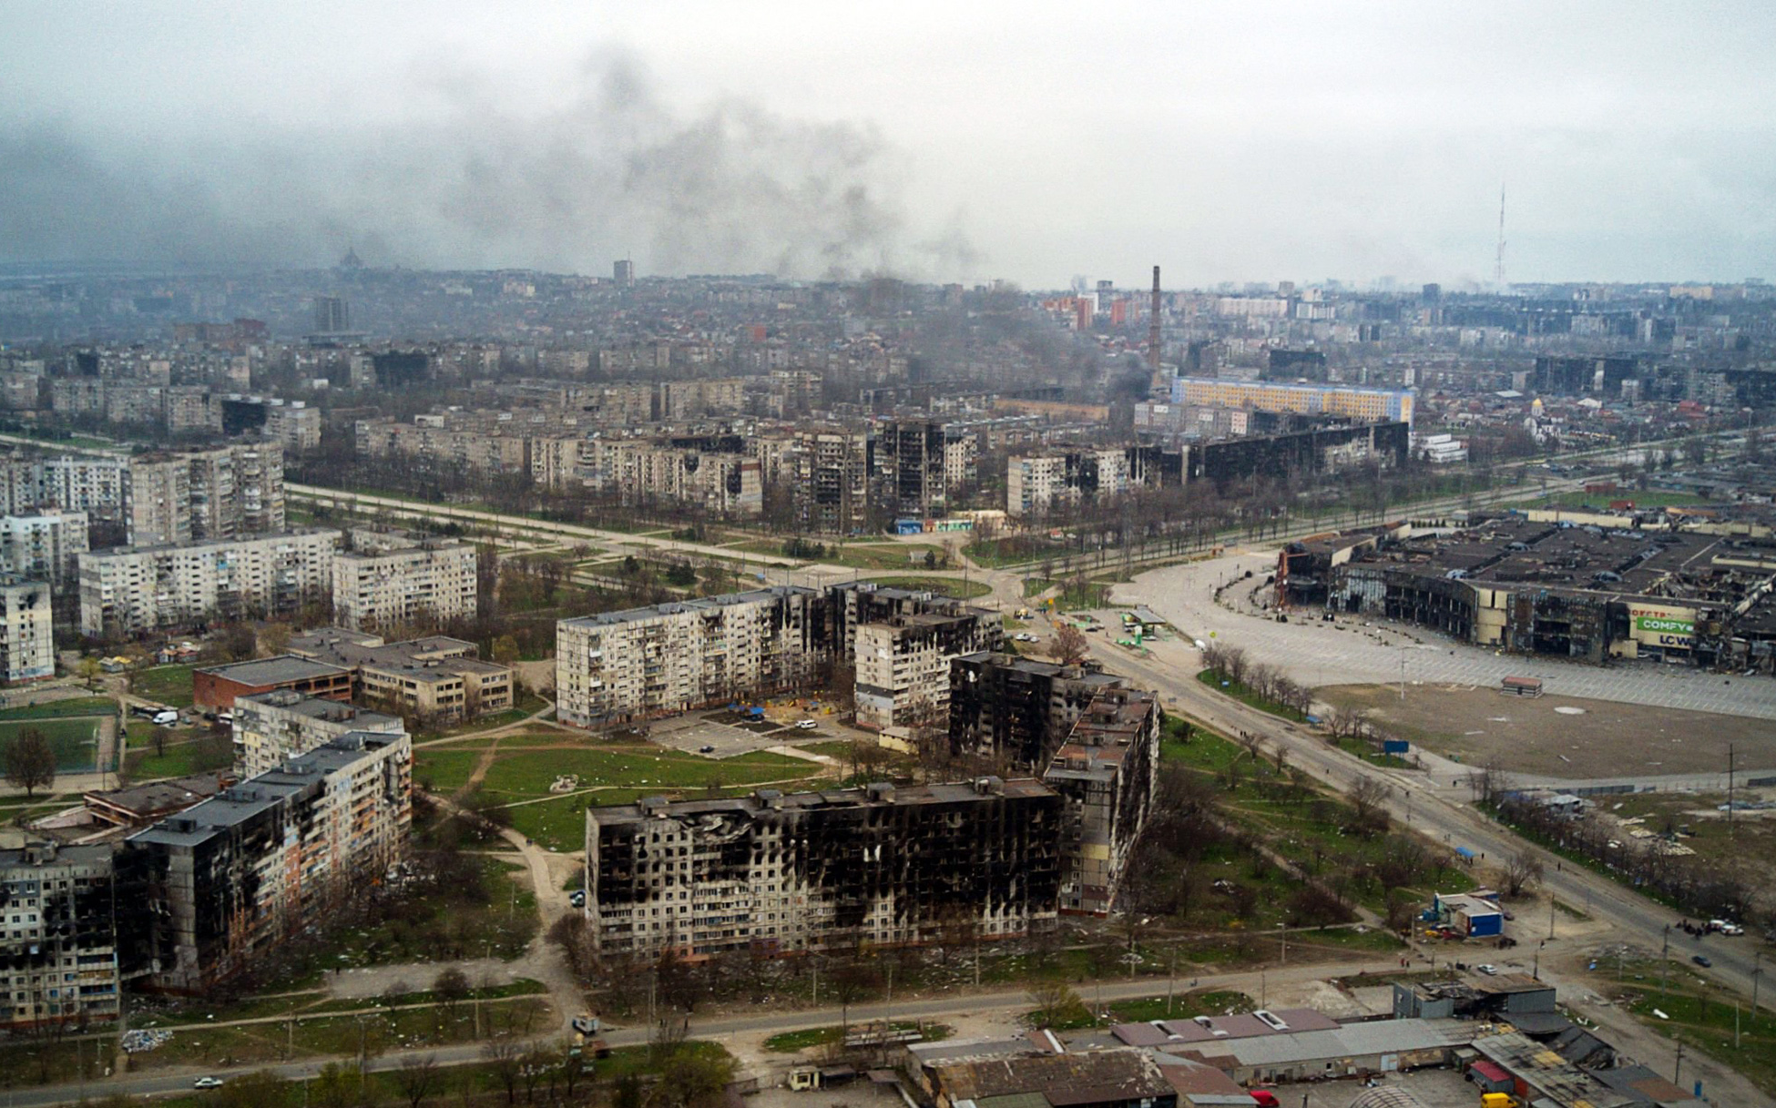
Russo-Ukrainian War
July 2023
Notes:
Mariupol

Slide 2
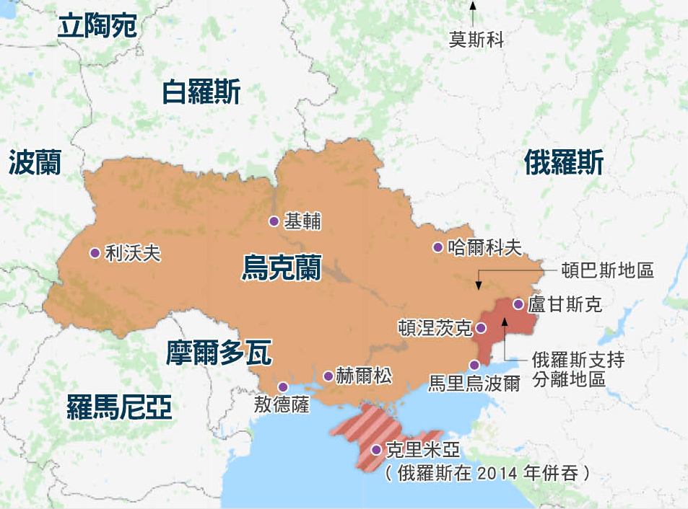
Russo-Ukrainian War
Russia-Ukraine History and Relations Russians, Ukrainians, and White Russians
Feb 24, 2022 Putin Invasion
Status of Russo-Ukrainian War Russian military casualty: 200,000 Ukrainian military casualty: 9,000+ Ukrainian civilian casualty: 20,000 Ukrainian refugees: 8.16 million
Notes:
Russia-Ukraine History and Relations
The ancient Rus’ tribes founded the Kievan Rus state in Ukraine.
Split into 3 branches: Russians (Great Russians), Ukrainians (Little Russians), and White Russians (Belarusians)
It was one of the founding republics of the Soviet Union in 1922. The former Soviet military and industrial center. Ukeraine became independent in 1991.
40% of the population in the eastern Donbass are Russians who predominantly speak Russian and are pro-Russian. It is an important military and industrial region. It has always been despised by the Ukrainian power.
In 2014, the Russian military annexed Crimea in the southeast. (The following is the background for reference.)
In 2014, Crimea held a referendum that was not recognized by the international community. The referendum asked residents whether they supported staying in Ukraine or joining Russia. It was believed that the majority of participating residents supported Crimea's independence and joining Russia.
The referendum sparked controversy with doubts about its legitimacy. There were reports of intimidation and oppression during the voting process, and international observers were unable to access the region.
Russia used this as a pretext to invade Crimea, claiming that the annexation was based on the expressed will of the local population and as a response to protecting the Russian ethnic group.
Putin Invaded Ukraine
On February 24, 2022, claiming to be under the threat caused by NATO’s expansion to the east, Putin declared invasion of Ukrainian in the pretext of "demilitarization" and "de-Nazification.” (More background for reference as follows)
The justification was it was necessary to protect “the people who were being abused and slaughtered" and to "demilitarize and de-Nazify Ukraine”, in order to "bring those who harm civilians to justice." He accused Ukraine of being controlled by extremists and therefore called for a change in government.
He also accused Ukraine of posing a threat to Russia by seeking NATO membership. In fact, NATO has never indicated acceptance of Ukraine's application, yet Russia has displayed more aggression than the threat he claimed.
Subsequently, Russian forces invaded Ukraine from three directions: conducting bombings in the capital city of Kyiv and several other cities and military facilities; landed in the port of Odessa; and attacked Kharkov.
The main focus of the war was the Mariupol region in the Donbass and Red Sea area.
The total military force at that time: Ukraine had 196,000 active-duty personnel and 900,000 reserves; Russia had 900,000 active-duty personnel and 2 million reserves.
Current State of the Russo-Ukrainian War
Military strength between Russia and Ukraine was disparate. Europe and the US provided Ukraine with military aids as self-defense weapons.
The Russian army had 200,000 casualties
Ukrainians army casualty was over 9,000. 20,000 civilian fatalities, 8.16 million refugees, and 5.35 million displaced people in the country.
The Ukrainian civilians paid the heavy and painful price.

Slide 3
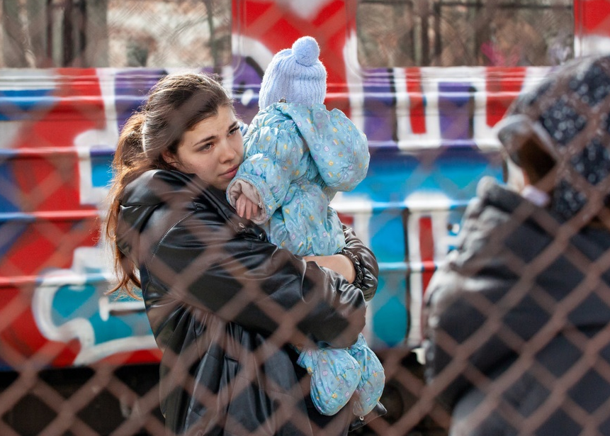
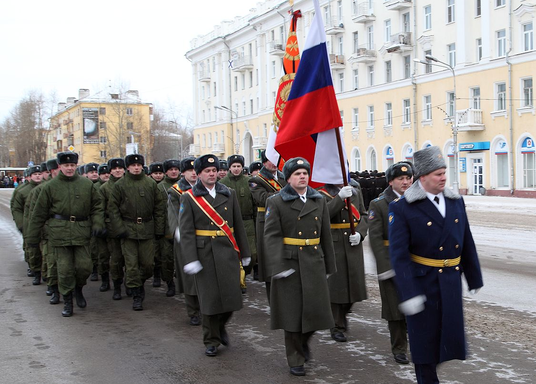
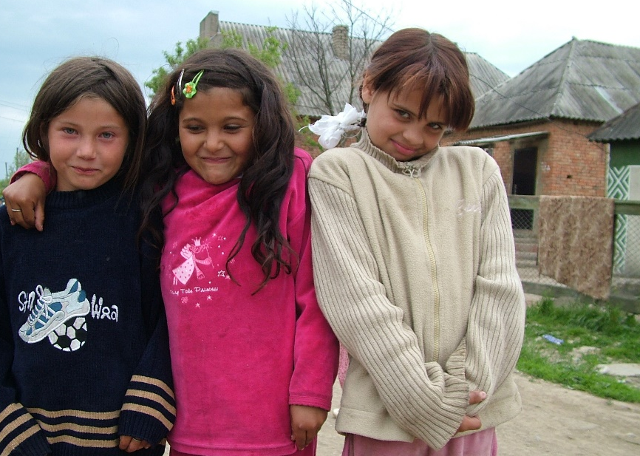
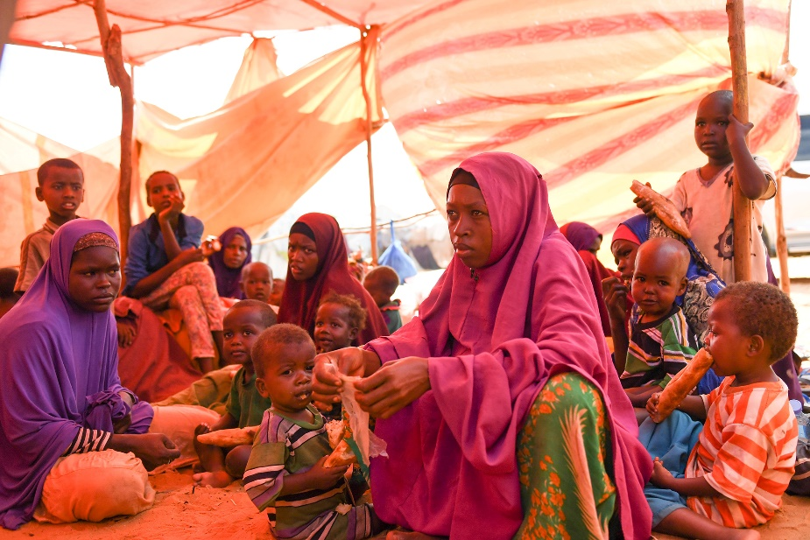
Amidst the War
Children’s childhood destroyed
Women’s situation in perilous
Plight of Russian’s ethnic minorities
Changing direction of global energy policy
Food crisis in East Africa
Nuclear threat of Russia
Notes:
Children’s childhood destroyed
No one in Ukraine can be sure that they will wake up tomorrow without a missile hitting their home.
Among the 14 million refugees, 7.1 million are children. Deep wounds engraved in their hearts. An example: 7-year-old Aretha, who watched her father died while driving a car and her mother critically injured by a Russian military plane on her escape.
6,000 children were forcibly transferred to areas controlled by the Russian authorities and subsequently being adopted by different Russian families.
Children who have experienced war and violence have wounds left in their hearts. They are depressed and anxious. They don't want to talk to people, don't trust people, and have violent tendency. They often have nightmares, cry all night long, and fall to the ground with their hands on their heads whenever they hear loud noises. These are the wounds extremely difficult to heal.
Women’s situation in perilous
Besides being tortured, raped, and killed by the Russian army, many women and children fled their home in a rush and settled in hastily built mixed gender shelters. They face the enormous risks of sexual harassment, sexual violence, and human trafficking.
Plight of Russian’s ethnic minorities
On September 21, 2022, Putin called up 300,000 reserve soldiers - half-forced, half-incentivised and offering them good pay - to join the infantry or airborne forces of higher casualty rate.
The BBC's Russian service discovered from a list of more than 6,000 Russian military deaths that a very high proportion were from ethnic minority border areas such as Dagestan and Buryatia.
Changing the direction of global energy policy
In 2022, as the world gradually emerged from the pandemic and various industries resumed production, the energy supply was at a low point due to US sanctions on Russian exports.
Russia retaliated by reducing production. Many countries resorted to restarting coal-fired power plants.
Countries such as India, Pakistan, Myanmar, and Sri Lanka faced nationwide power outages, leading many energy-consuming nations to reduce their reliance on fossil fuels, which contribute to global warming, but focus on the development of renewable energy.
Food crisis in East Africa
Ukraine is known as the world's breadbasket and a significant exporter of fertilizers, supplying Europe, Asia, Africa, and other regions.
After the outbreak of the war, Russia blockaded Ukrainian ports, resulting in food shortages in low-income countries like those in East Africa. ~7 million people in these countries are now facing famine.
With the continued deterioration of global climate, about half of the children in Somalia suffer from malnutrition. In Kenya, nearly 1.5 million livestock have died.
Nuclear threat of Russia
At the beginning of the war, the Russian army bombarded Ukraine's largest nuclear power plant and sent troops to occupy it. Amid the continuous exchange of fire, the nuclear disaster crisis is imminent. If the Ukrainian nuclear power plant explodes, the resulting nuclear radiation will affect the entire European region with unimaginable consequences.
In addition, Putin announced the suspension of Russia’s participation in the nuclear weapon mutual-trust mechanism – the "New Strategic Arms Reduction Treaty".
Many experts are concerned that Russia's move may allow China, North Korea, and Iran to expand their nuclear weapons recklessly, pushing the world to the brink of doomsday.

Slide 4
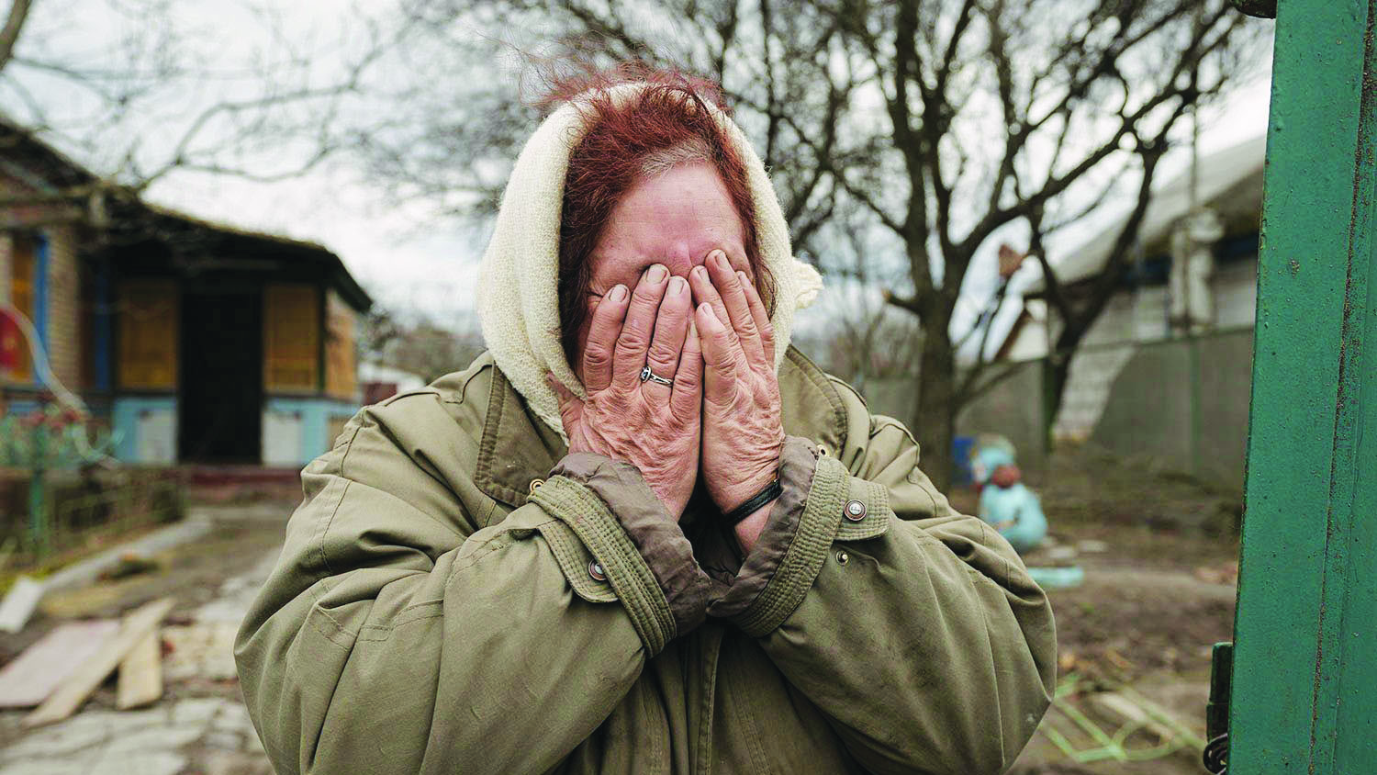
Let us pray for the victims in the Russo-Ukrainian War

Slide 5
Brothers: Heavenly Father! We pray for the refugee children and women in Ukraine!
We remember the 6,000 children who have been abducted to Russia.
May You not forget their suffering. May Your mightiness keep them from harm.
May Your faithfulness and righteousness protect them from those who oppressed them. Let them not lose courage or be scared, and heal their wounded hearts, bodies, and spirits.
May they have complete peace in the Lord!
Sisters: Bless the 14 million Ukrainian refugees.
May they find protection and provision in places they take refuge.
May the children have opportunities to continue to go to school; receive news from their families.
May they be healed by the Lord physically, emotionally, and spiritually.
May they return to their homeland soon and rebuild the destroyed city walls.
Congregation: Oh Lord, many ethnic minorities in Russia have been recruited to fight in the frontlines. Without adequate training and equipment, they died in the battlefield.
May our Lord comfort their families
and hear the prayers of the helpless people from both Russia and Ukraine. May the Gospel be the greatest support and hope for the people.
Notes:
Brothers, sisters, and the whole congregation taking turn to pray.

Slide 6
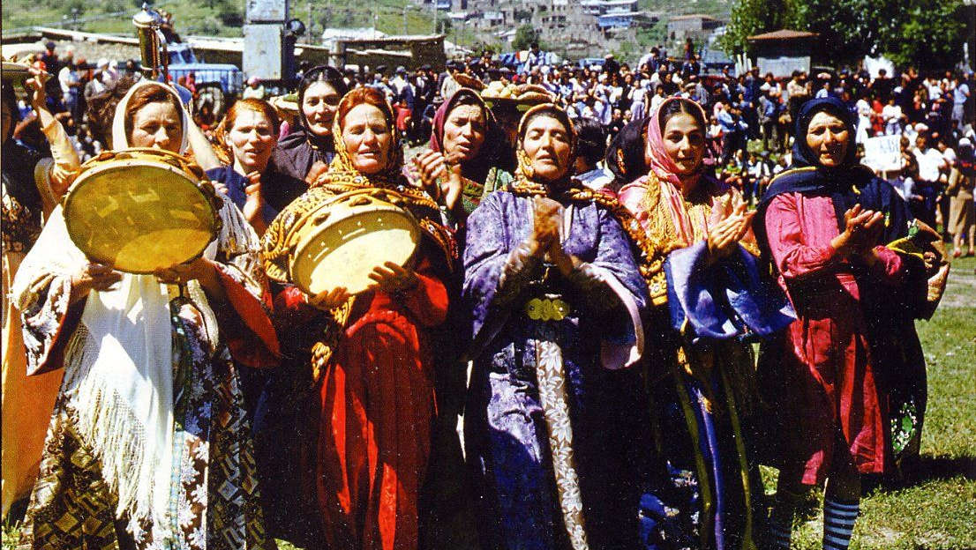
Heavenly Father, many people in the impoverished countries are
unable to buy food, medicines, and fuel because of the Russo-Ukrainian war.
7 million people in East Africa are facing famine,
And Sri Lanka, with a population of 22 million, has declared bankruptcy.
Heavenly Father, we pray that You will touch the hearts of people around the world to notice these struggling families and provide them with food, medical aids,
and long-term solutions.
Lord, we pray for Your mercy on humanity, forgive our excessive greed and exploitation, which has caused droughts, wars, and food crises.
May people turn back, manage the world according the will of God,
and not to waste resources anymore.
May Your grace cover the East Africa region and send rain for all living things to thrive. Merciful and Almighty God, please bring an end to the Russo-Ukrainian war,
heal Ukraine’s damaged farmlands, so that the land will no longer be abandoned,
but be fertile to provide food needed in Europe and Africa.
Notes:
The prayer is divided into the regular and bold fonts. It can be recited in response format, rotating by brothers, sisters, and whole congregation.
Mission Path July 9, 2023
Regarding the war intensifying global warming,
Facing the escalating trade blockade from the United States,
China, which relies on energy imports and is transitioning towards green energy generation,
has regressed by resorting to burning domestically mined coal for self-preservation.

Slide 7
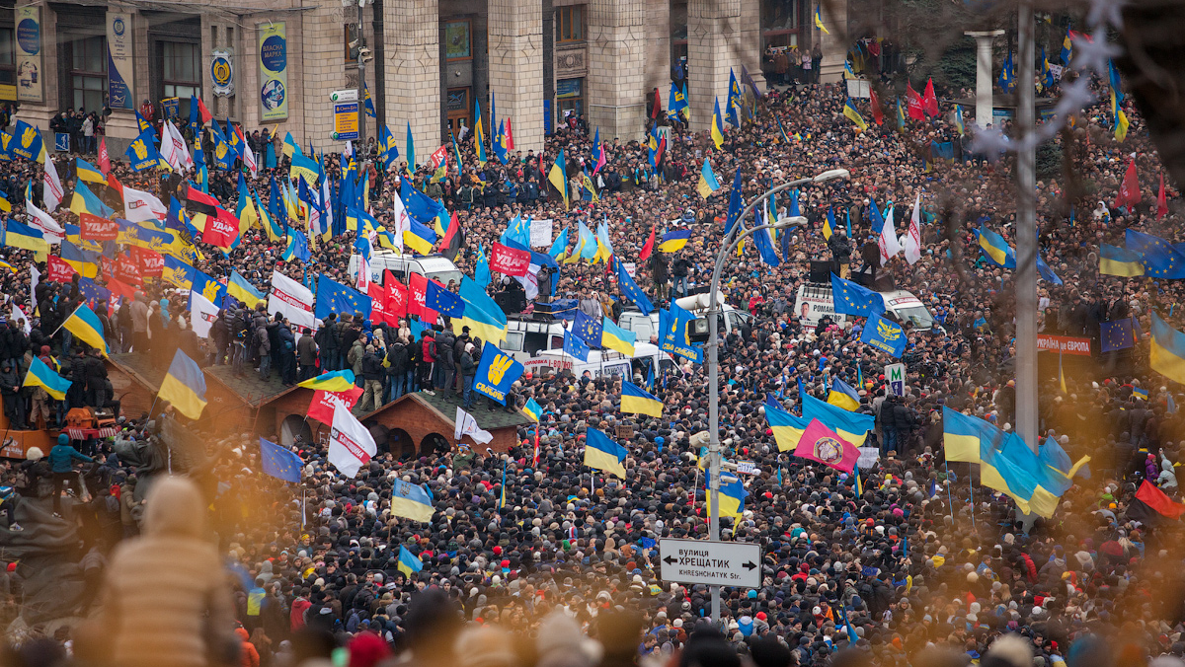
Heavenly Father, in this world filled with violence,
May the Holy Spirit lead the leaders of Western Europe and the United States to have humble hearts to be guided by the Lord’s way.
In their positions assigned by the Lord, to have integrity to do justice and love mercy.
May they thrive to eliminate racial, religious, and cultural antagonism;
to formulate good foreign policies; and build mutual trust.
Grant them wisdom and courage to be willing to abandon the development and deterrence of nuclear weapons, and to choose the path of peace.
Oh Lord, please have mercy on us and deliver us from threats and harm of war and nuclear weapons.
May we live each day in godliness, peace, and safety.
In the name of our Lord Jesus Christ, we pray. Amen.
Notes:
The prayer is divided into regular and bold fonts. It can be recited in response format, rotating by brothers, sisters, and whole congregation.

Slide 8
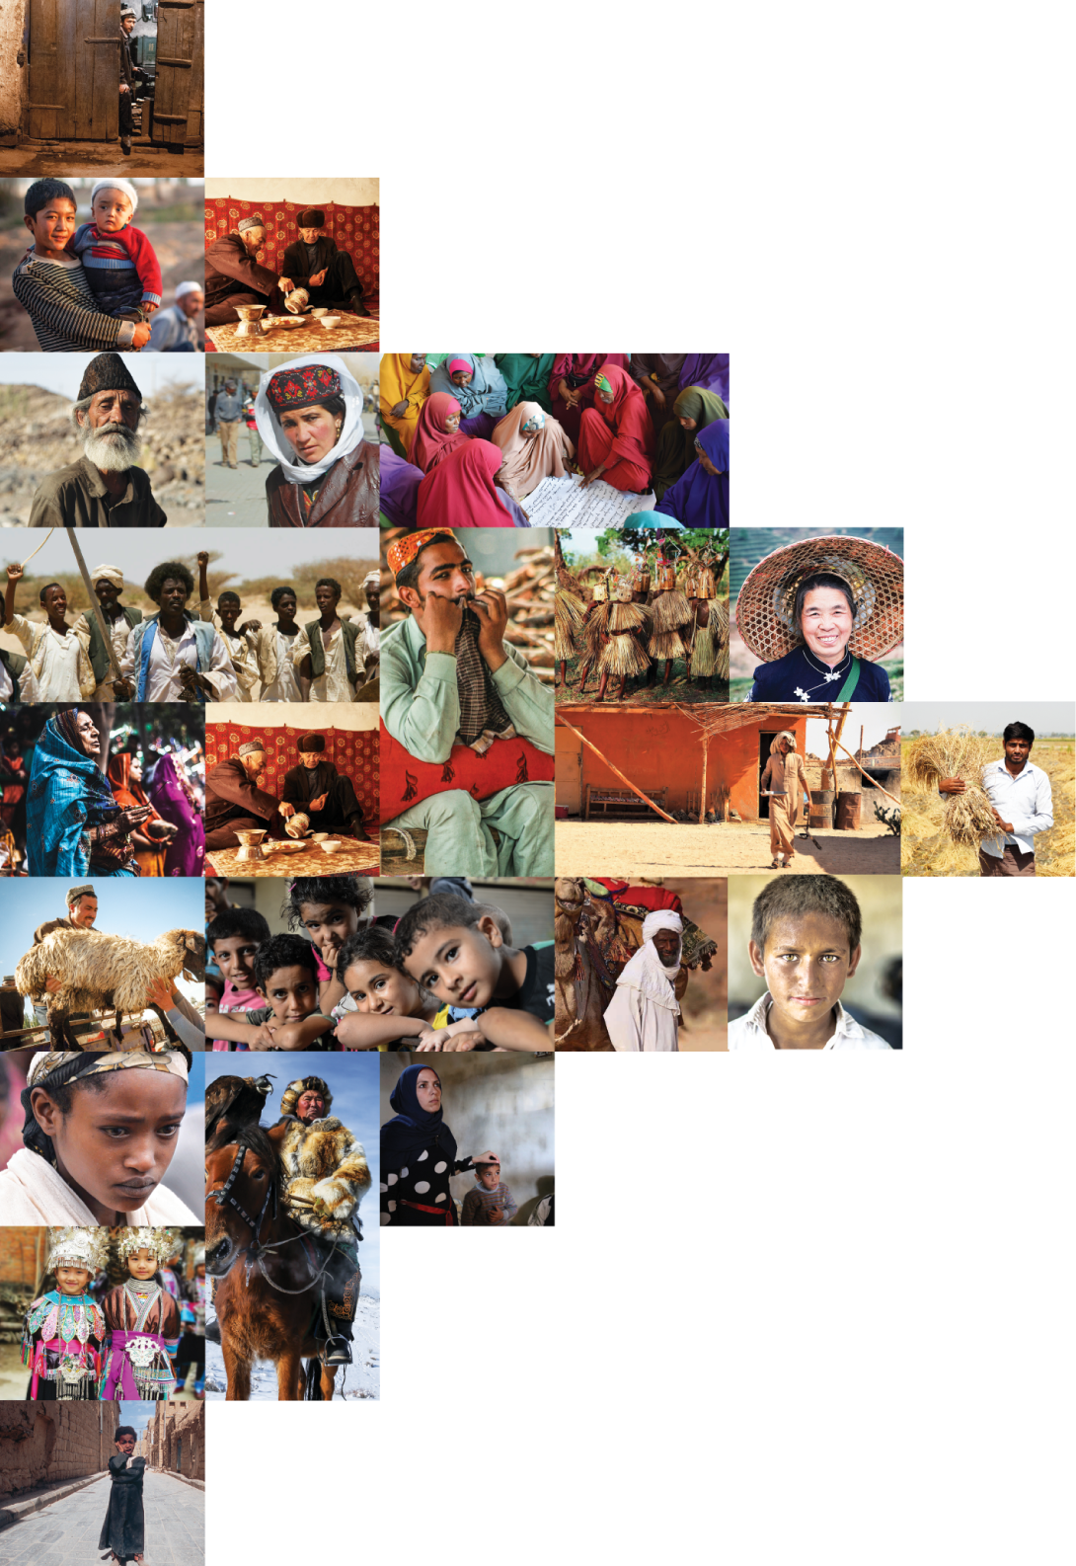
不再是个人的祷告，我们开始一起祈祷。 30分钟，生活再忙碌的人都能找到时间参与。

