Slide 1
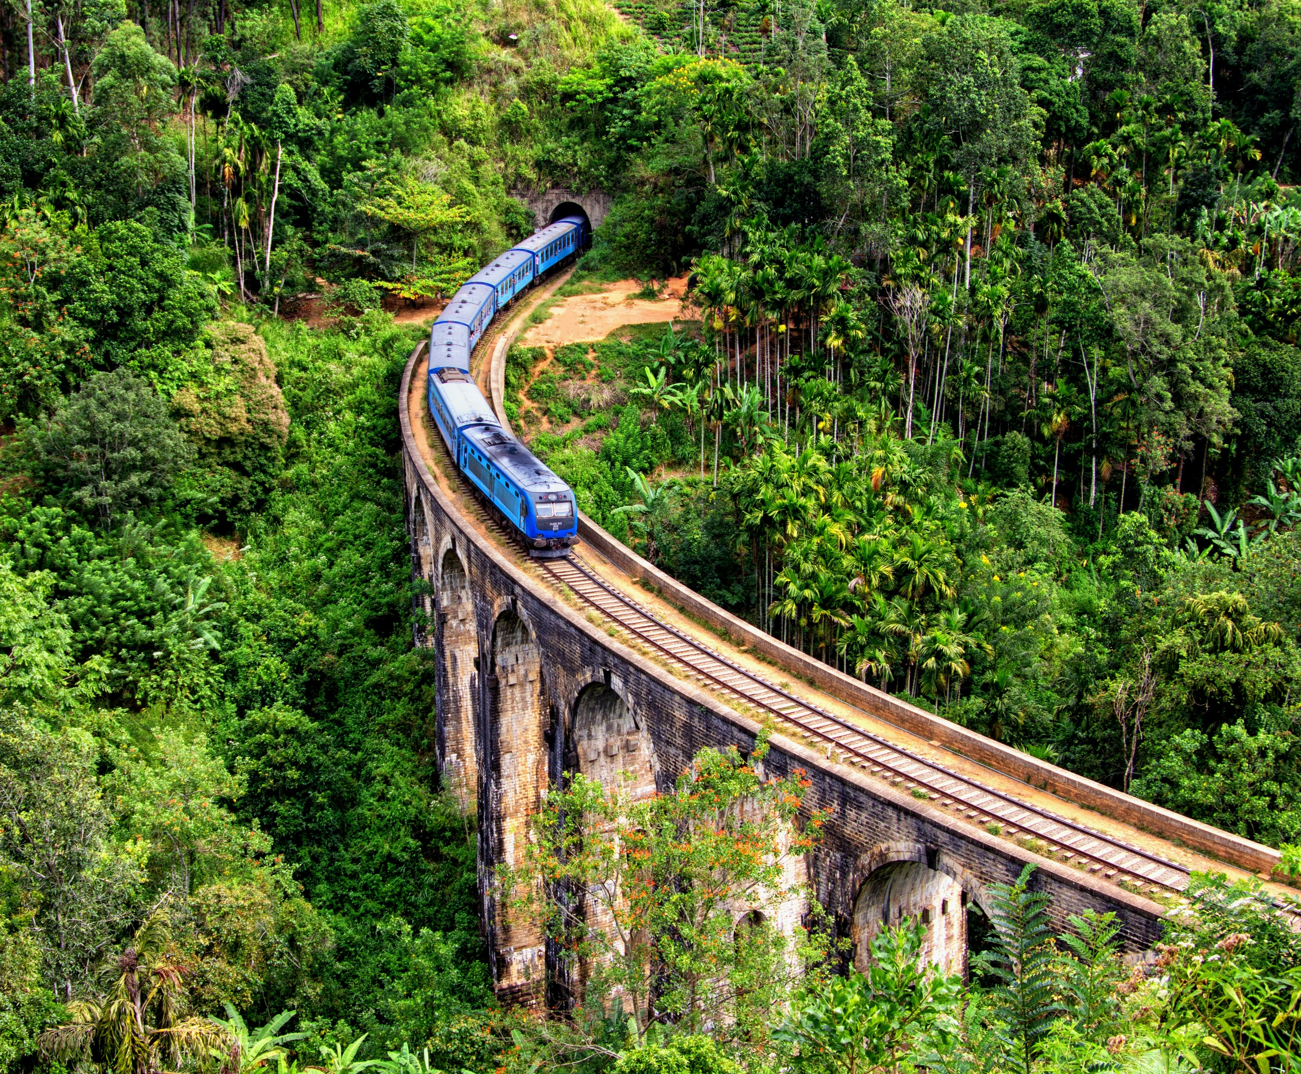
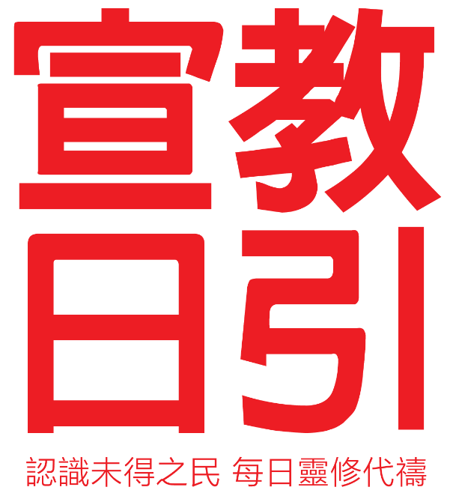
December 2023
South Sudan、Haiti、Sri Lanka
Notes:
The Mission Path continues to pray for countries that are in humanitarian crises – South Sudan and Haiti - in the month of December. We learn about their various vulnerable and acute sufferings and their hidden fundamental problems. Please prepare to have a praying heart.
We will then pray for Sri Lanka - a beautiful island in South Asia, a renounced producer of Ceylon black tea, and a glamorous pearl in the Indian Ocean. Yet, it was also the first East Asia country that announced bankruptcy in this century.

Slide 2
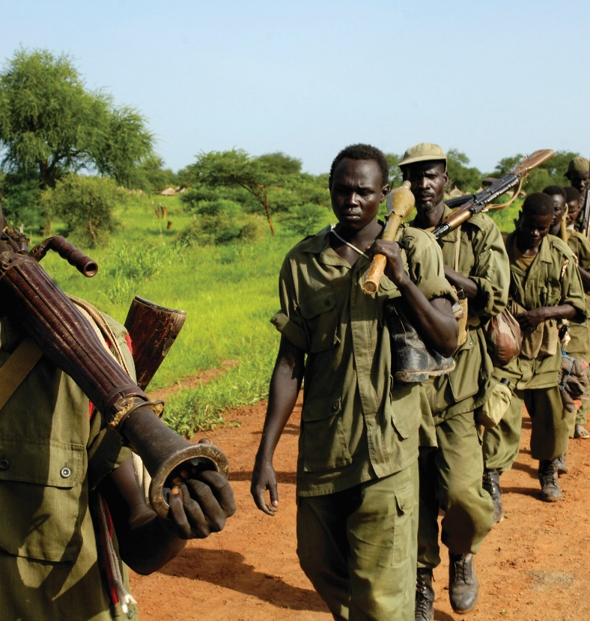
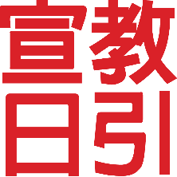
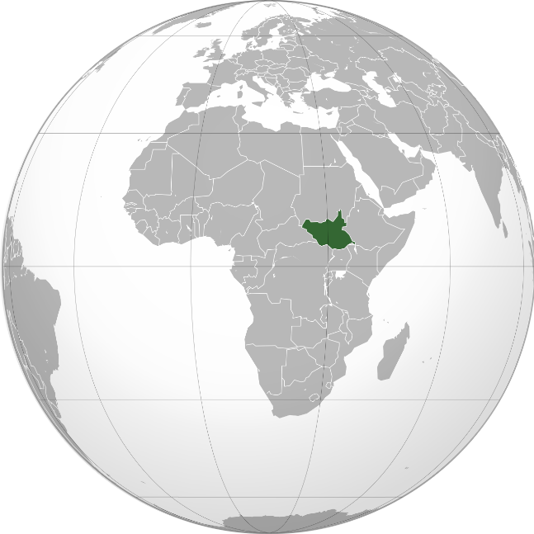
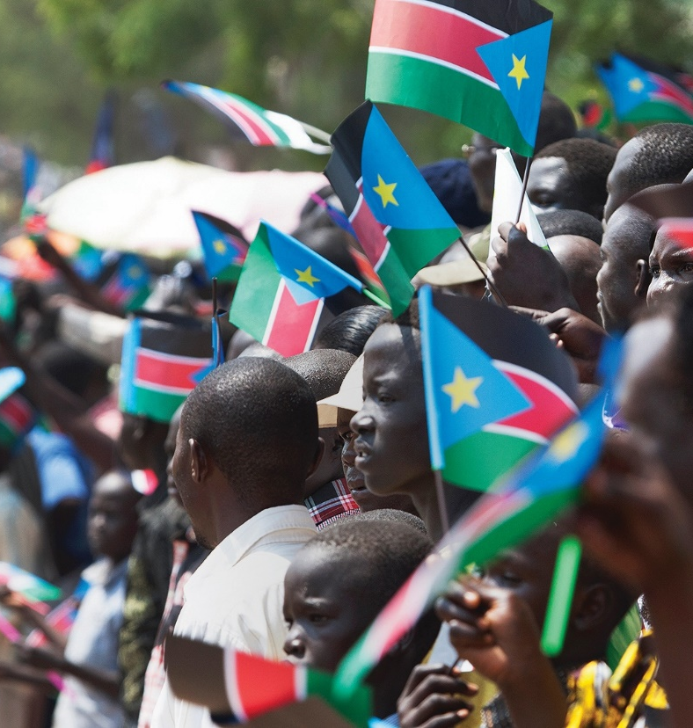
Pray for Countries in Humanitarian Crisis
The Brutal and Bloody Slaughterhouse in Africa – South Sudan
Sudan borders Egypt and was historically known as Nubia.
One of the scientific and academic research centers in the Islamic world
Long-standing conflict and civil war between South and North Sudan
Declared independence in 2011 with a population of 14 million
Military conflict between the president and vice president in 2013 resulted in serious casualties
In April 2023, an armed conflict broke out between two leaders in the military government
5.4 million people displaced, became refugees
Women and girls live under the risk and threats of sexual violence
Thousand of years of Christianity history only left with superficial presence
Notes:
Sudan, historically known as Nubia, is a neighbor of Egypt and was once a Christian nation.
With the spread of Islam, by the 11th century, North Sudan became one of the centers for scientific and academic research in the Islamic world. South Sudan retained its Christian faith, leading to cultural and religious differences.
In the 19th century, Sudan was invaded by Egypt under the Ottoman empire. The Arabized North became a politically strategic center.
On the other hand, South Sudan, with diverse ethnic groups and cultures, possesses most of the oil resources.
After the fall of the Ottoman Empire, Sudan was jointly ruled by Britain and Egypt. The political elite in North Sudan reinforced their power by promoting Islamic law, competing for resources, and suppressing other ethnicities, religions, and cultures. The region has experienced prolonged internal conflicts and wars.
After decades of internal conflict, South Sudan declared independence in 2011, seeking to break free from the Muslim rule and religious persecution imposed by North Sudan.
However, within just three years, conflicts between the President and Vice President erupted, resulting in hundreds of thousands of deaths and millions facing food shortages, displacement, and cholera outbreak.
The hardships and suffering faced by the citizens during the civil war much worse than the previous persecution from North Sudan. Because of its weak international standing, the nation had not received the attention and assistance that it should have from the world.
On April 15, 2023, armed conflicts erupted across various regions in Sudan involving the government forces and predominantly militia-based preparatory units.
In just a few months, this resulted in death of 4,000 people. 5.4 million people were forced to flee their homes and became refugees.
With a population of 14 million, a staggering 9.5 million people of South Sudan are in need of humanitarian assistance. Women and girls are living under the constant threat of sexual violence amid this crisis!
From the 6th to the 14th century, the South Sudan region experienced 800 years of Christianization. In the 19th century, Gospel was re-evangelized.
However, in the present day under power struggle, the area is marred by violence, sexual assault, massacres, and plunder. Love and light associated with the Christian faith is nowhere to be found!

Slide 3
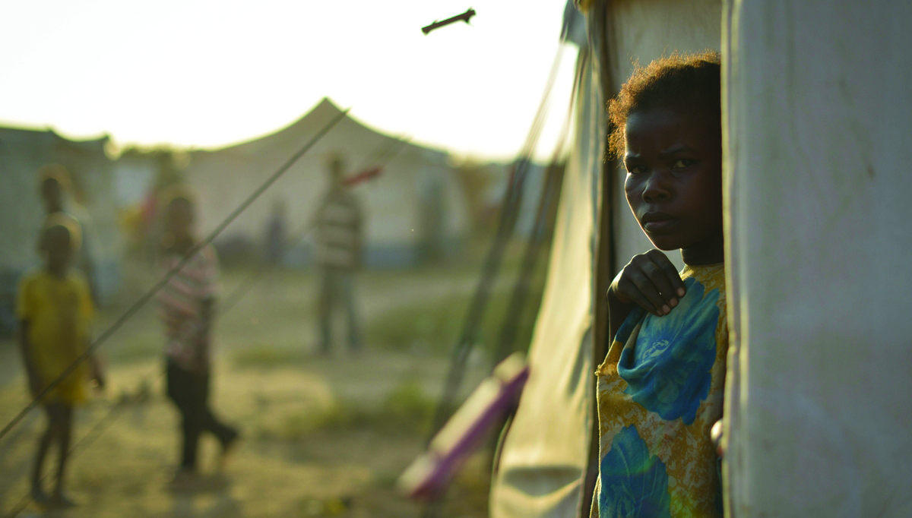
Pray for South Sudan
Heavenly Father, may Your grace and mercy be upon South Sudan,
break the structure that had led to the poverty of the country.
May your grant them divine light to bring repentance to the warlords and the soldiers,
that they will let go of their selfish desires and will earnestly pursue peace. Pray for the Holy Spirit to awaken the government and militia, redirect the country’s resources towards children education, improving livelihoods, enhance agricultural techniques, increase yields, and establish foundational and industrial infrastructure,
So that people may have a stable living environment and development.
May peace come upon the various ethnic groups in South Sudan, enabling them to humbly and patiently seek the Lord’s name.
Guard the people to be kind to each other, establish effective channels for negotiation and communication, and not to fall into the temptation of flesh and chaos.
In the name of Jesus Christ, we pray. Amen.

Slide 4
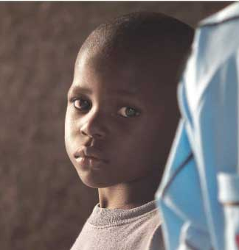
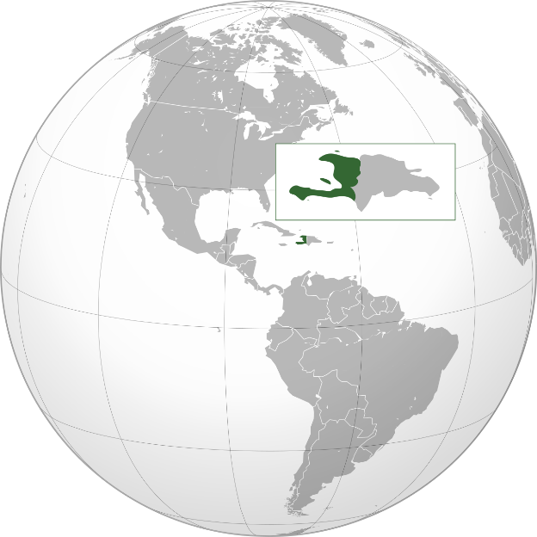
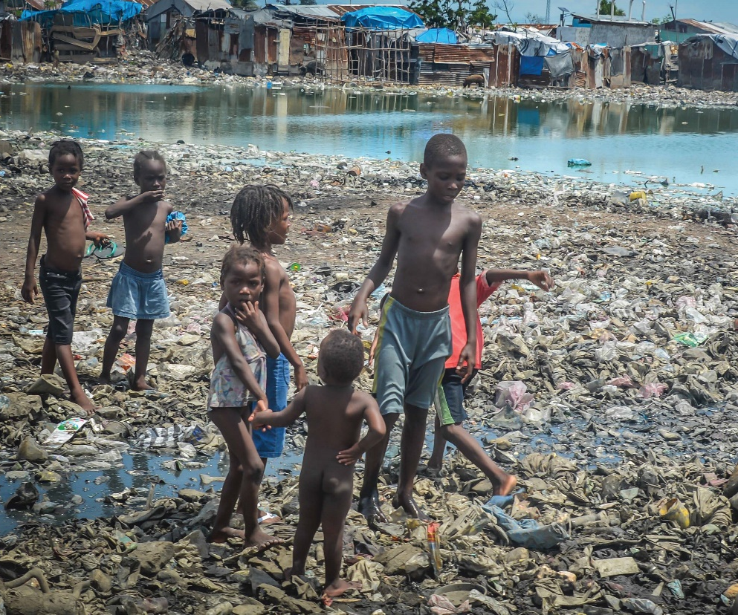
Pray for Countries in Humanitarian Crisis
An Elegy under The Caribbean Sun — Haiti
A Republic of despair
A nation with 200 years of history, 100 presidents
The rich and powerful colluded with the gangsters
Natural disasters more ruthless than human woes
Notes:
A Republic in despair
Haiti's original inhabitants were the Taino people, who were occupied by Span. Due to smallpox and massacres, this people group vanished.
The Spanish then brought in a large number of slaves from West Africa and introduced African voodoo practices to Haiti.
In 1791, slavery leaders launched a war for independence to break free from France’s ruling. They wanted to establish the first black people’s republic founded by African slaves in Latin America and the Caribbean. However, France demanded 150 million francs as compensation for the economic losses of the French slave owners due to Haiti's independence. If not complied, Haiti would face war.
Without the money/funding to build schools, hospitals, roads, water and electricity, people’s health was destined to be weak and disease-prone.
Today, it remains to be the least developed countries in the Americas. Unemployment rate is 75%, marked by poverty and chaos.
200 years of history, 100 presidents
After independence, Haiti had not been able to establish an effective democracy system. Political instability with dictators continuously coming to power and being overthrown.
Within its 200 years of history, Haiti experienced a hundred changes of government, reflecting the prolonged turmoil of the pollical arena and societal livelihood.
The rich and the powerful colluded with the gangsters
Haiti is the only country condemned by all five permanent members of the United Nations Security Council. This condemnation stems from the longstanding collaboration of the Haitian politicians, wealthy individuals, and gangs, involving in illegal activities and the use of gangs to attack enemies.
In 2022 alone, the Supreme Court was emptied of judicial documents five times by gangs. The social and political situation is extremely chaotic.
Natural disasters more ruthless than human woes
Located in an earthquake-prone zone, Haiti has experienced earthquakes, tsunamis, and in recent years, floods and mudslides, making people’s profound hardship even worse.
The earthquake in 2010 caused the death of 300,000 lives. The country has yet to recover.

Slide 5
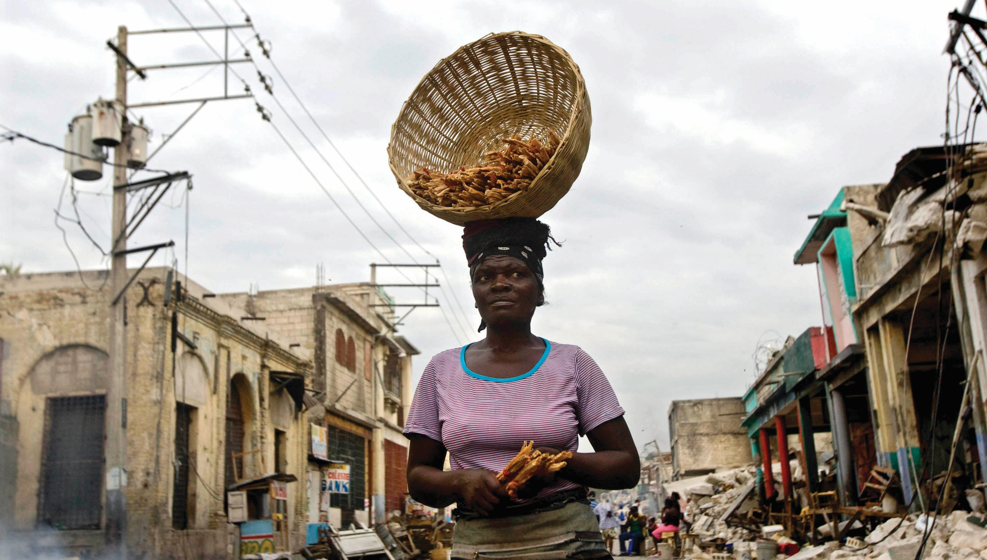

Slide 6
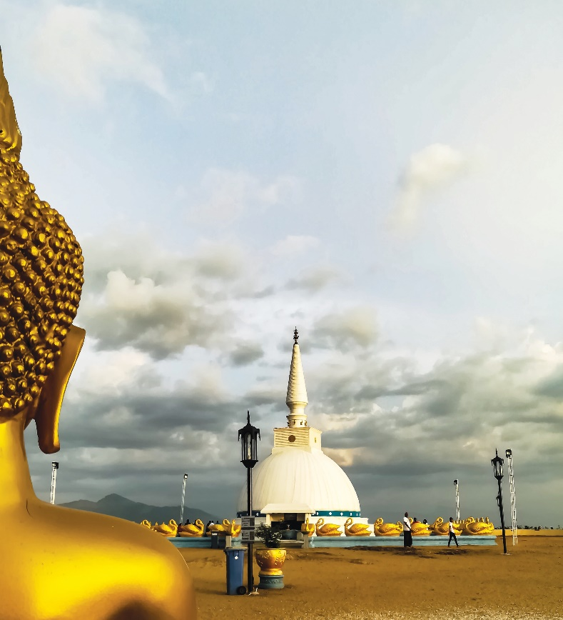
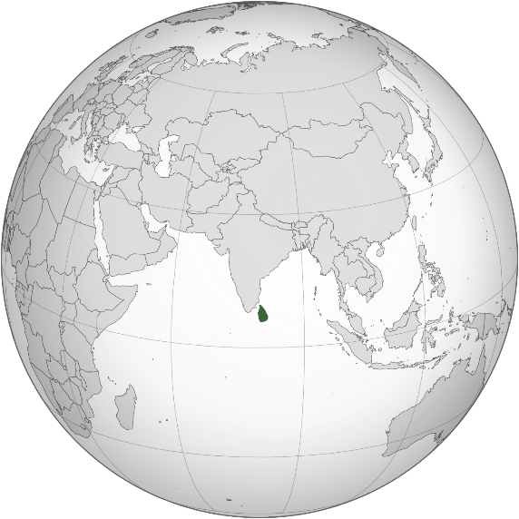
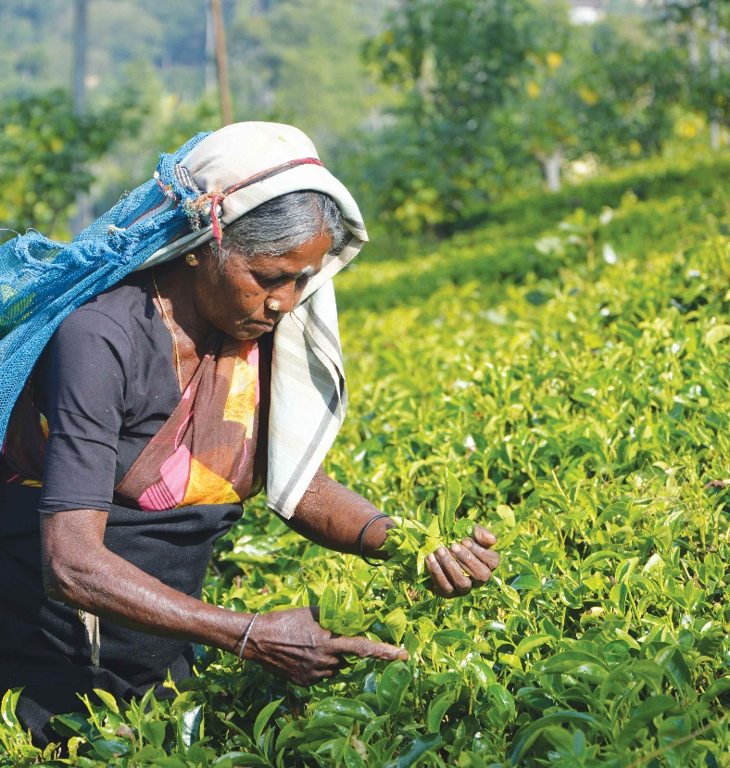
The Falling of a Glamourous Pearl – Sri Lanka
Population 22 million; “Pearl of the Indian Ocean”
Ethnic groups: 74% Sinhalese , 14% Tamils, 10% Arabs
A Theravada Buddhism center that focuses on meditation
Ceylon black tea, the third largest tea producing country in the world
Rich in gemstones production
25 years of civil war caused death of 140,000 soldiers and civilians
Crony governance, debt-financed construction, terrorism,
pandemic, Russo-Ukrainian war, failure in the launch of organic
agriculture, and rise in global interest rates –
Sri Lanka announced debt default and declared bankruptcy in July 2022
No national oil reserves led to immobilized vehicles and power outages in factories; empty store shelves; inadequate healthcare supplies.
The rate of malnutrition among children is the second-highest in South Asia, surpassed only by Afghanistan.
Notes:
Sri Lanka, originally named Ceylon, is a producer of Ceylon tea and a hub for gem production, referenced in the Bible as Ophir.
In the early 19th century, it was ruled by the British until gaining autonomy in 1948. The Sinhalese ethnic group, comprising 74% of the population and predominantly Buddhist, took over governance.
However, dissatisfaction arose among the Tamil ethnic group, which came from southern India, who practiced Hinduism, spoke Tamil, and held key positions during British rule. In addition, series of unequal laws and discriminatory policies against the Tamil people further deepened the discontentment, leading to 25 years of civil war.
Until 2005, Mahinda Rajapaksa was elected president and, in a swift approach, managed to end the civil war in just four years, becoming a mythical figure and a hero of the war.
However, Prime Minister Rajapaksa appointed family members to government positions and heavily relied on borrowing for public infrastructure projects, leading to severe inflation.
In 2019, the country was attacked by Islamist militants. Coupled with the impact of the pandemic, the tourism industry experienced significant downturn and the economy collapsed.
Without proper preparation, the government implemented a comprehensive shift to organic agriculture.
The conflict in Ukraine caused an increase in the cost of food and energy, along with a global rise in interest rates that added to the burden of debt.
These led to food shortages and rising prices.
Sri Lanka declared debt default in July 2022 and its economy went bankrupt.
There was no oil in the country, cars couldn’t run and no electricity generated. No goods on the shelves, and no medicines for illnesses. Mahinda fled to Maldives.
According to UNICEF, Sri Lanka currently has the second-highest child malnutrition rate in South Asia, just behind the war-torn Afghanistan.

Slide 7
Pray for Sri Lanka
We pray for the comfort from the Lord to be upon the people who lost their families, homes, and hope in the wars. Sri Lanka is facing the trauma and division caused by national bankruptcy, racial and religious tensions, civil war, and terrorism.
May the comforting of our Lord uplift the afflicted , grant them the resilience to rebuild their lives, finding unity in Christ.
May the Spirit of Truth guide the Sinhalese Buddhists, Tamil Hindus, and Arab Muslims as they seek truth, wisdom, and peace. May they all encounter Jesus Christ!
May different religions, ethnic groups, and communities be fairly treated, shielding them from forces of hatred and persecution.
We pray for the Tamils who have been oppressed, discriminated, and in poverty.
May they find peace and forgiveness in their hearts.
In the name of Jesus Christ, we pray.

Slide 8
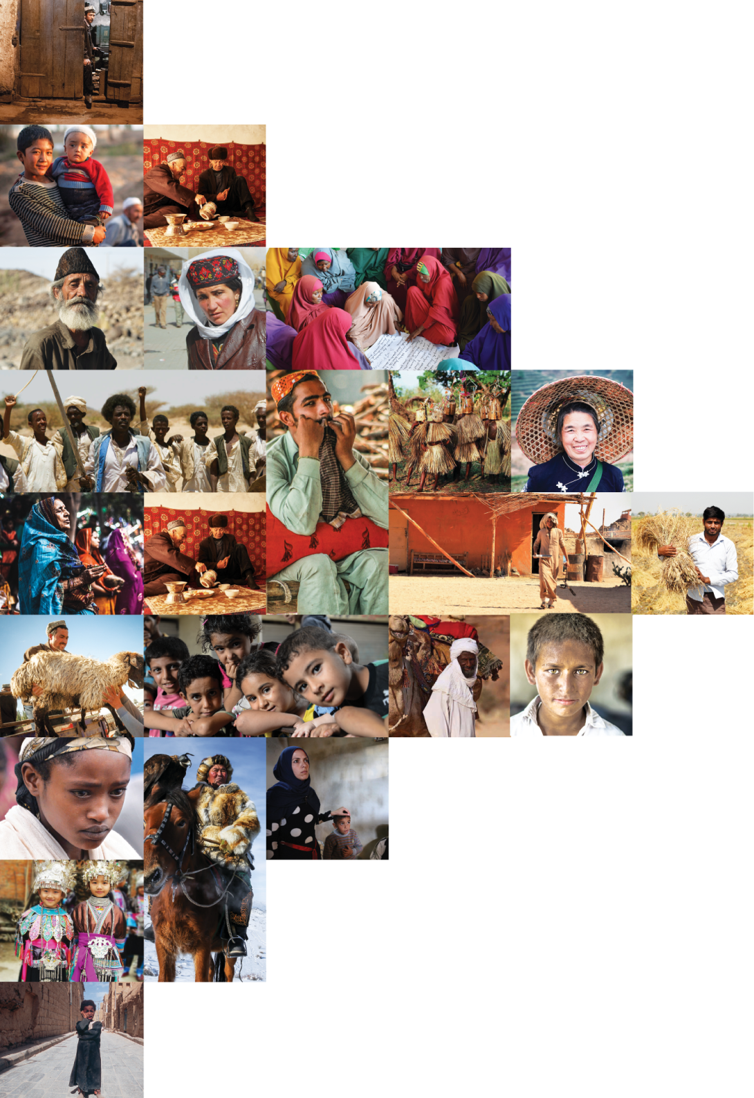
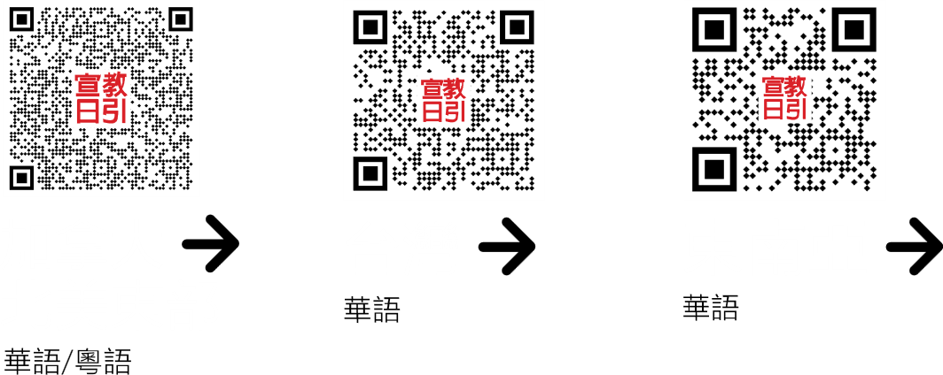
不再是个人的祷告，我们开始一起祈祷。 30分钟，生活再忙碌的人都能找到时间参与。

