Slide 1
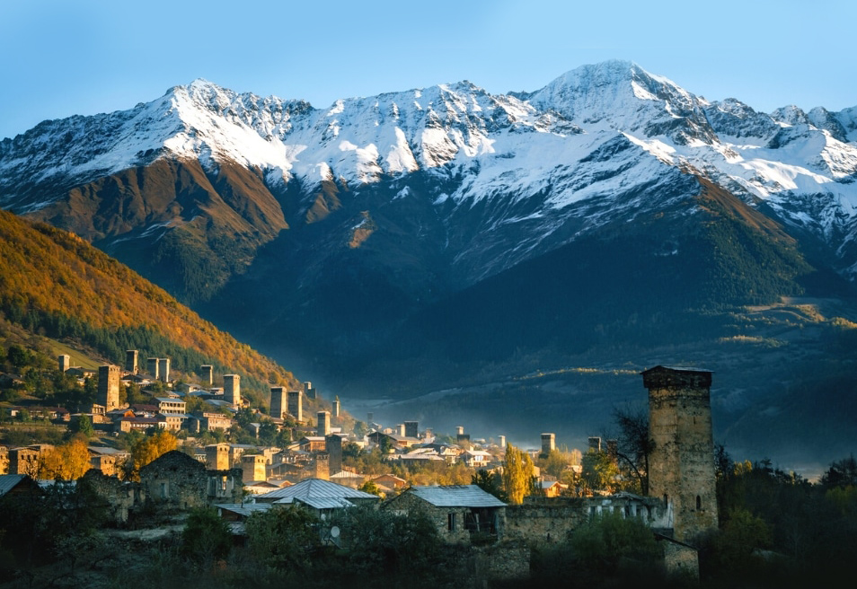
North Caucasus
August 2023
Notes:
Theme Picture: Svaneti
Sitting in the southern Greater Caucasus mountain range, Svaneti is listed as a USECO World Heritage Site for its architectural complexes and cultural landscapes.
A winter sports centre.

Slide 2
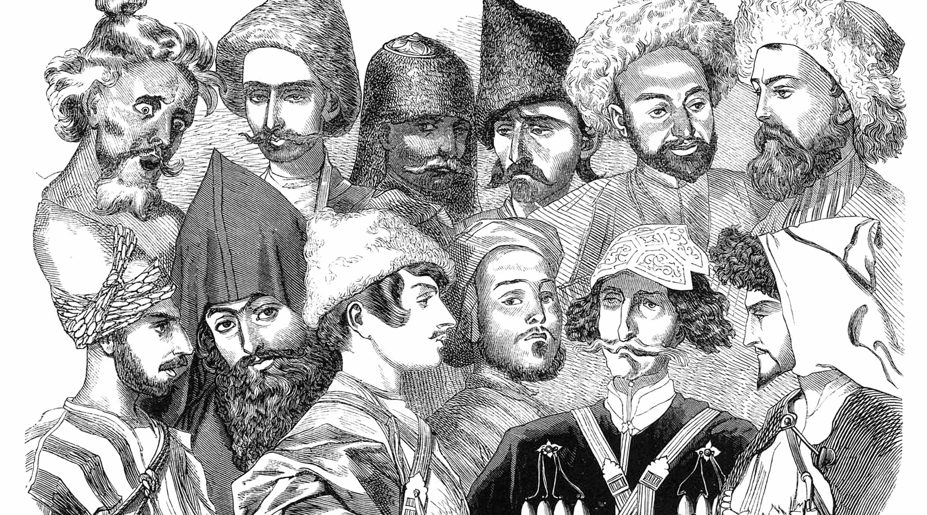
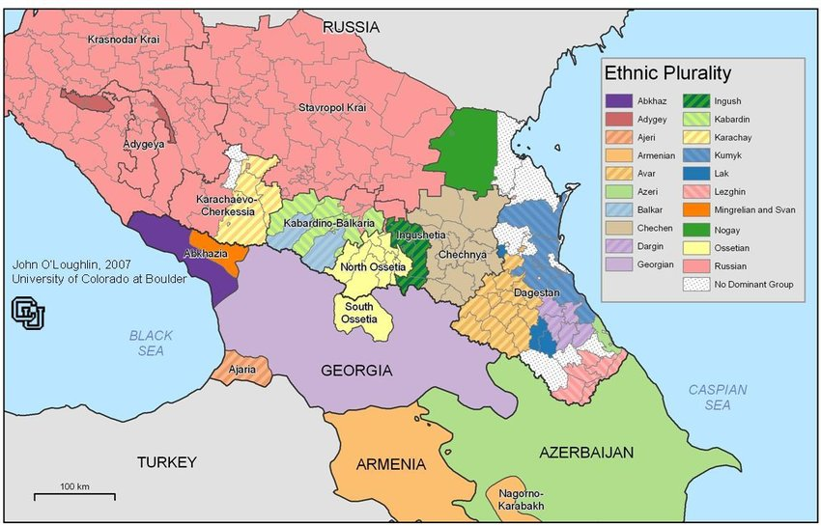
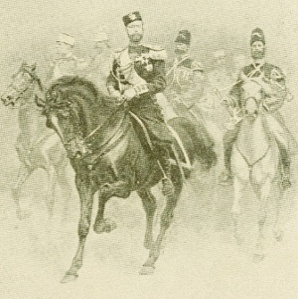
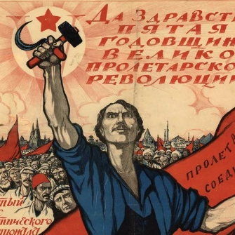
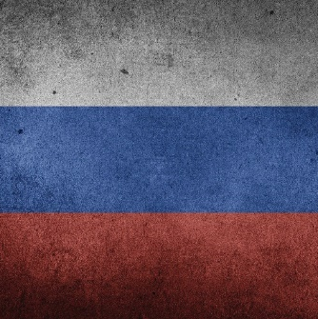
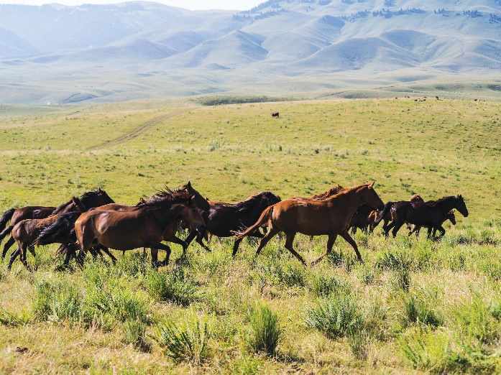
Caucasus At junction of Europe and Asia; Gathering and dispersing place
for steppe nomads
Mountain of Languages: 30 million people with over 50 ethnic groups and languages
Main Religions: Islam (43%); Christianity (57%)
Russian Rule: Conquered from south to north successively by Tsars, Soviet Union, and Russian Federation since the Beginning 19th century
South Caucasus: Established formal regime early on under influence of Near East powers
North Caucasus: Mostly Turkic nomadic tribes that resisted substantial control by authorities
Notes:
The Caucasus is a mountainous region located between the Black Sea and the Caspian Sea.
Besides serving as a natural boundary between Southeastern Europe and Asia, it also serves as a passage to Russia, Europe, Anatolia, the Iranian Plateau, Arabia, and Egypt. Since ancient times, it has been a gathering place for various nomadic pastoral ethnic groups from different regions, speaking different languages, and having diverse cultures and religious beliefs. These nomadic groups gather and disperse from this region, making it a crucial transportation hub and a strategically significant location.
The region has also been under the influence of many great powers throughout history, including the ancient Persians, Greeks, Romans, Arabs, Turks, and Mongols, who have ruled over the Caucasus. As a result, despite having a population of less than 30 million, the region is home to more than 50 ethnic groups. Due to the complex geography, many ethnic groups live in close proximity, yet their languages are completely different, earning the Caucasus the nickname "Mountain of Languages." It is recorded that conducting trade in the Caucasus required 80 translators. Moreover, the intertwining of various political entities in the region has led to various conflicts and tensions.
The southern region of the Caucasus has been influenced by powers from the Near East, such as the Byzantine Empire, Arabs, Persians, and Ottomans.
it has adapted to having government systems politically, economically, and culturally.
The northern regions have been deeply influenced by Mongol and Turkic nomadic tribes.
Except for certain areas like Dagestan, the rest still adhere to traditional mountainous tribal forms of governance and are not subject to any substantial control by any authority.
Before under the ruling of the Russian Empire in the 19th century, Islam was the dominant religion in the Caucasus.
After Russian governance in the forms of the Tsars, Soviet Union, and the Russian Federation, Christianity now constitutes 57% of the population, and Islam 43%.

Slide 3
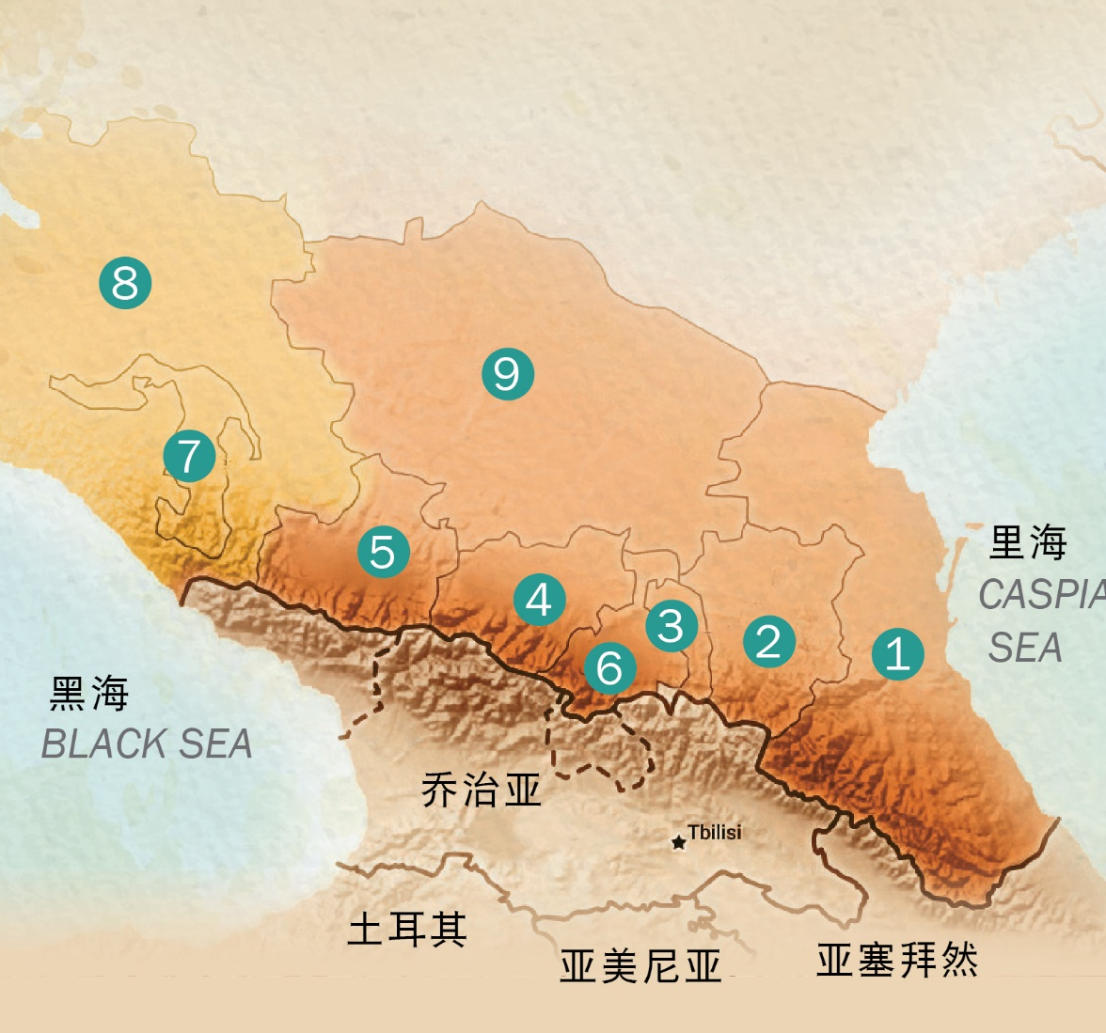
North Caucasus
7 Republics and 2 Border Regions
Republic of Dagestan
Republic of Chechen Republic
Republic of Ingushetia
Republic of Kabardino-Balkaria
Republic of Karachay-Cherkess
Republic of North Ossetia
Republic of Adygea
Krasnodar Krai
Stavropol Krai
Notes:
Today, we pray for the Muslim regions of the North Caucasus, which consist of seven republics and two border regions. (Note that the term "republic" here does not refer to independent countries as we commonly understand it, but rather entities within the Russian Federation.)

Slide 4
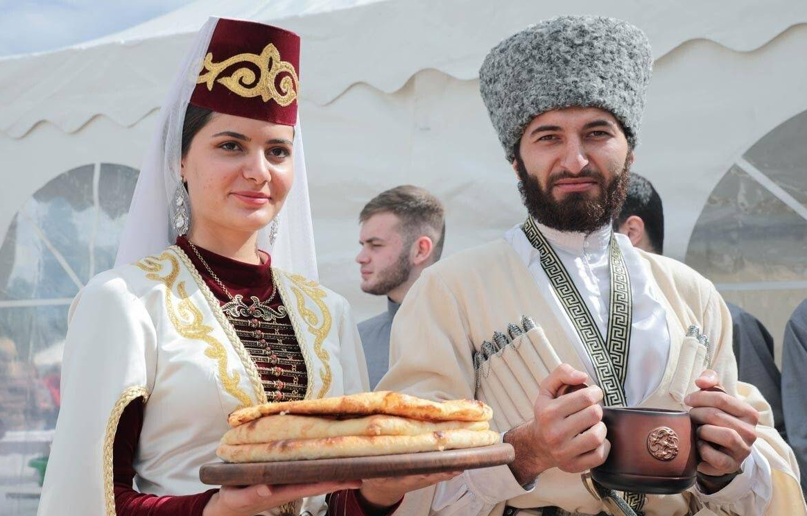
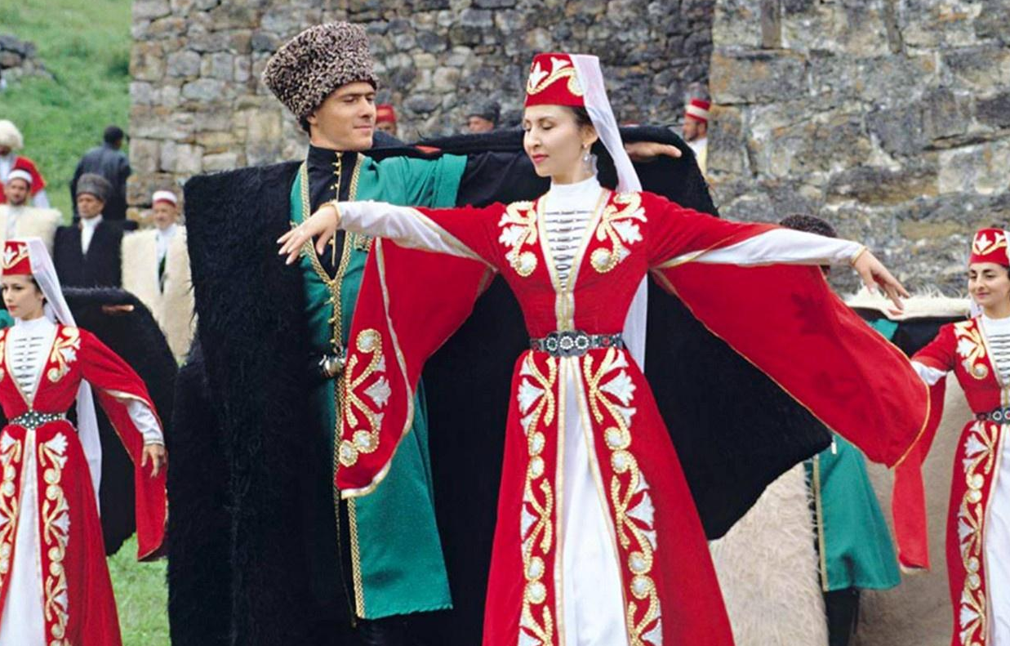
North Caucasus Region Obstacles and Needs in Spreading the Gospel
Geographically remote with complex languages.
Strong sense of pride and honor, a tendency towards conflict and suspicion of outsiders.
Unstable political situation and a breeding ground for unrest.
Deep-seated animosity and enmity between nations, which can only be healed by the power of the Lord.
Ossetians
Ingush
Notes:
After being governed by the Russians in three different periods—the Tsars, the Soviet Union, and the Russian Federation—today, the Caucasus region remains the poorest and most unstable area in Russia. It faces high unemployment, high birth rates, and severe corruption. Suppression of Muslim communities by the Soviet and Putin's regimes, along with racial displacement, has led to a rise in acts of revenge, terrorist attacks, and a surge in extremism.
The 50 ethnic groups in the Caucasus, including Turkish and Iranian ethnicities, are among the least reached people groups globally in hearing the Gospel. More than half of these ethnic groups do not have a translated version of the Bible. Besides the challenges from various geographical remoteness and complex languages, the inherent nature of nomadic pastoral communities, characterized by combativeness, closedness, pride, and a defensive attitude towards outsiders, along with a culture centered around honor and revenge but forgiveness.
During World War II, the Soviet Union accused the Ingush people of supporting Nazi Germany, resulting in the forced expulsion of the entire ethnic group to Kazakhstan and Siberia. Two-thirds of the population died during this forced exile. After more than a decade, they were allowed to return to their homeland, but their lands had been occupied by other ethnic groups and were assigned to the North Ossetia Republic, which was predominantly Christian. This led to severe conflicts.
After the dissolution of the Soviet Union, Islam experienced rapid growth, and extremist Islamic ideologies spread widely and deeply into society. This led to the emergence of military forces seeking to counter Russia's influence and strive for independence.
Because of its significant oil production, the region became a target of both major powers and oil-producing nations, leading conflicts and unrests.
Today, we pray for the seven republics and two border regions of North Caucasus’ Muslim regions.

Slide 5
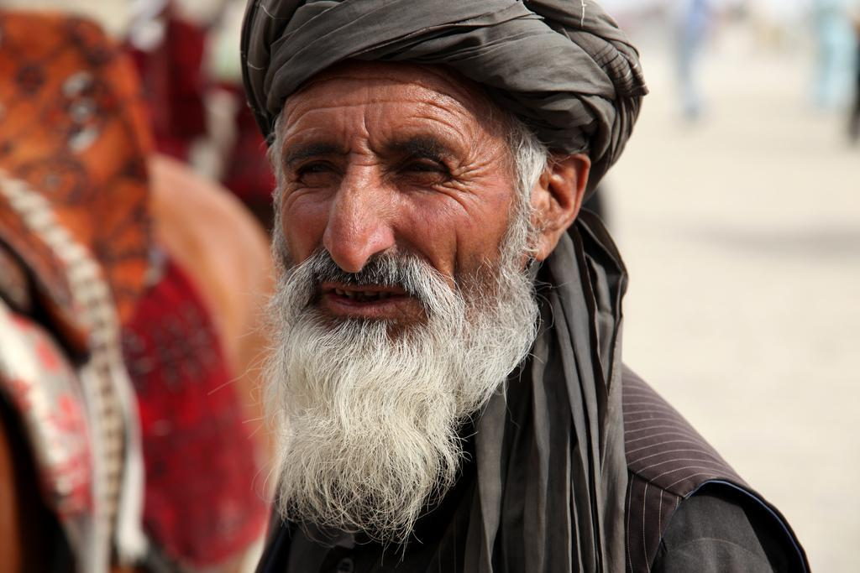
Let us pray together for North Caucasus

Slide 6
Heavenly Father, when rulers on earth maintain their power through violence and killings,
You govern all things with grace, love, and faithfulness.
We pray that You heal the deep historical wounds of many ethnic groups in North Caucasus, grant them a willing spirit to forgive and reconcile, break the animosity between Chechens and Russians, and resolve the hatred between Ingush and North Ossetian communities.
Your wisdom surpasses human understanding. Please remove the divisive consciousness that separates different ethnic groups.
You are the eternal King. May all peoples become Your children, united as one in Christ!
Heavenly Father, ethnic groups in North Caucasus are afraid of dark powers and heavily rely on witchcraft.
May the Holy Spirit set them free from bondage, bring their bodies, minds, and spirits health and abundance.
We pray, glorious Father, that You will grant the spirit of wisdom and revelation to those translating the Bible.
May Your words be proclaimed throughout North Caucasus.
May each ethnic group hear Your message in their own language.
We ask God to help Muslims in the North Caucasus understand that the Quran only seeks to maintain a master-servant relationship with Allah,
whereas the triune God desires to restore our relationship with Him as His children.
Notes:
The prayer is divided into two font sizes and can be done in responsive reading. Men, women, or the congregation take turns leading in prayer.
Gentle reminder: When leading the prayer, please avoid reading too fast. For the entire congregation, it might be their first time seeing the prayer. If the leader reads too fast, the congregation may not be able to keep up. When they feel unable to keep up, they might choose to just read silently, and that would defeat the purpose of unified responsive prayer.
Thank you, prayer leader.

Slide 7
Heavenly Father, North Caucasus is a breeding ground for turmoil, harboring hatred and national animosity.
Terrorist attacks and extremist ideologies prevail. People cannot live in peace.
We pray for Your mercy and blessings.
In one heart, we beseech You to draw the 50+ ethnic groups in North Caucasus to be touched by Your love.
May they come together under the shelter of Your mighty wings, protected from the ravages of war.
May You provide for all their needs.
We ask the Lord to oversee the leaders of the 7 republics and 2 border regions in North Caucasus.
May they come to know You, hold You in reverence, and remove all corrupt desires from their hearts.
May all sectors of society experience stable growth and a solid economy, and the people lifted out of poverty.
We pray for the Lord to send His angelic hosts to protect the churches, ministers, and missionaries.
May they not fall into temptation, but delivered from evil, and always be accompanied by miracles and wonders.
May the Holy Spirit strengthen, comfort, and edify the churches in North Caucasus,
enabling them to experience Your presence and deliverance in times of difficulty.
In the name of our Lord Jesus Christ, we pray. Amen!
Notes:
The prayer is divided into two font sizes and can be done in responsive reading. Men, women, or the congregation take turns leading in prayer.

Slide 8
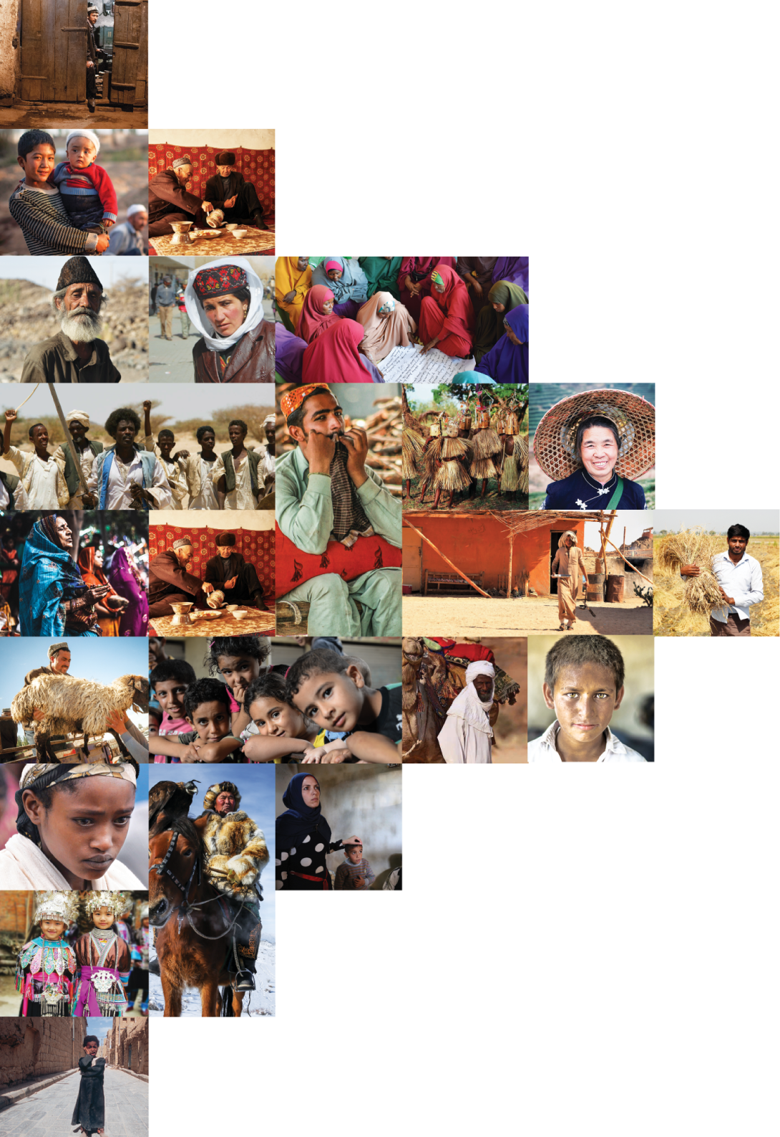
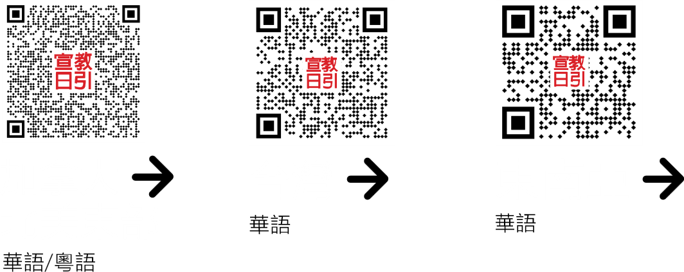
不再是个人的祷告，我们开始一起祈祷。 30分钟，生活再忙碌的人都能找到时间参与。

