Slide 1
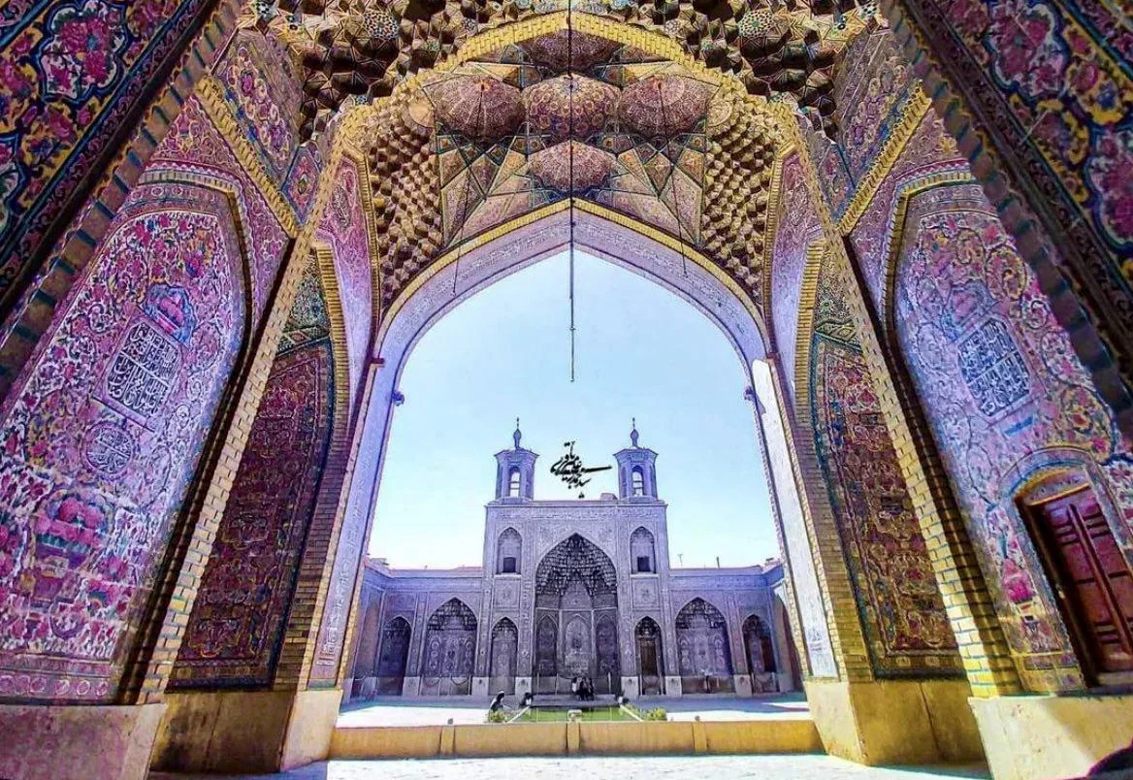
April 2023
30-Day Prayer for the Muslim World
Notes:
Nasir ol Molk Mosque is located in Shiraz, a famous historical and cultural city in Iran.
Shiraz is the legendary capital in ”One Thousand and One Nights" and the Persian soul of "The Rose and the Nightingale".
Nasir ol Molk Mosque is known as one of the most elegant and photogenic mosques,
It is also known as the "Pink Mosque" because of the large number of pink tiles in the interior.
Construction of the mosque began in 1876 and was completed in 1888.
In addition to the typical features of traditional mosque architecture, it also has the very rare, large stained-glass windows (usually seen in European churches).
https://k.sina.cn/article_6529083486_18529e85e00100hvkt.html

Slide 2
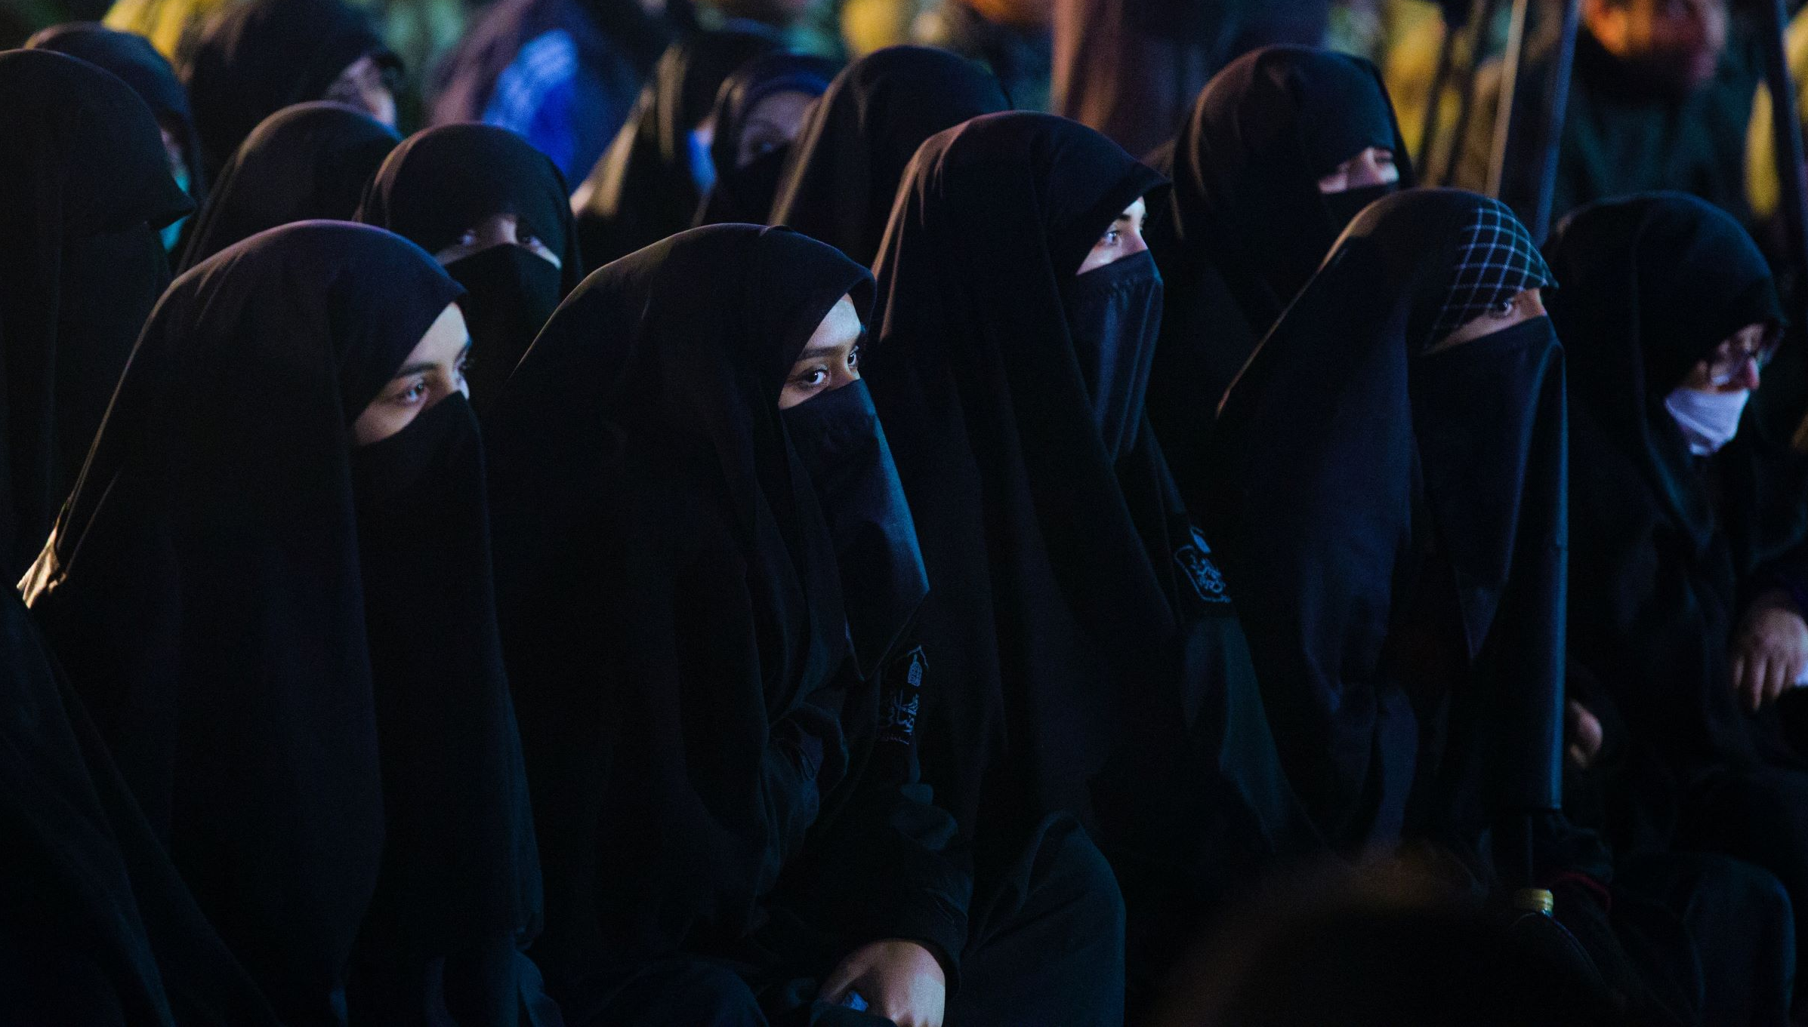
Getting to Know Islam
RAMADAN The Muslim fasting month: 3/22-4/20
Islamic Sects | % of Muslim Population | Interpretation of Doctrine / Enactment of Law | Leadership
Sunni | 85% | Practices Islam according to hadith and holy scriptures | Public selection
Shia | 15% | Laws made and doctrines interpreted by successors | Muhammad's direct relative
Notes:
This year, March 22 to April 20 is Ramadan for Muslims. Let us learn more about the sects of Islam - the Sunni and the Shia.
Islam believes that Allah sent many prophets to teach mankind. Those prophets included Abraham, Moses, and Jesus.
Muhammad, the founder of Islam, was the greatest and the last prophet.
Muhammad was born in Mecca. He lost his father when he was young and was raised by his uncle.
Muhammad then took care of his uncle's son, Ali, who later became his son-in-law.
After Muhammad's death in 632 AD, believers divided into Sunni and Shiite denominations as they split on who should be the heir.
Sunnis believed that successors should be chosen openly from those leaders who were capable and virtuous. Sunni means ‘Sunnah'.
The Shiites supported Ali and believed that the leadership should be inherited by Muhammad's closest relatives and that was, Ali, who was both his first cousin and son-in-law to Mohammad.
Shia is the abbreviation of Arabic ‎”Shia-ne-Ali”, which originally means followers of Ali.
Ali was assassinated in 661. 18 years later, Ali's son was massacred together with 72 companions and family members in a bloody siege.
Every year Shiites gather in Ashura to commemorate the event with tears and chants for ten days. Shiites often consider themselves victims.
Sunni： Accounts for about 85% of the world’s Muslim population. it advocates teachings should be interpreted by hadith and holy scriptures, not individual leaders or scholars. Leaders should be chosen by the entire Muslim community, not Muhammad's direct relatives.
Shia：
Accounts for about 15% of the world’s Muslim population, it advocates that Muhammad's successors can define laws and interpret teachings.
The selection of its leaders is exactly the opposite of the Sunnis. Shia countries include Iran and Iraq.
Additional information about Shia:
Ali's father, Abu Talib, and Muhammad's father, Abdullah, were brothers of the same parents (Muhammad's other uncles had different mothers), so the two families are extremely close.
Muhammad lost his father in his early years and was raised by Ali's father. And Muhammad raised his first cousin, Ali.
After Muhammad married his favorite fourth daughter, Fatima, to Ali, he implicitly designated Ali as his heir.
The division between Sunnis and Shiites began after Muhammad's death. Shiites believed that Muhammad designated his son-in-law, Ali bin Abi Talib, as his successor.
But Sunnis believed that Mohammad had no designated successor and recognized Abu Bakr, elected by the community, as the orthodox first caliph.
Shiites also believed that Muhammad's family was absolutely correct and innocent, and that they were the Muslim leaders chosen by Allah.
Shia Islam came from the abbreviation of Arabic شيعة علي (Shīʻatu ʻAlī, Shia-ne-Ali), which originally meant followers of Ali
Iran and Iraq are predominantly Shia Muslim countries. Bahrain and Lebanon also have many Shia Muslims.
Historically, Shiites have been repeatedly suppressed by the Sunnis, so they often regarded themselves as victims.

Slide 3
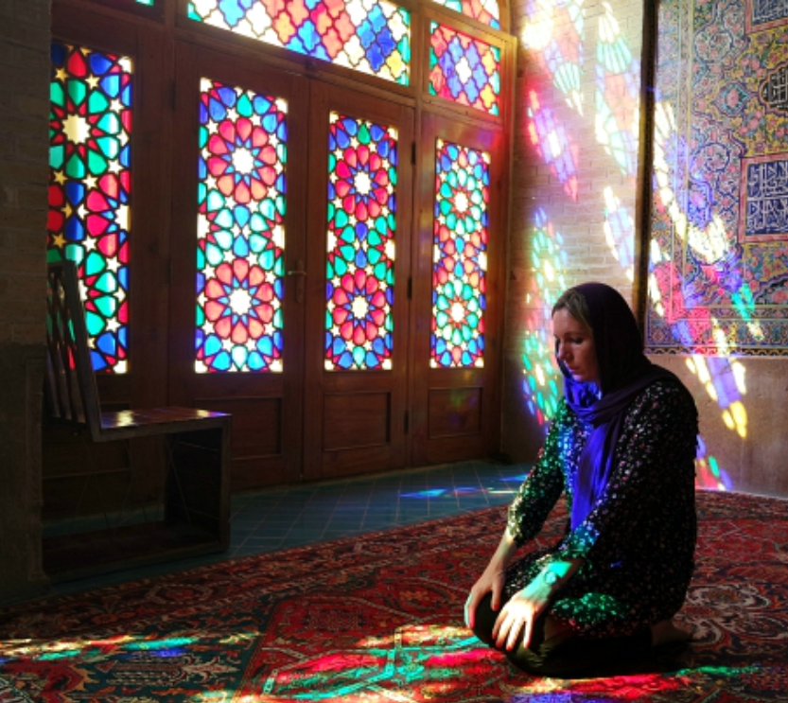
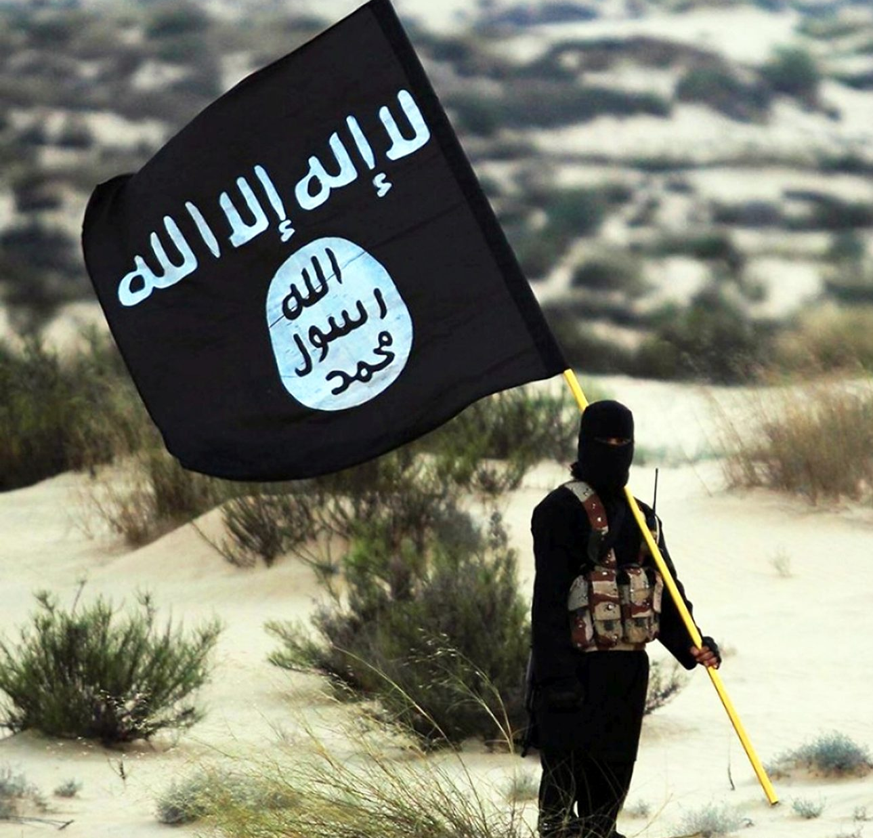
Sufism
Through ritual practices to express love for Allah, get close to him, and reach the state of unity with Allah.
Accounted for 5-20% of all Muslims
Jihadism
The greatest deed is to please Allah in order to be saved.
Different aspects, which include self-denial of the individual and using attacks to restraint any rejection or opposition to Islam. The goal is to have the whole world to eventually become Muslims.
Ideological: Prioritizing, absolutize, and extremize violence as the means to achieve.
Notes:
Sufism
Both Sunni and Shia have Muslims practice Sufi
It is believed that the love for Allah can be expressed through abstinence, meditation, prayer, music and spinning dance - in order to get close to and to unite with Allah, without the need to wait for the doomsday judgement.
The moderate and mystic group in Islam. The number of people is about 5-20% of total Muslims.
Jihadism
Islamic radicals who advocate the expansion and protection of Islamic development by means of force.
Its goal is to establish an Islamic social order throughout the world, and people all over the world will eventually become Muslims. The most famous groups are Al Qaeda, Taliban, and ISIS.
It has been condemned by the vast majority of scholars in the Islamic world, who believed that Jihadism has distorted the Islamic spirit.
Jihad is considered the greatest deed
Since there is no certainty of salvation in the Islamic faith, one can only be saved by doing things that please Allah to gain mercy. Performing jihad is regarded as the most pleasing thing to Allah.
Muhammad said: “To believe in Allah and His Apostle (Muhammad) is the best deed. The next is to participate in Jihad (religious fighting) in Allah’s Cause.” (Bukhari 1:2:25)
Different aspects of jihad
Jihad is an action to fight for Allah and to expand Islam. It is also a way for Allah to test and to be with Muslims. Actions include armed attacks on any person or country that rejects, opposes, or goes against Islam. It is not purely for self-defense.
It can also include doing your best, working hard, competing, struggling, and dealing with your own evil and selfish desires. Jihad also laid the foundation for violent conflicts between sects
Muhammad recognized jihad as a legitimate means of defending and preaching. Therefore, when there is a conflict between sects, they can legally go to war by labeling the other party as violating Allah.
Jihad tends to be ideological among minorities
Jihadism refers to the prioritization, absolutization, and extremization of violence by certain Muslim factions in order to overthrow Western rule, establish an Islamic state, and force non-Muslims to convert.
After the Soviet Union invaded Afghanistan in 1979, various jihadist movements emerged and were later expanded into various Islamic terrorism, of which Al Qaeda being the representing force.

Slide 4
Let us pray together for the Muslim World

Slide 5
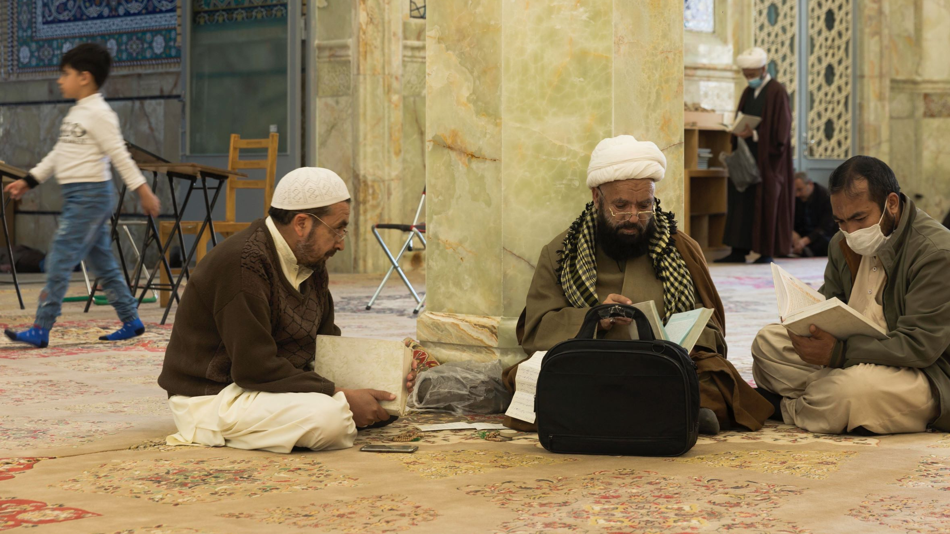
Pray for the Shia Muslims
Dear Loving Father, Thank you for sending your only son to this group that is full of history of killings and hatred. Please reveal to all Shia Muslims your only son, Jesus Christ.
Only Christ can heal the tremendous wounds they suffered in the past. Please release Shia Muslims by the Holy Spirit from the bondage and hatred left from the murder of their ancestor, Ali, and turn their lamentation into dancing.

Slide 6
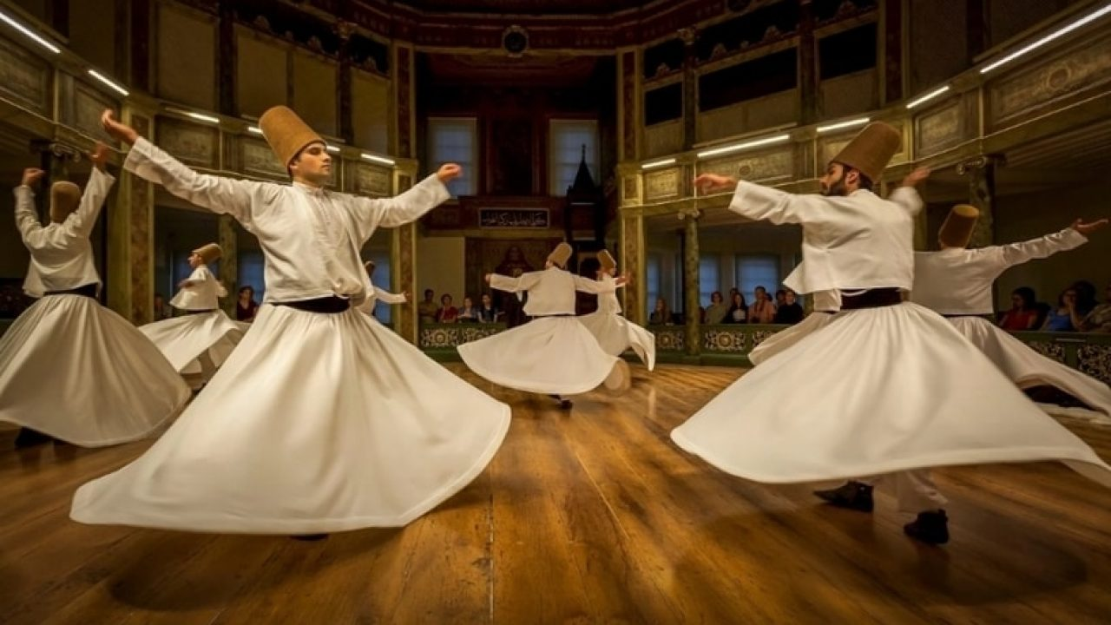
Pray for the Sunni Sufi Muslims
Oh Lord, Your word is a lamp for my feet, a light on my path. Only Jesus Christ is our example to follow.
Please lead all Sunni Muslims and Sufi Muslims to be enlightened by the Holy Spirit when fasting, praying, and meditating. By hearing the message about Jesus, our Savior, they will receive divine revelation, experience the kingdom of God that only Jesus Christ can enter and through him to be saved.

Slide 7
Pray for the Stability of the Muslim Society
Dear Heavenly Father, Please open the minds of the Muslim community, so that they realize that the best way to solve problems is not to conquer by force, but to rely on the love and peace that comes from the true God.
Please make them see through the mistakes of the few extremists, no longer be manipulated and used by the evil ones, cherish their own lives and the lives of others, pursue the peaceful coexistence with all nations and peoples.

Slide 8
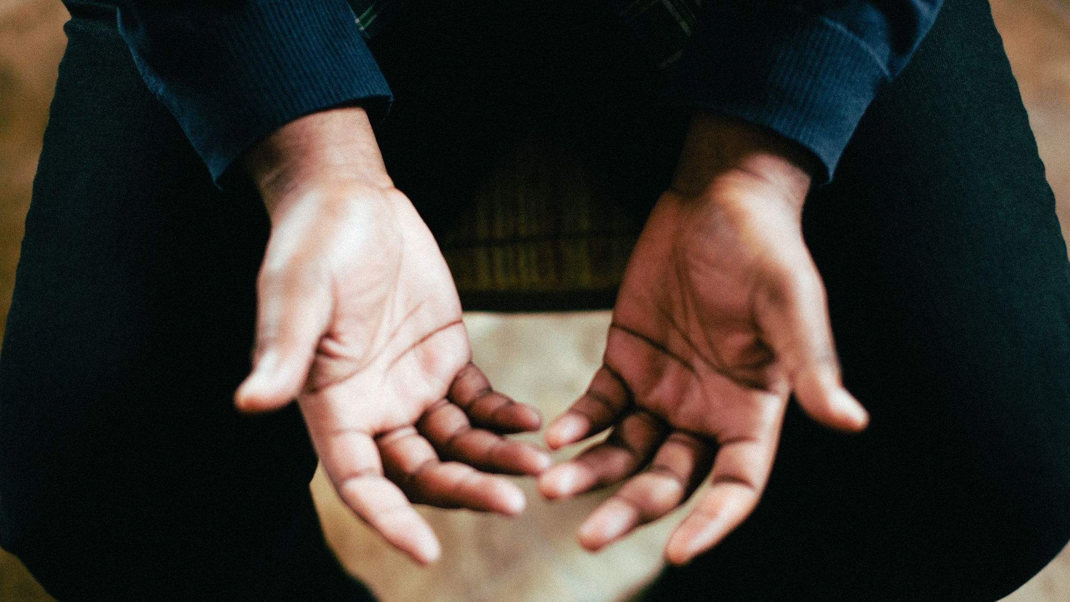
Pray for Jesus’ Followers among Muslims
Dear Heavenly Father, We pray for all brothers and sisters who keep the faith and are disciples of our Lord, Jesus Christ, in the Muslim world.
We ask the Lord to provide your people with their daily needs and keep them safe. May the Lord give them courage and hope, With the power of the Holy Spirit to be light and salt among their people, and in wisdom to spread the gospel of the Savior's grace. In the name of our Lord Jesus Christ. Amen!

