Slide 1
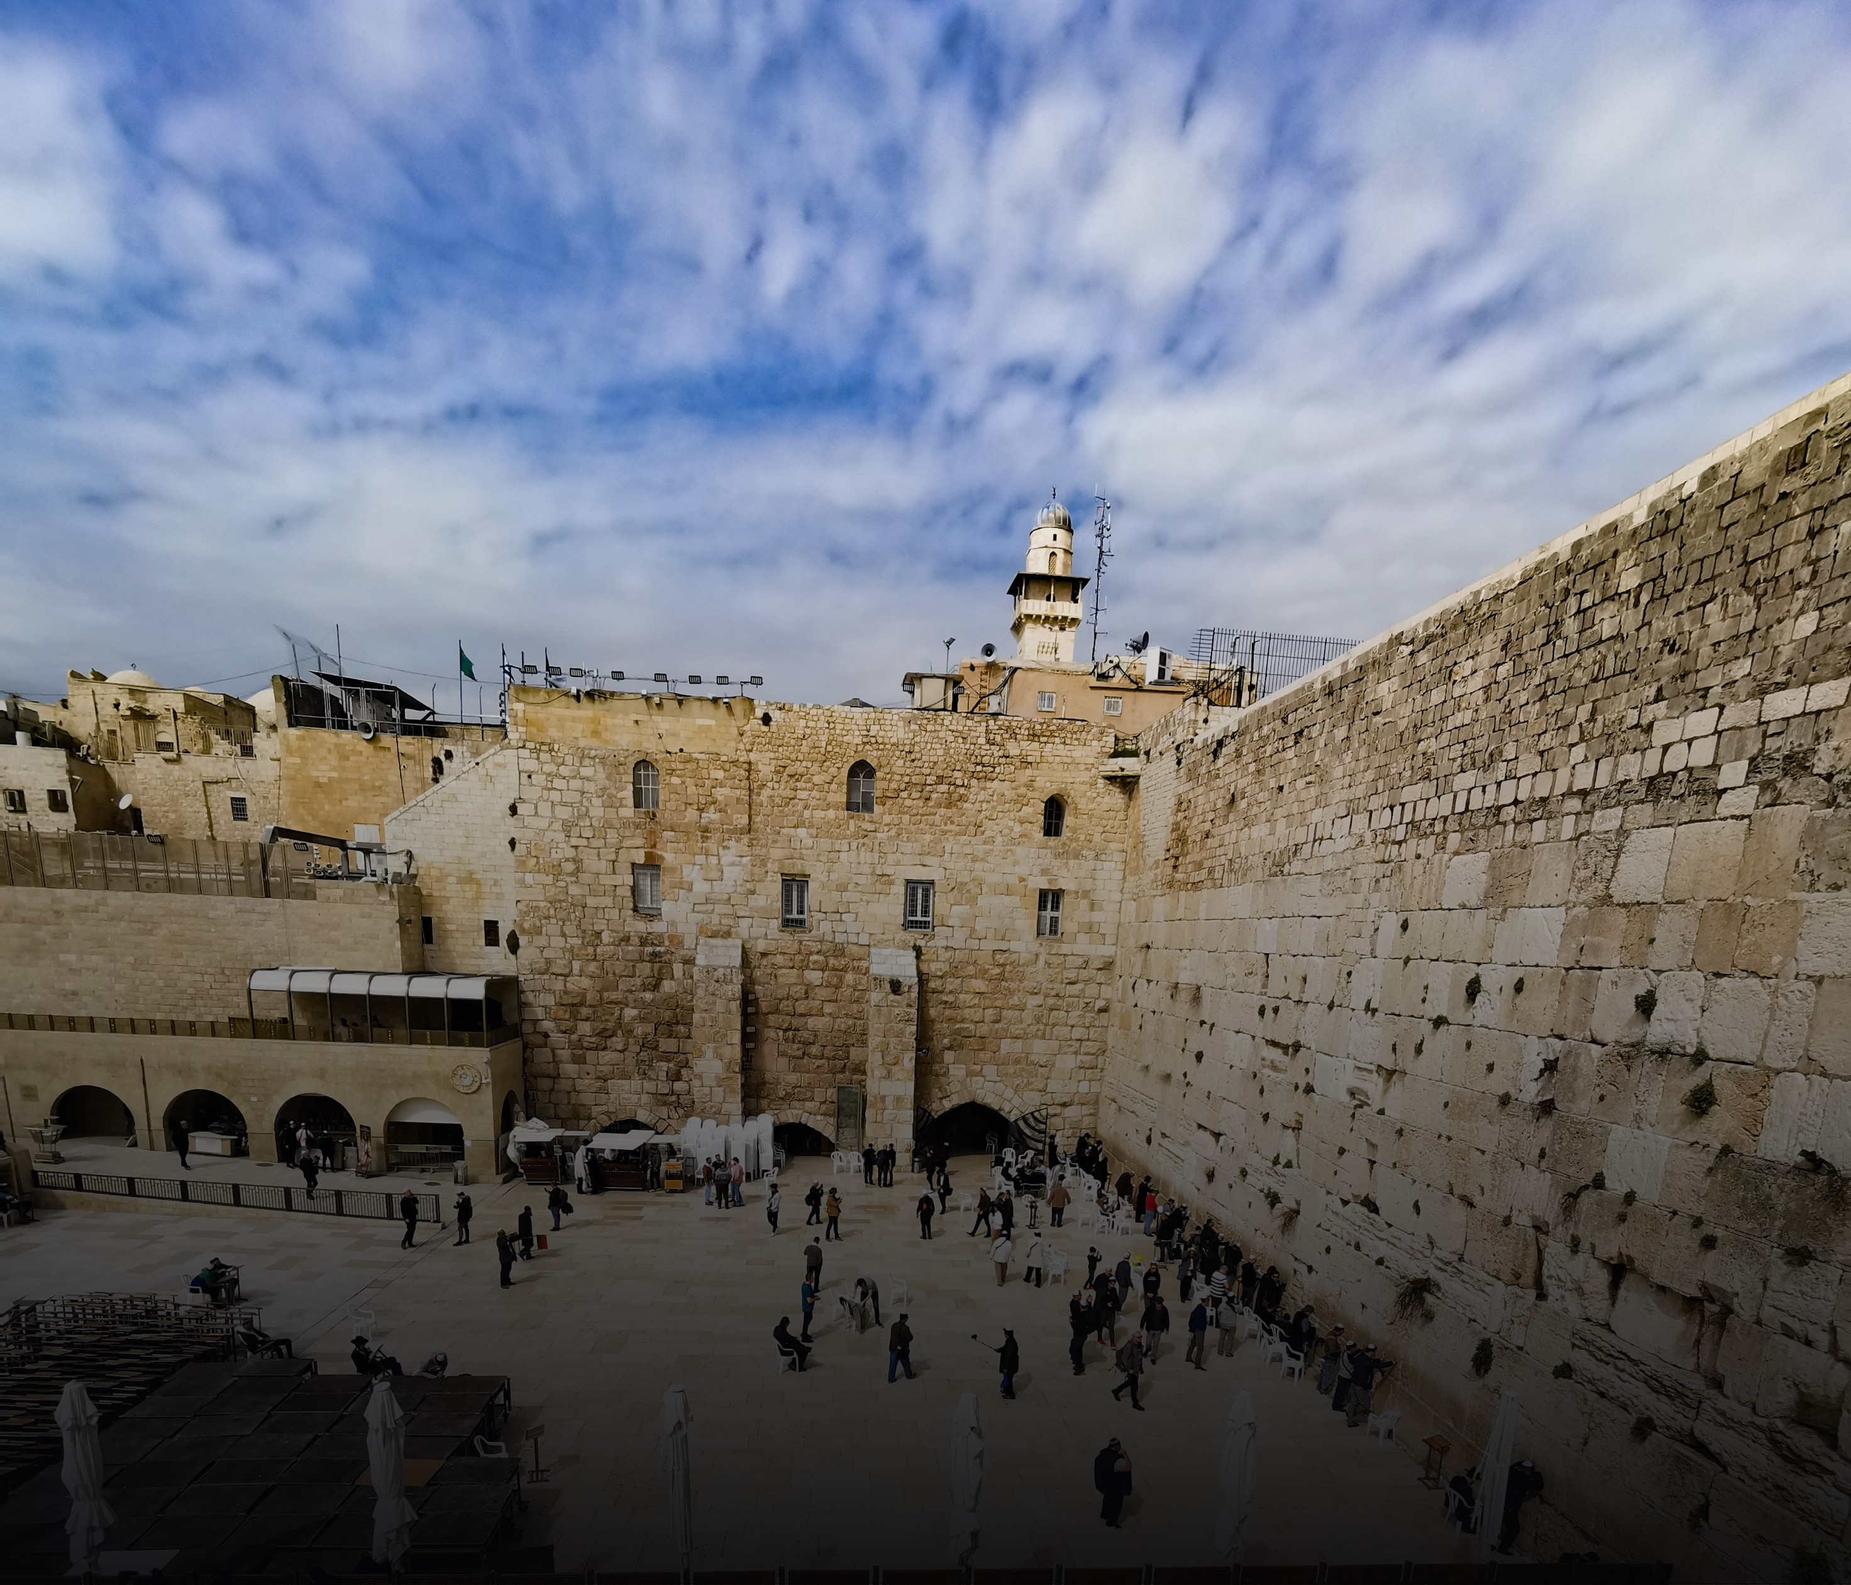
September 2022
Pray for the Jews
Notes:
Speaker Notes for Reference
Introduction:
Today, let us pray for the Jewish people who have been displaced for two thousand years.

Slide 2
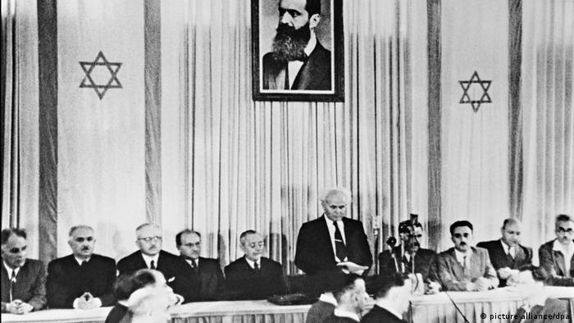
《Declaration of the Establishment of the State of Israel》
After being forcibly exiled from their land,
the (Jewish) people kept faith with them throughout their Dispersion
and never ceased to pray and hope for
their return to their land and for the restoration in it of their political freedom.
- May 14, 1948 -
Notes:
Speaker Notes for Reference
The Jewish nation was destroyed and had been tossed in all directions among the nations of the world. The beliefs and lifestyles of Jews everywhere are different from the "Jews" we know in the Bible.
What have they experienced? What do Jews nowadays think about Jesus?
Source of《Declaration of the Establishment of the State of Israel》
https://www.gov.il/en/Departments/General/declaration-of-establishment-state-of-israel#:~:text=On%20May%2014%2C%201948%2C%20on,of%20the%20State%20of%20Israel.
1948 復國宣言Source:
https://www.dw.com/zh/%E5%86%85%E5%A1%94%E5%B0%BC%E4%BA%9A%E8%83%A1%E5%80%92%E5%8F%B0-%E4%BB%A5%E8%89%B2%E5%88%97%E6%96%B0%E6%80%BB%E7%90%86%E8%B4%9D%E5%86%85%E7%89%B9%E6%98%AF%E8%B0%81/a-57877663

Slide 3
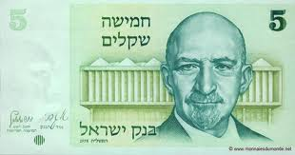
1948 Nation Restored
Returned again
Jews - the Diaspora
Sojourn - Enslaved
Wander - Nation founded
Captivity - Returned
Diaspora – Massacred
Chaim Weizmann
Israel’s 1st Prime Minister
Notes:
Speaker notes for reference
The Jews, God's chosen people, are a diaspora.
Jacob's family of 70 sojourned in Egypt and served as Egyptian slaves for 400 years.
After 40 years wandering in the wilderness, the Israelites settled in the Promised Land. 400 years later, the country was founded. The Israelites were scattered by Ashur for worshipping idols and going their own way. They were taken captive by Babylon in 586 BC, then returned to Jerusalem after 70 years.
70 AD Because of the rebellion against the Romans, Jerusalem was destroyed by the Roman army. The temple was burned, Jewish leaders and elites were killed, fled or taken captive to all parts of Rome to be sold as slaves, and the Jews began to scatter all over Europe.
1933-1945 The Nazi government of Germany was facing economic difficulties. In order to snatch the wealth of the Jews and influenced by the theory of racial superiority, the Nazi government of Germany carried out genocide on the Jews. 6 million Jews died in the Holocaust.
The Bible predicts that the Jews will be scattered abroad from Israel, but it also predicts that they will return to their homeland again, and all Israel will be saved.
President of the Zionist Movement, Weizmann, was a Russian-born British-Jewish chemist. During the First World War, he led the Royal Naval Laboratory of the United Kingdom and invented the production of smokeless explosives through bacterial fermentation, which brought victory to the Allied countries led by the United Kingdom and the United States.
After the victory, he persuaded the British to consider the plight of the Jews and facilitated the British’s support of the Zionist cause.
In 1948, the nation of Israel was restored. Weizmann became Israel's first prime minister.

Slide 4
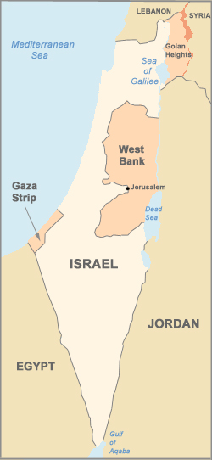
Israel The Challenges of the 7.02 million Jews
Conflict with the Arab world
Lack of housing and employment opportunities due to surge in immigration
Conflicts among sects
50% of Jews inclined to be secular,
turning away from the word of God.
Jews are wary of and resistant towards Christians and Jesus Christ. The government also boycotts evangelism.
Notes:
Speaker notes for reference:
Before the Holocaust, there were 16.7 million Jews. Today, there are 15.2 million Jews in the world, 7.02 million in Israel.
In 1948, when the country was restored, there were 800,000 Jews in Israel. 3.3 million returned from various places.
The returning Jews came from everywhere, with different cultural backgrounds, languages, beliefs, personalities and physical appearances.
In this seemingly single but diverse ethnic group, Judaism alone is divided into Orthodox, Conservative, and Reform.
Their attitudes towards the state and religion are very different.
Therefore, the challenges faced by the Jews in Israel, besides the conflicts with the Arab world, also include inter-sectarian conflicts and lack of housing and employment opportunities due to a surge in immigration
In terms of faith/belief, 50% of Jews are becoming more and more secular, turning away from the Word of God.
Jews are wary of and resistant towards Christians and Jesus Christ. Israeli government boycotts evangelism.
But thanks to the Lord that there were about 23 Messianic believers (that is, Jewish Christians) when the nation was restored, and there was no church yet.
Currently there are more than 150 churches in Israel, with a conservative estimate of 30,000 Messianic believers.
It is still a long way from the whole house of Israel being saved. Let's understand more about the Jewish faith.

Slide 5
Judaism
Christianity
Believe in the Unitarian God.
The Messiah is human, not God.
Do not believe in original sin, but that the tendency to sin can be overcome by repentance.
There is no concept of personal salvation and little emphasis on the afterlife.
It doesn’t believe that personal atonement is necessary through blood; but it believes that repentance, good works, prayer, and personal suffering can replace the sin offering.
The knowledge and succession of the emphasize of the necessity of good deeds and strict observance the commandments in the Pentateuch, is passed on to the next generation through tradition..
.
Believe in the Trinitarian God.
Messiah is fully man and fully God.
The fall of Adam affects all mankind, and it is only through the blood of the Messiah that they can be spiritually renewed and transformed.
Have the concept of personal salvation and value the destination of afterlife. The afterlife is very important, especially between heaven and hell.
Man can only be saved through the substitutionary atonement of the Messiah.
Emphasis on good deeds and regenerated life; stronger emphasis on faith
Notes:
Let us pray for the salvation of all Israelites.

Slide 6
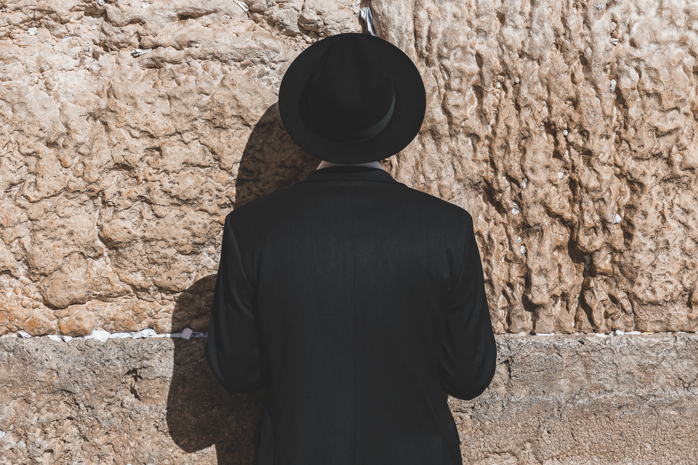
Let us pray for the Jews together

Slide 7
Our Lord, who reigns over history,
many of Your chosen people are still scattered around the world.
May You put an end to all anti-Semitic sentiments.
May You make them be respected among the nations, free from persecution, and able to bear witness to the world that Your word stands firm in heaven.
May the Lord make them no longer wary of Christians, may the Holy Spirit lead them into the truth,
be transformed by the renewing of their minds,
no longer depend on works and self righteousness, accepting that Jesus Christ is the culmination of the law, and Jesus is the Messiah, Son of Almighty God.
Notes:
Scattered in Turkey, Iran, Brazil, Portugal, Iraq, Uruguay, India, France, Romania, Poland, the United Kingdom, the United States, Canada, Australia, etc.

Slide 8
May the Lord protect and strengthen the Messianic believers in Israel,
Raise up shepherds who follow your heart to take care of the people,
Help them to be mature and steady in faith,
May the Lord bring believers of Jews, Arabs and other ethnic groups in love and be united in the Lord,
be kind and compassionate to one another, that your people be equipped and the church be built .
May they be united in helping the immigrants returning to Israel to integrate into society
and be witness of Jesus.
Notes:
Photo： https://ots.org.il/program/hertog-center-jewish-christian-understanding-cooperation-cjcuc-2/

Slide 9
Dear Father, may Your spirit be poured out on Israel’s young generation. Teach them Your way.
Protect them from the worldly thoughts,
And honor Your words.
Father, we ask you to preserve the godly offspring for your people, and raise up among them leaders who fear you, walk in the light, and be blessings to the world.

Slide 10
Father God, we pray for Israel's upcoming presidential election this fall.
Abolition and establishment of kings
are all in your hands. Lord, please guide the hearts of the voters to choose a president who acts justly, loves mercy, and walks humbly with You.
Grant him decision-making wisdom and execution ability.
Please raise up godly government, head in defense,
treasury, commerce, education, health departments,
and show them the way they should go.

Slide 11
Our Father who are in heaven,
May your kingdom come, and your will be done in Israel as it is in heaven above,
Draw your people to you Son, heal and bring them back in full repentance
Satisfy them with your goodness
Forgive their transgressions as they also forgive others.
Lead them not into temptation. Deliver them from evil.
For thine is the kingdom,
and the power, and the glory, forever.

