Slide 1
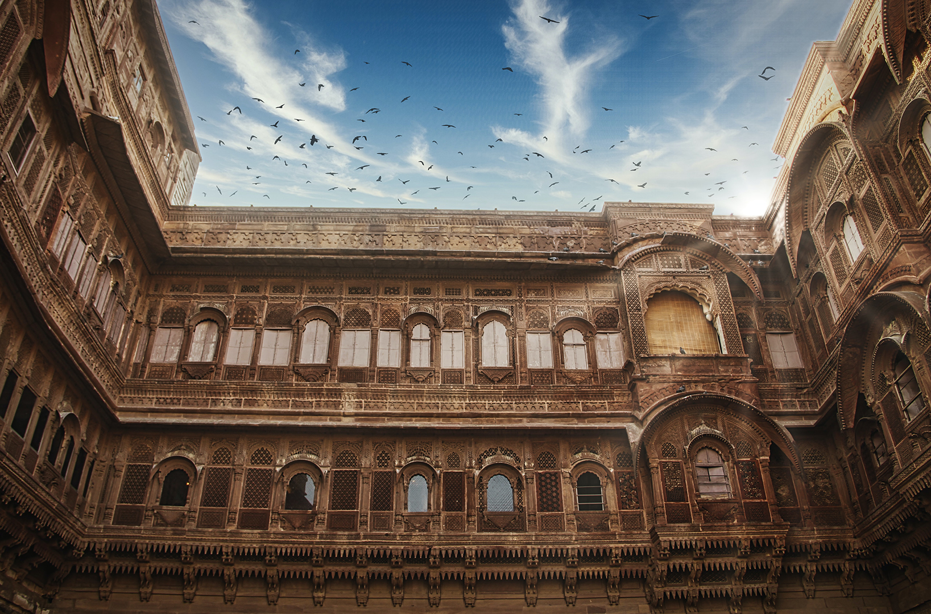


March 2022
The Least Reached Provinces（III）
Notes:
introduction:
Starting in 2022, the 22-week global prayer theme will be about "a least reached province" every week. In March, we pray for Rajasthan of India, Banten of Indonesia, South Sumatra, and Madhya Pradesh and Punjab of India.

Slide 2
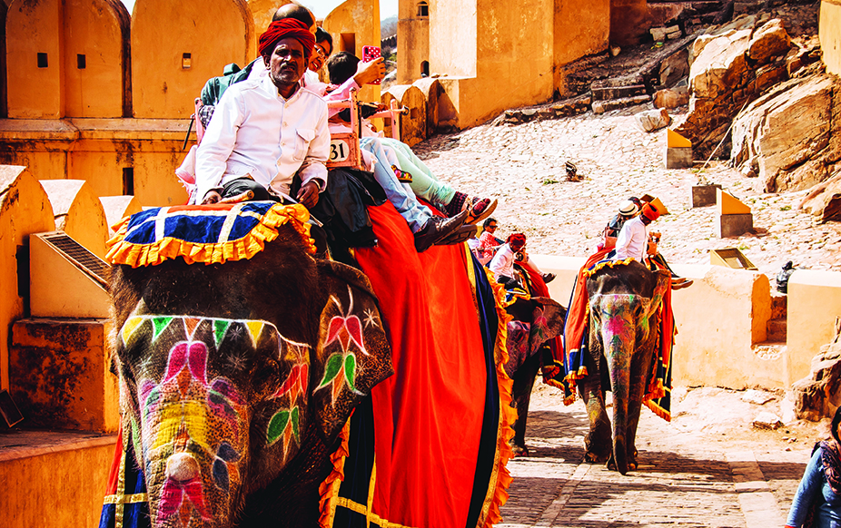

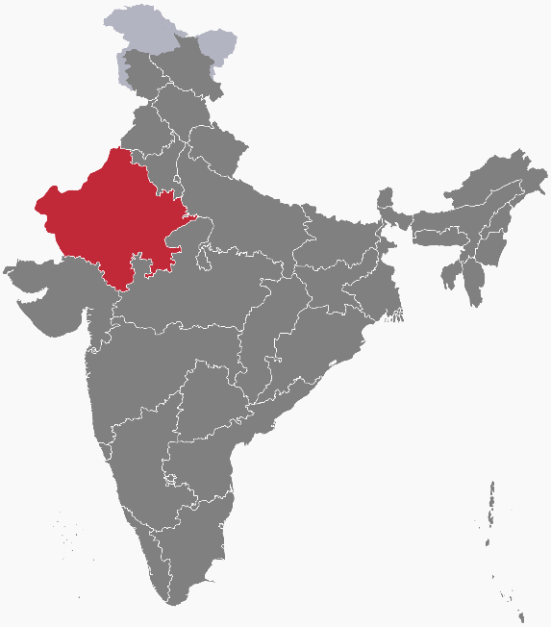
{
Rajasthan, India
Meaning the “Land of Kings”, an area where higher castes reside.
The largest province in India with the most tourists.
A population of 80 million with 545 unreached people groups, of which 90% is Hindus.
The main ethnic group is the Rajputs, a Hindu military caste
Christians are often violently attacked by the Hindu militants.
Evangelism has mostly focused on the lower caste groups in the big cities. Church planting work in rural areas is rare.
Notes:
Meaning the “Land of Kings”, an area where higher castes reside.
The largest province in India with the most tourists.
In the state, there are desert dunes, camels, Indian tigers, temples, castles, four-colored cities
In the village of Abhaneri near Jaipur, the capital of Rajasthan in western India, is a famous and ancient moon well "ChandBaori” that belonged to a king.
It is almost 1,200 years old, with 3500 steps of stairs, built in the way of an inverted triangle,
It is known by the people as the oldest and deepest first well in India. The closer you get to the bottom, the cooler you feel.
https://www.ettoday.net/news/20170609/941346.htm#ixzz7LUkSD7tc
In the past, Rajasthan was extremely spiritually barren. In 1994, Global Prayer Digest began to pray for Rajasthan, and God answered the prayers. A major spiritual breakthrough took place!
There are already 300,000 Christians! Today, even though Christians are often persecuted by Hindu militants, there are still 165 Christian organizations and churches in this place that bear witness to the Lord.

Slide 3
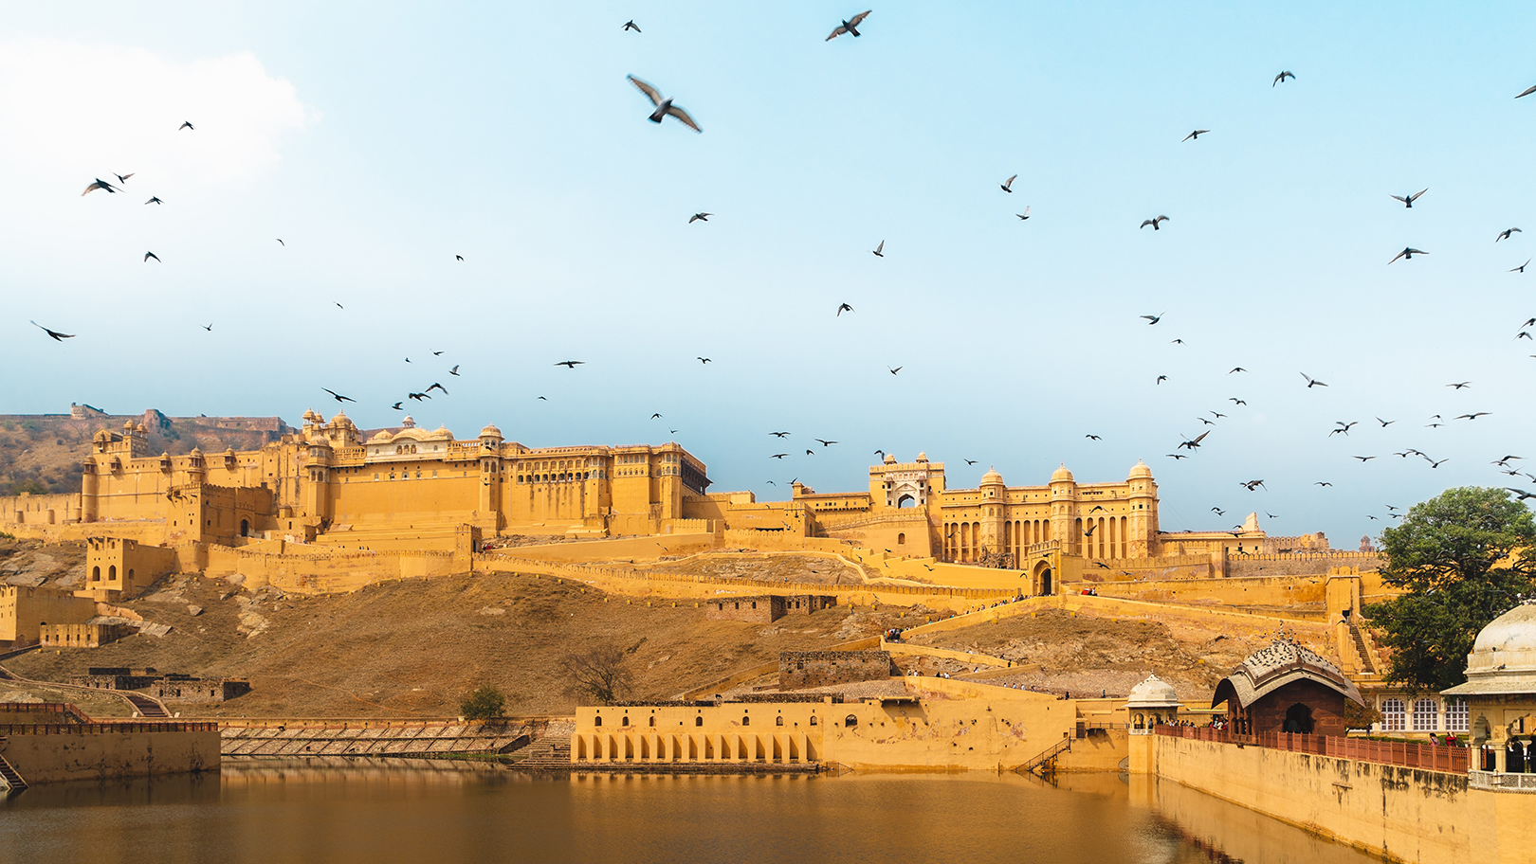
Heavenly Father, we pray for the 545 unreached people groups in Rajasthan. Many of them are Muslims and higher-caste Hindus who showed no response to the Gospel. They also look down upon people of the lower castes.
Oh Lord, they are blinded in many ways. They cannot recognize you as the King of kings. May the Lord deliver their hearts from the evil and bring them back to the Lord of lords.
In the name of Jesus Christ, Amen!

Slide 4
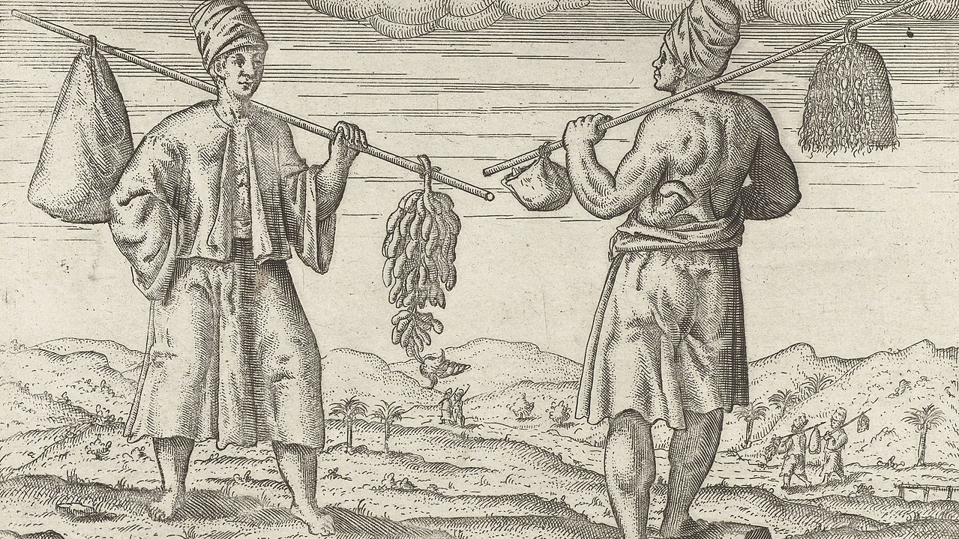

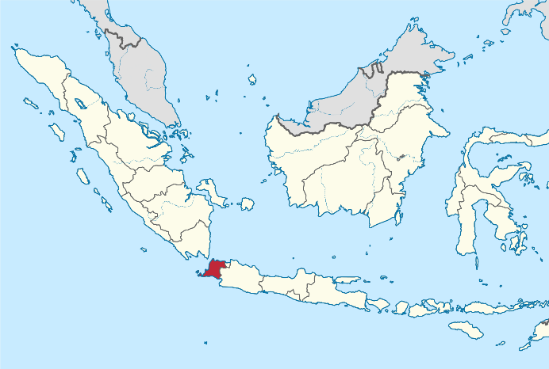
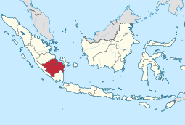
{
Banten Province, Indonesia and South Sumatra
Banten Province
Population: 11 million
People group: 4.6 million Sundanese
Culture: Sudan culture; Debus black magic
Religion: Islam
South Sumatra
Population: 8.47 million
People group: Javanese
Culture: Authentic apparel, dance, food, coffee beans
Religion: Islam
Notes:
Indonesia has gone through many dynasties. E.g., Yogyakarta in Java is a former sultanate. As a result, Banten is rich in multiculturalism: Sultan culture, Islamic culture, Chinese culture, indigenous culture of Indonesian ethnic groups and Debus witchcraft .
Banten is the collective name for the Sundanese people living in Banten Province, Indonesia. They are also the largest group in the province, with a population of about 4.6 million.
They mainly engage in agriculture, while the rest are involved in manufacturing and tourism services in the cities. Most Banten people are Sunni Muslims.
Debus is an ancient witchcraft unique to Banten province. People walk freely on hot coals and pierce the body with sharp weapons.
They believe that only the pure can obtain the mysterious inner power and the extraordinary Debus ability from spirits . Many people come here to learn from wizards.
Currently, only a few urban areas in Banten province have Christians. It is still one of the hardest places for the gospel to reach the people.

Slide 5
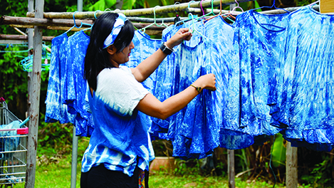
Heavenly Father, please raise up the Indonesian churches to see the needs of the 20 million Bantenese and South Sumatrans. Give them wisdom and strategies to share the Gospel with the people.
Please free the Bantenese from the bewitchery and bondage of witchcraft, ancestor worship, and sacrifice to false gods. Please bring linguists to translate the Bible into the Sumatran language, so that the people get to know Christ as the Lord of all
and experience the Gospel as the power of God unto salvation. In the name of Jesus Christ, Amen!

Slide 6
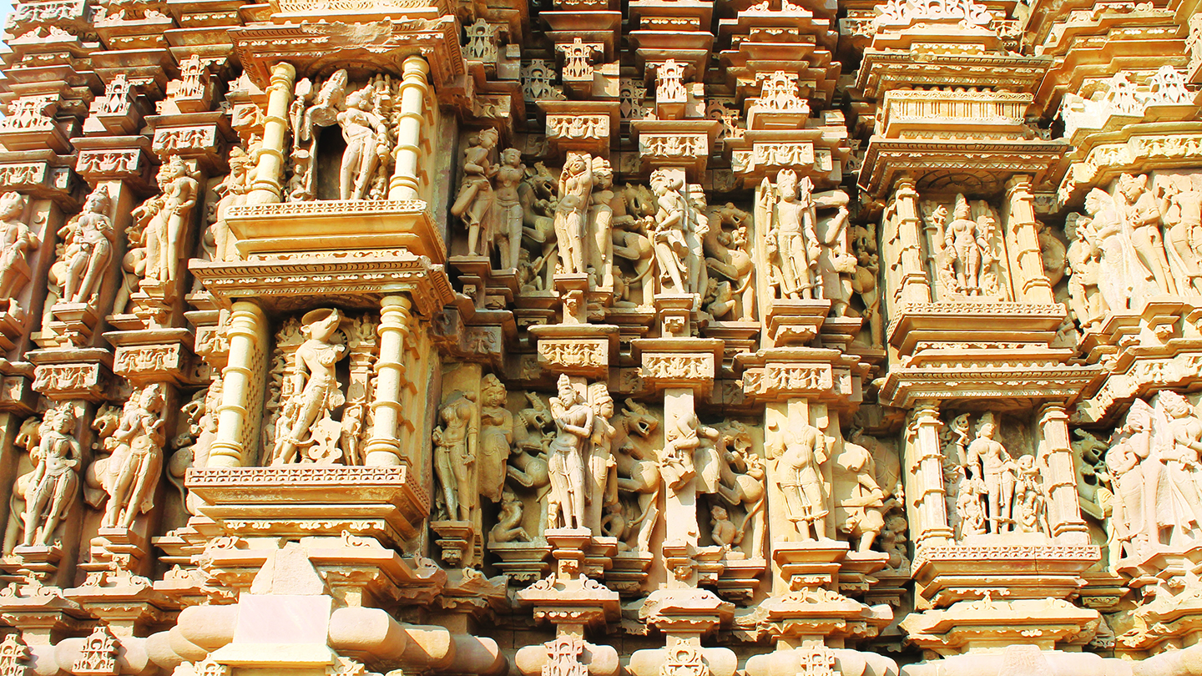
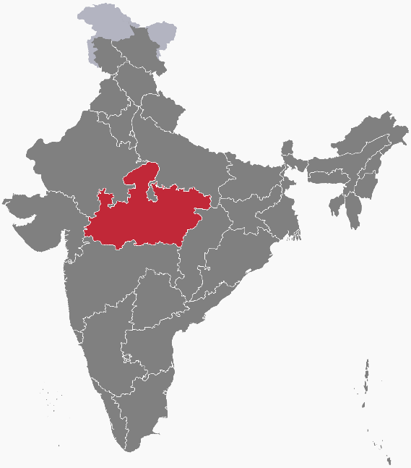
{
Madhya, India
The heart of India; the most diversified people group in the world.
Rich Mauryan culture with a lot of paintings in grotto heritage.
Thriving tourism; India’s interstate transportation hub.
Inequality in resources distribution; crimes and poverty are commonly seen social issues.
Strong Hinduism; Higher caste communities reject the Gospel. Under the anti-reform law, Christians decreased from 0.9% to 0.3%.
Notes:
Madhya Pradesh was the location of the most prominent slavery dynasty in ancient India. Its emperor, Ashoka, was the main leader who promoted Buddhism at that time. He was famous for his fondness raising peacocks.
Situated in the center of India. Together with the rich historical heritage, it is called “The heart of India”.
Hinduism has a profound influence on Madhya Pradesh. In recent years, the "Anti-Reformation Law" has been passed to strengthen the status of Hinduism. Between 2010 and 2015, there were many persecution incidents such as arsons in churches, beatings of pastors, and arrest of missionaries, which made the situation of Christians in the local area even more dangerous. Between 1981 and 1991, the percentage of Christians dropped from 0.9% to 0.3%. Although the development of the gospel ministry in Madhya Pradesh is still effective, it is currently limited to tribal or lower caste groups. It is difficult to spread the gospel to higher caste groups due to the caste system.
The rural population of Madhya Pradesh is 2.5 times that of the city. Although there are many well-known academic research institutions in the state, the distribution of resources is extremely uneven. Literacy of the tribe is far below the national average. India's two major tribes, the Gond and the Bhil, both live in Madhya Pradesh. However, the commonly used language is not Hindi. It is very different from the mainstream society. Social problems such as crime and poverty are still quite common.

Slide 7
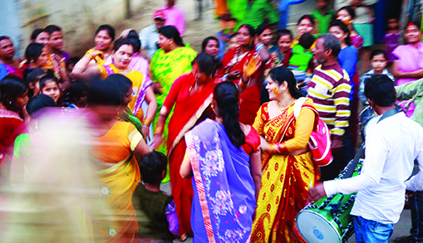
Heavenly Father, even though so many people despised the lower caste communities, you see them as the most precious and receive into the family of God. Please strengthen the Madhya Pradesh Christians under the anti-reform law to be strong and courageous, to have faith and hope in all things
Please raise up great leaders among them, help them walk in wisdom and be filled with the Holy Spirit, testifying that the Lord reigns over all nations. In the name of Jesus Christ we pray, Amen!

Slide 8
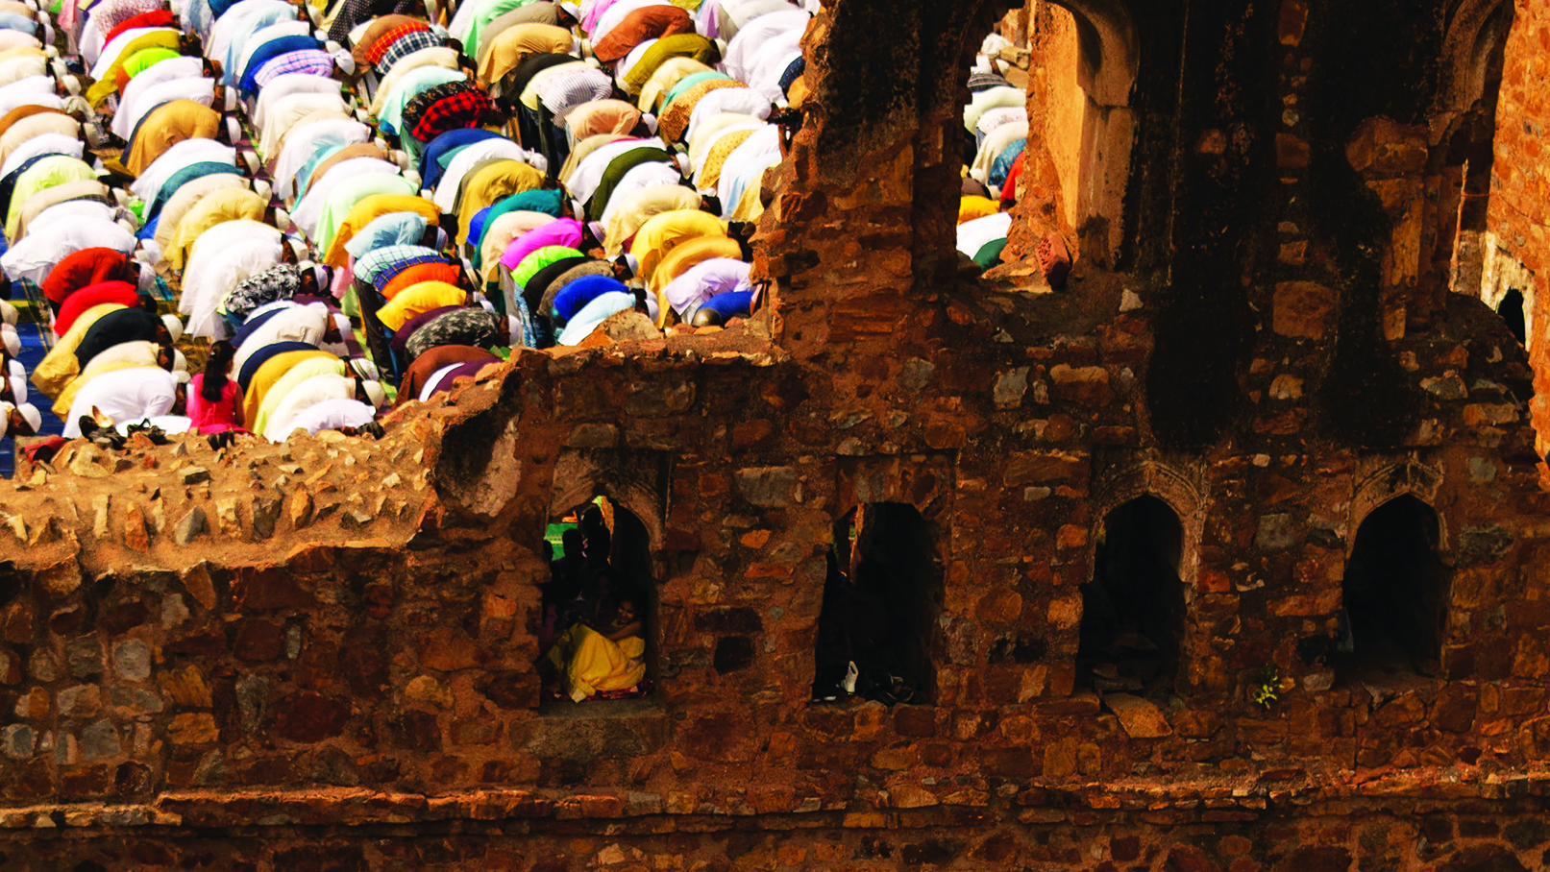
{
Punjab, Pakistan
Breadbasket and political center of the country. Produces ¾ of the country’s grain supplies. The industrial, nuclear, and military center. 110 million, over 1/2 of the country’s population, live here.
Hinduism and Islam split here. The 1947 partition of India and Pakistan divided Punjab into east and west, during which a lot of riots occurred.
Body of Christ 80% of Pakistani Christians are in Punjab. There has been a revival, but also a huge shortage of workers
Notes:
Breadbasket and Power Center
110 million, over 1/2 of the country’s population, lives here.
The Indus River and its tributaries form many fertile river valleys in Punjab, making it the breadbasket of Pakistan, producing three-quarters of the country's grain supplies.
Punjab is a hub of industry, nuclear power plants and military facilities. It is one of nine countries in the world with nuclear weapons. Pakistan's largest economic system.
Hinduism and Islam split here. The partition of India and Pakistan in 1947 divided Punjab from east to west according to religion. West Punjab became part of Pakistan, Muslims lived in the West,
The Sikhs and Hindus had to flee to East Punjab, which became part of India after division. Riots and waves of refugee during that period engraved memories of hatred and tears for this land.
Body of Christ 1873, Punjab was not divided into East and West. A large-scale conversion movement among the lower caste leather workers, the Chuhras, took place.
The movement grew rapidly, reaching nearly 400,000 in 1930. Therefore, 80% of Pakistani Christians were in Punjab. Nonetheless, since 90% of the province's population (100 million people) are Muslims, Christianity is considered "the belief of the poor and the lower castes”. Most people do not want to be associated. So it's still Gospel hard soil. There are still 269 unreached groups in Punjab who have not yet had a spiritual breakthrough and need to be harvested.

Slide 9
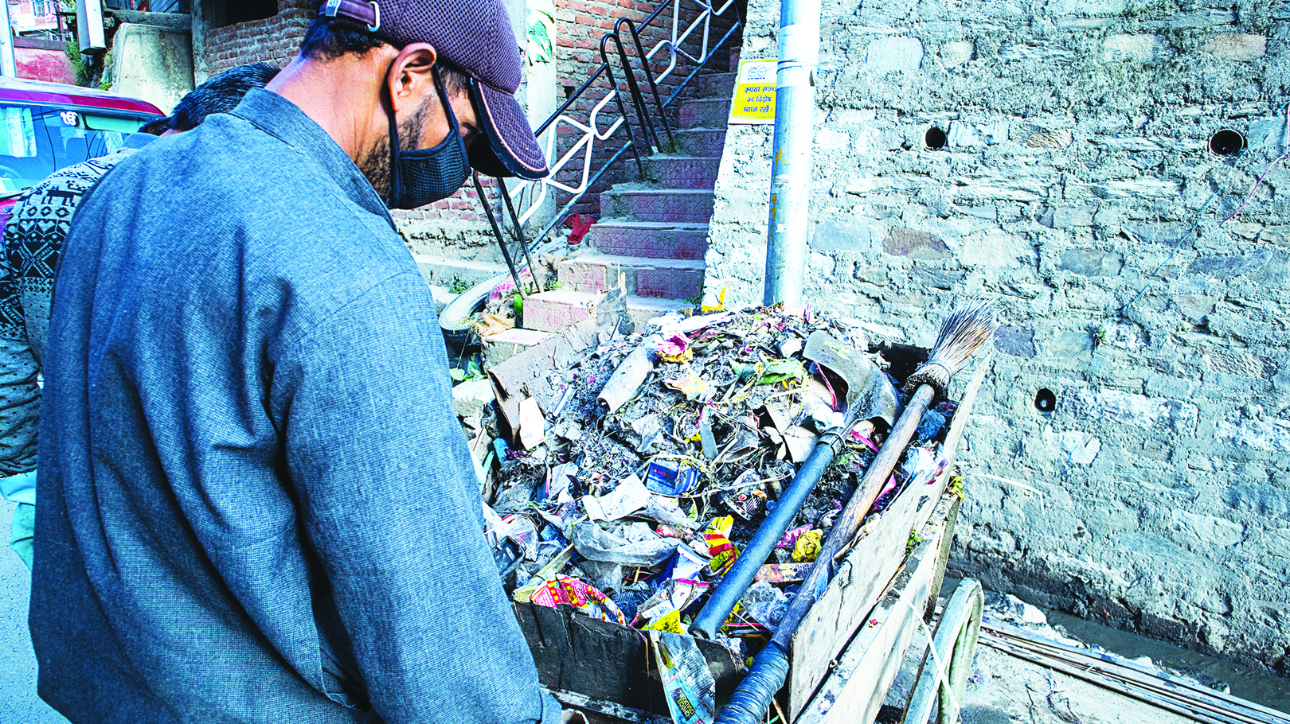
Heavenly Father, may missionaries and Gospel resources reach the Punjabis broadly and heal the wounds caused by the partition.
Please make Punjab the center of life and peace in Pakistan, manifesting the richness of your grace and power. Oh Lord, please dismantle the Muslim prejudice that sees Christianity belongs only to the lower castes. May the Holy Spirit enlighten them to know the Christ. We pray in the name of Jesus Christ, Amen!

Slide 10



