Slide 1
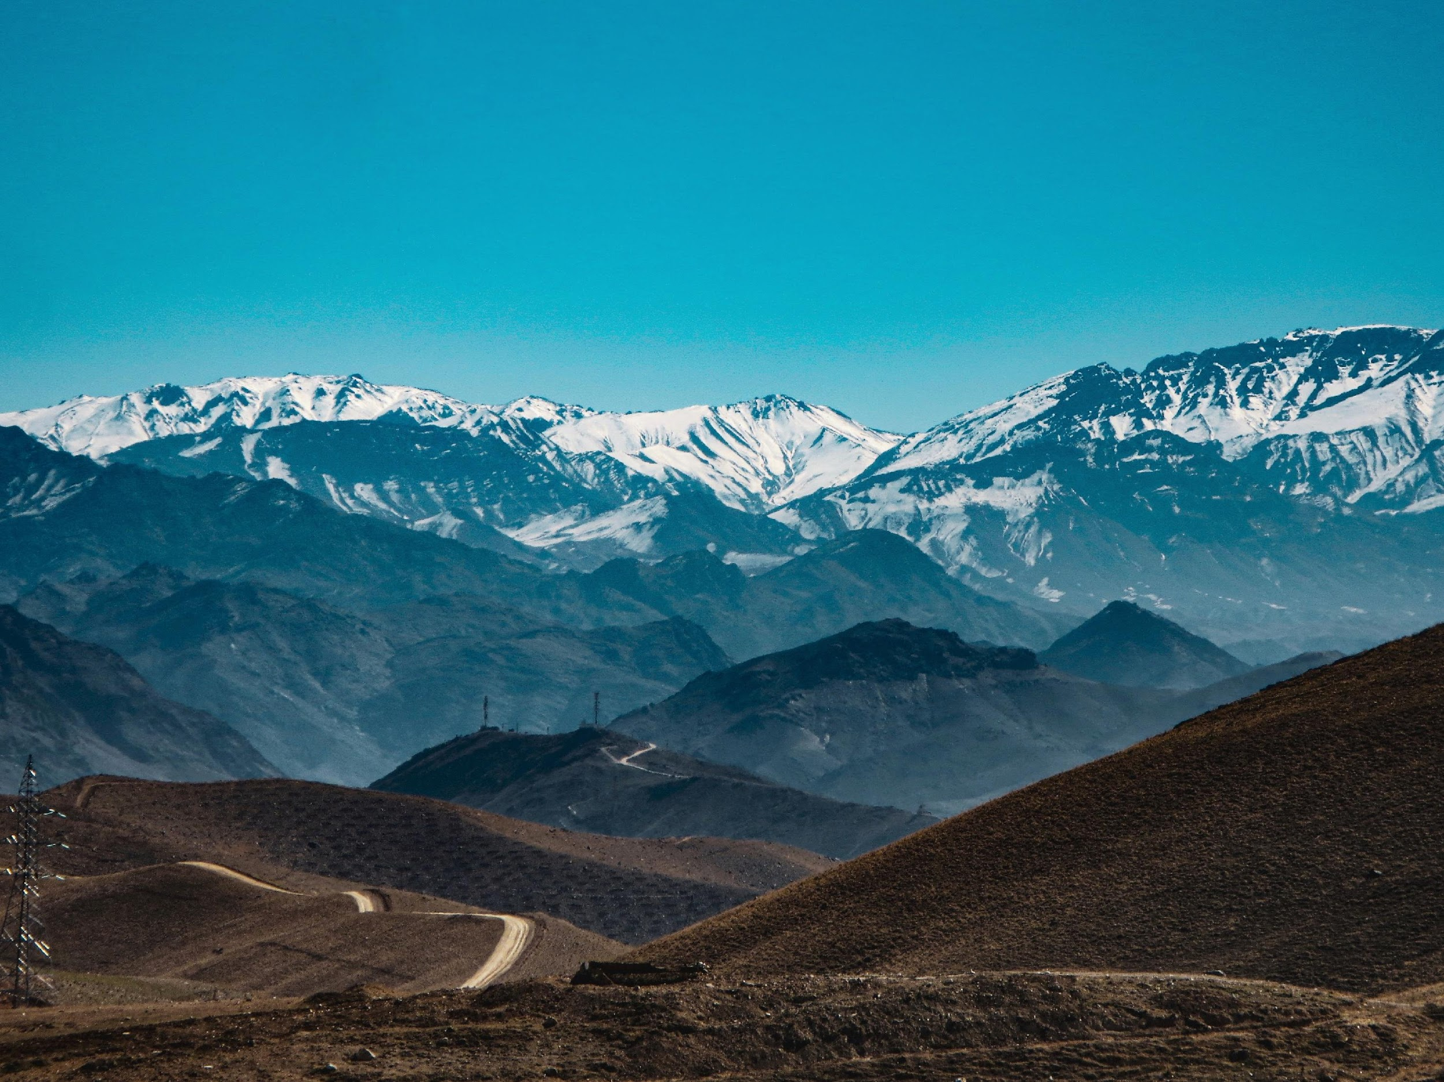
July 2022
Pray for Afghanistan
Notes:
introduction:
We do not retreat.
The images from news stories of Afghans pouring into airports, clinging to planes, desperately trying to escape their home countries, should be fresh in our memory.
After the US withdrew its troops and the Taliban took over again, a group of people took the initiative to approach the Taliban and demanded to stay in Afghanistan and told us about the ongoing humanitarian disaster over there.

Slide 2
Afghanistan
Situated in the middle of Asia. On its east is China, on its south is India, on its west is the Iranian plateau, and north of it is the five former Soviet republics in Central Asia.
Tribal groups scattered over the mountains with different origins, varied cultures, unrelated to each other, independent governance – the fundamental elements of different political forces in the country.
Population: 40 million
99.8% are Sunni Muslims
70 unreached people groups
Main tribal group: the Pashtuns who honor and follow Pashtunwali, the Pashtun law
“Taliban”: a Pashto word referring to an Islamic theologian
Notes:
Afghanistan
The fundamental elements of different political forces in the country:
Afghanistan is located at the intersection of West Asia, South Asia, and Central Asia. Because of its geopolitical landform of numerous mountains and plateaus, historically Afghanistan has experienced cycles of dominations by different political powers.
China is to the East of Afghanistan, India to its South, the Iranian plateau to its west, and to its north, the five independent former Soviet republics in Central Asia. Controlling Afghanistan means controlling Eurasia. That is the reason why major Afghanistan cities have been declared by surrounding powerful countries as vassals or frontier. The Afghan tribes scattered in the deep mountains with inconvenient transportation are also in lack of mature political and military structure. Historically they could only seek refuge from British or India Commonwealth or Russia, striving for survival of their limited territory in the crevice.
The broken terrain of Afghanistan resulted in multiple tribes, big and small, everywhere in the country. Without hesitation, they join any power beneficial to them or turn against any forces that harm their interests. Due to difficulties in transportation, its natural environment, and ferocious culture, it is hard for any of the imperial forces to directly control Afghanistan. Even an empire as strong as the British empire at its peak, the local forces jointly defeated them when they tried to seek control of Afghanistan. Between 1838-1885, the powerful Anglo-Indian army twice invaded Afghanistan. While they smoothly occupied the big cities, the military coalition forces of the Afghans urgently came together forced these enemies out of the country. At the end, the British-Indian army lost miserably. In desperation, the British and Russian empires could only choose to remotely control their Afghan territories behind the scenes, building and empowering the local warlords to compete for power and profits.

Slide 3
Ancient Times: An intersection for
Nomadic and agricultural culture
Chinese, Indian, and Middle Eastern civilization
Zoroastrianism, Islam, Nestorianism, and Buddhism to go into China
The 4 great inventions of ancient China to reach the Arab world and Europe
Contemporary: Battleground of UK vs. Russia, and US vs. Soviet Union
Post-Soviet civil unrest and the Taliban's ties to terrorism brought disasters to Afghanistan.
The 9/11 event led to US’ 20 years of anti-terrorism war

Slide 4
US army withdrew in Aug 2021.
Pashtun Taliban returned to power
Clearly declared implementation of Sharia doctrines and not to become a democratic country. Anticipated friendly international relationships.
Women’s rights exploited, all women must wear full-length covers, not allowed to work or to go to school
Economic meltdown and food shortage – 24 million, i.e., over half of the population are starving. Parents sold their children to pay for debts. Today’s income is mainly from supplying 80% of the world’s opium.
Delivery of humanitarian aid obstructed, 6 million refugees (2.5 million fled to other countries, 3.5 million in Afghanistan)
Overtook N. Korea as the country of worst persecution of its Christians. The second fastest growing country in Christian believers. A lot of them fled to rural areas or refugee camps in nearby countries. Gospel broadcast and TV programs brought a lot of people to Christ.
Notes:
Pashtun Rules: A specific set of moral and behavioral disciplines among the Pashtun tribes.
After the 9/11 terrorist attack in 2001, US demanded the Afghan Taliban regime to turn in bin Laden. However, Mullā Umar refused. One of the important Pashtunwali doctrines is “Nang”, which means “dignity”. One cannot hand over any friends who came to seek asylum to their enemies. Otherwise, his dignity will be damaged. It is better to die than living without dignity. People would fight the battle until they lose their lives.
A Pashtun must ultimately defend his dignity. Every Pashtun man must protect their women and their territory. He can keep himself reputable only when his mother, sisters, and wives maintain good reputation. Therefore, the Pashtuns highly regard the chastity of a woman. Knowing this helps people understand why the Pashtuns keep their wives at home after marriage. The wife cannot meet other men, let alone casually talking to them, without the husband’s permission.
Another doctrine that is more respected is called “Badal”, which means “revenge”. When being offended or insulted by an enemy, the Pashtun not only takes revenge against that person, but also the family and tribe. There are a lot of reasons for a revenge. Most of the time are about land, money, and/or women. If a Pashtun’s dignity is offended, he definitely retaliates. This is the most important doctrine deeply integrated into the blood of every Pashtun. Minor disputes can be resolved through negotiation, but for a murder, it must be “blood for blood”.
Until today, the Pashtuns are still following these tribal guidelines.

Slide 5
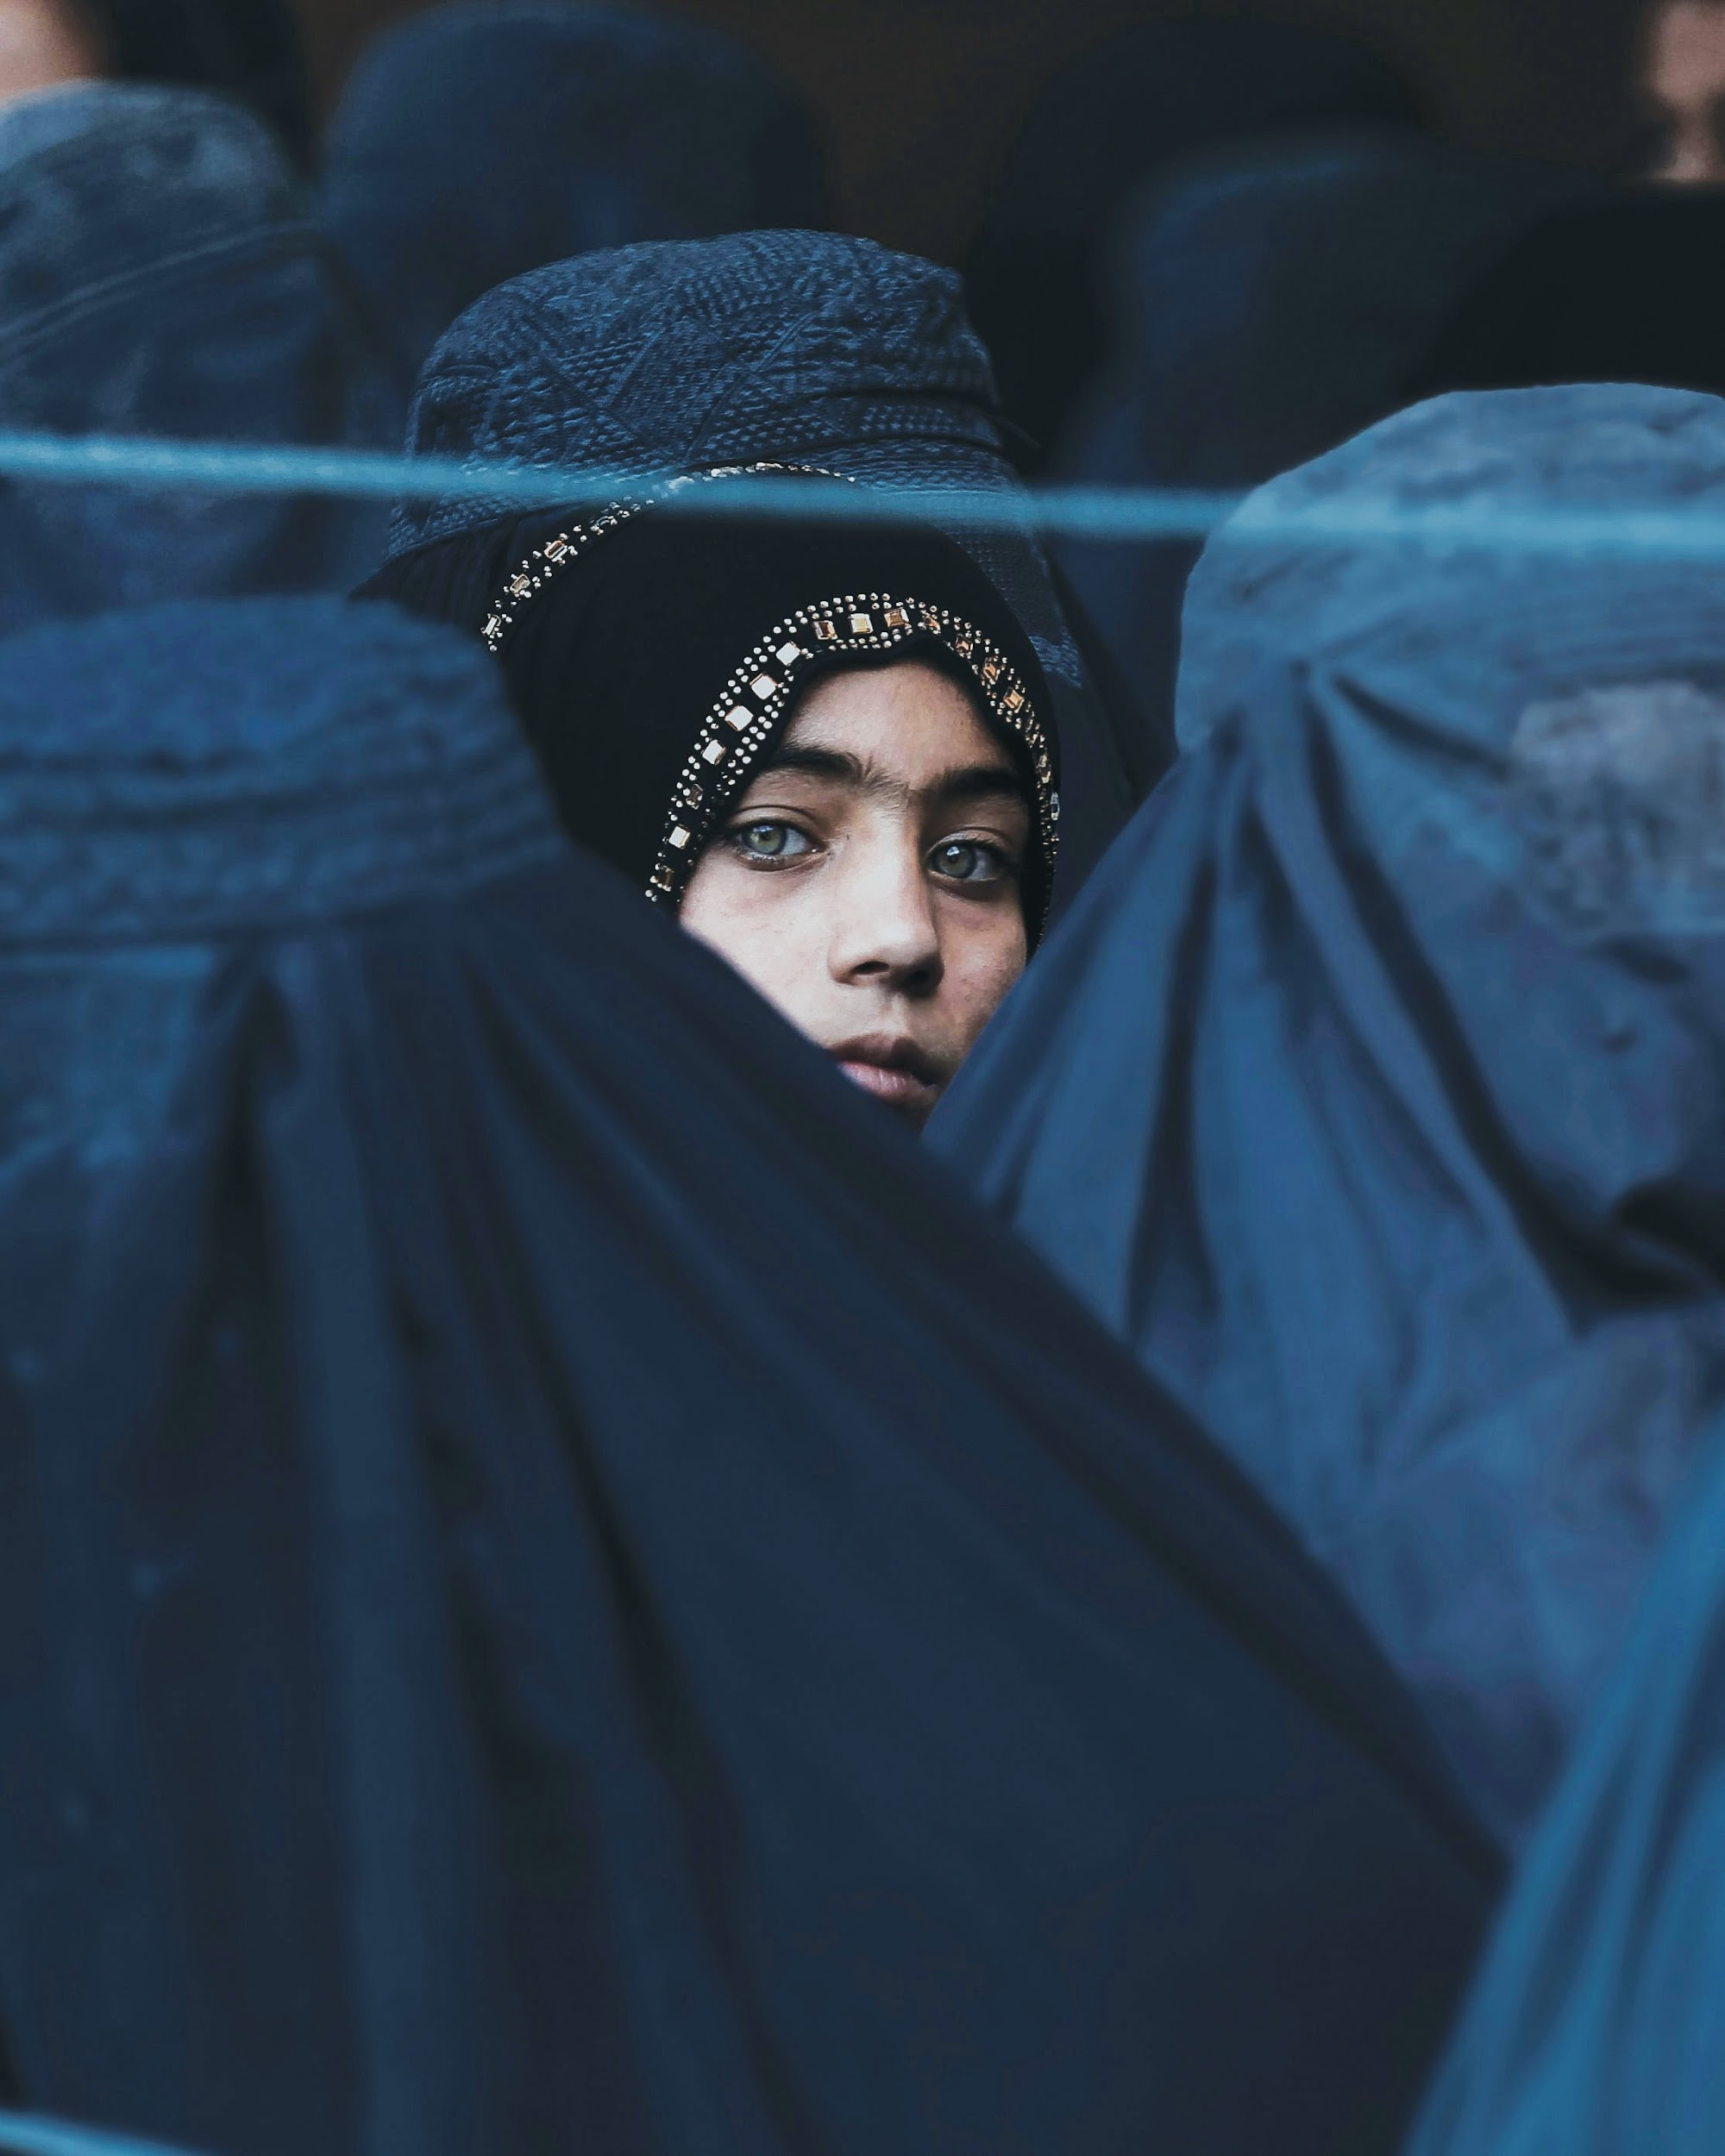
Together we pray for Afghanistan

Slide 6
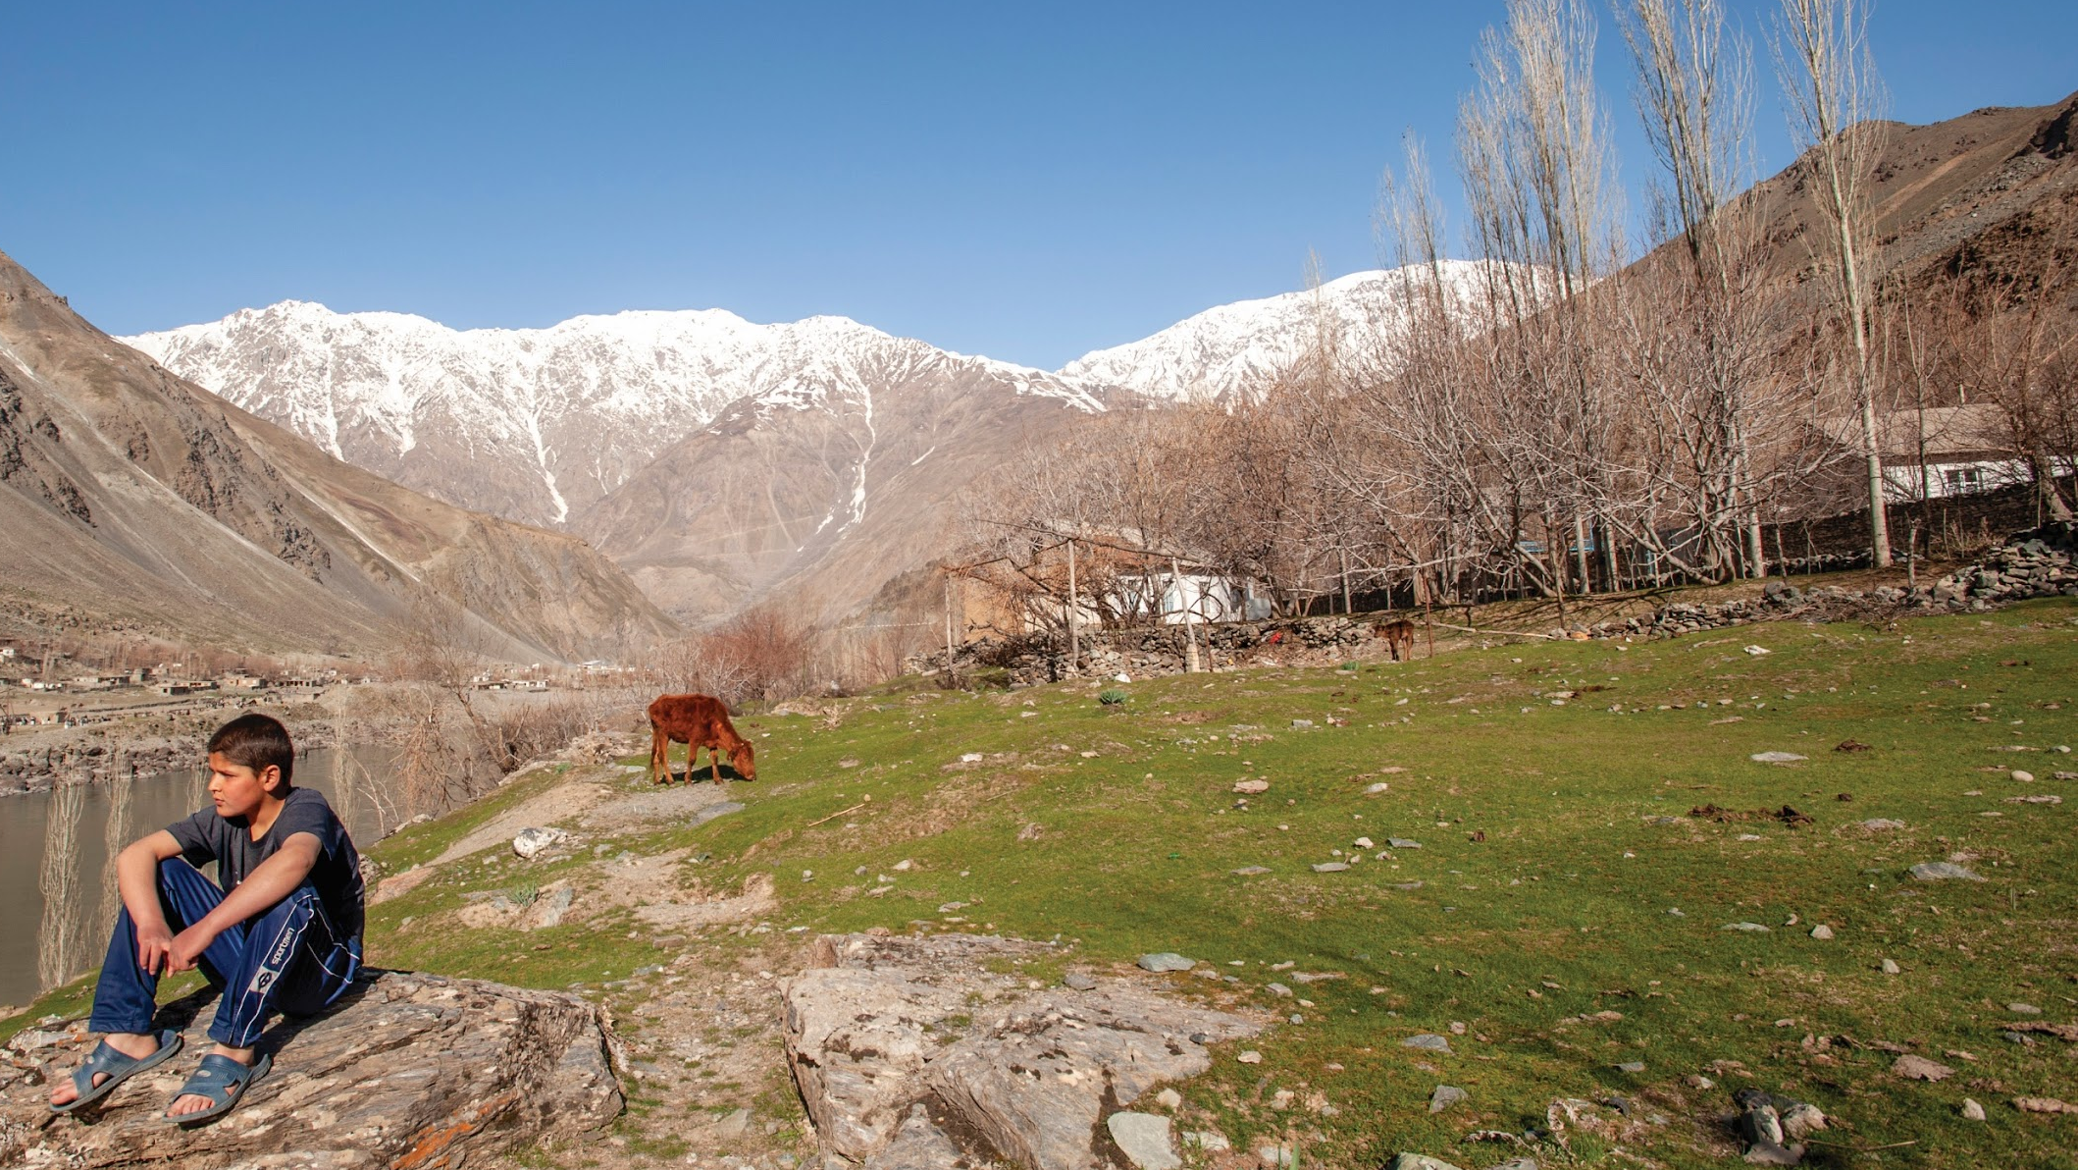
Heavenly Father,
we know that you have mercy on those who suffer.
For the Afghans who are uncertain about their future,
please help them know your love early and
experience the peace in you.
Lord Jesus, we pray for the 6 million displaced people. For the families in the refugee camps, we pray for the Lord’s protection and provision. May those refugees who settled in the Western countries adapt to their new lives and be able to find jobs and places to live.
Heavenly Father, please protect the 10,000 Christians in Afghanistan, give them their daily bread and deliver them from the evil hands. When suffering from persecution, they experience the unimaginable peace and stability in your presence. We also pray that the Lord will increase the number of people being saved.

Slide 7
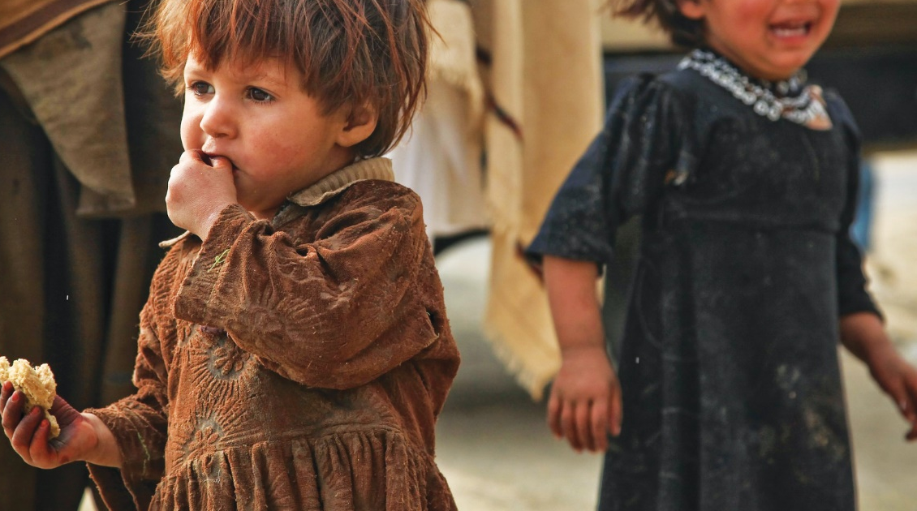
Lord Jesus,
we pray for the Afghan Taliban leaders.
Please control their hearts so that they will treat the different tribes in kindness, stop persecuting the churches, not to rule in extreme totalitarianism,
and to break away from violence and terrorism.
Heavenly Father, we pray for the Afghan children. May they no longer be sold to pay for debts nor sleep in hunger and the sound of gunfire.
Dear Lord, we pray for the Afghan women. Please be the protector of their security and rights, that they will be free from violence and oppression, have freedom to act, to receive education, to work, and to participate in and enjoy all aspects of life.

Slide 8
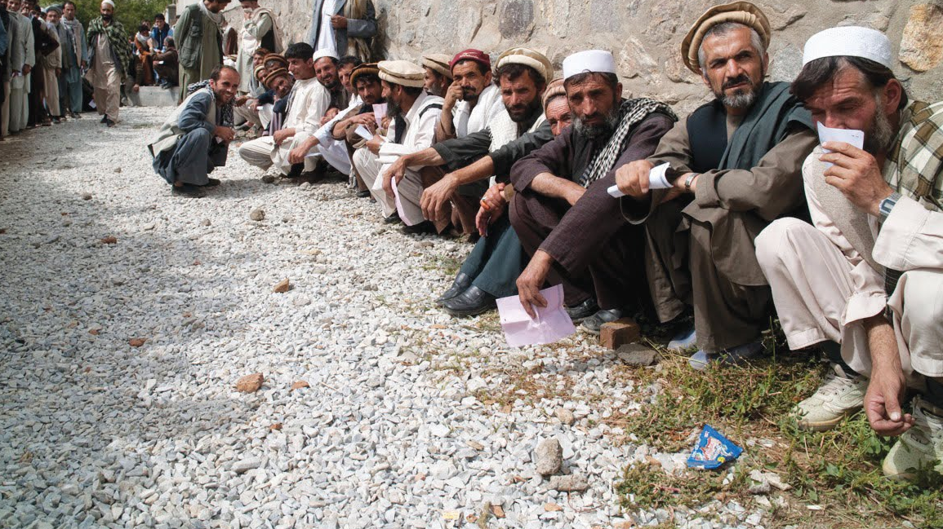
Heavenly Father, we pray for the World Vision humanitarian aid workers
who stayed behind and the 300 local staff.
Please provide them with the necessary resources and
enable them to work with the government, so that there will be no delay
in health, medical, food, and education services.
Heavenly Father, we pray for the churches of the countries that have received the Afghan refugees. Please touch and shake the hearts of your children to care for the refugees. Be grateful for receiving a kingdom that cannot be shaken, and thus let us offer to God acceptable worship, with reverence and awe.
In the name of Jesus Christ, we pray. Amen.

