Slide 1
January 2022
Provinces with the Least Exposure to the Gospel（I）
Notes:
Beginning 2022, the Mission Pathway will change from monthly themes to praying for at least one province that has the least exposure to the Gospel each week. Our January focuses are:
Chittagong, Bangladesh
Punjab, India
Gansu province, China
Khyber Pakhtunkhwa, Pakistan

Slide 2
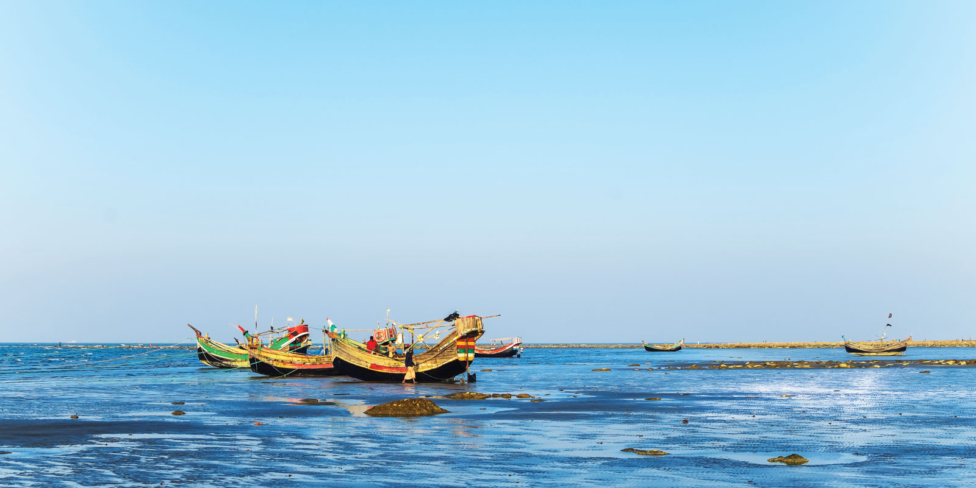
Chittagong, Bangladesh
Bangladesh was originally part of the British India. It was turned over to Pakistan during the Partition of India in 1947. In I971, it left Pakistan to become Bangladesh and went through 18 military coups after that.
With investments from Russia and Japan on the heavy industry, the Port of Chittagong became the economic vitals of Bangladesh.

Slide 3
Heavenly Father, we pray in unity for the 194 unreached ethnic groups in Chittagong, including the Tibetan, Burmese, Rohingya, Indian, and others. They experienced multiple wars for their independence and 18 civil wars in 40 years. Now they are trying to get back onto their feet amid the post-war devastation. May the Lord heal the sorrow and insecurity in their hearts, so that they will be open to receiving the Good News.
Lord Jesus, most of the believers in Chittagong have Hindu background. Their local churches are weak and lack of training. May your Spirit fill the pastors with prudent insight in understanding the teaching of righteousness and the power to testify for the unshaken hope in Christ among their Muslim neighbors.
In the name of Jesus Christ, amen!

Slide 4
{
Punjab, India
The place where Sikhism was born. In order to soften the difference between Hinduism and Islam through religious reform.
Believe in monotheism. Oppose to the caste system and believe in karma and reincarnation.
Of the 491 Sikh communities, 469 are in Punjab, India.

Slide 5
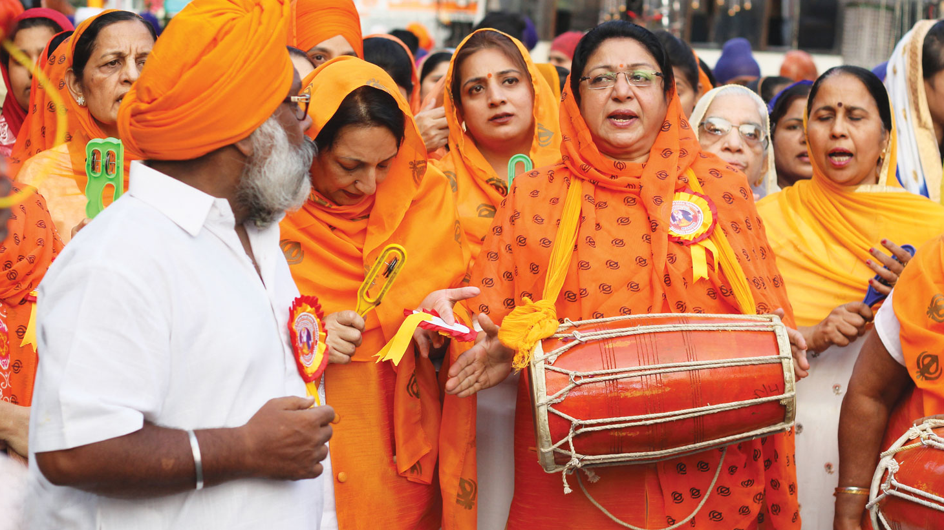
Heavenly Father, the Sikh have always been seeking the only true God. However, they got lost and did not realize that you are the Lord of all.
Lord, please let them know that you have been looking for them and wanting them to return to you.
Please bless the churches in Punjab - to be established by the Holy Spirit, able to live a mature, abundant and victory life,
To witness your righteousness, goodness, holiness, love, and mercy.
May the Lord be glorified among them.
In the name of Jesus Christ, amen!

Slide 6
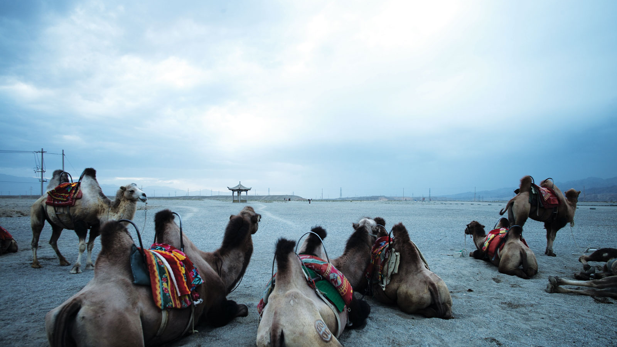
Gansu, China
An area inhabited by diverse ethnic groups. 2.65 million-11% of the population of are ethnic minorities.
Tibetan Buddhism and Islam are the main religious beliefs

Slide 7
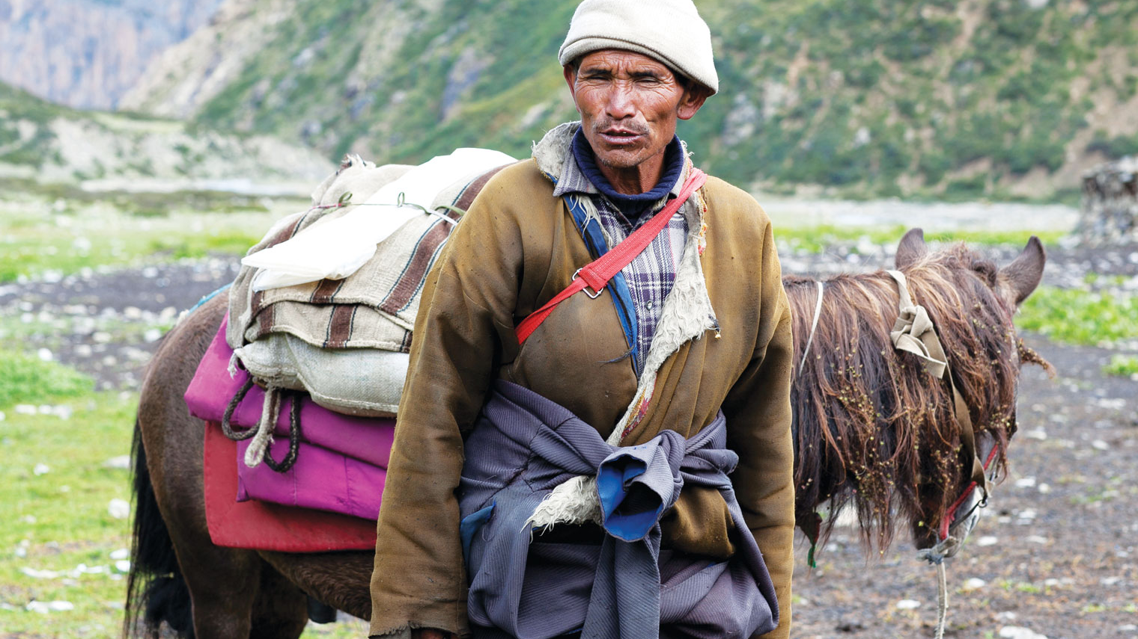
Heavenly Father, may your truth be spread rapidly among the Tibetan Buddhists in the Gansu Province. They are the Tibetan tribes of Tebu, Boyu, Zhouqu, Rongmaboba, and Yugu who share the same origin as the Uyghurs.
Please enlighten the Christians in China to serve them through medical and educational services, so that they can experience Jesus as the Lord who listens to their prayers.
We pray for the limited number of Tibetan Christians. Please protect them from the evil ones attack, delight in your word, able to stand firm, and to shine for the Lord.
In the name of Jesus Christ, amen!

Slide 8
{
Khyber Pakhtunkhwa, Pakistan
In the 18th century, Afghanistan, Pakistan, and northern India were all included in the territory of Afghanistan
In the 19th century, Britain put in place the 1,640-mile Durand Line as the border between Afghanistan and British India
As a result, Pashtuns, the main ethnic group, was divided between Afghanistan and Pakistan.
Notes:
In the 18th century, Afghanistan, Pakistan, and northern India were all included in the territory of Afghanistan
19 century, UK ruled India, and Pakistan was still a part of India.
In order to fight against Russian’s expansion to the East, Afghanistan was used as a buffer by British,
Nov 1893,a border between Afghanistan and Pakistan was set by British Indian governor Sir Mortimer Durand, with the agreement of Abdur Rahman Khan, the ruler of Afghanistan,
The 1640-mile border thus called Duran Line.
85% of the Durand Line follows rivers and other physical features, not ethnic boundaries.
It split the Pashtuns , the major ethnic group of Afghanistan into two separate countries. Afghanistan and Pakistan

Slide 9
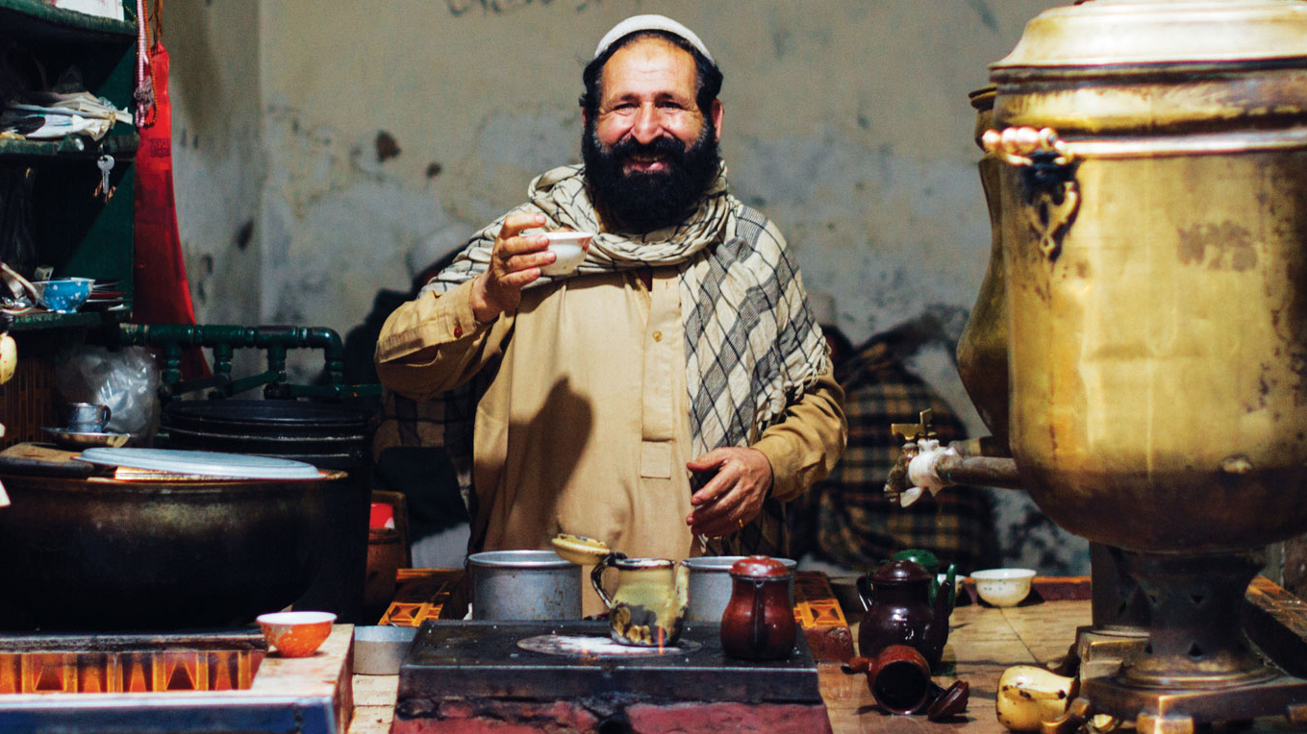
Heavenly Father, we pray for all the ethnic groups in Khyber Pashtun Province. They have experienced tremendous hardships and have been deeply influenced by the Pashtun's culture of supremacy of honor. Endless hostility and resentment are buried in the hearts of individuals, families, and ethnic groups.
Oh Lord, it is only through experiencing and knowing how you, because of love, willingly gave up all the glory so that enmity can be abolished. We hope that the Khyber Pashtun tribe will soon belong to the same body and the same Holy Spirit with us, and to have a unity in the same glory and hope.
In the name of the Lord Jesus Christ, amen!

