Slide 1
February 2022
The Least Reached Provinces（II）
Notes:
引言：
2022年開始《宣教日引》的22周環球拓荒禱告主題，將會每個星期為“一個最少接觸福音的省份”禱告。 2月份我們為印度比哈爾邦、印度北方邦、中國廣西省以及孟加拉達卡省禱告。

Slide 2
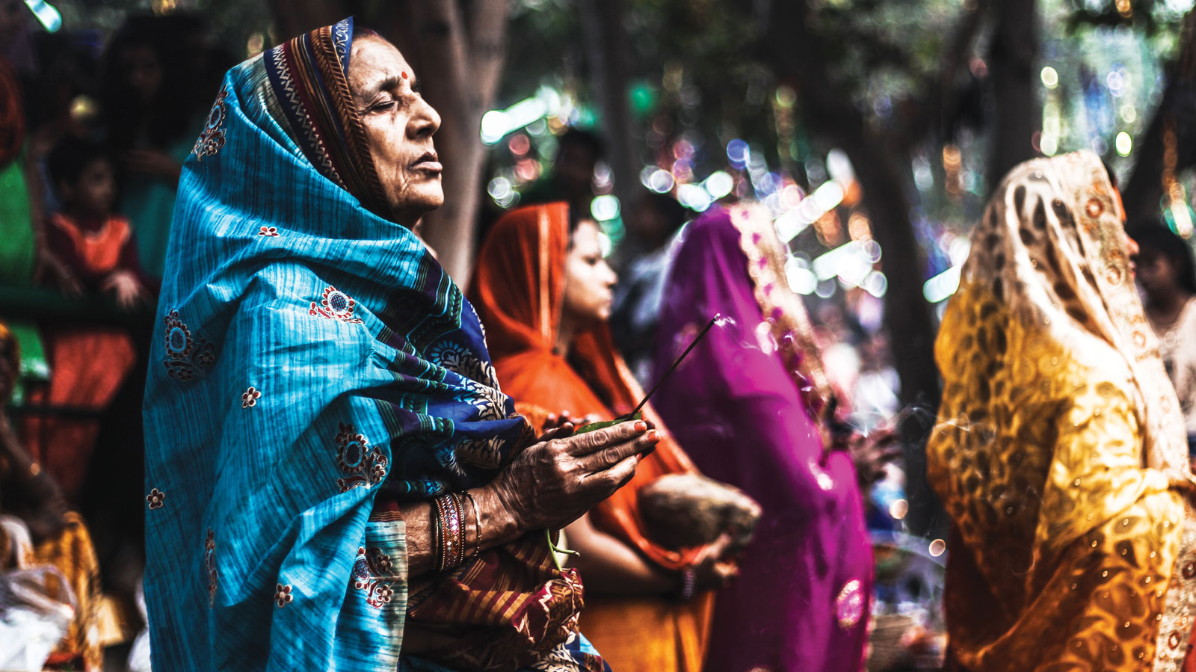
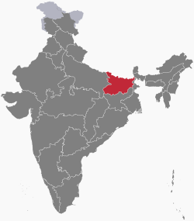
{
Bihar, India
Bihar is where Brahmins and Dalits have the most serious conflict. It is also one of the poorest provinces in India.
Most of the Christian converts are from low caste groups.
Many violent, anti-Christian incidents occurred.
Prayer targets: the 5 million Dusadhs

Slide 3
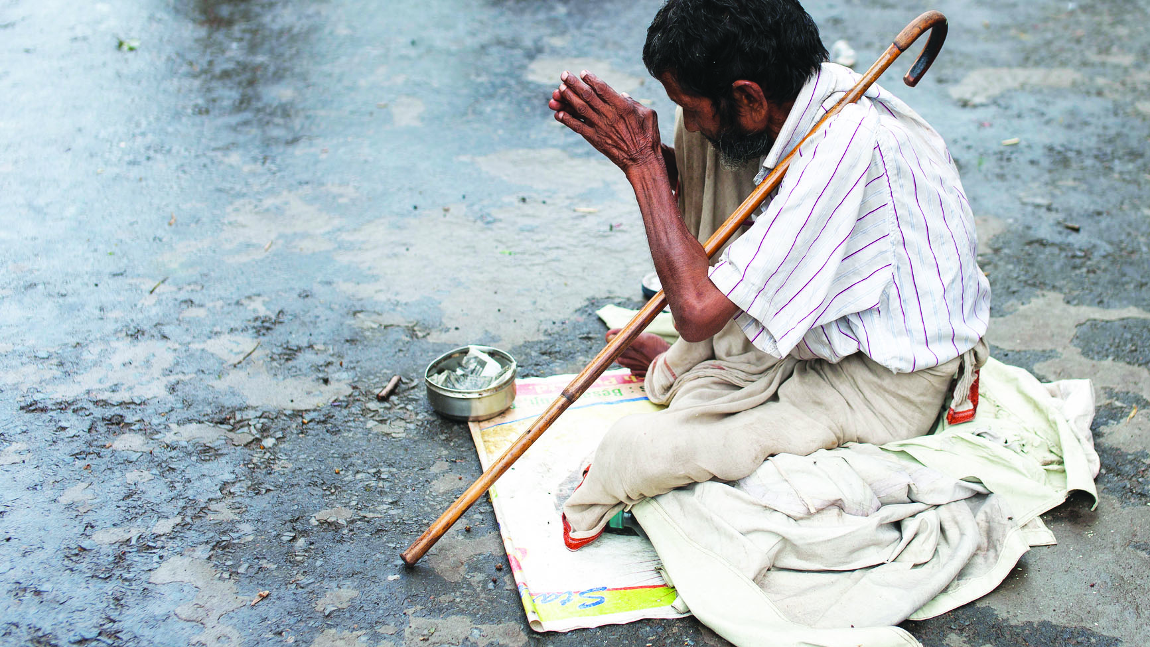
Heavenly Father, the 5 million Dusadhs are poor, and lack of skills. They are also bound by the Hindu caste system.
May the Lord move the Christians in India not to ignore the suffering Dusadh community; call professionals to work with the churches in Bihar to be attentive to and care for their needs; to live a life of respect, love, and equality in Christ ; to alleviate the class conflict between Brahmins and Dalits and share their burdens.
May all communities in Bihar find hope and comfort in God's promises. We pray in the name of Jesus Christ, Amen!

Slide 4
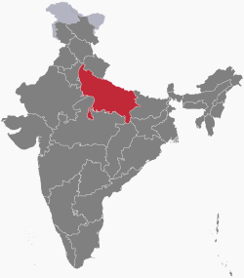
{
Uttar Pradesh, India
Uttar Pradesh (UP) is the most populous province in the world. Of the 200 million people there, 78% lives in rural areas where clean water can rarely be found, and water-borne diseases are prevalent.
The Ganges River flows through the province, making UP the heartland of Hinduism. The Kumbh Mela festival held every 3 years draws 100 million to worship at the Ganges River.
Buddha lived and preached in UP, there are a lot of Buddhists pilgrimage sites. Meanwhile, the renowned mosques draw Muslim pilgrimage as well.
UP is the home of several rapidly growing church planting movements. Most Christians are from the Dalit community.

Slide 5
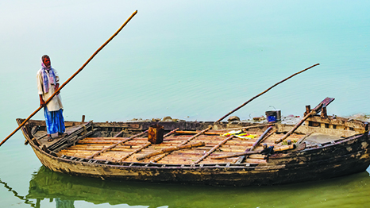
Dear Heavenly Father, although the churches in UP are growing rapidly, hundreds of millions of people are still living in the bondage of idolatry and the power of the dark force. Many places still do not have a church nearby.
Believers also encounter threats and intimidation that pressure them to convert from their belief. Dear Lord, please send your laborers to preach the gospel with heavenly ability and wisdom. Please give the believers courage and love to live as testimony for Christ.
May the Lord have mercy on the well-off, high caste communities that they will humble themselves to turn to Christ.
In the name of Jesus Christ, Amen!

Slide 6
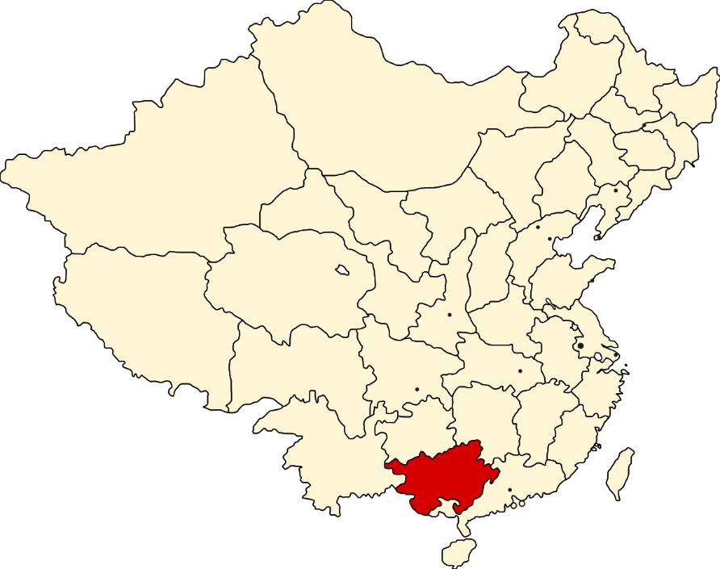
{
Guangxi Province, China
Homeland to various ethnic minorities from 12 aboriginal tribes.
The Gospel first reached the area through Southern Baptist missionaries.
Prayer target：7,000 Yi people in northern Guangxi.
There is hardly a Christian among the 19 Yi villages.

Slide 7
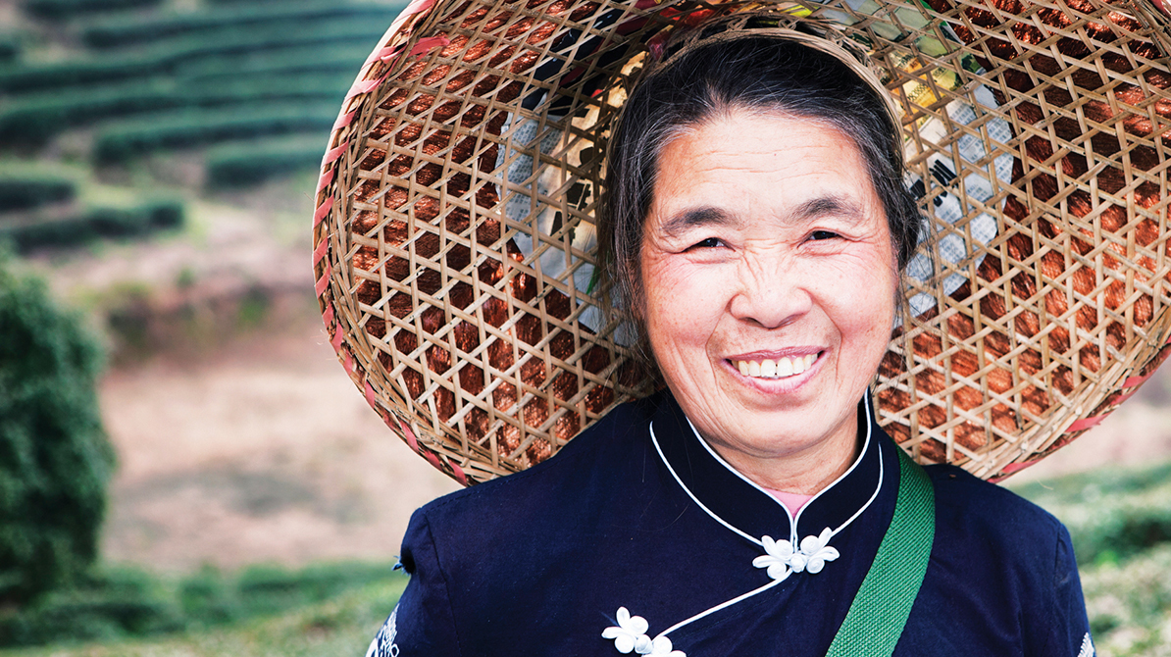
Dear Heavenly Father, we pray that the Yi people will experience a great spiritual breakthrough, and that the iron wall that have blocked the Gospel for thousands of years will collapse. The truth will destroy the lies and idolatry that Satan has spread throughout the ages and generations, so that the Yi people can taste the goodness of the Lord's grace.
Please equip and send missionaries and Christian professionals who feels the burden to serve the Yi people to the 19 Yi villages, assisting the production and delivery of Gospel resources in the Yi language.
We pray together for the first fruits of the Gospel in the Yi people to come soon. May the Holy Spirit transform the Yi community. We pray in the name of Jesus Christ, Amen!

Slide 8
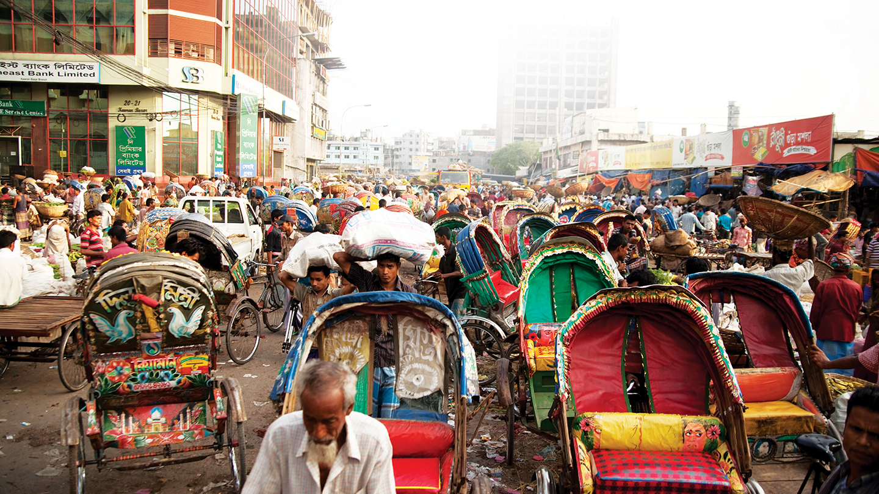
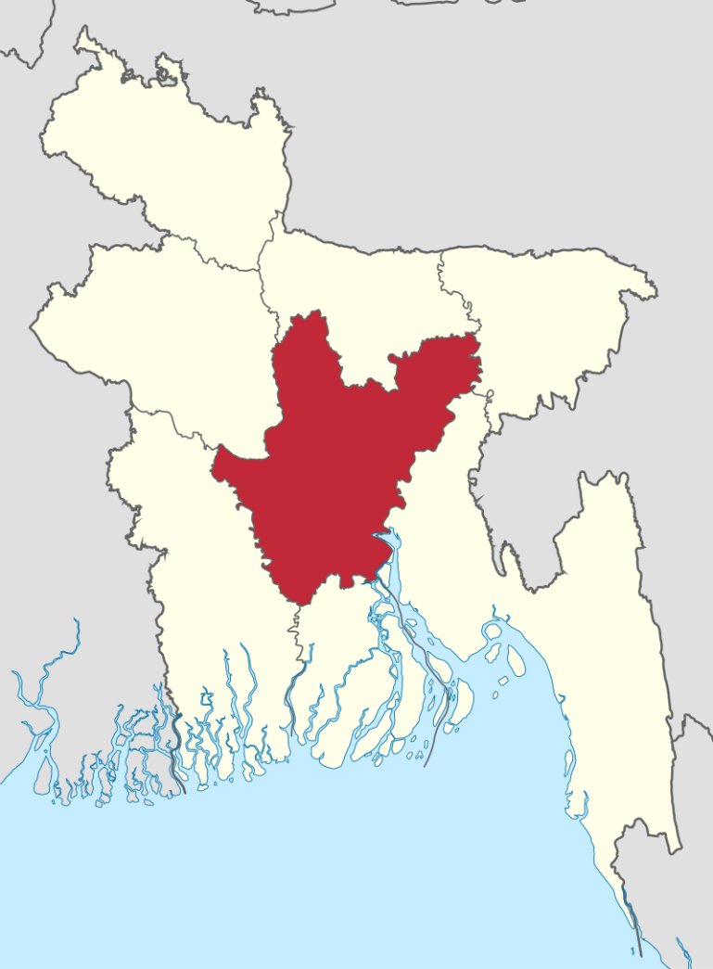
{
Dhaka, Bangladesh
The most densely populated area in the world.
Centered around textiles and pharmaceuticals.
Situated at the lower Ganges. Monsoons and rainfall from the Himalayas result in flooding to 20% of Bangladesh every year.
William Carey, the father of modern missions, translated the Scriptures into Bengali when he was in the nearby Serampore.
The churches are growing, but lack of workers.
224 unreached communities. Among the 15 million people, 88% is Muslims, 11% Hindus, and 0.3% Christians.

Slide 9
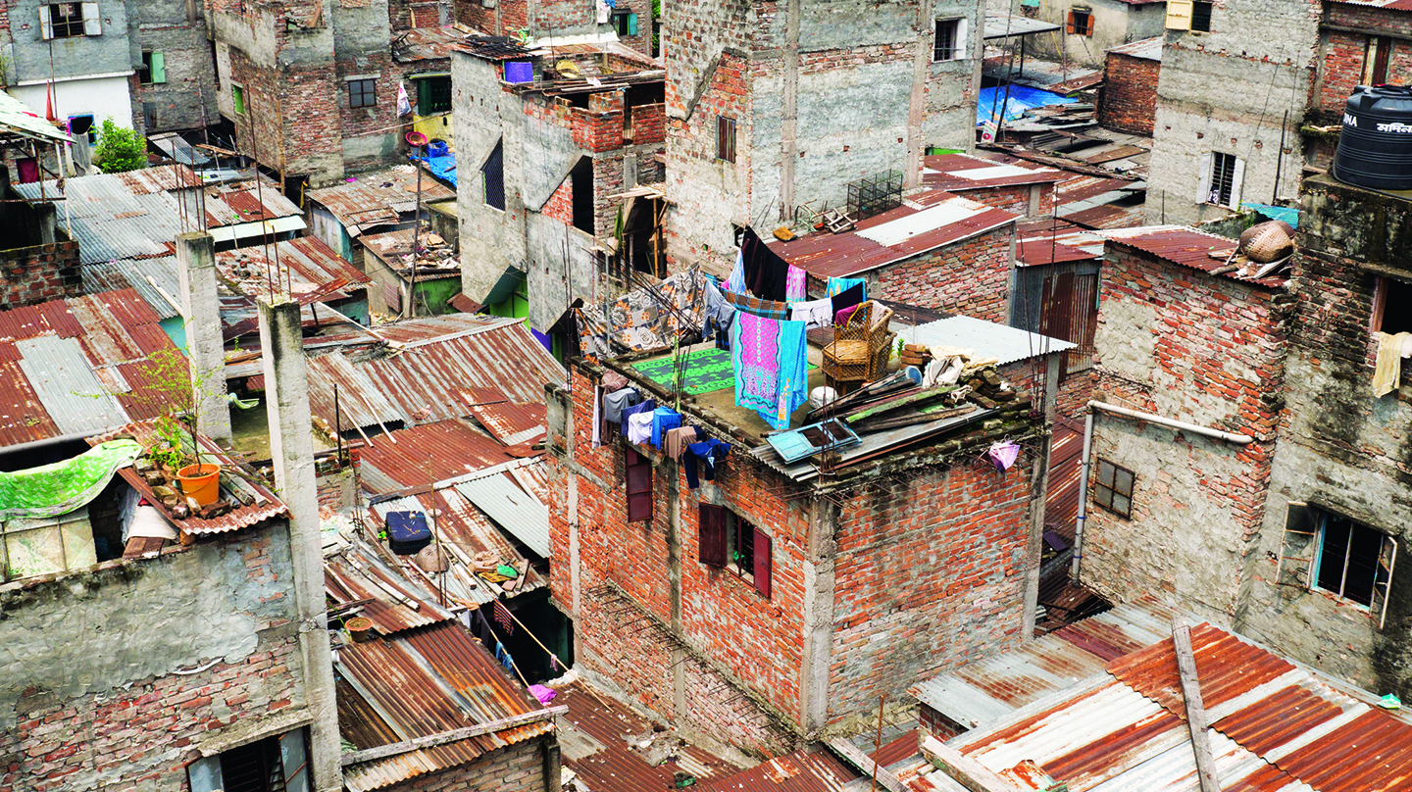
Dear Heavenly Father, the 13 million Muslims in Dhaka province do not know that you are the true God who loves them. Not only do the 1.65 million Hindus not know Jesus, but they are persecuted just for being a religious minority.
Dear Lord, all the them needed you.
Dear Father, unemployment in Dhaka is high. Besides being in poverty, believers in the lower caste also face oppression.
We pray that, Father, you remember their daily needs, raise up church leader, who are spiritually mature, to shepherd your children and live a joyful life.
In the name of Jesus Christ, Amen!

