Slide 1
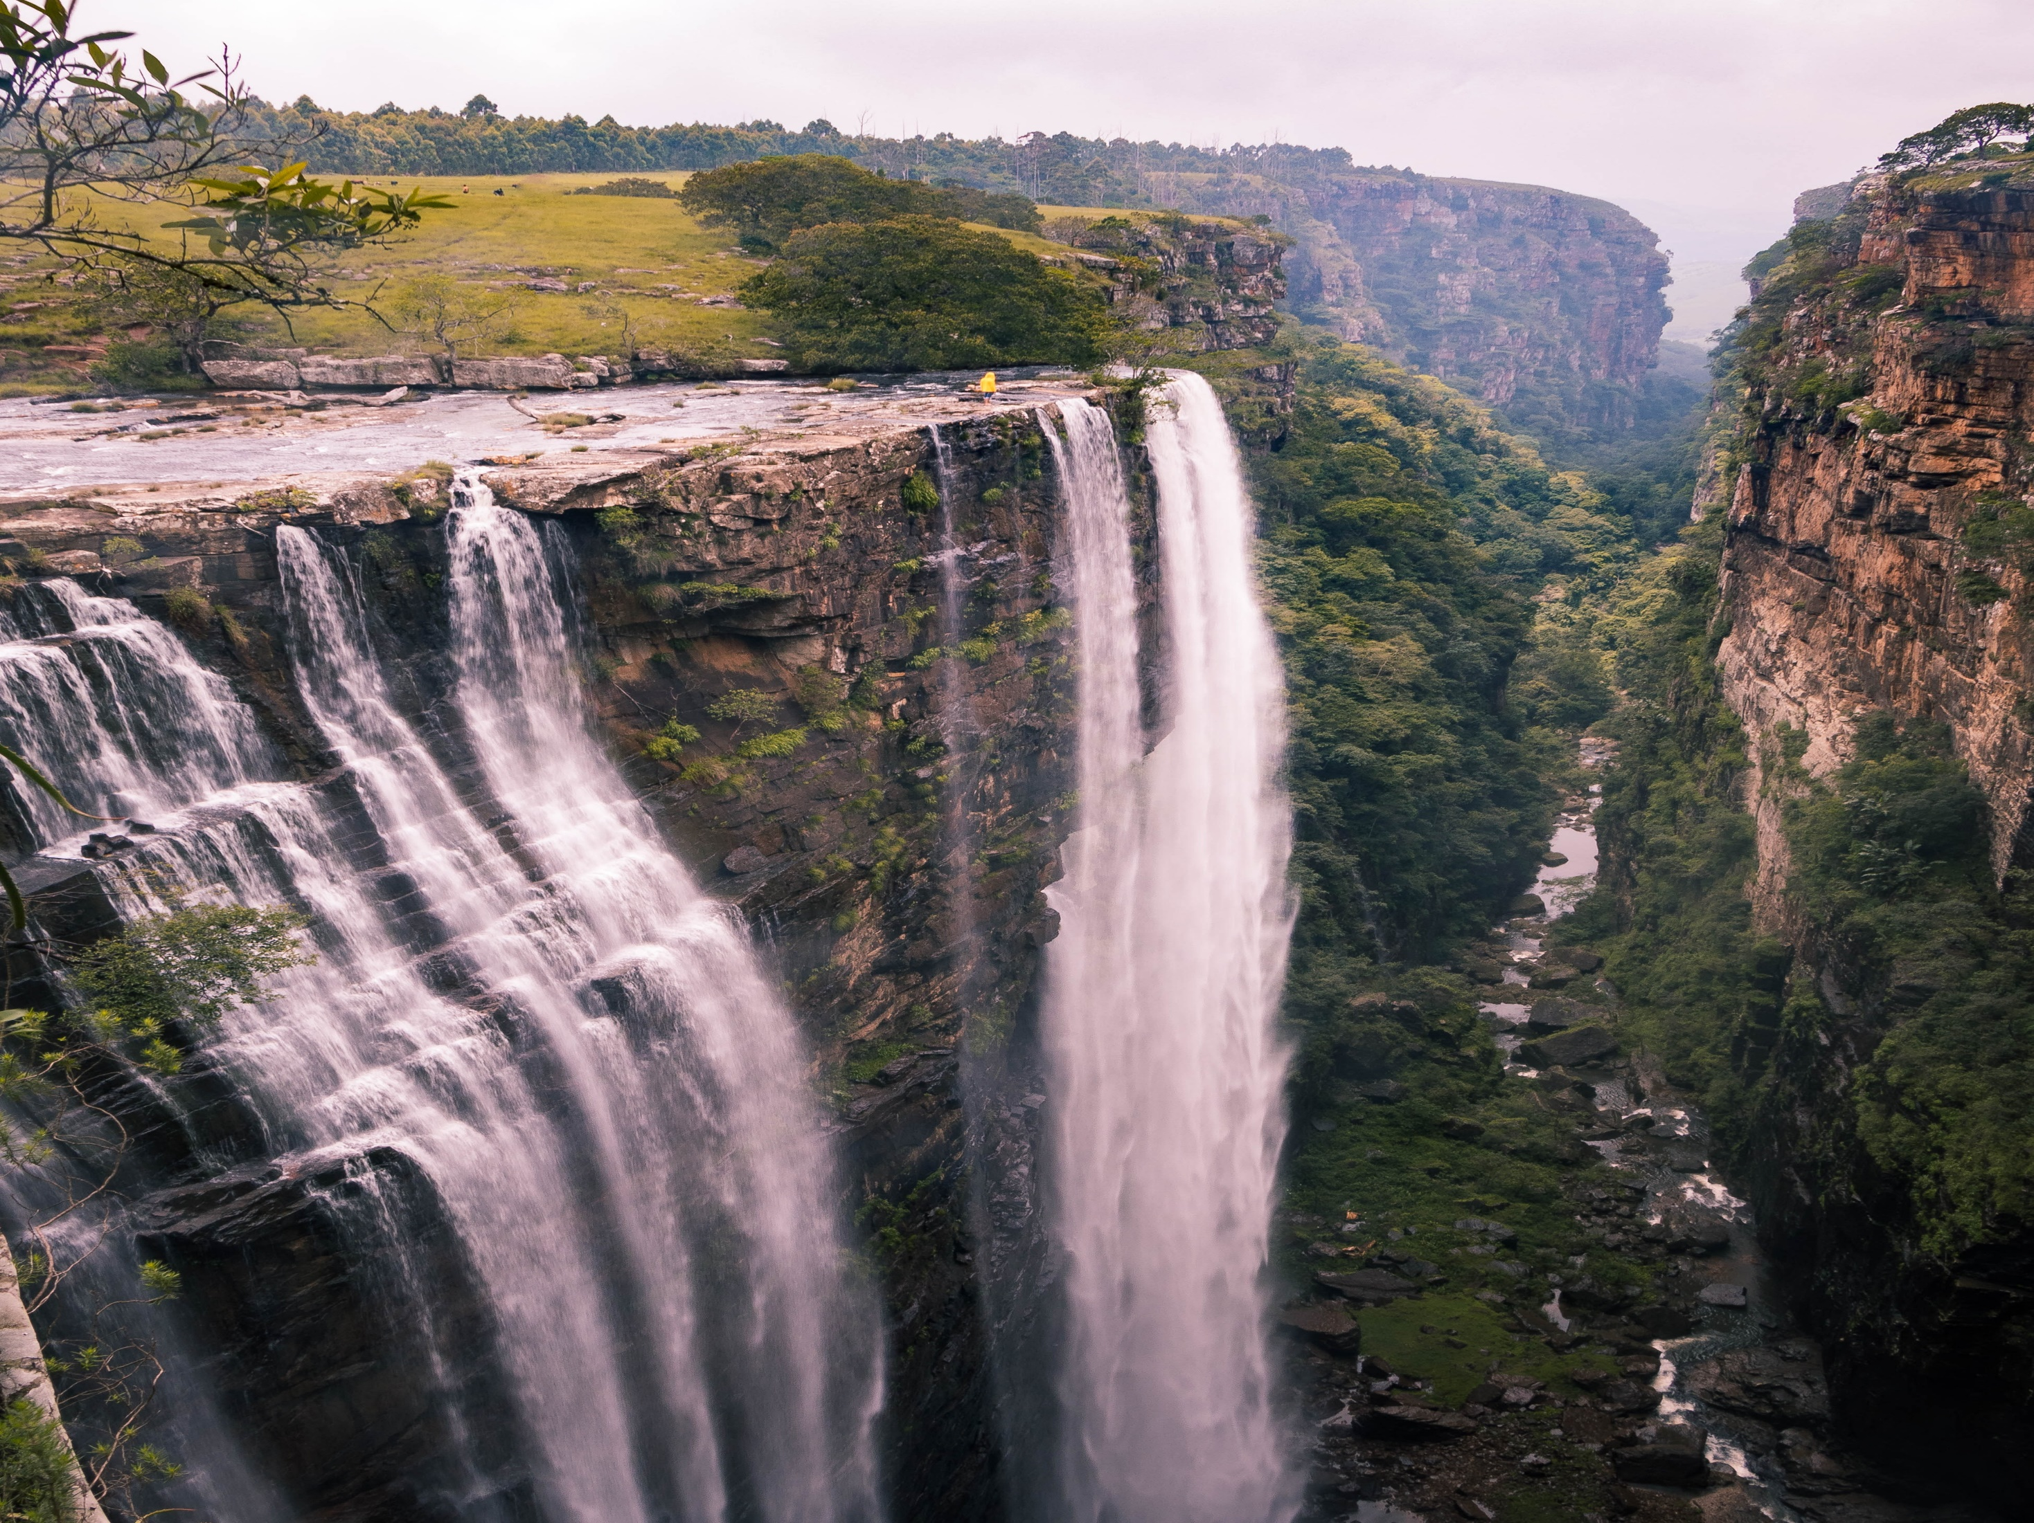
December 2022
Africa

Slide 2
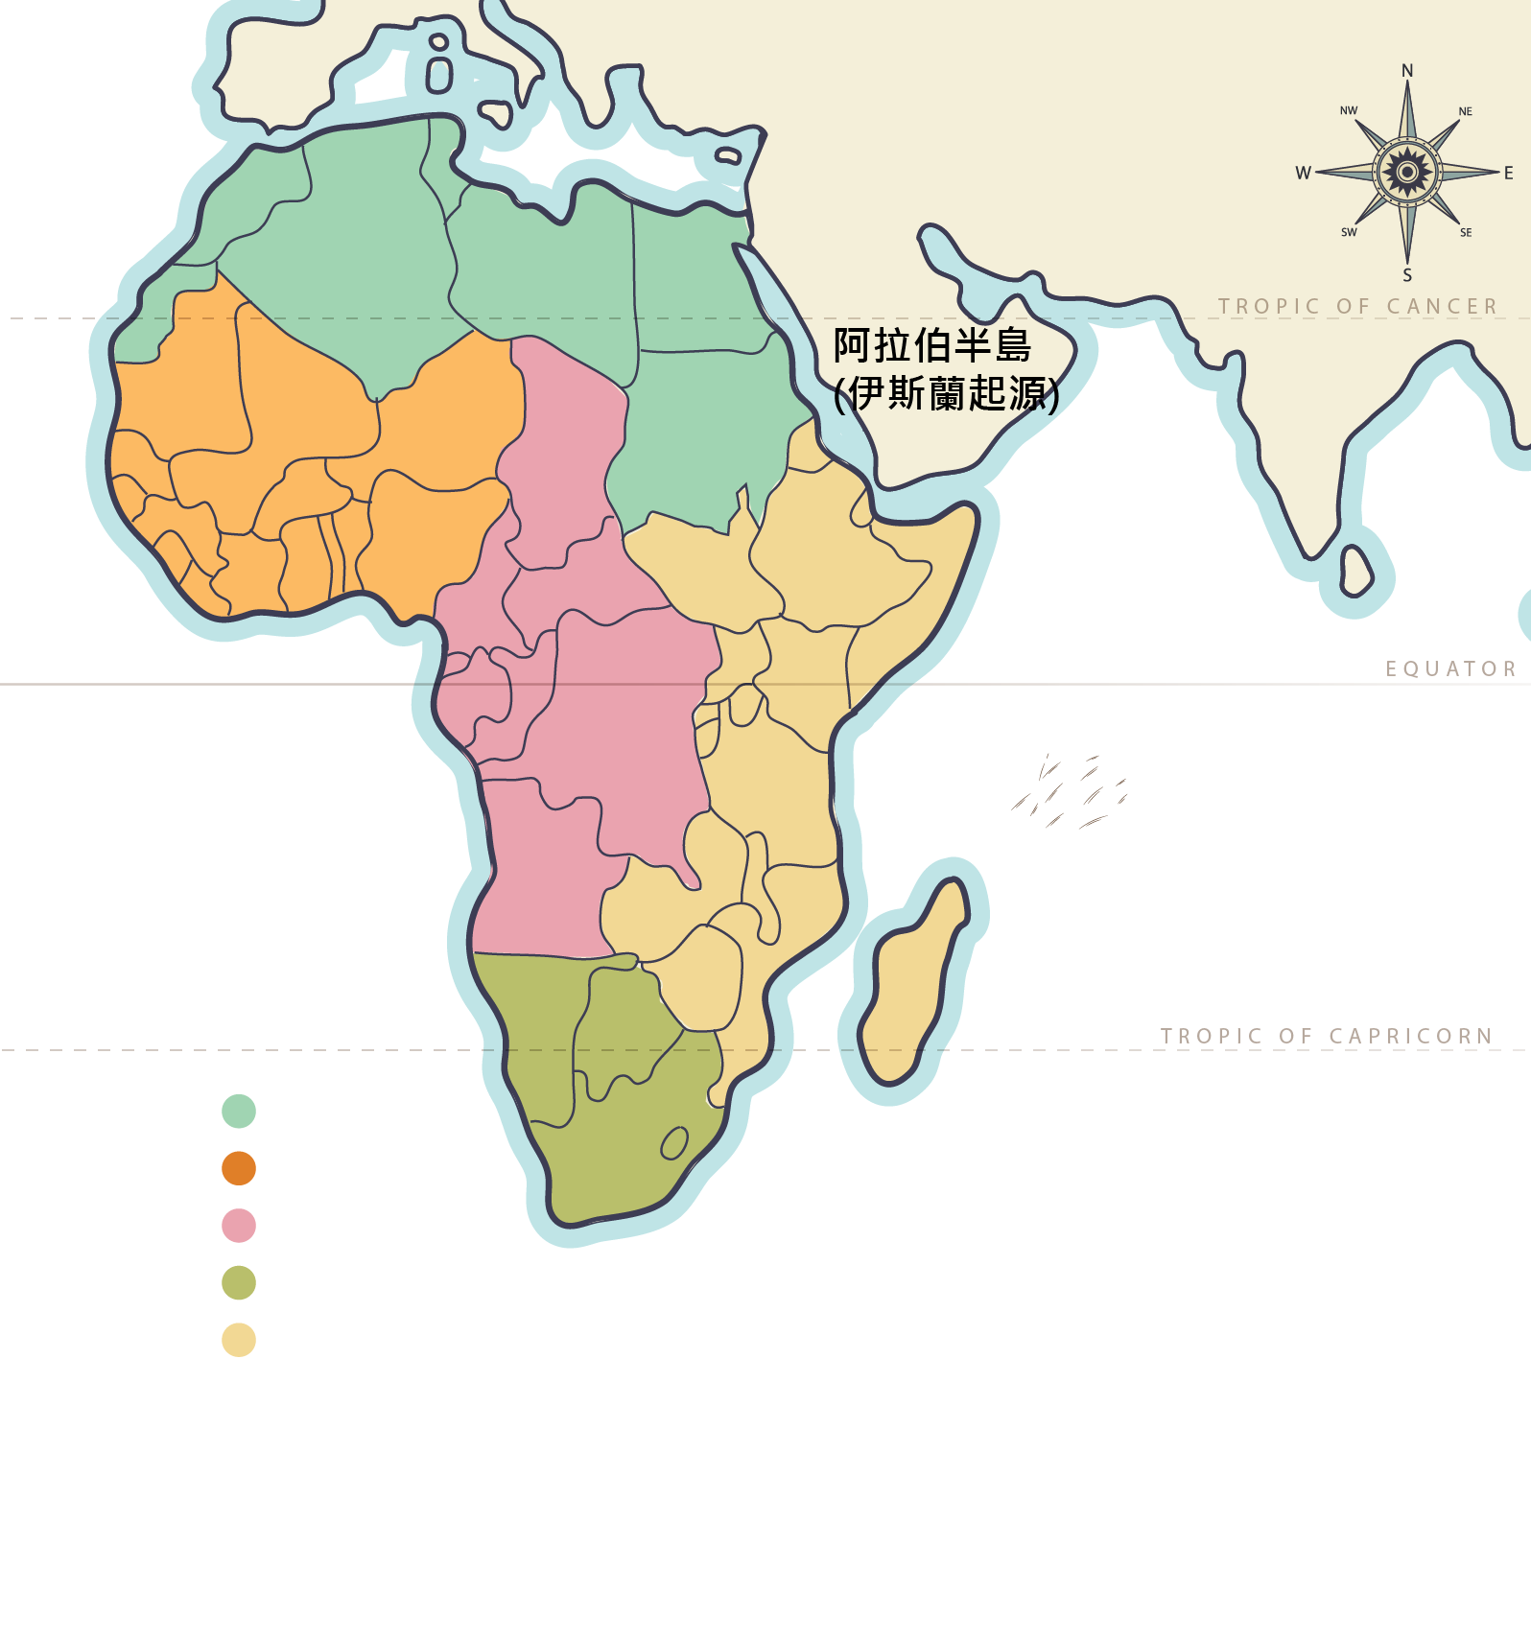
Africa
Latin aprica, Greek aphrike: sunny without cold
Population: 1.2 billion (16% of world total)
1/3 of the world's youth will be in Africa by 2050
The world's poorest continent with 37 of the 40 poorest countries in the world
Before the rise of Islam in the 7th century, Christianity was the main religious belief
In late 19th century, colonialism reintroduced Christianity to Central, South, and West Africa
Further towards the South, greater the coverage of Christianity. Africa has ¼ of Christians worldwide
AIDS epidemic is under control
Improvements seen in clean drinking water, maternal and child health, basic education, and electricity supply

Slide 3
North Africa: Where preaching of Islam to Arabs started
West Africa: Origin of gold mining and export of slavery
Central Africa: Higher proportion of Christian in these countries, which, unfortunately, caught in civil wars
South Africa: Broad coverage of Christianity - Localized churches is a key factor to the growth
East Africa: Setback in growth of Islam
Notes:
North Africa｜The starting point for Islam in the Arabs
In the 7th century, Islam spread from the Arabian Peninsula to Persia, Byzantium (Turkey) and Egypt. in less than half a century, Arabic became a common language through trading and swept across North Africa, which was originally dominated by Byzantium.
West Africa｜The Legend of Gold and the Export of Slaves
The Mali Empire in West Africa was rich in gold and believed in Islam. It was the richest and the most powerful country in ancient Africa. Trading of slaves has been widespread since ancient times, including the ancestors of many African-Americans who were trafficked to the United States from West Africa.
Central Africa｜Found to be the New World of the Gospel
Central Africa is rich in resources. During the colonial period, a large number of missionaries entered Central Africa and South Africa. They went there to set up schools, build hospitals, and serve the community, resulting in abundant spiritual fruitfulness. Almost all countries in Central Africa have a high proportion of Protestants and Catholics. Unfortunately, Central Africa has been suffering from eruption of civil wars in recent times and remained in misery.
South Africa｜Broad coverage of Christianity
The further south Africa goes, the greater the coverage of Christianity. South Africa is the most industrialized country in Africa and colonists mined minerals here. From the 19th to 20th century, localized independent church movement was launched. Churches that embraced African culture grew significantly and became one of the key factors to the growth of Christianity in southern Africa.
East Africa｜Setback in growth of Islam
East Africa is located on the edge of the Red Sea and Indian Ocean. Ethiopia has records of Philip baptizing a eunuch and the legend of the Queen of Sheba. As localized churches flourished, that also hindered the growth of Islam, except for the tribes dominated by commerce and nomads.

Slide 4
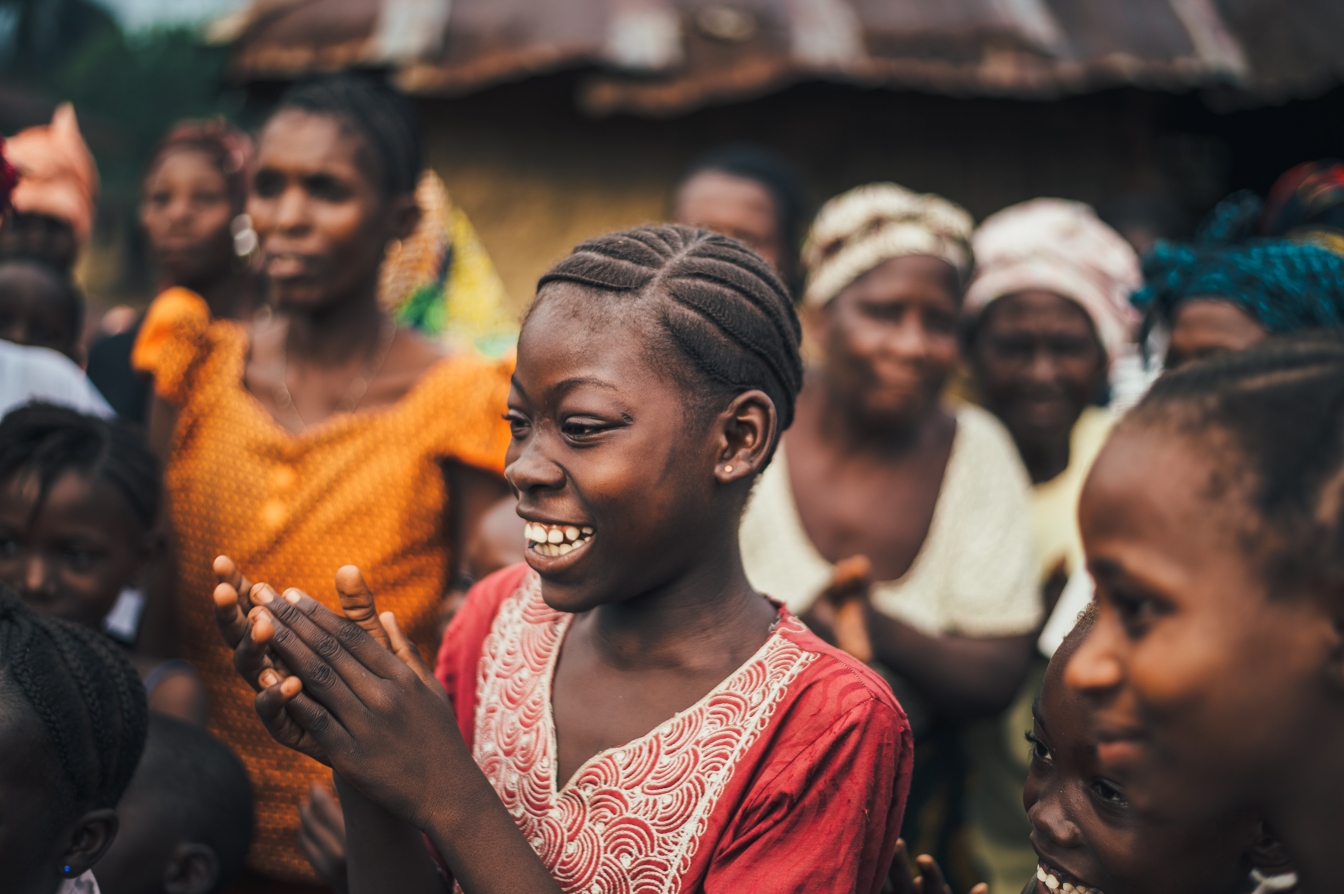
Let us pray for Africa together

Slide 5
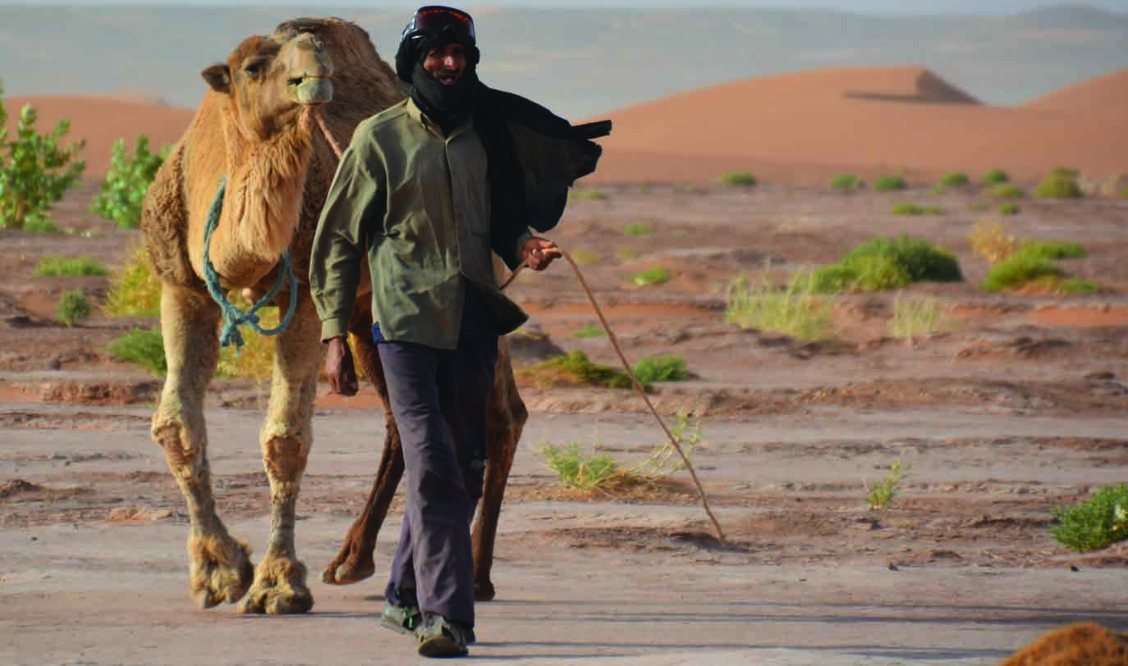
Heavenly Father, we pray for the five countries in North Africa - Egypt, Morocco, Algeria, Libya, and Mauritania.
May Your Word prosper among them.
Protect the messages of gospel radio and TV programs from being blocked but to enter the hearts of the listeners and generate their desires for the truth.
Fill workers with wisdom and power when answering questions.
May the Lord have mercy on the impoverished Sahel region. Make a way for them to experience the peace of Christ and provision of Heavenly Father amidst the killing and enslavement of multiple terrorist groups.
Notes:
December 2022 – We pray for North and West Africa
The Sahel region is an area 5,400+ kilometers in length and a width of up to 1,000 kilometers between the Sahara Desert in northern Africa and the grasslands in central Sudan. It mostly consists of dry grassland vegetation. The few plants are mainly herbs.
Desertification.
Severe drought occurred in this area, and rainfall decreased significantly. The acute drought triggered scathing desertification. Large areas of pastural vegetation were destroyed. Sand dunes originally stabilized by vegetation had become active in general, forming wind-eroded patches and mobile sand dunes.
2 million herders in the Sahel zone of West Africa lost about half of their livestock, and there is basically no agricultural harvest. The serious destruction of agriculture and animal husbandry caused many herdsmen and farmers to move to cities or flee to refugee camps in the south. Due to desertification and famine, it is estimated that at least 100,000 to 250,000 people died of starvation during this period of time.
Since 2009, militants who self-labeled "Al-Qaeda in the Islamic Maghreb" have been active in the region. The group frequently kidnaps Western citizens and launches attacks on multinational forces, posing a serious threat to security in the Sahel region. In November 2022, French President Macron announced the withdrawal of the security military set up in this area.

Slide 6
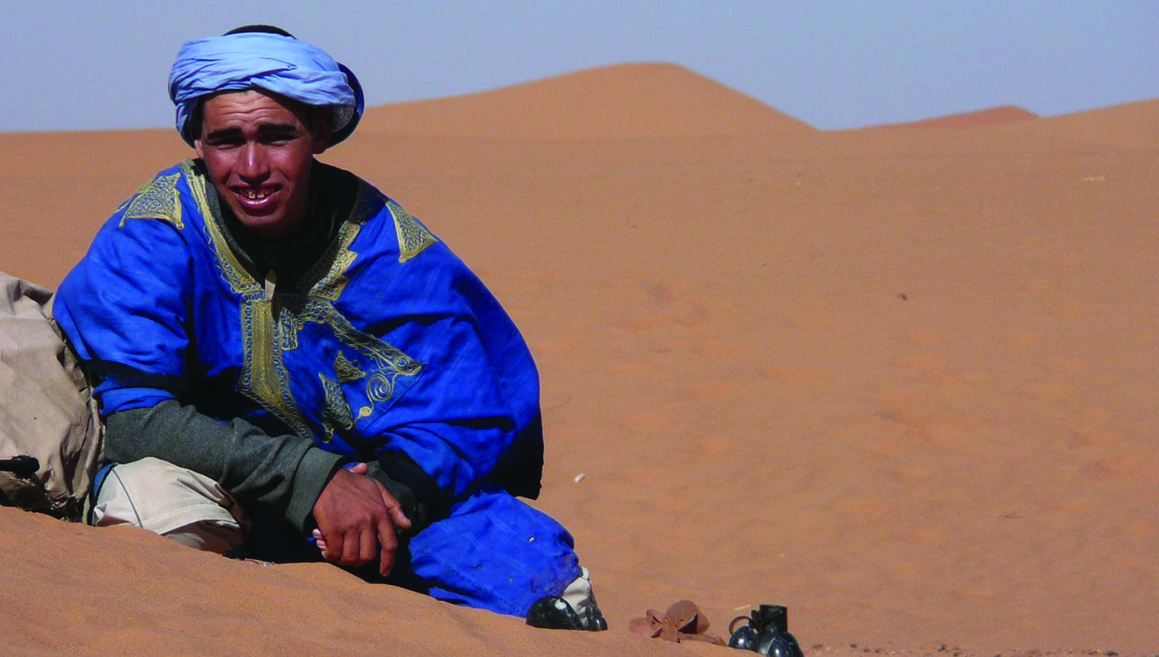
Lord Jesus, we pray for the Bedouin nomads in North Africa.
May Your love draw near to them. Lead them back to your sheepfold and to be the Lord's sheep, resting beside the living water and experiencing the goodness of Father God.
Heavenly Father, please bless the natives of North Africa,
Guide the ministry to the 40 million Berbers to a breakthrough, Lead them to know God's love and to restore their ancestors’ faith,
Preserve and equip Berber Christians to be evangelists,
Sharing the good news with their own people.
Notes:
https://www.persecution.com/stories/berber-christians-in-algeria-share-christ-with-muslim-oppressors/
Algeria Berber Baptism
One of the two/three most important theologians in Christian history: Augustine, who was Berber and grew up in North Africa.
St. Augustine (354-430) came from the city of Thagaste, which is probably near present-day Annaba, Algeria

Slide 7
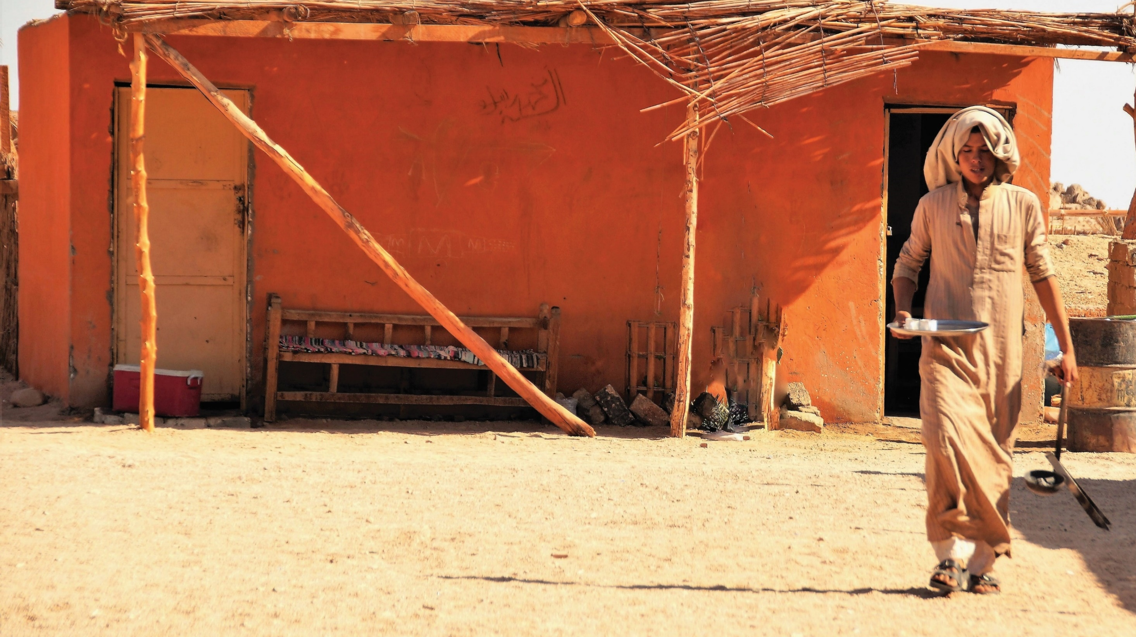
Heavenly Father, we pray together for the 6.2 million Wolof people in West Africa. They do not have a complete Bible written in Wolof. We ask the Lord to take care of these believers, who are
less than 1 in 10,000 Wolof people, that they will not lose their faith,
but will grow in grace and truth in Christ.
Pray that they will accept medical missionaries.
Heavenly Father, the worsening drought in West Africa has caused death of a lot of children younger than five.
We pray that the government and community decision makers will cooperate in sincerity, wisdom, and patience.
Bless the most vulnerable families with the opportunity
to improve their livelihoods and feed their children.
We pray in the name of Jesus, Amen.
Notes:
For West Africa
Millions of people in West Africa are affected by increasingly frequent and severe droughts. Poor harvests lead to high food prices and ultimately food insecurity and malnutrition among children and families struggling to earn a living.
Pray for underprivileged children. During droughts, children are more susceptible to disease. They have to travel long distances to find water - making them vulnerable to wildlife and human predators. When food resources are threatened, families migrate in the hope of better opportunities elsewhere. Sometimes children have to find work to support the family. This means children drop out of school, or even if they stay in class, find it difficult to concentrate in class due to hunger.

