Slide 1
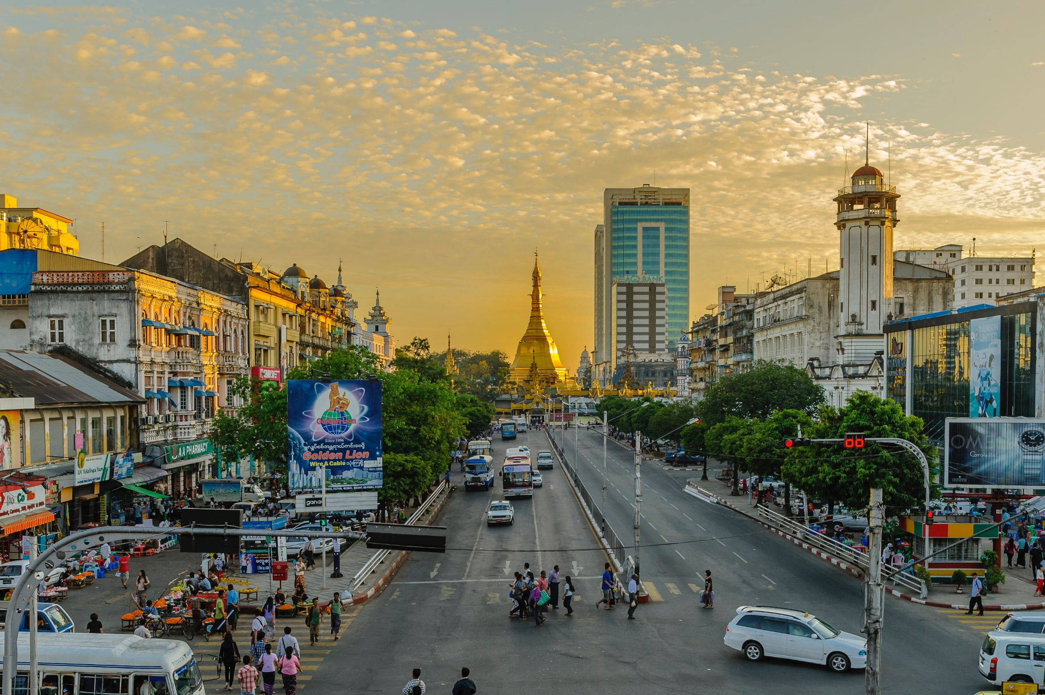
August 2022
Pray for Myanmar
Notes:
Introduction:
The Shocking Takeover of Power
In February 2021, the military attacked at dawn to overthrow the elected government. Revolts and repression began in various places while the epidemic Covid-19 simultaneously attacked people mercilessly.
Through the perspective of missionaries and local pastors, we will walk into the Myanmar impacted by the February coup d'état, share our hearts with the suffering people, and cry out for God's mercy.

Slide 2
The Burmese are Weeping
55.7 million people, 149 ethnic groups in this second largest country in Southeast Asia; 52 unreached groups (34.9%).
90% Buddhist, 6% Christian, 4% Islamic and others.
Multiple coups and civil wars in the 70 years after independence from UK in 1948.
印度
中國
寮國
泰國
The Min Aung Hlaing military coup on February 1, 2021 and the epidemic led to:
Civil instability, shootings, and bombings. People lost their homes and became refugees.
Economy shrank; Young people, unemployed and out of school, stole and looted.
Under the paralyzed medical system and shortage of medicines, Covid-19 patients could not be treated in time.
Religious persecution began. Chin State, where Christians accounted for 80%, was bombed by the military; Priests were arrested, and churches were destroyed.
Notes:
Myanmar :
Country name: Republic of the Union of Myanmar. "Myanmar" means "far outskirts".
Location: Located in the western part of the Indo-China Peninsula, bordering India and Bangladesh in the northwest, China in the northeast, and Thailand and Laos in the southeast.
Main ethnic groups: 68% Bamar, 9% Shan, 7% Karen, 3.5% Rakhine, 2.8% Mon, 2.5% Chinese, 1.5% Kachin, 1.3% Indian, 1% Chin, 5.8% Kayah, Wa and others.
Official language: Burmese.
Important festivals: National Day on January 4; Songkran in mid-April.
History: A British colony before independence in 1948.
In the 10th century, Burmese and Mon people established a dynasty that combined Hinduism and Buddhism. After that, the country experienced the Bagan, Toungoo and Gongbang dynasties.
The Ne Win coup took place on March 2, 1962. The pro-democracy movement took place on August 8, 1988. The Su Maung coup took place on September 18, 1988.
February 1, 2021 Min Aung Hlaing coup: Junta seized power and claimed that the National League for Democracy (NLD) cheated in 2020 elections. They arrested leader Aung San Suu Kyi, President Win Myint and several high-ranking officials and announced one-year state of emergency.
After the coup, shootings and explosions happened everywhere. Villages and churches were burned down. People lost their homes and became refugees. As of January 14, 2022, 1,469 people were killed, 11,554 people were arrested, and 1,966 people were wanted. Among these numbers, 80 pastors were killed. >48,000 refugees hid in caves. After each coup, the intellectuals went abroad. Those who stayed were vulnerable groups who could not help themselves and were in poor conditions, which was obviously a disadvantage to the development of the country.
Myanmar's economy is projected to shrink by 18% and the value of the kyat to depreciate by >20% in year 2022. Prices skyrocketed and cash flow has been in shortage. 25.6% of people live below the national poverty line. 67% of the working population earn less than $2 a day.
COVID-19: As of July 14, 2022, 613,000 confirmed cases and 19,434 deaths. "Covid-19 on Children" has recently occurred in remote areas. There are also strong monsoons that have caused flash floods, making the situation even worse for the victims.
Myanmar has nearly 90% Buddhists and 6% Christians, mostly ethnic minorities. The Burmese who believed in Buddhism controlled Myanmar's military and politics and used politics to manipulate religion.
Christians were persecuted and treated unfairly. Villages and churches were destroyed. The military arrested pastors for being "rebels" and slander. They broke into churches and confiscated Bibles and poetry collections. In June 2021, three priests were detained in the town of Naumeng. They were accused of using inflammatory language in their prayers. On September 18, 2021, in Tanlang Township, Chin State, a pastor was shot and killed while trying to put out a fire caused by military shelling. Soldiers sawed off his fingers and snatched his wedding ring, an example of the brutality of the soldiers.

Slide 3
A Cup of Cold Water in the Ruthless Disaster
”Mission Pathway" initiated fundraising for Myanmar refugees
Helped the family of the pastors who died caring for members of the congregation who contracted the virus
Provided supplies to Thai-Myanmar border ministry partners, delivering rice, grain and materials to Myanmar.
Notes:
The military continued to slaughter people in brutal ways, yet no country was willing to pay the price to stop it in practical and effective actions. The continuous conflict between the People's Self-Defense Forces and the military and the blockade of the Internet and transportation made the refugee aid ministry a huge challenge.
Thank God that the “Myanmar Timely Rain Relief Funds” has received the attention and support from many churches. The funds have helped many overseas churches that are persecuted and pastors and their families who are in distress. We are very grateful for the participation of the churches.
Thanks to the grace of the Lord, the Manmin Gospel Mission, a partner of the Mission Pathway on the Thai-Myanmar border continues to traverse mountains and mountains, working tirelessly, risking arrest, and in a low-profile to deliver rice, grain and other aid materials to the poor and starving families in Myanmar - a lot of them are old, weak, sick and disabled people. At the same time, stationery and toys were sent to the children who fled, so that they could still have the opportunity to learn and play in some joy. The hope is to allow them to ease their fears and continue to live with hope in difficult circumstances.
For details, please read: Myanmar Timely Rain Relief Briefing and Intercession.
https://www.cross-roads.org/caring.php#myanmar。

Slide 4
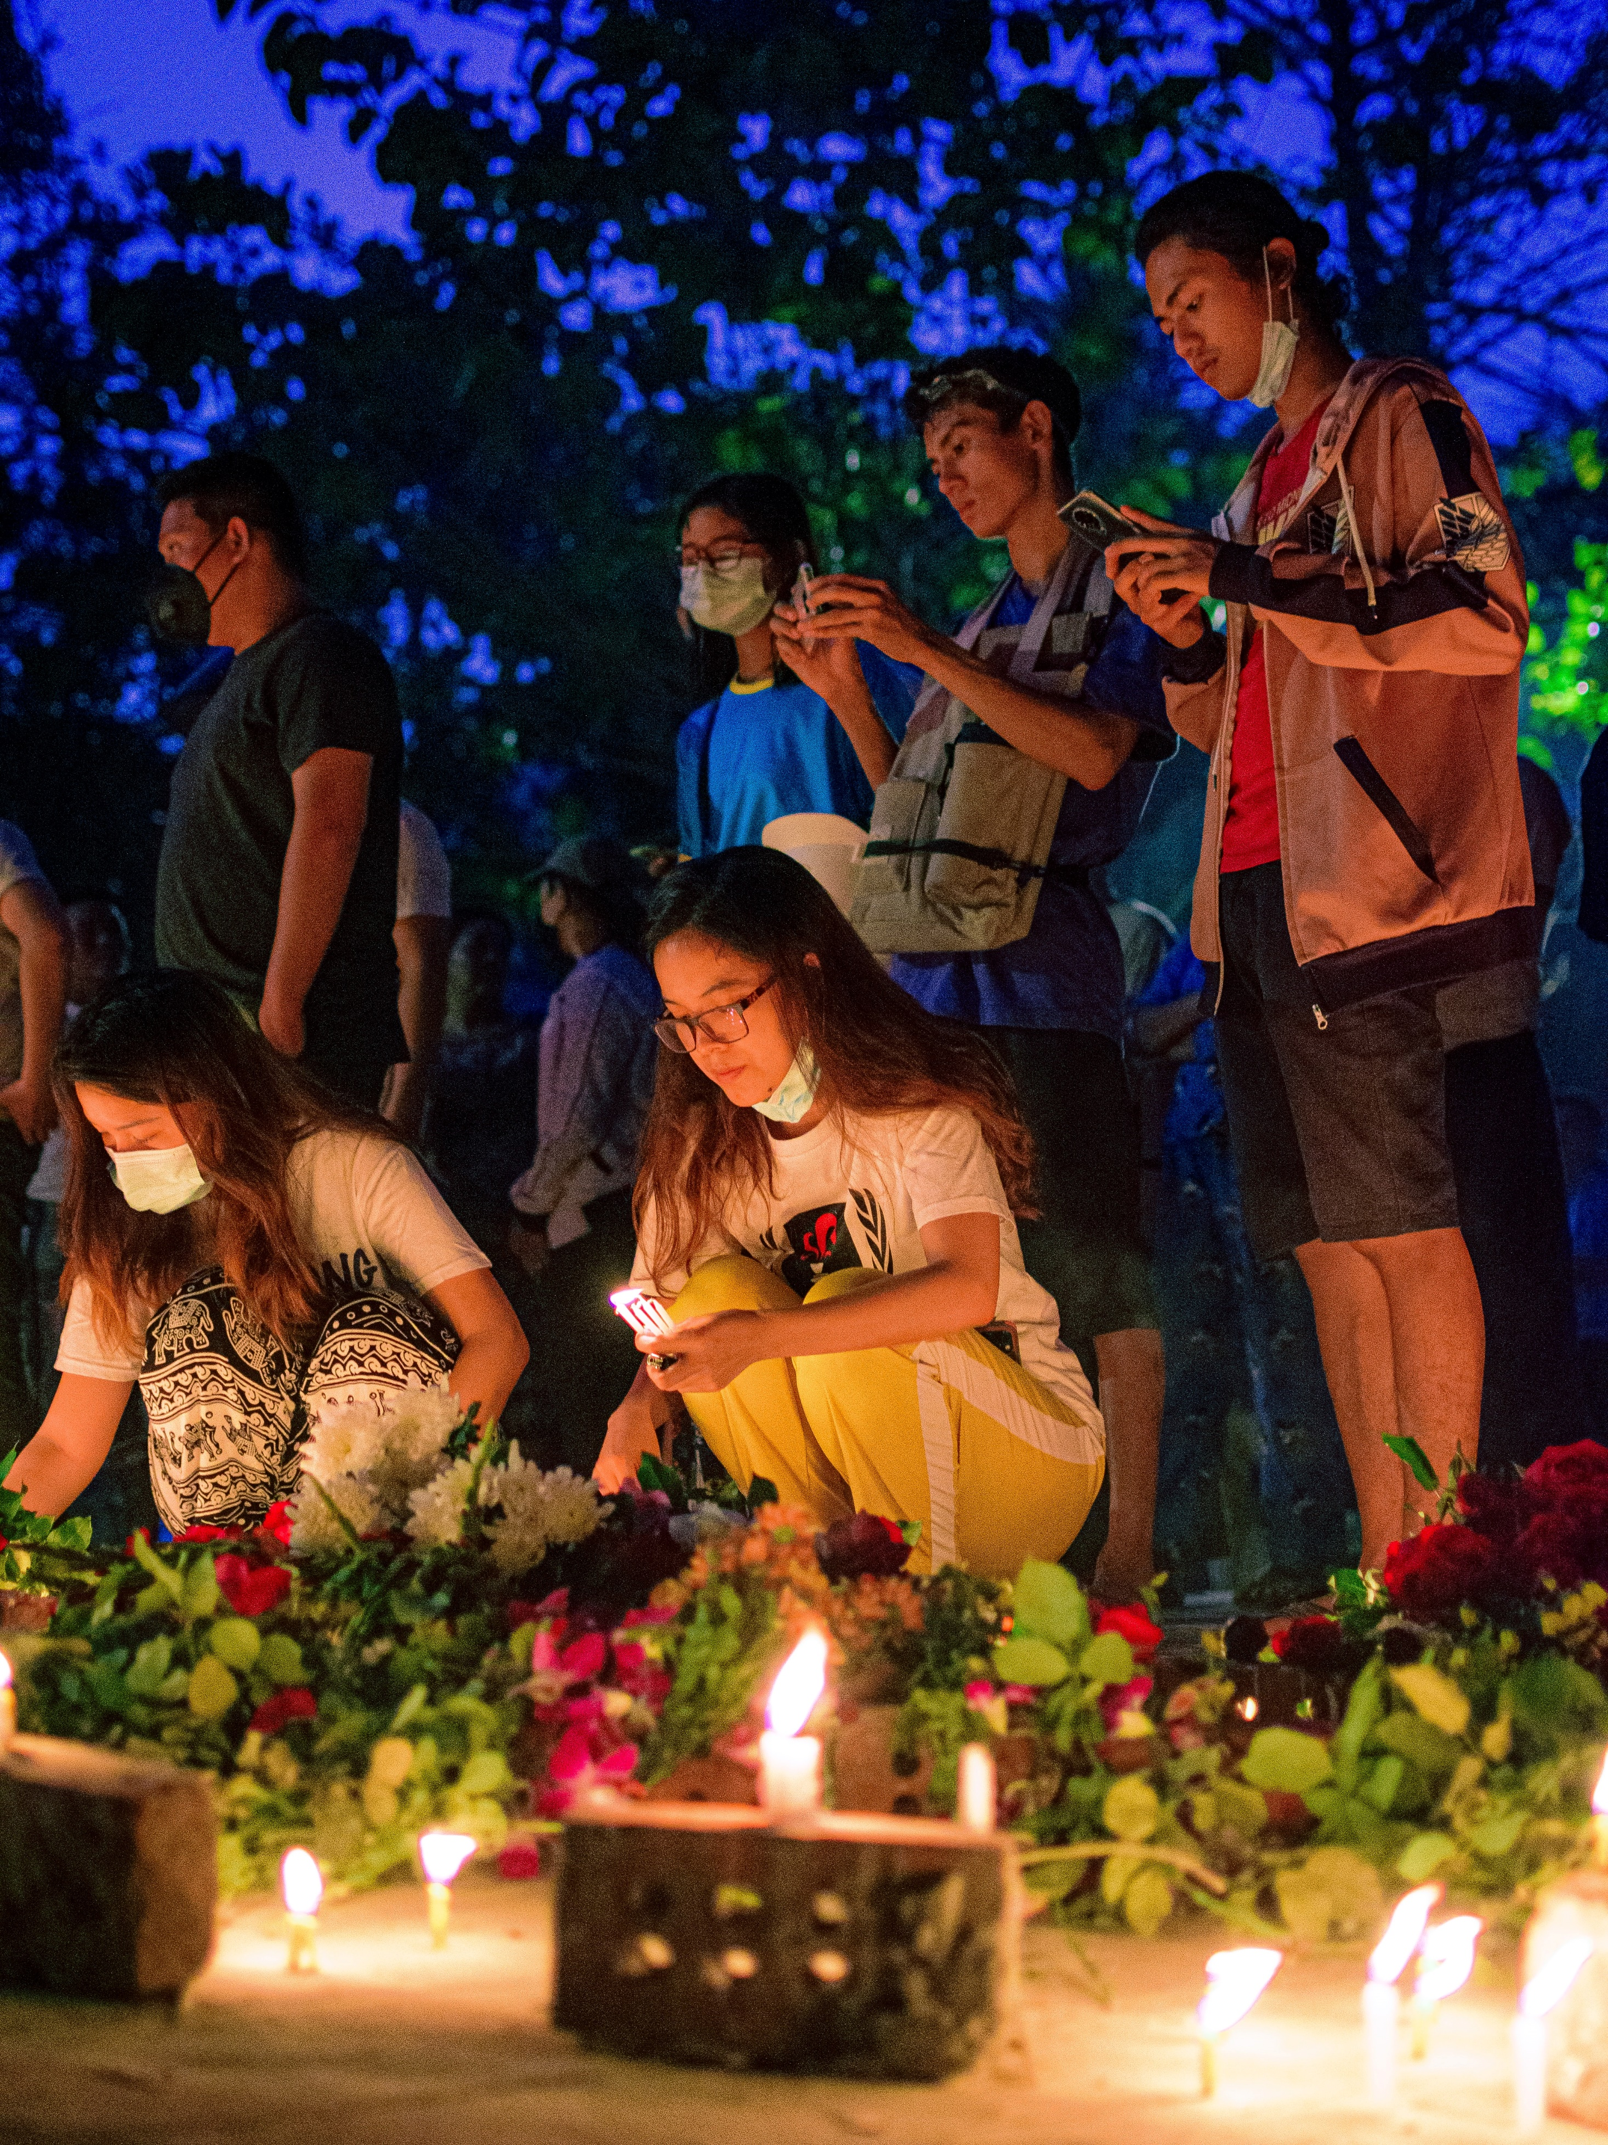
Let us Pray for Myanmar together

Slide 5
Father, thank you for being “our refuge and strength,
an ever-present help in trouble."
We pray for Your beloved Myanmar people and the 52 unreached groups.
We cry to the Lord for mercy on these afflicted and helpless people, forgive their sins, turn them from their idols and their wicked ways, and guide them to repent and turn back to You.
Through the blood of Christ, may they be cleansed from all bondages, curses, and evil forces.
May they find salvation, deliverance, and freedom in Christ.
May they know the name of the Lord, fear You, and walk in Your ways.
May they know to call upon Your name and take refuge in You when they are weak and helpless.
For You have promised, "You will keep in perfect peace
those whose minds are steadfast, because they trust in you."
We pray in the name of Jesus Christ. Amen!

Slide 6
Father, You said:
"In the Lord’s hand the king’s heart is a stream of water
that he channels toward all who please him.”
We trust deeply that the hearts of the kings of this earth are in Your hands.
We pray to the Lord to forgive the sins of the corrupt and abusive leaders.
May the Lord soften the minds of the leaders quickly, so that they will stay away from evil, act justly and love mercy, walk humbly with your God, and bless the people of the country.
May healing come to this land.
So that the political situation in Myanmar can be stabilized,
the economy can recover,
and the people can return to their normal daily lives.
Let riots, theft, robbery, and anything illegal all over the country stop.
Let the social injustice stop.
The relationship among people be harmonious,
and people enjoy a safe and secure life.
We ask in the name of Jesus Christ. Amen!

Slide 7
Father, You see from Your eyes the Burmese weeping.
Please comfort Your people, speak tenderly to them,
and proclaim to them, "her hard service has been completed,
that her sin has been paid for".
Let them face coups, disasters and religious persecution without fear,
because You are with them. Your Holy Spirit Himself comforts them and helps them. You will bestow on them a crown of beauty instead of ashes, the oil of joy instead of mourning, and a garment of praise instead of a spirit of despair. May You bless the refugee aid ministry.
May You provide for the needs of poor and hungry families, Christians, and pastors, so that they can see hope in their suffering.
May Your Church seek unity in turmoil. May believers be filled with Your love as You feed them like their shepherd.
In You there is eternal security. Blessed are those who trust in you.
We ask in the name of the Lord Jesus Christ. Amen!

