Slide 1
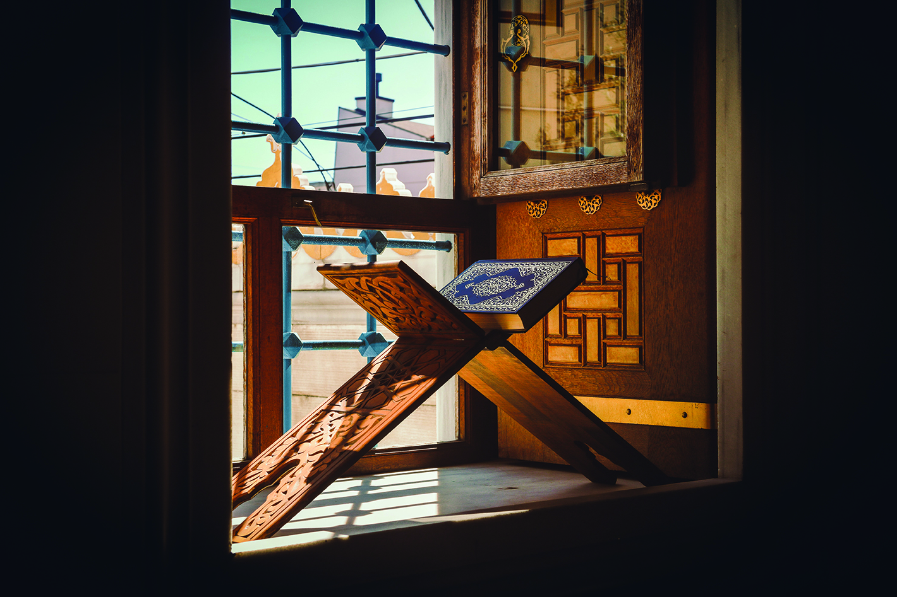
{
April 2 to May 1, 2022
30 Days of Prayer for the Muslim World
Notes:
Ramadan, the holy month of fasting and prayer for Muslims that lasts for 30 days, begins on April 2 in 2022.
The ninth month of the Islamic calendar ends on May 1 this year.
This month's PPT briefly introduces the teachings of sin and forgiveness in Islamic beliefs.
Please encourage brothers and sisters to use the 30 Days of Prayer for Muslim World 2022,
https://www.30daysprayer.com/
To learn about and to pray for our world’s Muslim neighbors.
The material contains daily readings that focus on various topics,
people groups and geographical areas of the Islamic world.
Each day’s subject focus is followed by prayer points.
It also features informative background articles and resources for involvement.

Slide 2
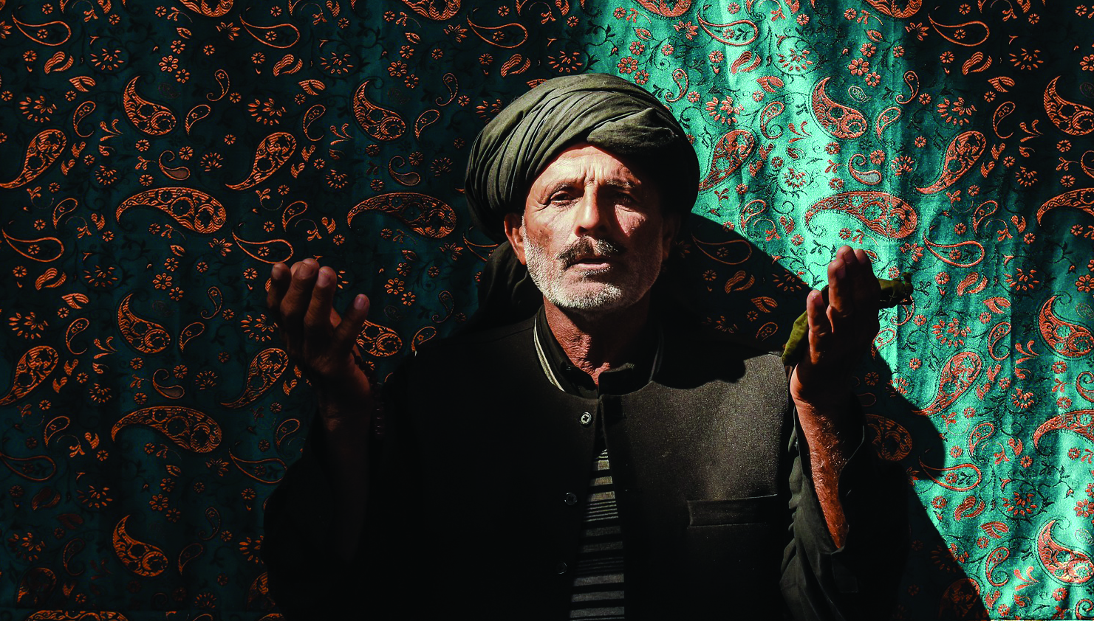
Muslims
Global Population
2000: 1.3 billion
2022: 1.94 billion
By Country
Malaysia: 19 million
US: 3.45 million
Singapore: 3.2 million
Hong Kong: 1.8 million
Canada: 1.3 million
Taiwan: 50,000 – 60,000

Slide 3
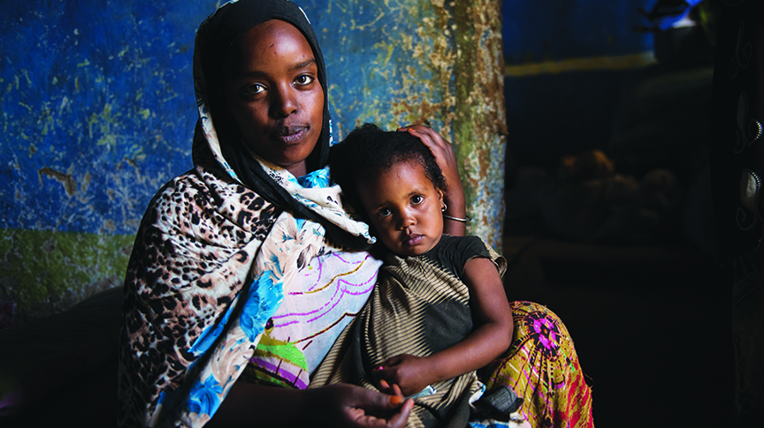
{
Islamic Doctrines on Sins and Forgiveness
Islam believes that human sins are not due to their rebellion against God, it is a result of their weaknesses and negligence. Through practicing Allah’s requirements in good deeds, sins can be redeemed. Therefore, there is no real repentance, confession, forgiveness, and redemption in Islamic belief.
Muslims have no way to guarantee their sins to be completely forgiven after death. Their biggest hope is Muhammad will intercede for them on the Day of Judgement.
Muslims regard the Bible as a altered and corrupted text. Hence, it is unreliable.
They believe that God has no son. Jesus was only a prophet and a messenger of God.
Muslims do not accept the doctrine of the Trinity and consider that as heresy.
Sins are categorized as major sins and minor sins.
Worshipping or deifying any beings other than Allah is the greatest sin. Those people will be sent to the hell of fire.
Other major sins: disobedience to parents, usury, adultery, act of cowardice in military.

Slide 4
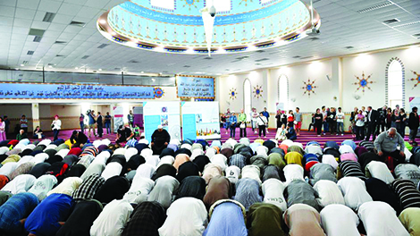
Heavenly Father, we thank you for the
“30 Days of Prayer for the Muslim World” that began in 1993.
Please encourage us to see the Muslim world through Your loving eyes.
Lord, in our daily prayer for the Muslims, please help us to have a heart of knowledge and comprehension, through which we can gain a deeper understanding of God's love for the Muslims.
Lord, raise up more of Your people to join in prayer, so that the number of intercessors united in blessing the salvation of Muslims increases day by day, praying for them in undivided attention from all over the world.

Slide 5
Holy God, we admit that men are sinful and cannot enter heaven with sin. Sins must first be forgiven, and people need to be redeemed.
We ask the Holy Spirit to speak to the Muslims through dreams and visions, telling them that only Jesus Christ’s death on the cross can atone for our sins, and give us the grace of forgiveness.
May God let every Muslim encounter Jesus Christ during Ramadan.
Let them have a whole new experience, feel the peace of Christ’s salvation, and be willing to seek You continuously.

Slide 6
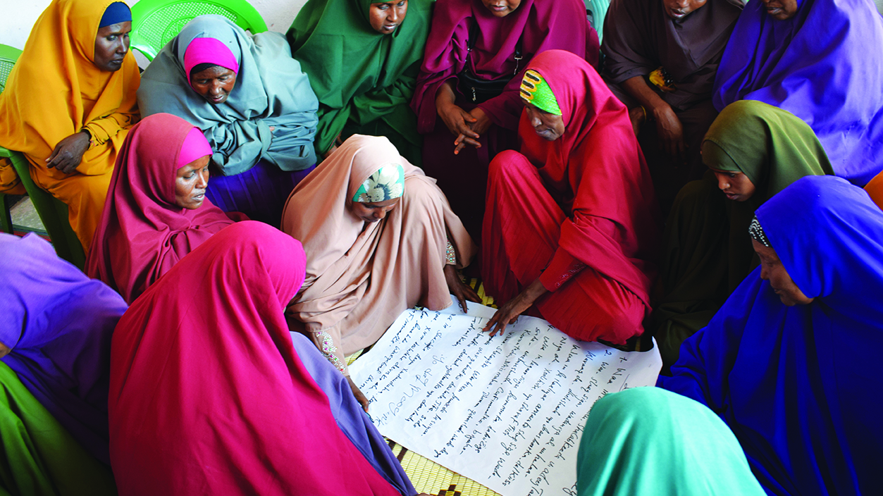
Heavenly Father, Muslims know that they must face the judgment of Allah. In their daily prayers, they repeatedly ask for Allah's forgiveness,
But they are unassertive if Allah would listen to their prayers.
Father God, please inspire them to read the Bible and watch the Jesus Film
To know that they need a loving Heavenly Father who is willing to communicate and answer prayers.
We pray that, through their willingness to trust Jesus, they will experience God’s acceptance and love, and receive the help of the Holy Spirit to live an abundant life.

Slide 7
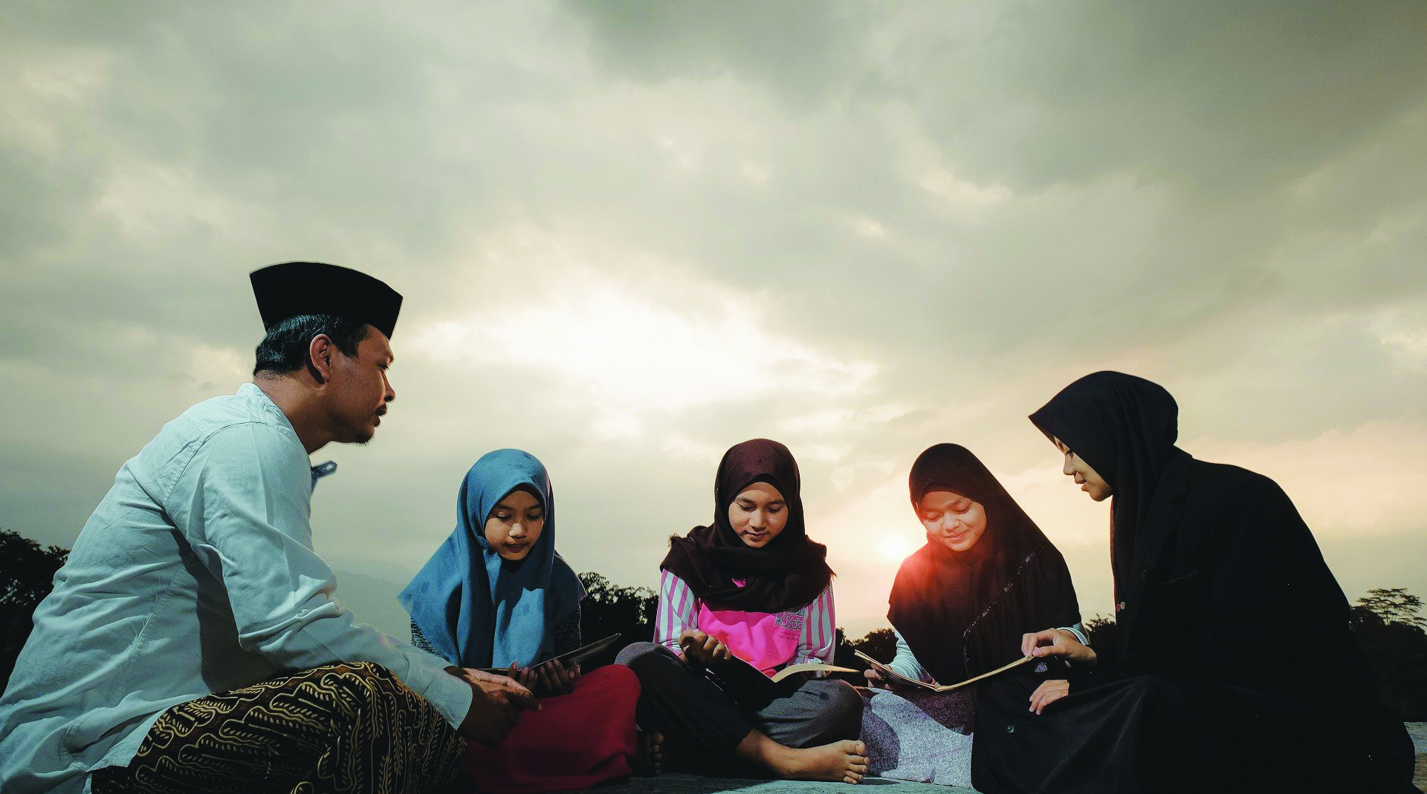
Heavenly Father, the inappropriate moral lifestyle of the Christians in the western countries and their ignorance of Islam has become a hindrance for Muslims to accept the Gospel. Please cleanse Your church to become the light in this age, revealing the way to truth and life.
May praise, honor, glory, and power be to Him who sits on the throne, and to the Lamb forever and ever!

