Slide 1
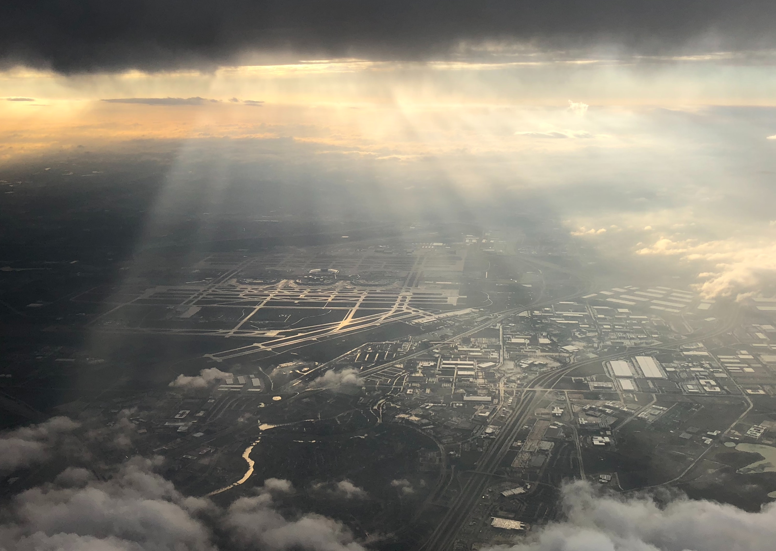
October 2021
Dallas Fort Worth

Slide 2
Dallas Fort Worth ( DFW)
The 4th largest metropolitan in the US with a population of over 7.5 million, 350 migrant communities, of which ¼ is from non-English speaking regions.
A cowboys’ hometown with a variety of agricultural markets, diverse and secular.
Home to over 20 corporate headquarters including Nokia, Texas Instruments, AT&T, Exxon-Mobil, Motorola, American Airlines ….. and Southwest Baptist Seminary.
This city of highest growth rate in US population is/has
A major refugee resettlement area with 246 new immigrants daily;
A city with rapid growth in ethnicities;
The 4th largest Muslim community
Used to be the “Bible Belt” of the evangelicals. However, beginning 1970, with the decline of Christian churches, church buildings have been converted into temples or meditation gardens.

Slide 3
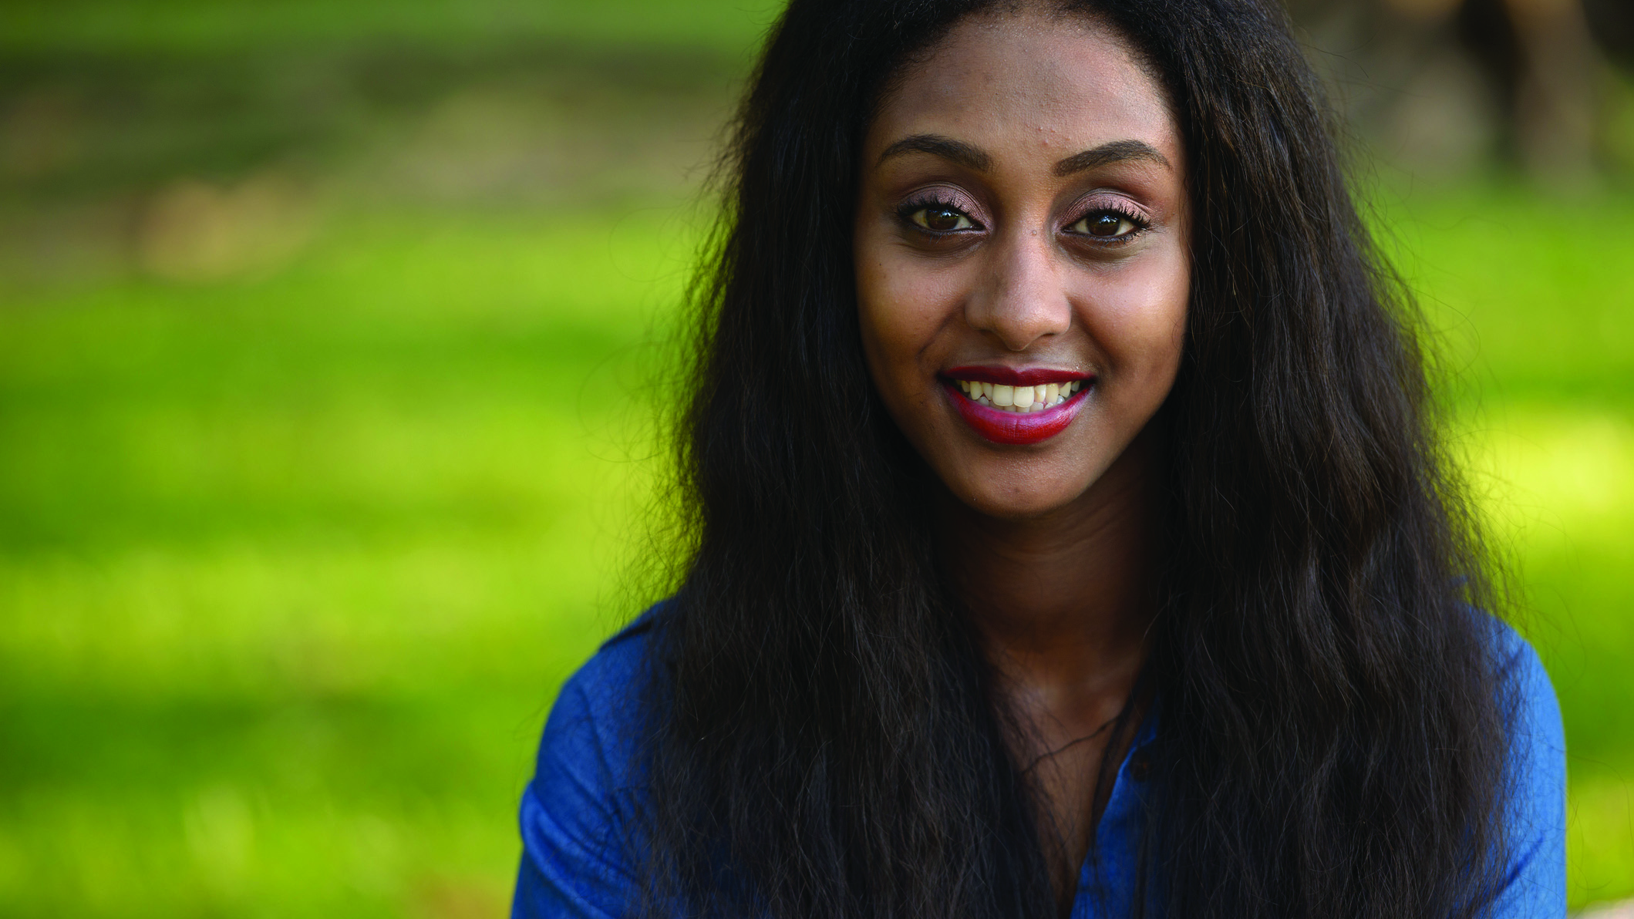
DFW is a Gateway city.
The Lord brings people who have never heard about the gospel to this city from around the world.
If they accept the good news, their relatives and friends in their hometown will have the chance to learn about the grace of salvation.

Slide 4
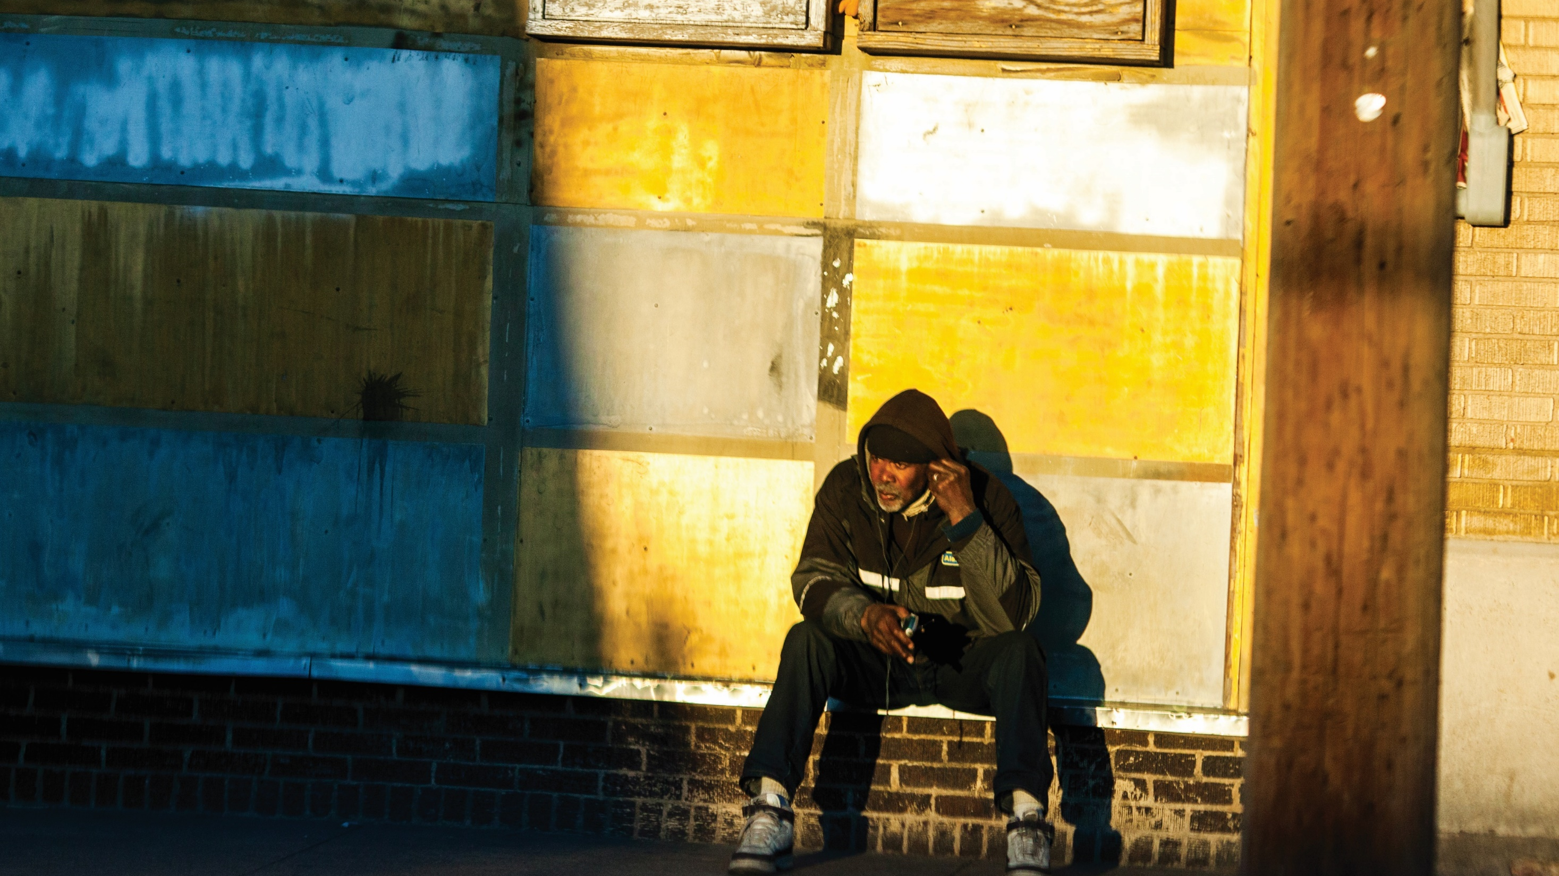
Let us pray for Dallas Fort Worth

Slide 5
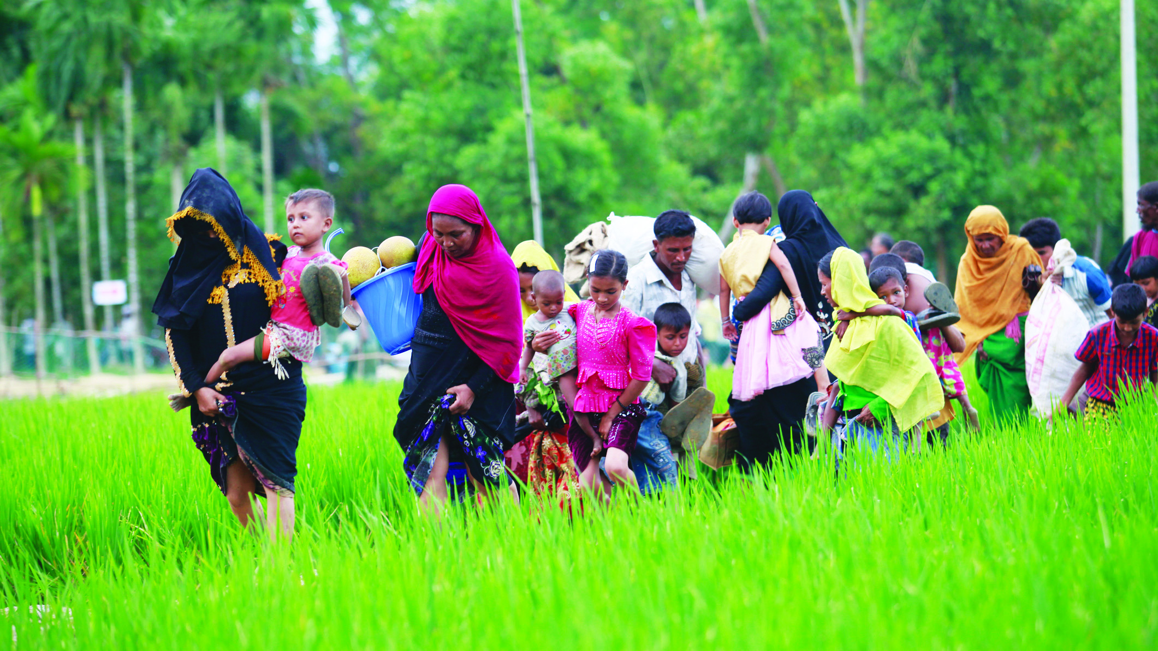
Dear Heavenly Father, we give thanks for DFW’s culture of acceptance of the immigrants who came from South Africa, Algeria, Egypt, Libya, Iraq, Lebanon, Kurdistan, Afghanistan, Iran, Laos, and more.
A lot of their home countries have been suffering from continual wars, food shortage, and oppression from their own governments.
May the mercy, healing, and caring of the Lord reach every ethnic group that experienced these trauma.
Notes:
提議: 主領者讀第一段
會眾:第二段

Slide 6
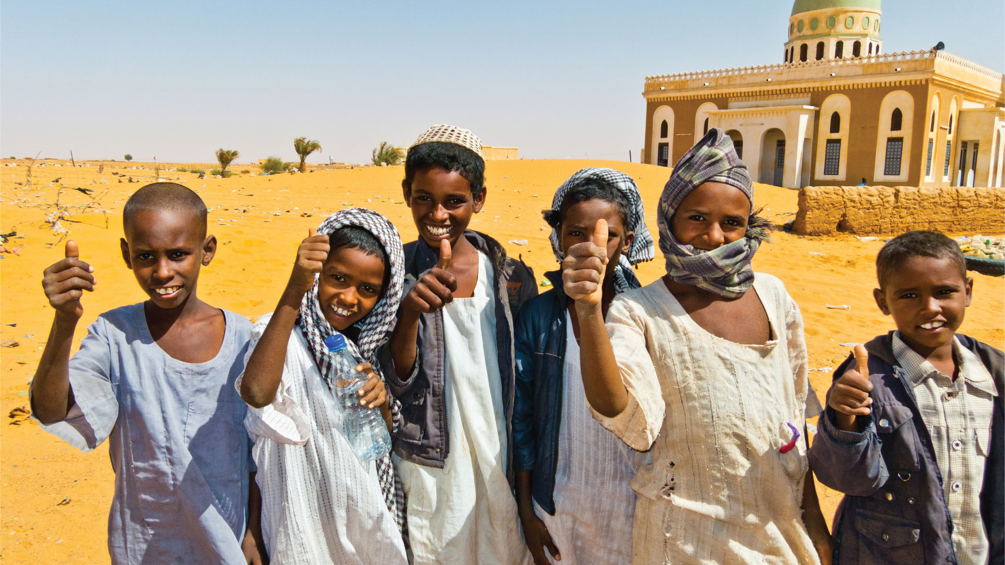
Heavenly Father, these new immigrants have their own religions and cultures, making it difficult for them to interact with other ethnic groups.
We pray that churches will send over workers to these communities to help them understand the ONE, who is the foundation of the country of the United States – Jesus Christ.
Lord, please help them to be willing to become a citizen of the Heavenly Kingdom and to bring the Heavenly good news back to their home country. May your righteousness, peace, and the joy of the Holy Spirit reach their homeland.
May there be the son of peace in every tribe to receive the gospel workers with open-hearts.
Notes:
提議: 姊妹讀第一段
會眾:第二段

Slide 7
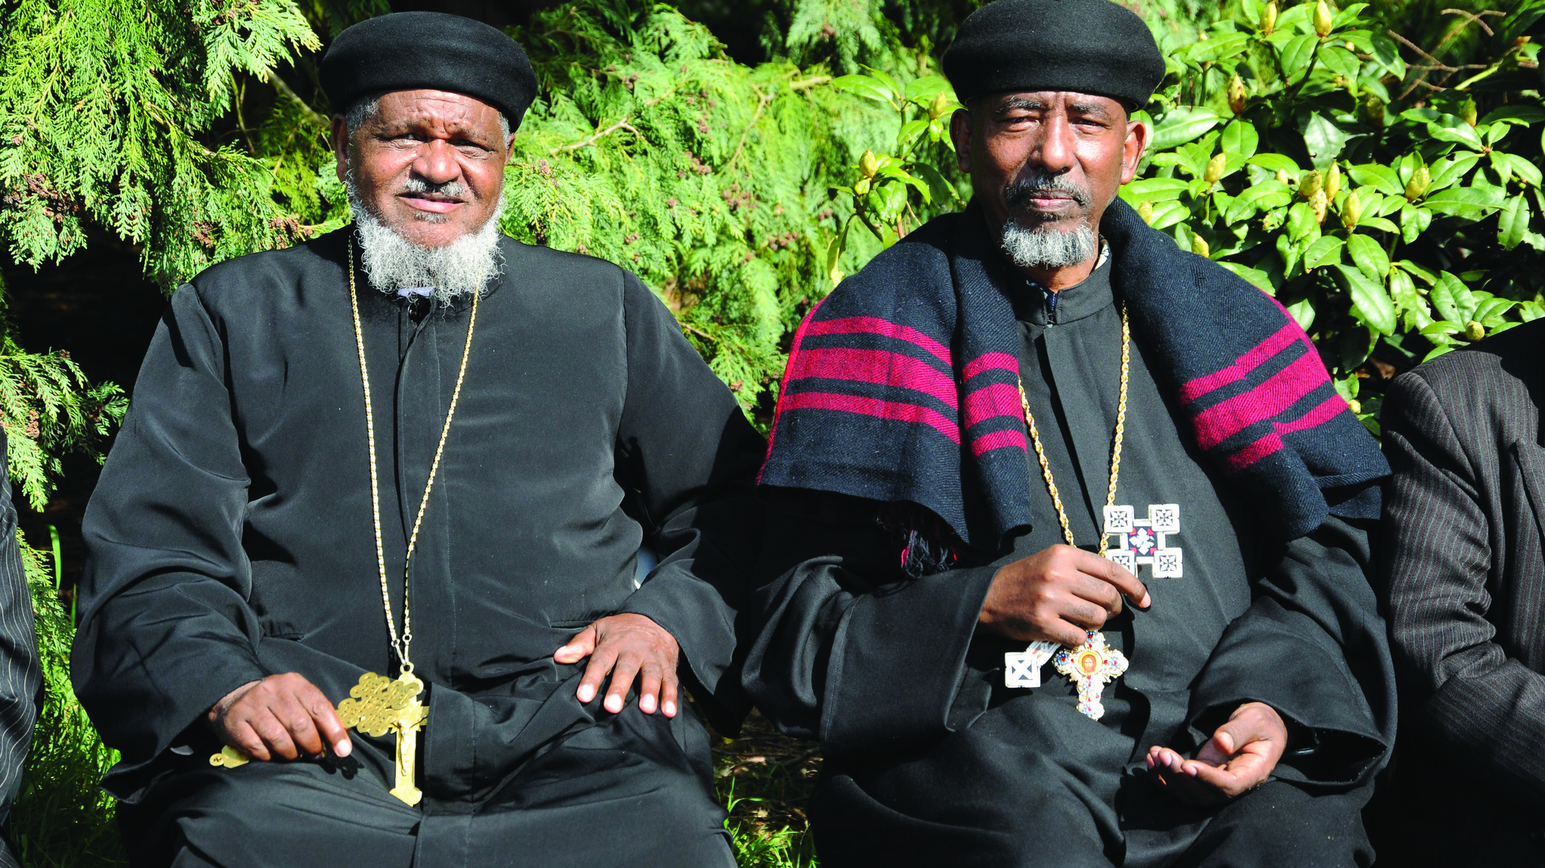
Heavenly Father, may the DFW churches thrive and become the light and the salt in their community.
Please rise up Christian businessmen/women and entrepreneurs from different industries to serve the immigrants, to teach them English, to know the community, and to provide job opportunities. May the new immigrants find stable jobs suitable for them, thereby experiencing the grace of our Heavenly Father.
We pray that the Lord will protect the leaders of this city, to do justice, to love kindness, and to walk humbly with God.
Notes:
提議: 弟兄讀第一段
會眾:第二段

Slide 8
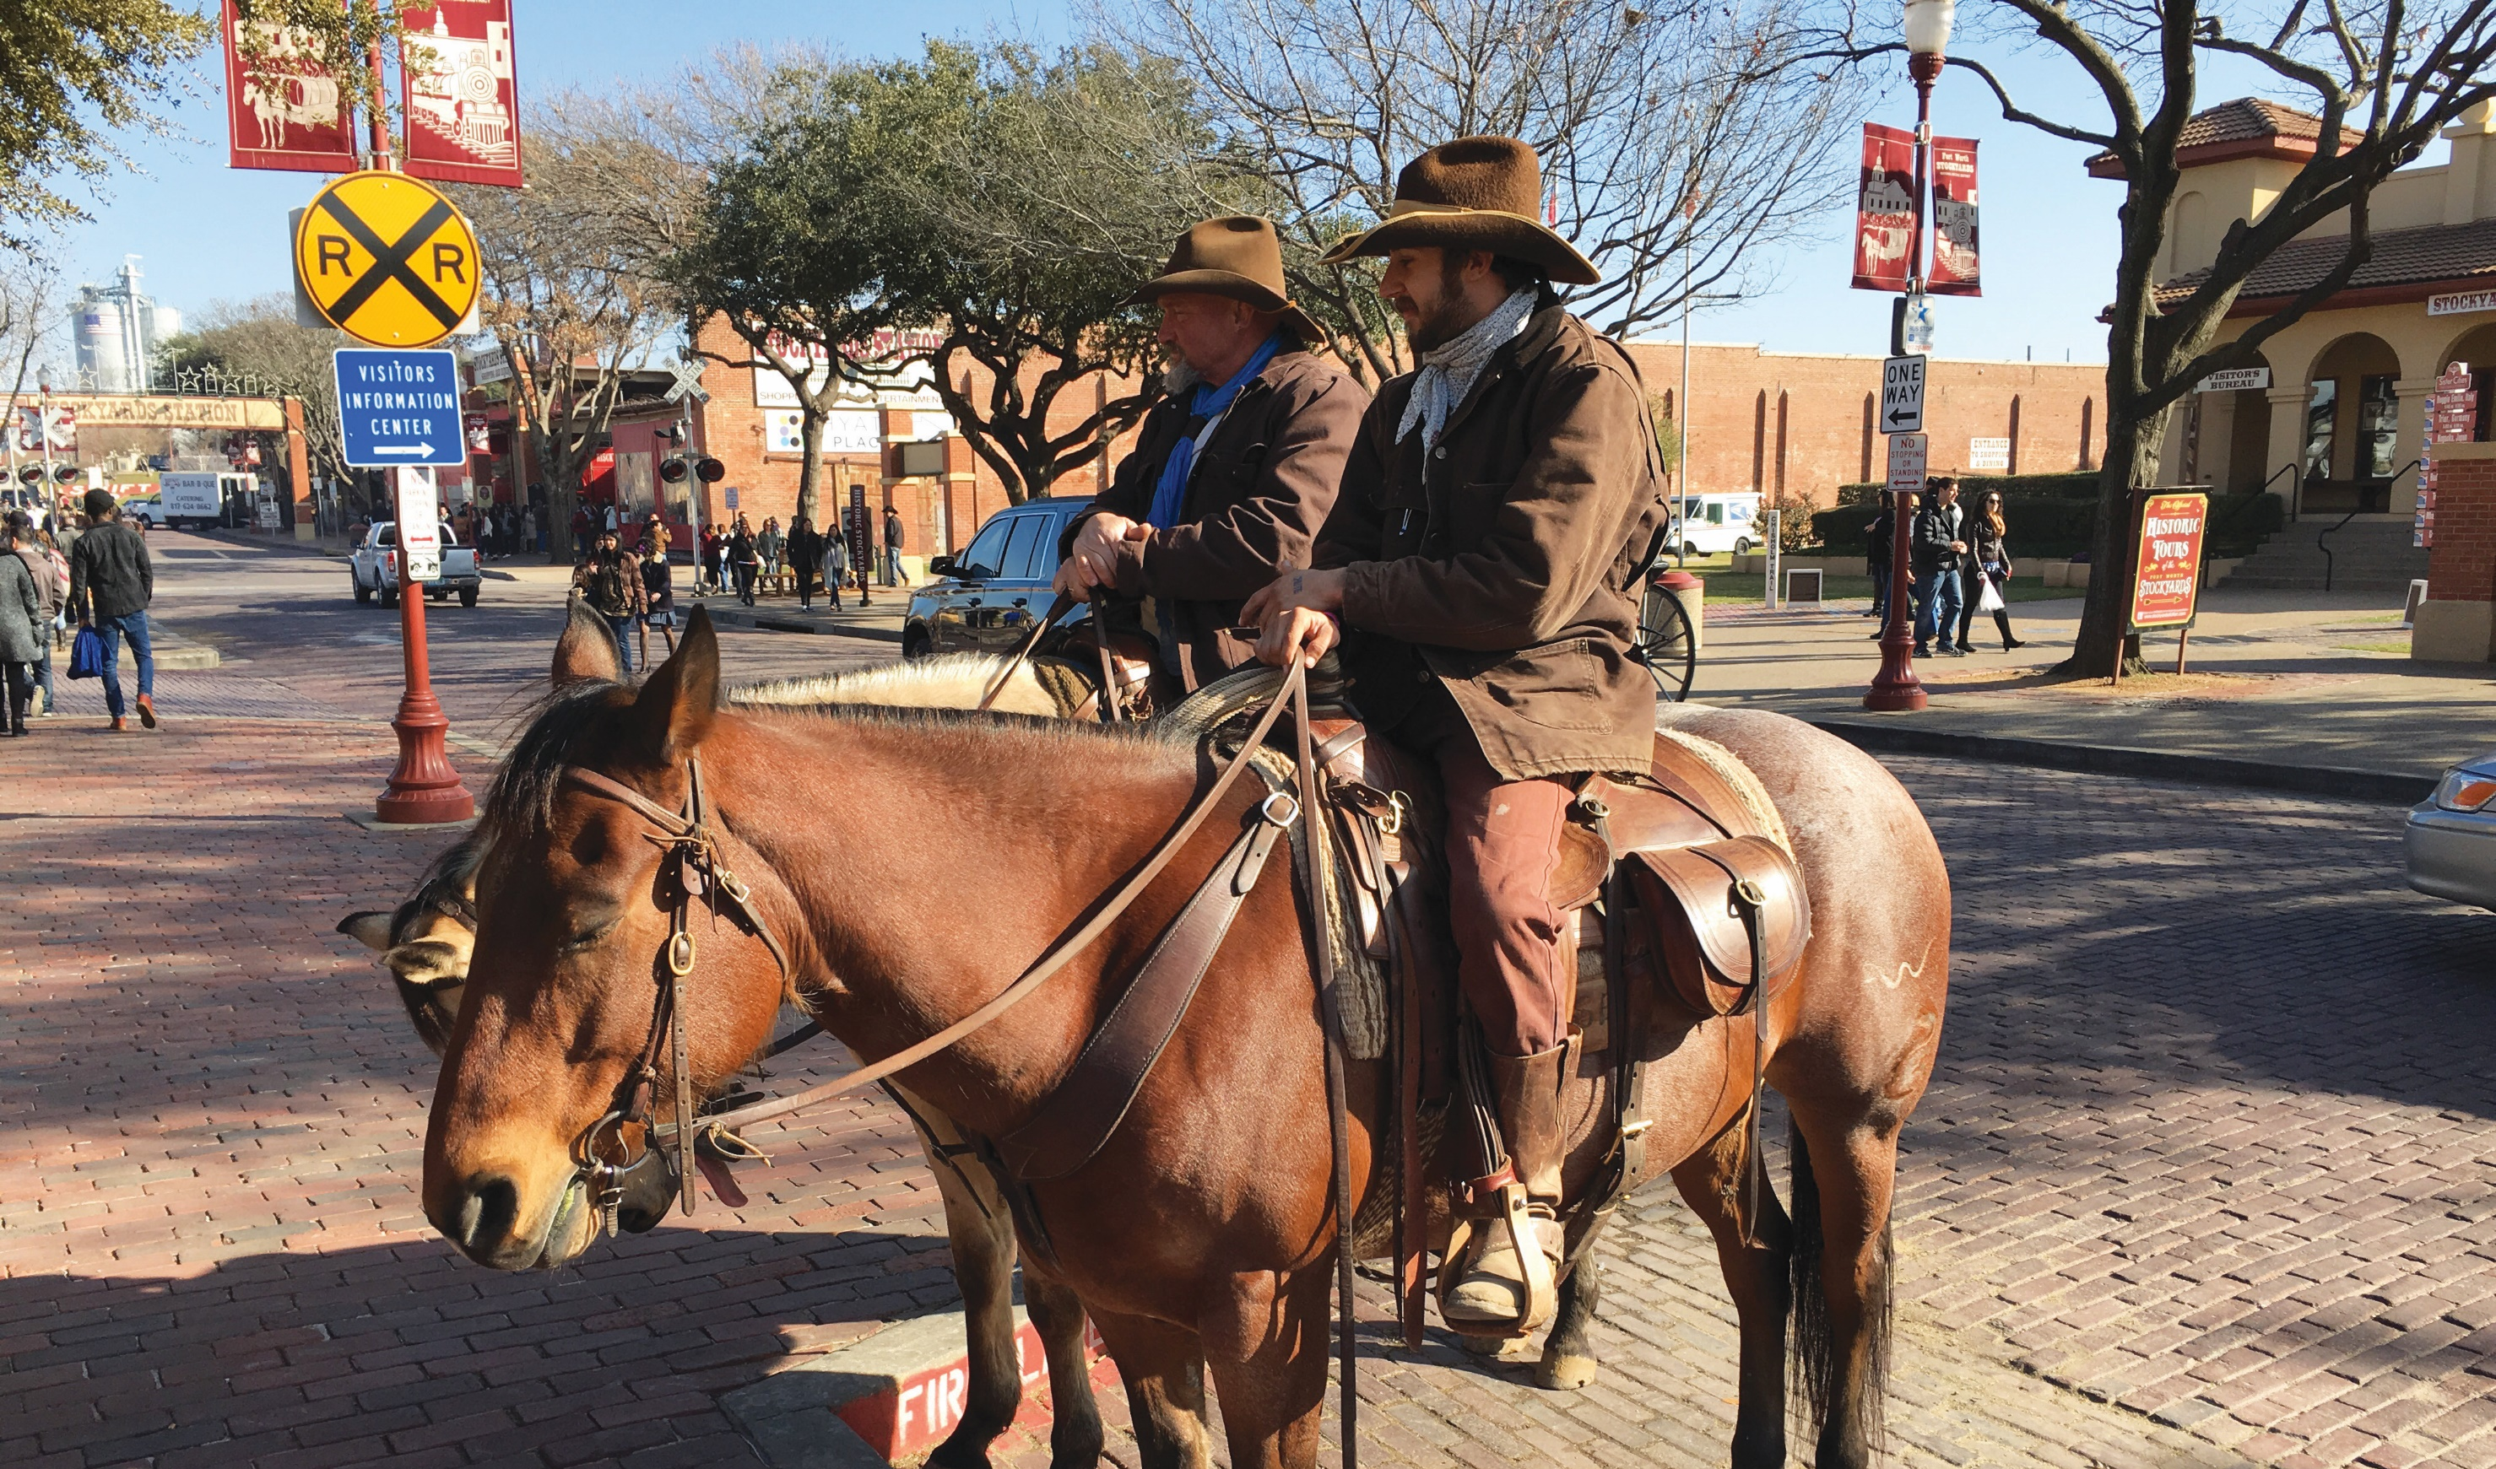
We pray for the blessings of the Lord on DFW, making this historic Bible Belt the hub of global evangelism.
May people worship and praise the Lord. May DFW be filled with the glory of God's presence!
In the name of the Jesus Christ, Amen!
Notes:
全體會眾

Slide 9
